Slide 1
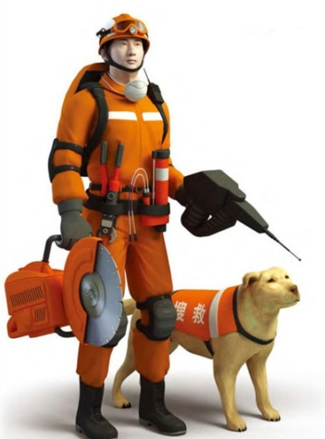

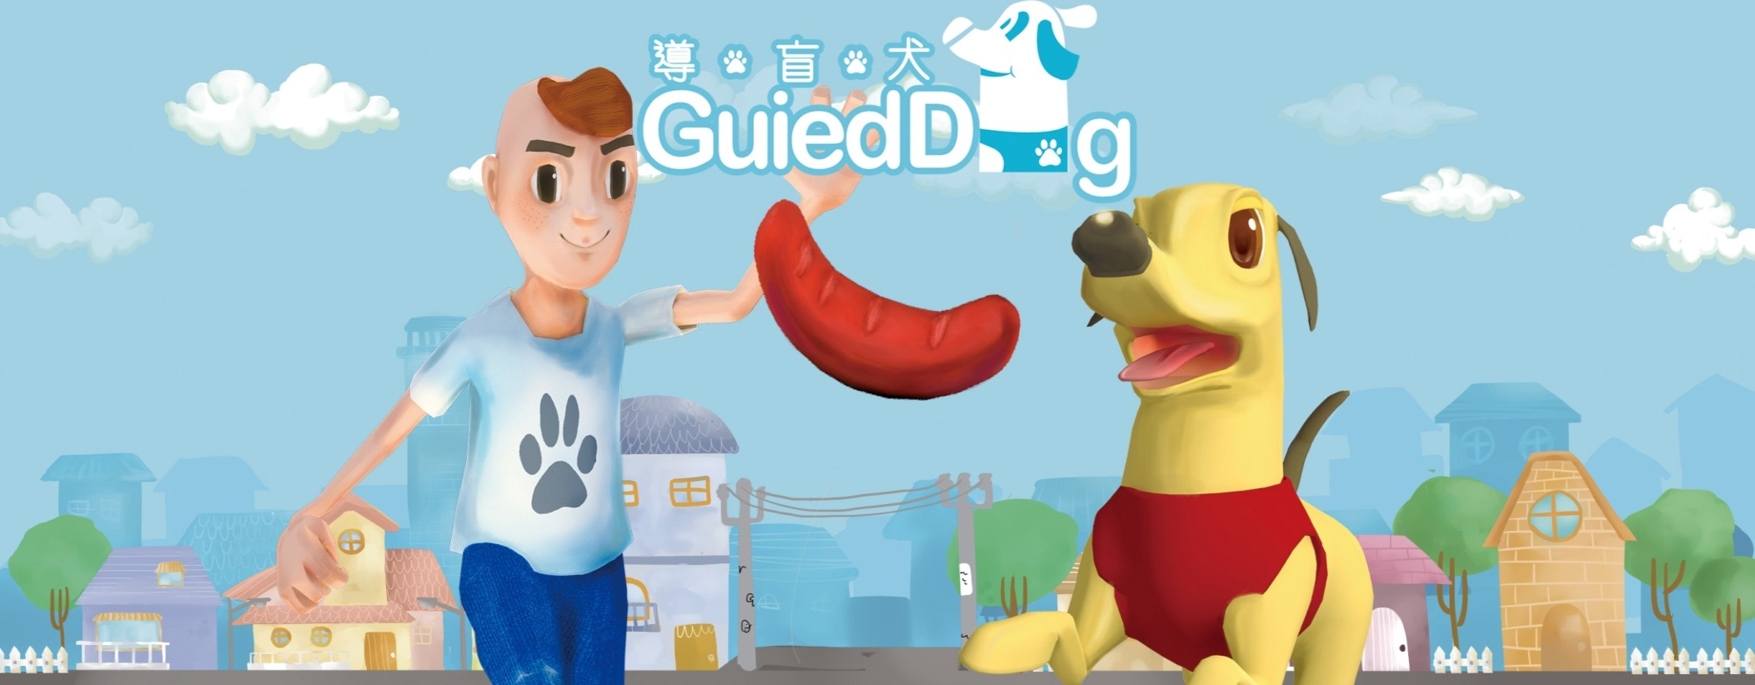
Unit 3 Our animal friends
Reading

Slide 2
目录
Lead-in
1
Pre-Learning
2
3
While-Learning
Post-Learning
4
5
Review

Slide 3
Part I Lead-in

Slide 4
Brainstorming: work in pairs
Do you like snow?
Do you think it is dangerous to get out in the heavy snow?
If you get in trouble in the snow, how will you feel and what will you do?

Slide 5
Part II Pre-Learning

Slide 6
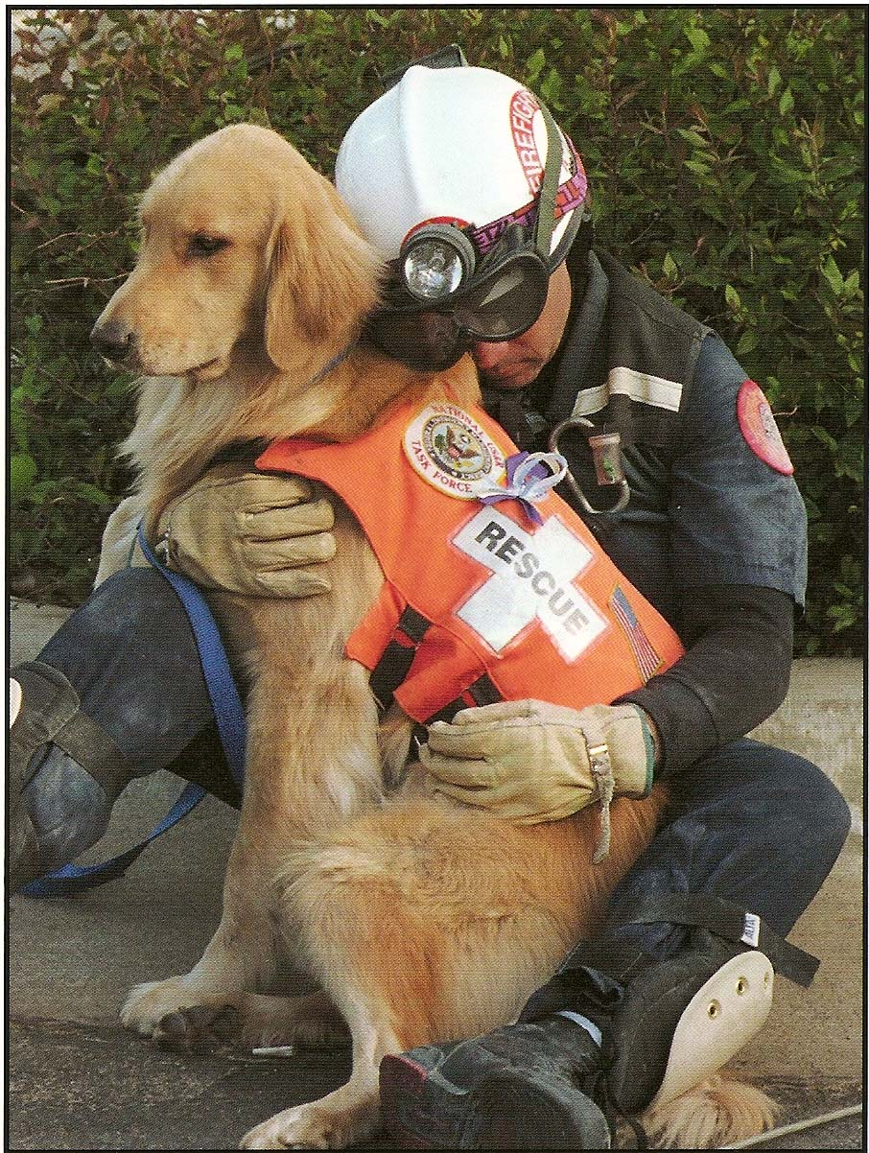

Helpful dogs
We have learnt stories about many helpful dogs.
Here is another story about a rescue dog.

Slide 7
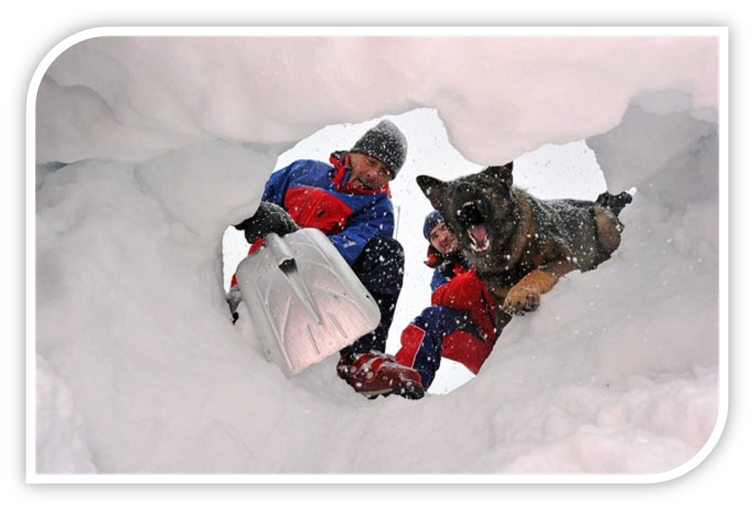
A rescue story
In the snow

Slide 8
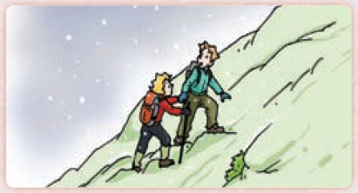
Picture talking
Look at the first picture and answer the following questions:
What are the two people doing?
What’s the weather like?

Slide 9
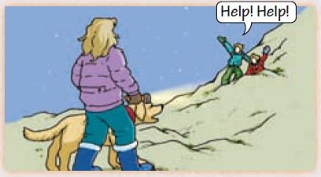
Look at the second picture and answer the following questions:
What can you see in the picture?
What are the two people doing?
What will happen?

Slide 10
Part III While-Learning

Slide 11
In the snow
Last year, Mary and Kevin went on a holiday. They stayed at Mrs Smith’s house at the bottom of a mountain.
On the morning of the second day, ______
____________________________________
____________________________________
(climb the mountain / start to snow / get dark/
not / find their way)
“What should we do?” asked Mary.
they started to climb the mountain. Soon it started to snow. It got dark and they couldn’t find their way.

Slide 12
“Nothing. We have some food,” said Kevin.
“Let’s sit down and wait.”
It got colder in the evening and they fell asleep.
____________________________________
____________________________________
____________________________________
(hear some noise / wake up / shout / soon / see)
Suddenly they heard some noise. They woke up and shouted, “Help! Help!” Soon they saw Mrs Smith and her dog Jimmy.

Slide 13
“Jimmy led me all the way here,” Mrs Smith said.
“Thank you, Mrs Smith, and thank you too, Jimmy!”
said Mary and Kevin.
Jimmy barked happily. Then they all went back to Mrs Smith’s house to have dinner.

Slide 14
The beginning of the story | _____________ went on a holiday ________. They stayed at ______________ at the bottom of the mountain. They started to climb the mountain ____________.
The development of the story | It started to ______. They lost their way. They could do ______, so they ________ and ______. They __________ and suddenly they ________________. Mrs Smith and her dog ______ found them.
The ending of the story | Mary and Kevin thanked Mrs Smith and Jimmy. They ____________ Mrs Smith’s house.
Mary and Kevin
last year
Mrs Smith’s house
the next morning
snow
nothing
sat down
waited
fell asleep
heard some noise
Jimmy
went back to

Slide 15

Let’s learn the new words and expressions.

Slide 16
New words and expressions
P39
climb v. 攀登；攀爬
dark adj. 黑暗的
nothing pron. 没有什么；没有一 件东西

Slide 17
Notes P39
1. They stayed at Mrs Smith’s house at the bottom of a mountain.
他们住在山脚下的史密斯夫人家。
at the bottom of 在……底部
at the top of 在……顶部

Slide 18
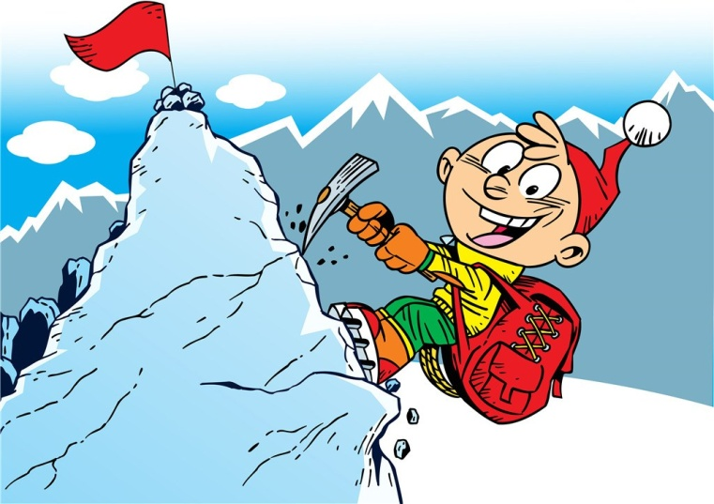
2. climb v. 攀登，攀爬
climber n. 登山的人
你认为你能爬上那棵树吗？
Do you think you can climb that tree?
他的爸爸是个优秀的登山者。
His father is a good climber.

Slide 19
3. get dark 天黑了
get此处用作连系动词，意为“变得”，后接形容词。
如：
Sometimes we can get sick.
有时我们会生病。
The teacher got angry.
老师生气了。

Slide 20
4. nothing pron. 没有什么；没 有一件东西
如：
There is nearly nothing left.
这儿没什么东西留下。
She’s nothing like her brother.
她一点也不像她哥哥。

Slide 21
Part IV Post-Learning

Slide 22
Writing
假设你是动物园的工作人员，今天你需要带几位外国游客参观一只名叫勤勤的狮子。请根据以下表格的信息，写一篇英语导游词,向游客们介绍勤勤，可适当发挥。词数70以上，开头已给出，不计入总词数。

Slide 23
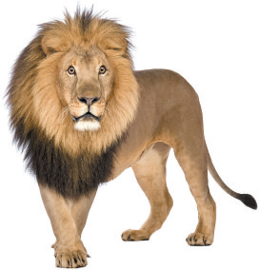
勤勤
 | 年龄3岁。
 | 尽管还小，但他能够自己觅食；非常喜欢吃肉。
 | 他每天需要约20 小时的睡眠；经常一趴下就睡着；饿了就会醒来。
 | 他很友好、漂亮、聪明。
 | 在工作人员的帮助下，他的寿命可超过30 年。
 | 他经常在阳光下玩球，而且玩得很开心。

Slide 24
Step 1: 激活词汇
你能想到本单元或以前学过的一些与描述动物及其生活习惯有关的短语吗？把它们写下来吧！
1. 能够 2. 独自
3. 喜欢做某事 4. 入睡
5. 趴下 6. 醒来
7. 在某人的帮助下 8. 玩得开心
be able to
by oneself / on one’s own
like doing /
to do sth
fall asleep
get down
wake up
with sb’s help / with the help of sb
enjoy oneself / have a good time

Slide 25
Step 2: 精彩结构
运用以下结构，可以让你的文章更出彩哦。
1. 主句+ though +让步状语从句
“尽管……，但是……”
【例】He often helps me with my English
though he is quite busy.
尽管他相当忙，但他还常常帮我学英语。
【译】尽管勤勤还小，但他能够自己觅食。
Though he is still young, Qinqin is able to find food by himself.

Slide 26
2. as soon as “一……就……”
【例】
The school bell rang as soon as the
student stepped into the classroom.
这个学生一踏进教室，上课铃就响了。
【译】勤勤经常一趴下就睡着。
Qinqin often falls asleep as soon as he gets down.

Slide 27
3. 主句+ when +时间状语从句
“当……的时候，……”
【例】
When I miss my parents, I will write
to them.
当我想念我父母的时候，我会写信给他们。
【译】当勤勤感到饿了，他就会醒来。
Qinqin will wake up when he feels hungry.

Slide 28
Step 3: 谋篇布局
文章应使用 ______ 人称进行叙述，并采用____________时态。
Step 4: 小试身手
Hi, everyone! Here you can see a lion. His name is Qinqin.______________________________
______________________________________________________________________________
第三
一般现在

Slide 29
One possible version:
Hi, everyone! Here you can see a lion. His name is Qinqin. He is three years old. Though he’s still young, he is able to find food by himself. He likes eating meat very much. He needs to sleep about 20 hours a day. He often falls asleep as
soon as he gets down. And he wakes up when he feels hungry. Qinqin is very friendly, beautiful and smart. With the workers’help, he can live over 30 years! He often plays with balls and enjoys himself in the sun.

Slide 30
Part V Review

Slide 31
一、翻译下列短语。
1. 去年
2. 去度假
3. 留在……
4. 在第二天早上
5. 爬山
6. 入睡
7. 醒来
last year
go on a holiday
stay at / in ...
on the morning of the second day /the next morning
climb the mountain
fall asleep
wake up

Slide 32
二、翻译下列句子。
1. 去年我们去了上海度假。
We went on a holiday to Shanghai last year.
2. 第二天早上我们去爬山了。
On the morning of the second day, we went to
climb mountains.
3. 我们在上海留了三天。
We stayed in Shanghai for three days.
4. 早上我们尽力早点醒来。
We tried to wake up early in the morning.
5. 晚上我们总是很晚才入睡。
We always fall asleep late in the evening.

Slide 33
Thank you!

