Slide 1
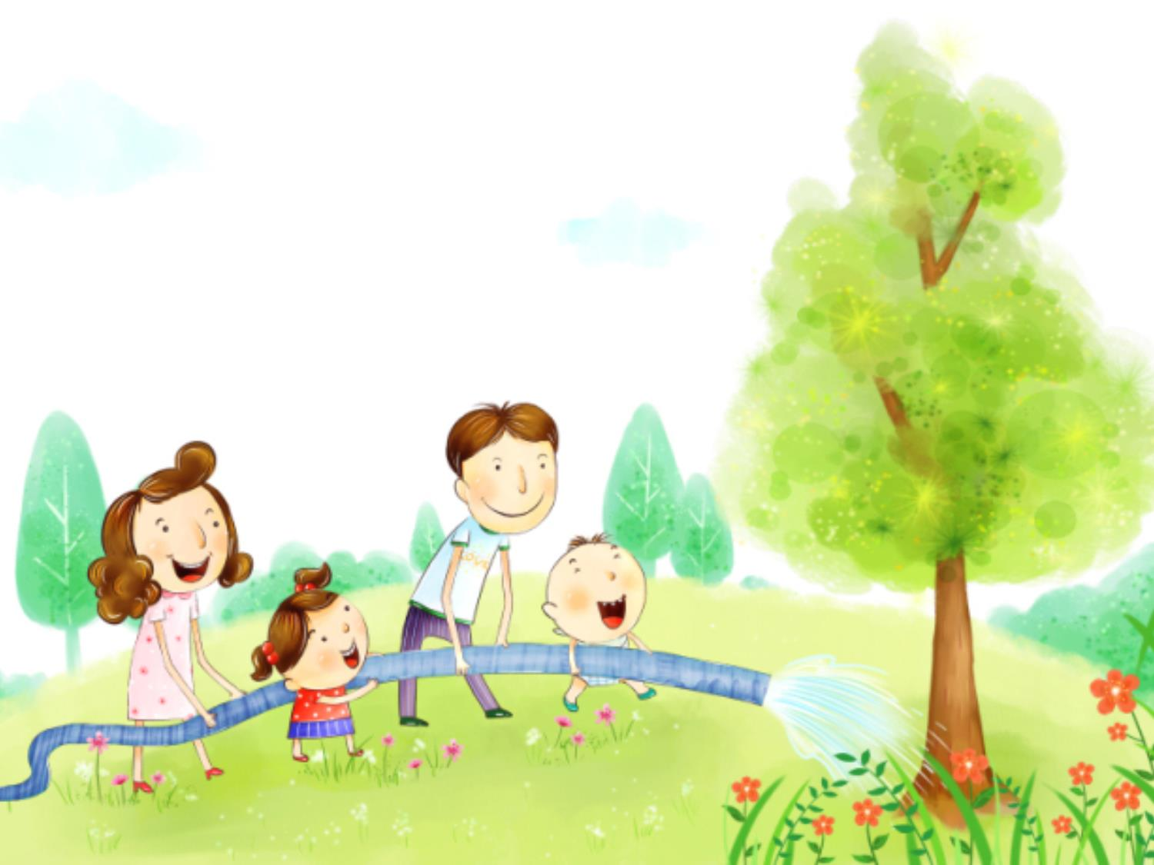
Unit 4 Save the trees
Grammar

Slide 2
目录
Lead-in
1
Pre-Learning
2
3
While-Learning
Post-Learning
4
5
Review

Slide 3
Part I Lead-in

Slide 4

Tom, what are you doing now?
I am reading a book.

Slide 5
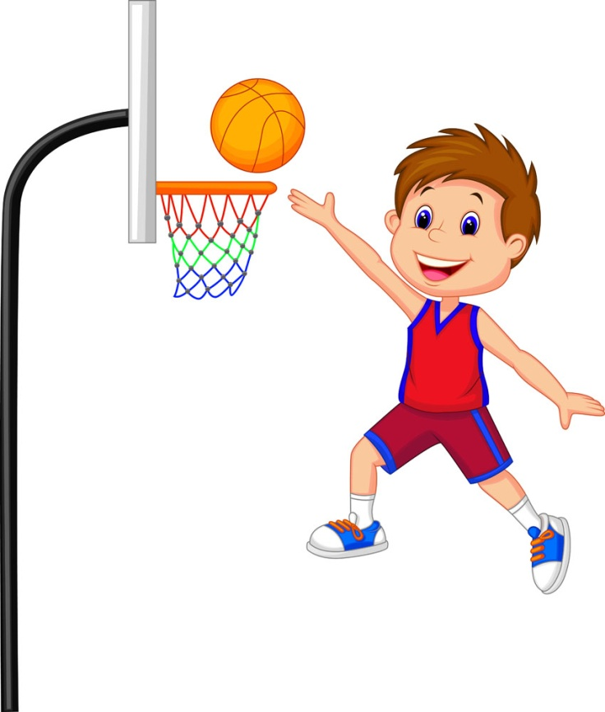
What is the boy doing now?
He is playing basketball.

Slide 6

What is the girl doing now?
She is singing a song.

Slide 7
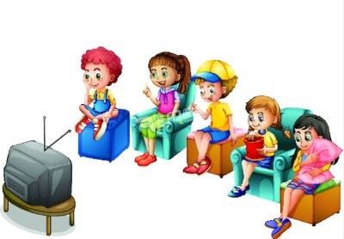
What are the children doing now?
They are watching TV.

Slide 8
Part II Pre-Learning

Slide 9
1. 现在进行时的定义
( The present continuous tense)
①现在进行时态表示现在(说话瞬间)正在进行
或发生的动作。如：
The students are listening to the teacher.
He is watching TV now.
②现在进行时态还可以表示当前一段时间内的
活动或现阶段正在发生的事情。如:
We are working on a farm these days.
I am writing a book this month.

Slide 10
Part III While-Learning

Slide 11
请找找规律：
now
现在进行时标志词：
look
listen
I
watch
be
am
ing
TV.
She
is
be
does
homework.
ing
He
be
is
books.
reads
ing
The boy
is
exercise.
be
ing
does
They
are
be
wash
the dishes.
ing
The girls
be
in the room.
are
ing
sing

Slide 12
2、现在进行时的谓语结构
be + 现在分词
(V-ing)

Slide 13
请找找规律：怎样变否定句和一般疑问句？
I
am
not
watching TV.
?
She
is
not
doing homework.
?
He
is
not
reading books.
?
is
The boy
not
doing exercise.
?
are
washing the dishes.
They
not
?
The girls
are
not
cleaning the room.
?

Slide 14
3. 现在进行时的句式
1. 肯定句: 主语+am/is/are+V-ing +其它.
如: I am reading a book in the library.
2. 否定句：直接在am/is/are后加not
如：I am writing.
I am not writing.
3. 一般疑问句及回答: 问句,直接把am/is/are提句首, 若原句有第一人称，把第一人称变成第二人称。

Slide 15
肯定回答:
Yes, 主语 + be (be是要变化的，即am/is/are).
否定回答:
No, 主语+ be + not.
You are drawing a pig.(变一般疑问句，再作肯定回答和否定回答）
---Are you drawing a pig?
---Yes, I am. / No, I’m not.
特殊疑问句：
对be + V-ing 提问要用what.
格式为：What + am / is / are +主语+doing?

Slide 16
4. 与现在进行时连用的时间状语：
at present 目前;现在
at the moment 此刻,现在
right now 此刻,现在;立刻,马上
now 现在
提示语: look, listen

Slide 17
Practice
根据题目要求，完成下列句子。
1. They are doing the housework now.
(分别改成一般疑问句和否定句)
Are they doing the housework now?
They aren’t doing the housework now.

Slide 18
2. The students are cleaning the classroom.
(改为一般疑问句并作肯定和否定回答)
Are the students cleaning the classroom?
Yes, they are. No, they aren’t.
3. I’m playing football in the playground.(改为否定句)
I ’m not playing football in the playground.

Slide 19
4. Tom is reading books in his room.(改为一般
疑问句)
Is Tom reading books in his room?

Slide 20
The present continuous tense
We use the present continuous tense to show
that something is happening now.
(The children are playing in the park)
We also use the present continuous tense to
talk about temporary situations.
(We are staying at Peter’s house at the moment.)

Slide 21
We form the present continuous tense like
this:
Subject | Verb to be | Main verb
I | am (not) | dreaming
You/We/They | are (not)
He/She/It | is (not)

Slide 22
We form Yes/No questions and short answers in
the present continuous tense like this:
Am I reading? | Yes, I am.
 | No, I am not/’m not.
Are you/we/they reading? | Yes, you/we/they are.
 | No, you/we/they are not/aren’t/’re not.
Is he/she/it reading? | Yes, he/she/it is.
 | No, he/she/it is not /isn’t/’s not.

Slide 23
We form Wh-questions in the present continuous tense like this:
(What are you doing now?)
(Why is he sleeping here?)
Work out the rule
We form the present continuous tense with the verb to be+(the base form/the –ing form)of the main verb.

Slide 24
We form the –ing form of the main verb like this:
Main verb -ing form Example
Most verbs
Verbs ending in -e
Verbs ending in -ie
Some verbs ending in a vowel
letter + a consonant letter
+ing
去e+ing
去ie+ying
Double the consonant letter + ing
feel→feeling
write →writing
die →dying
run →running

Slide 25
现在分词的构成方式
主要动词 | 现在分词 | 例子
大多数动词 | +ing | feel→feeling
以-e结尾的动词 | 去e+ing | write →writing
以-ie结尾的动词 | 去ie+ying | die →dying
一些以一个元音字母+一个辅音字母结尾的动词 | 双写这个辅音字母+ing | run →running

Slide 26
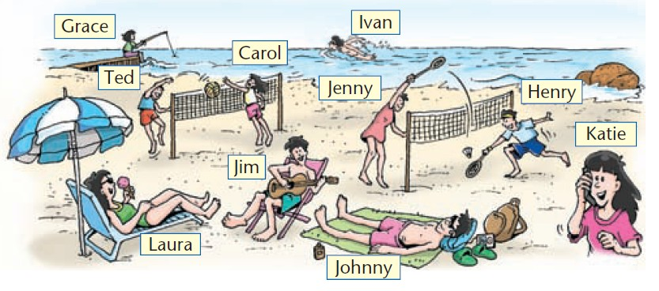
A. Katie is on holiday with her friends. She is telling
Alex what everyone is doing. Look at the picture below and complete the conversation with the verbs in brackets.

Slide 27
Katie: Hi, Alex.We ⑴ are having (have) fun at the beach.
Alex: What ⑵ ________ everyone ________(do)?
Katie: Ted ⑶ ________ (play) volleyball with Carol. Jenny and Henry ⑷__________(play) badminton. Grace ⑸ _________(fish). Ivan ⑹ ___________
(swim) in the sea. Laura and Johnny ⑺________
(lie) on the beach. Laura ⑻ ________ (eat) an ice
cream too. Jim ⑼ _________(play) the guitar. And I ⑽ __________ (talk) to you on the phone, Alex.
is doing
is playing
are playing
is fishing
is swimming
are lying
is eating
is playing
am talking

Slide 28
We do not usually use the verbs in the box below in the present continuous tense. Instead, we use them in the simple present tense.
Special rules
下面的动词一般没有现在进行时态，我们用一般现在时作为替代。
believe hear like prefer smell understand
hate know love see taste want
✔ I know the answer now.
✘ I am knowing the answer now.
✔ She likes this poem.
✘ She is liking this poem.

Slide 29
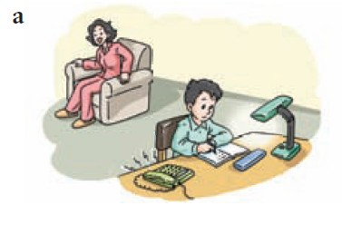
B. Look at the pictures below and complete the conversations with the verbs in brackets.
Mum: The phone
_______(ring), Sam.
Sam: I________(know), but I’m very busy. Could you answer it, please?
is ringing
know

Slide 30
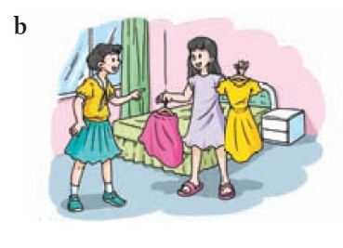
am thinking
Mary: I __________ (think) about what to wear to Jane’s birthday party tonight. Can you help me?
Ann: Sure. I ________
(prefer) the long dress better.
prefer

Slide 31
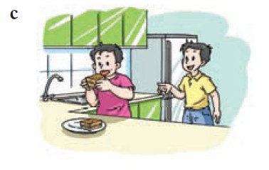
Fred: That ________ (smell) very nice. What ____ you
_____(eat), Tom?
Tom: I _________(eat) some cake. _____you_______(want)
some?
smells
are
eating
am eating
Do
want

Slide 32
Part IV Post-Learning

Slide 33
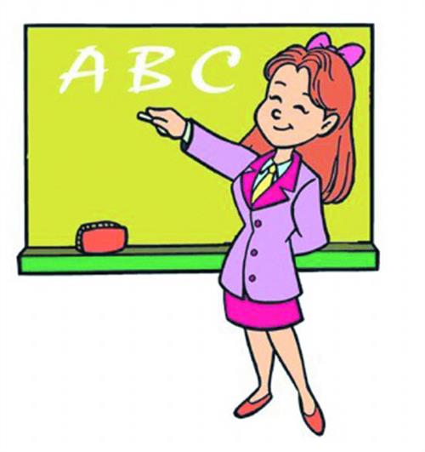
Summary
现在进行时

Slide 34
1. 现在进行时的定义
( The present continuous tense)
①现在进行时态表示现在(说话瞬间)正在进行
或发生的动作。如：
The students are listening to the teacher.
He is watching TV now.
②现在进行时态还可以表示当前一段时间内的
活动或现阶段正在发生的事情。如:
We are working on a farm these days.
I am writing a book this month.

Slide 35
2、现在进行时的谓语结构
be + 现在分词
(V-ing)

Slide 36
3. 现在进行时的句式
1. 肯定句: 主语+am/is/are+V-ing +其它.
如: I am reading a book in the library.
2. 否定句：直接在am/is/are后加not
如：I am writing.
I am not writing.
3. 一般疑问句及回答: 问句,直接把am/is/are提句首, 若原句有第一人称，把第一人称变成第二人称。

Slide 37
肯定回答:
Yes, 主语 + be (be是要变化的，即am/is/are).
否定回答:
No, 主语+ be + not.
You are drawing a pig.(变一般疑问句，再作肯定回答和否定回答）
---Are you drawing a pig?
---Yes, I am. / No, I’m not.
特殊疑问句：
对be + V-ing 提问要用what.
格式为：What + am / is / are +主语+doing?

Slide 38
4. 与现在进行时连用的时间状语：
at present 目前;现在
at the moment 此刻,现在
right now 此刻,现在;立刻,马上
now 现在
提示语: look, listen

Slide 39
现在分词的构成方式
主要动词 | 现在分词 | 例子
大多数动词 | +ing | feel→feeling
以-e结尾的动词 | 去e+ing | write →writing
以-ie结尾的动词 | 去ie+ying | die →dying
一些以一个元音字母+一个辅音字母结尾的动词 | 双写这个辅音字母+ing | run →running

Slide 40
Part V Review

Slide 41
一、根据句意，用括号中所给单词的适当形
式填空。
1. The boy _________(draw) a picture now.
2. Listen! Some boys __________ (sing) in the
classroom.
3. My mother ________ (make) a cake at the
moment.
4. What ________ you ________ (do) now?
is drawing
are singing
is making
are doing

Slide 42
are having
5. Look! They __________ (have) an English
lesson.
6. They _____________ (not, water) the flowers
now.
7. Look! The girls __________ (dance) in the classroom.
8. — What is our grandma doing?
— She __________ (listen) to music.
are not watering
are dancing
is listening

Slide 43
二、选择填空。
1. What are you doing? I_____
A. eat B. can eat
C. eating D. am eating
2. We want _________this book now.
A. reading B. am reading
C. read D. to read
3. Our teacher is ________a red sweater .
A. putting on B. put on
C. wearing D. wear
4. That boy isn’t ____the teacher .
A. listen B. listens
C. listening D. listening to
D
D
C
D

Slide 44
B
5. It’s eight o’clock. Jim’s family __TV.
A. is watching B. are watching
C. watch D. to watch
6. My mother is __a cake __my birthday.
A. making ,to B. making ,for
C. doing ,to D. doing ,for
7. Let me __these books in the box.
A. puts B. put C. to put D. putting
8. __you __the window? —Yes, I am.
A. Do, clean B. Is, cleaning
C. Are, cleaning D. Do, cleaning
B
B
C

Slide 45
Thank you!

