Slide 1
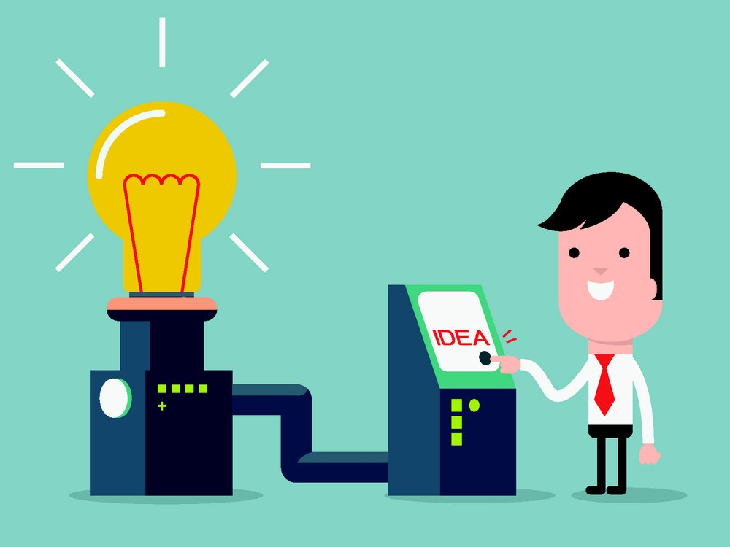
Unit 6 Electricity
Writing

Slide 2
目录
Lead-in
1
Pre-Learning
2
3
While-Learning
Post-Learning
4
5
Review

Slide 3
Part I Lead-in

Slide 4
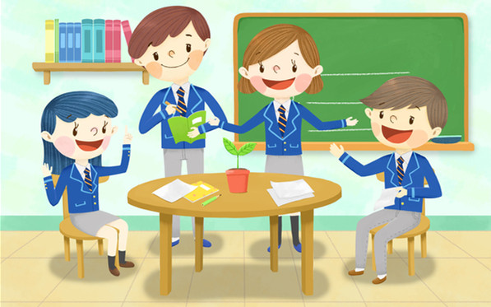
Discussion
With a partner, discuss some rules at home that you agree or disagree with. Make some notes in the chart.

Slide 5
Sample dialogue 1:
A: I have a lot of rules to follow at my
home.
B: So do I. Can you go to the movies with
friends on Friday nights?
A: Yes. But I have to be
home by 10 p.m.
B: Me too.

Slide 6

Sample dialogue 2:
A: Do you have lots of rules at home?
B: Yes, of course. Only on Saturday
afternoon can I go shopping with my
friends.
A: That’s nice.
B: And I can choose my own clothes, but I
can’t get my ears pierced. And what
about you?
A: I’m not so lucky as you.

Slide 7
I don’t think we should be allowed to play computer games.
Sure, I agree with it. Because it is bad for us, and we should follow the rule.

Slide 8
How about watching TV?
Well, I don’t agree with it. I think the rule should be changed. We can watch TV at weekends.

Slide 9
Hum, do you think if we should be allowed to have part-time jobs?
I agree. We can learn a lot from working.

Slide 10
Part II Pre-Learning

Slide 11

Let’s learn the new words and expressions.

Slide 12
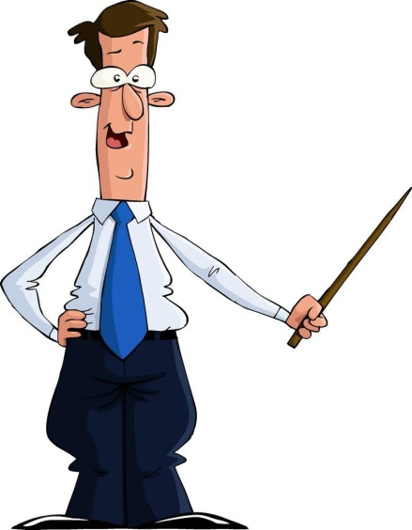
New words and expressions
P82
air conditioner 空调
touch v. 触摸；碰

Slide 13
Notes 82
Johnny’s father is asking Johnny to make some rules for the family to follow.
约翰尼的父亲正在让约翰尼制订一些家庭遵守的规则。
① ask sb to do sth 要求某人做某事
Mum asked me to help her with the dishes.
妈妈让我帮她洗碗。
② make sth for sb 为某人制订/制作……
My father made some rules for our family.
爸爸制订了一些家庭规则。

Slide 14
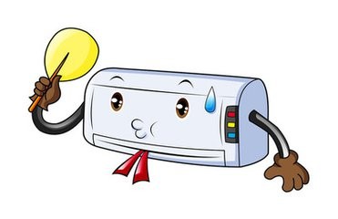
2. air conditioner 空调
The air conditioner of my room is not
working.
我房间的空调不工作了。

Slide 15
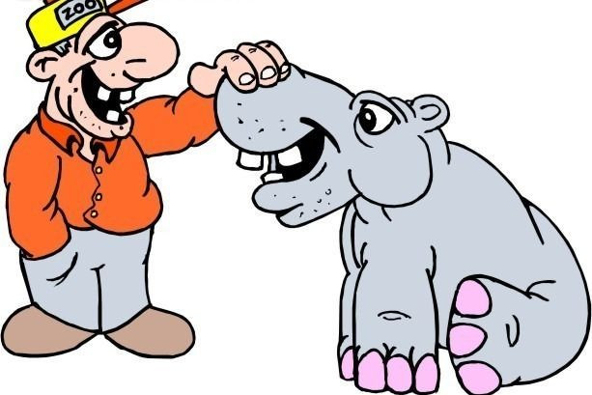
3. touch v. 触摸；碰
I can touch the picture on the wall.
我能摸到墙上的画。

Slide 16
Part III While-Learning

Slide 17
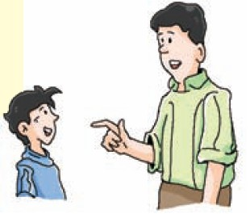
A. Johnny’s father is asking Johnny to make some rules for the family to follow. In pairs, help Johnny make four rules.
Home rules
close/ windows/ when/ air conditioner/ on
put/ newspapers/ near/ heater
remember to take/ keys/ when/ go out
touch/ TV / wet hands

Slide 18
Home rules
We must:
close the windows when the air conditioner is on;
____________________
remember to take the keys when we go out.
We must not:
1 _____________________
2 _____________________
put the newspapers near the heater;
touch TV with the wet hands.

Slide 19
B. Add 4 more rules to the Home Rules in A.
We must:
____________________
4____________________
switch off the lights when we leave home;
keep the house clean.
We must not:
3_____________________
4_____________________
put our hand in the washing machine
when it is on;
speak rudely.

Slide 20
Part IV Post-Learning

Slide 21

Discuss
What must we do when we use water/fire/electricity…?
What must we do at home to have a safe and healthy life?
What must we do at home to help protect the Earth and the environment?

Slide 22
Discuss with your partners and fill in the blanks.
What we must do | What we must not do

Slide 23
Example
We must | We mustn’t
sleep with the window open
turn off the TV on stormy days
turn off the tap when brushing our teeth
come home before six o’clock
sleep with the window closed
watch TV when a storm comes
leave the tap on when brushing our teeth
come home late

Slide 24
Part V Review

Slide 25
一、翻译下列短语。
1. 按时
2. 穿校服
3. 到达学校
4. 校规
5. 对……有礼貌
6. 互相帮助
7. 对……友好
8. 保持安静
on time
wear school uniform
arrive at school
school rules
be polite to ...
help each other
be friendly to ...
keep / be quiet

Slide 26

二、请根据以下表格的内容提示，写一篇题为Using electricity safely 的英语短文，说明电的重要性及危害，并介绍安全使用电器的注意事项，可适当发挥。词数80 以上。

Slide 27
电的重要性及危害 | 电在我们的日常生活中非常重要，电器使我们的生活更方便。但是，电会伤害人或引起火灾，如果不安全用电会非常危险。
安全使用电器的注意事项 | 1. 开关电器之前，要确保手是干的。 2. 使用电饭锅时，必须保持锅的 外表干燥。 3. 如果看到电线破损，则不要打 开电器。

Slide 28
Step 1: 激活词汇
你能想到本单元或以前学过的一些与用电有关的词汇吗？把它们写下来吧！
1. 在某人的日常生活中
2. 电器
3. 使……更方便
4. 引起火灾
5. 打开或关掉（电器等）
6. 电饭锅
7. 保持……干燥
in one’s daily life
electrical appliance(s)
make ... more convenient
start a fire
switch / turn on or off
rice cooker
keep ... dry

Slide 29
Step 2: 精彩结构
运用以下结构，可以让你的文章更出彩哦。
1. if 引导的条件状语从句“如果……”
【例】如果你不去那个派对，那么西蒙会
不高兴的。
If you don’t go to the party, Simon
will be unhappy.
【译】如果我们不安全用电，那会很危险的。
If we don’t use electricity safely, it will
be very dangerous.

Slide 30
2. make sure +宾语从句“确保……”
【例】Make sure what he said is true.
要确保他说的话是真的。
【译】在我们开关电器之前，要确保我们
的手是干的。
Before we switch on or off the
electrical appliances, make sure our
hands are dry.

Slide 31
Step 3: 谋篇布局
文章内容可分成两段。第一段说明电的______________，第二段介绍 ______________________。短文应采用 ________时态。
重要性及危害
安全使用电器的注意事项
一般现在

Slide 32
Step 4: 小试身手
Using electricity safely
Electricity is very important in our daily lives. Electrical appliances make our lives more convenient. But electricity may hurt people or start a fire. It will be very dangerous if we don’t use it safely.
We should use electrical appliances safely. For example, before we switch on or off the electrical appliances, make sure our hands are dry. What’s more, when we use a rice cooker, we must keep the outside of the pot dry. If we see the wires are broken, we mustn’t turn on the electrical appliances.

Slide 33
Thank you!

