Slide 1

Unit 7 Poems
M
P
O
E
Grammar

Slide 2
目录
Lead-in
1
Pre-Learning
2
3
While-Learning
Post-Learning
4
5
Review

Slide 3
Part I Lead-in

Slide 4
A Game
Simon says
Do as Simon says!

Slide 5
Simon says,
put your left hand up.
Good job!

Slide 6
put your right hand on your head.
You lose! Did I say “Simon says”?

Slide 7
Simon says,
put your left hand down.
Good job!

Slide 8
Did I say “Simon says”?
Stand up!

Slide 9
Simon says,
point to the door.
Good job!

Slide 10
Simon says,
Good job!
wave your left hand.

Slide 11
Part II Pre-Learning

Slide 12

Grammar A
祈使句

Slide 13
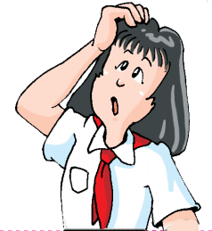
Read and think
Read the following sentences and tell their meanings.
Open the door, Daisy.
Don’t open the door, Daisy.
Let’s make a million smiles.
Be quiet, girls.
Don’t be late again!
When do we use these sentences?
We use these sentences to give orders or advice.

Slide 14

Read the sentences again to see what they have in common.
Open the door, Daisy.
Don’t open the door, Daisy.
Let’s make a million smiles.
Be quiet, girls.
Don’t be late again!
Open
Don’t open
Let’s
Be
Don’t be
They are called imperatives.
这种句子叫做祈使句

Slide 15
Part III While-Learning

Slide 16
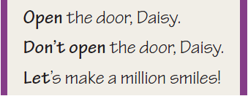
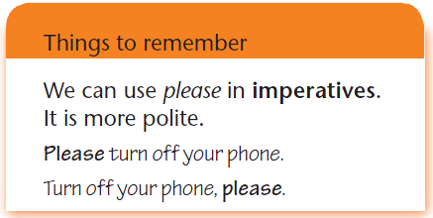
We use imperatives to give orders or advice.
我们用祈使句来
给出命令或建议。
在祈使句中使用please会更礼貌

Slide 17

We need to add be before adjectives when we use them as imperatives.
形容词用作祈使句时要在前面加be动词。

Slide 18
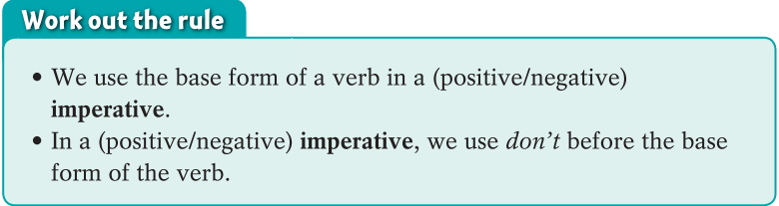
Work out the rule
在肯定祈使句中，用动词原形。
在否定祈使句中，在动词原形前加don’t.

Slide 19
祈使句
1. 祈使句是表示命令、要求、警告、
劝告、禁止、建议、鼓励、请求等语气的句子。
其主语常为第二人称且常常省略
（Let’s ...除外）。
在祈使句中，为了缓和语气，使表达更委婉、有礼貌，常常在句首或句末加上please。

Slide 20
2. 当祈使句用来表达命令、要求时，用降调；
当祈使句用来表达鼓励、请求，或者想使语气委婉一些，让人容易接受时，通常用升调。

Slide 21
3. 祈使句的句式
肯定式 | 1. 动词原形（+宾语）+其他成分 2. Be +表语（名词或形容词）+其他成分 3. Let’s +动词原形+其他成分
否定式 | 1. Don’t / Never +动词原形（+宾语）+其他成分 2. Don’t / Never +be+表语（名词或形容词）+其他成分

Slide 22

如：
Please turn off your cell phone.
请关掉你的手机。
Be careful when crossing the road.
过马路的时候要小心。
Let’s have a rest.
我们休息一下吧。
Don’t swim in the river.
不要到河里游泳。
Don’t be late again, Jack.
不要再迟到了，杰克。

Slide 23
Practice
将下列句子翻译成英文。
1. 请坐下。
2. 请安静。
3. 别傻了。
4. 别忘了给这些花浇水。
5. 让我们坐火车去那里吧。
6. 不要打开电脑。
7. 永远都不要放弃！
1. Sit down, please. / Please sit down.
2. Be quiet, please. / Please be quiet.
3. Don’t be silly.
4. Don’t forget to water the flowers.
5. Let’s go there by train.
6. Don’t turn on the computer.
7. Never give up!

Slide 24
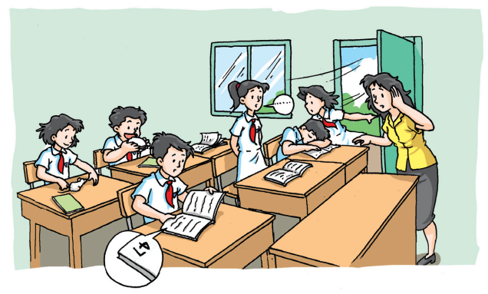
Grammar exercise
Look at the picture. What will the teacher say? Make sentences with the words from the box on page 95. Some of them must begin with Don’t.

Slide 25
bring close eat sleep speak louder turn to
1. Bill is eating in class.
________________________________
2. Rose left the door open on a windy day.
________________________________
3. Jane is answering a question in a low voice.
________________________________
Don’t eat in class, Bill.
Close the door, Rose.
Speak louder, Jane.

Slide 26
bring close eat sleep speak louder turn to
4. James is sleeping at his desk.
__________________________________
5. Steven is looking at page 47. He should look at page 74.
___________________________________
6. Mary brought her pet mouse to school.
___________________________________
Don’t sleep in class, James.
Turn to page 74, Steven.
Don’t bring pets to school, Mary.

Slide 27
Grammar B
Exclamations
感叹句
Use exclamations to show strong feelings or for emphasis!

Slide 28

Read and think
Here are a few sentences to show the feelings.
The flowers are so beautiful.
The weather is bad.
We are lucky.
Time passes quickly.
The stars are beautiful.
Any better ways to show the feelings?

Slide 29
Sometimes we use sentences with emphasis and strong feelings. These sentences are called exclamations.
强调和带强烈感情的句子叫做感叹句。
What + (a/an) + adjective+ noun + subject+ verb+!
How+ adjective/adverb + subject+ verb+!
What + (a/an) + 形容词+ 名词 + 主语+ 谓语动词+!
How+ 形容词/副词 + 主语+ 谓语动词+!

Slide 30
This is how we make an exclamation:
感叹句的构成
It is a beautiful flower.
They are beautiful flowers.
1
What + (a/an) + adjective+ noun + subject+ verb+!
What + (a/an) + 形容词+ 名词 + 主语+ 谓语动词+!
a beautiful
beautiful
flower
flowers
it
they
is
are
What
!

Slide 31
The flower is beautiful.
The flowers are beautiful.
2
How+ adjective/adverb + subject+ verb+!
How+ 形容词/副词 + 主语+ 谓语动词+ !
the flower
the flowers
is
are
How
beautiful
!

Slide 32
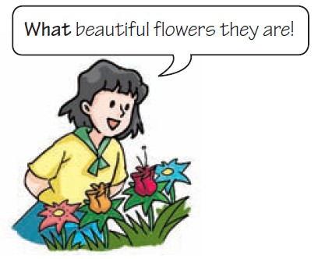
What an interesting poem it is!
How lucky they are!
What beautiful flowers they are!
How quickly the time passed!
What bad weather it is!
How bright the stars are!
Examples of exclamations.

Slide 33
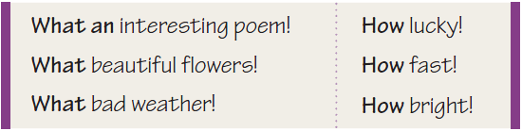
We can use a word or phrase as an exclamation, such as Oh no! or Lovely! We can also use a word or phrase with what or how to show strong feelings.
一个单词或短语可以成为感叹句。
what或how加一个单词或短语也可以成为感叹句。

Slide 34
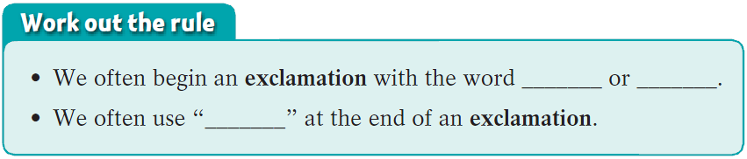
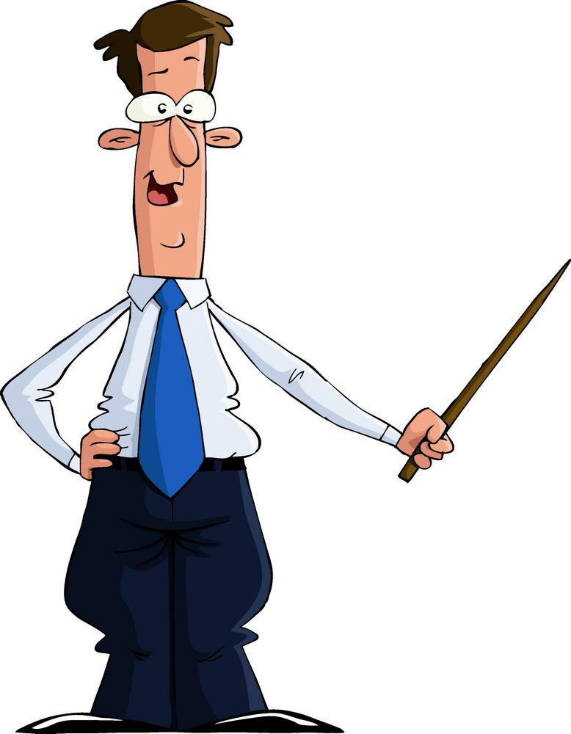
What
How
!
感叹句经常以what或how开头。
在感叹句末尾经常使用“！”

Slide 35

感叹句
1.感叹句是用来表达赞美、惊叹、喜悦等强烈情感的句子。通常由what或how引导，句末多用感叹号。

Slide 36
2. 感叹句的用法和句式
引导词 | 用法 | 句式
what | 对句子中的名词表示感叹 | 1. What + a / an +形容词+可数名词单数(+主语+谓语)! 2. What +形容词+不可数名词/可数名词复数(+主语+谓语)!
how | 对句子中的形容词或副词表示感叹 | 1. How +形容词/副词(+主语+谓语)! 2. How +主语+谓语!

Slide 37
What an interesting story (it is)!
真是个有趣的故事啊！
What fresh air it is in this town!
小镇的空气真清新！
What interesting books you are reading!
你正在读的书真有趣！
How cold it is today!
今天真冷啊！
How wonderfully they are dancing!
她们跳舞跳得真好！
How time flies!
光阴似箭啊！

Slide 38
3. what与how引导的感叹句，一般情况
下可以相互转换，转换后意义不变。如：
What an interesting story it is!
= How interesting the story is!
How beautiful the building is!
= What a beautiful building it is!

Slide 39
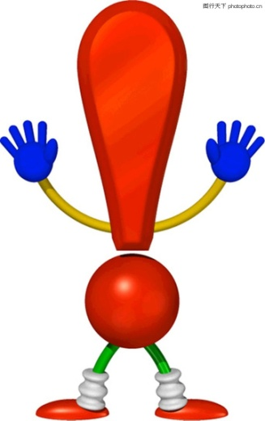
4. 在英语口语中，由what 引导的感叹句
中的主语、谓语，甚至形容词有时可省
略，如：
What fresh air!
What a match!
同样地，由how 引导的感叹句有时也可
省略主语和谓语，如：
How cold!
How wonderfully!

Slide 40

5. 英语中还可以用其他方式表示感叹。如：
运用语气词：
Ah! Wow!
运用单词或短语：
Great! Good! Very interesting!
运用简短的句子：
He works fast!

Slide 41
Practice
将下列感叹句补写完整。
1. _____ tall the man is! _____ well he plays basketball!
2. _____ beautiful flowers they are!
3. _____ wonderful news it is! All of us are very happy.
4. _____ fast the students run!
5. ______ nice day it is today! Let’s go out to play.
How
How
What
What
How
What a

Slide 42
How
6. _____ clever the girl is!
7. — ________ interesting film they
introduced to us!
— Oh, yes! _______ film!
8. — _____ snowy day!
— Yes! _____ cold!
What an
What a
What a
How

Slide 43
B1 Rewrite the sentences below using exclamations with what or how.
1. You are wearing an old shirt.
_________________________________
2. The boys are very excited.
_________________________________
3. They are friendly people.
_________________________________
4. She studies very hard.
_________________________________
What an old shirt you are wearing!
How excited the boys are!
What friendly people they are!
How hard she studies!

Slide 44

B2 Lisa and Bob are talking about their friends. Complete their conversation with the exclamations from the box.
Oh no! How wonderful! What a lovely baby!

Slide 45
Oh no! How wonderful! What a lovely baby!
Lisa: Tom won the first prize in the speech
competition.
Bob: _______________ He must be very happy.
Lisa: Yes. But Jeff hurt his leg when he played
basketball.
Bob: ______________ How is he feeling now?
Lisa: He’s feeling better. By the way, our Maths
teacher had a baby last month. Look,
here’s a picture.
Bob: Wow! _________________
How wonderful!
Oh no!
What a love baby!

Slide 46

Let’s learn the useful expressions.

Slide 47
Notes P94-96
1. Please turn off your phone. （P94-A）
请关上你的电话。
turn off 关闭（水源、煤气、电灯等）
turn on 打开（水源、煤气、电灯等）
turn down 关小、调低（音量、电灯等）
turn up 调大（音量、电灯等）

Slide 48

如：
离开前请关上所有的灯。
Please turn off all the lights before you leave.
收音机声音太大，你能关小一点吗？
The radio is very loud. Would you please turn it down a little?

Slide 49
2. Speak louder（P95-A） 大声说
loud adv.大声地(常用比较级louder)
辨析：loud, aloud与loudly
① loud既可作形容词也可作副词。如：
说话声音请再大一点。
Please speak a little louder.
托尼大声喊道：“服务员，请过来！”
“Please come here, waiter!” said Tony in a loud voice.

Slide 50
② aloud副词，意为“出声地；大声地”，指为使人听见而发声，不是心想，不是默读。如：
老师让他大声朗读新单词。
The teacher asked him to read the new words aloud.
③loudly副词，意为“大声地；吵闹地”，强调声音高、喧闹、不悦耳。如：
有人在使劲儿敲门。
Someone is knocking at the door loudly.

Slide 51
3. Tom won the first prize in the speech
competition. （P96-B2）
汤姆在演讲比赛中获得一等奖。
① win the first prize 获得一等奖，赢得第一名
获得一等奖是我的心愿。
It’s my dream to win the first prize.
② in the speech competition 在演讲比赛中

Slide 52
Part IV Post-Learning

Slide 53
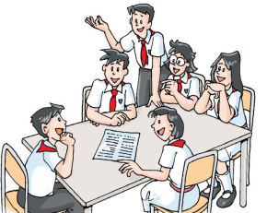
Group discussion
In groups, discuss the following questions.
When do we use “a” and “an” in exclamations?
When do we not use them?

Slide 54
用what或what a/an填空。
1. ________ clever girl she is!
2. ________ interesting story it is!
3. ________ beautiful flowers they are!
4. ________ delicious food it is!
What a
What an
What
What
单数名词前用what a/an
复数名词前或不可数名词前用what

Slide 55

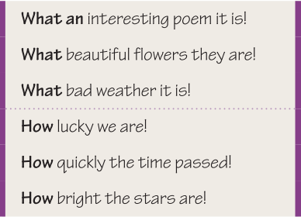

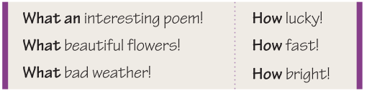
Consolidation
Read the following exclamations aloud with feelings.

Slide 56

Work in pairs. One read the family rules we learnt in Unit 6, the other changes it into imperatives. .

Slide 57
S1: You mustn’t change the bulb with the
electricity on.
S2: Don’t change the bulb with the electricity on.
S1: You must cover the meat.
S2: Cover the meat, please.
S1: You must lock the door.
S2: Lock the door , please.
S1: You must test the water.
S2: Test the water , please.

Slide 58
Part V Review

Slide 59
选择最佳答案填空。
( )1. — Please ____ to return my book by Friday. I’ll
use it on Saturday.
— No problem. I’ll finish reading it on Thursday.
A. don’t forget B. not to forget
C. not forget D. forget not to
( )2. — ____ clever the girl is!
— So she is.
A. How B. What C. How a D. What a
( )3. ____ wonderful news it is! All of us are very
happy.
A. What a B. What C. How a D. How
A
A
B

Slide 60
( )4. — ____nice day it is today! Let’s go out to
play, shall we?
— That’s a good idea.
A. How B. What
C. How a D. What a
( )5. ____ beautiful flowers they are!
A. How B. What
C. How a D. What a
( )6. ____ tall the girl is!
A. How B. How a
C. What D. What a
D
B
A

Slide 61
Thank you!

