Slide 1

Unit 8 From hobby to career
Writing

Slide 2
目录
Lead-in
1
Pre-Learning
2
3
While-Learning
Post-Learning
4
5
Review

Slide 3
Part I Lead-in

Slide 4
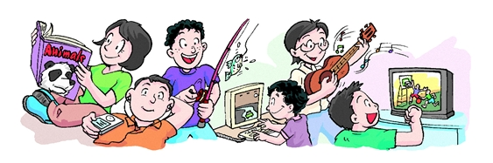

Writing
My favourite hobby

Slide 5
Different hobbies
Read the following words about hobbies.
I like making model trains. Maybe I could
become an engineer on a train.
I enjoy making model trains.
My hobby is making model trains.
I often make model trains in my free time.
When I …… That was the beginning of my hobby.
I/My parents and I used to …

Slide 6
Part II Pre-Learning

Slide 7
How to express your hobby?
My hobby is running.
I like/enjoy/love
running.
Hobby:
running
Running is my hobby.
I usually run when
I am free.

Slide 8

My hobby is playing basketball.
a. Playing basketball is my hobby.
b. I usually play basketball with my friends after school.

Slide 9

Mike loves listening to music when he is free.
a. Listening to music is Mike’s hobby.
b. Mike usually listens to music when he is free.

Slide 10

Fishing is my brother’s hobby.
a. My brother's hobby is fishing.
b. My brother usually goes fishing at weekends.

Slide 11
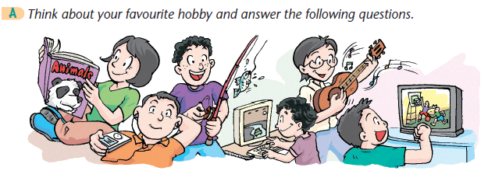
Before you write

Slide 12
1. What is your favourite hobby?
2. How often do you do it?
3. Where do you do it?
4. Do you do it alone or with a group of friends?
5. Why do you like it?
6. Would you like to make your hobby your future career?

Slide 13
Part III While-Learning

Slide 14
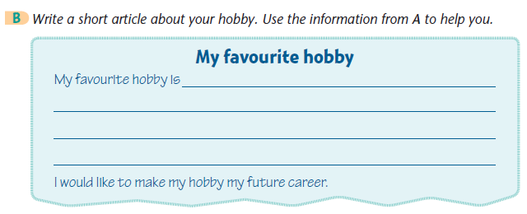

Writing about hobby

Slide 15
Good afternoon, everyone!
My name is Jason. My favourite hobby is reading
books. I usually read books every day. I read
books at home and in the school library. I prefer
to read by myself, but sometimes I share books
with my friends. I usually read for two hours and
then take a break. I like reading because it helps
me learn more about the world. I would like to be
a writer in the future.
Thanks for your attention.

Slide 16
 | Jason’s favourite hobby | My favourite hobby
What is your favourite hobby?
How often do you do it?
Where do you do it?
Do you do it alone or with a group of friends?
Why do you like it?
Would you like to make your hobby your future career?
reading books
every day
at home and in the school library
I prefer to read by myself, but
sometimes I share books with my friends
because it helps me learn more about the world.
I would like to be a
writer in the future.

Slide 17

Third Reading
Let’s learn the new words and expressions.

Slide 18
Notes P113
1. alone=by oneself adv. 独自
lonely adj. 孤独的；寂寞的
我一个人在家时总是害怕。
I am always afraid when I stay home alone/by myself.

Slide 19
区别：alone和lonely
如： 我独自一人在荒凉的山里。虽孤身一人但我并
不感到寂寞。
I was alone in the lonely mountains.
I didn’t feel lonely though I was alone.
lonely | 形容词 | 作表语或定语 | 孤独的；寂寞的；荒凉的 | 表示（主观感情上的）孤单寂寞。指精神上的孤单。
alone | 形容词 | 作表语 | 单独的；独自的 | 表示（客观上的）独自，单独。指形体上的单独，独自一人。
 | 副词 | 作状语 | 单独；独自地

Slide 20
Practice
1.选用lonely或alone填空。
(1) We should do our homework ________.
(2) The poor boy is________ and has no friends.
(3) It is not convenient to live in a(n) ________ area.
(4) I don’t feel ________though I am________ in a strange city.
alone
lonely
lonely
lonely
alone

Slide 21
Part IV Post-Learning

Slide 22
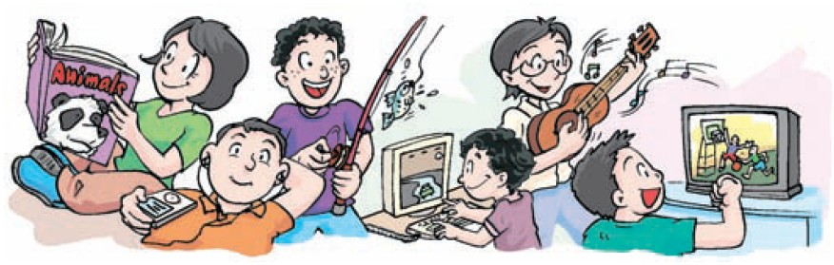
Pair work
S1: What is your favourite hobby?
S2: ....
S1: How often do you do it?
S2: …
S1: Where do you do it?
S2: …

Slide 23
S1: Do you do it alone or with a group of
friends?
S2: …
S1: Why do you like it?
S2: …
S1: Would you like to make your hobby
your future career?
S2: …

Slide 24

请根据以下表格的内容提示，写一篇英语短文，谈谈阅读的好处，并提出多阅读的建议，可适当发挥。词数80 左右。文章开头已给出，不计入总词数。

Slide 25
阅读的好处 | 1. 阅读是乐趣。阅读好书使我们感到快乐。在阅读时，我们不觉得乏味或疲惫。 2. 阅读对学习有益处。阅读帮助我们对世界了解更多，使我们更有智慧。 3. 阅读在日常生活中很有帮助。从书中学习到知识之后，我们会找到方法来解决问题。
建议 | 使阅读成为我们的爱好，在闲 暇时间享受阅读。多阅读，我 们会逐渐取得进步。

Slide 26
Step 1: 激活词汇
你能想到本单元或以前学过的一些与阅
读有关的词汇吗？把它们写下来吧！
1. 使某人感到快乐
2. 对……有益处
3. 学习；了解
4. 在某人的日常生活中
5. 找到方法
6. 使阅读成为我们的爱好
7. 享受阅读
8. 在某人的空闲时间
9. 取得进步
make sb feel happy
be good for ...
learn about
in one’s daily life
find a way
make reading our hobby
enjoy reading
in one’s free time
make progress

Slide 27
Step 2: 精彩结构
运用以下结构，可以让你的文章更出彩哦。
1. Doing sth is ... “做某事是……”
【例】听音乐让人放松。
Listening to music is relaxing.
【译】阅读对我们来说是乐趣。
Reading is fun for us.

Slide 28
2. when 引导的时间状语从句“当……时”
【例】 当我在做作业的时候，我听到了一个
奇怪的声音。
I heard a strange sound when I was
doing my homework.
【译】当我们阅读时，我们不觉得乏味或疲惫。
When we are reading, we don’t feel
bored or tired.

Slide 29
3. after引导的时间状语从句“在……之后”
【例】在他走了之后，我才到。
I arrived after he left.
【译】从书中学习到知识之后，我们会找到
方法来解决问题。
After we learn knowledge from books,
we will find ways to solve problems.

Slide 30
4. 祈使句的肯定式
【例】请写下你的名字。
Write down your name, please.
【译】使阅读成为我们的爱好，在闲暇时间
享受阅读。
Make reading our hobby, and enjoy
reading in our free time.

Slide 31
Step 3: 谋篇布局
文章内容可分成两段。第一段说明电的___________，第二段介绍 _____________。短文应采用 ________时态。
阅读的好处
建议
一般现在

Slide 32
Step 4: 小试身手
Reading has many advantages. Firstly, reading is fun for us. Reading good books makes us feel happy. We never feel bored or tired when we are reading. Secondly, reading is good for our studies. Reading helps us learn more about the world and makes us wiser. Thirdly, reading is helpful in our daily lives. After we learn knowledge from books, we will find ways to solve problems. Make reading our hobby, and enjoy reading in our free time! Read more, and we will make progress step by step.

Slide 33
Part V Review

Slide 34
翻译下列短语和句型。
1.下象棋
2. 当我五岁时
3. 教某人做……
4. 放学后
5. 使我变得更聪明
6. 感到兴奋
7. 把……变成
play chess
when I was five (years old)
teach sb to do ...
after school
make me cleverer
feel excited
turn / change into / make

Slide 35
Thank you!

