Slide 1



Unit4
Cartoons and comic strips
Vocabulary

Slide 2
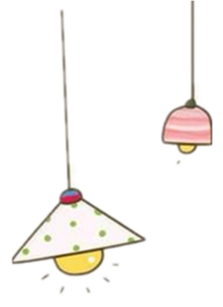
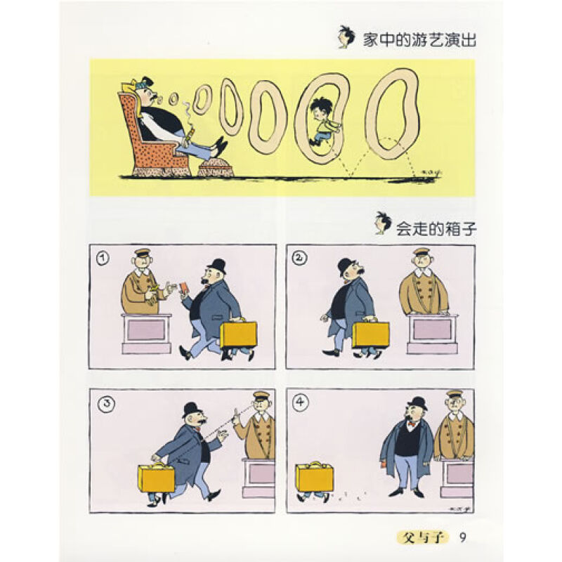
1. cartoon [C] 动画片；卡通片
2. comic strip [strɪp] [C]连环漫画
comic adj. 滑稽的；好笑的
喜剧作家
喜剧
strip [C] 连环漫画
comic writer
comedy
[ˈkɑ:mədi]

Slide 3
3. warning [C,U] 警告；警示
洪水警报
发出警报
warn v. 警告；提醒；告诫
①警告某人（不）做某事
②警告/通知某人某事
a warning of flood
give a warning
warn sb. (not) to do sth.
warn sb. of/about sth.
③警告/告诫某人不要做某事
warn sb. against doing sth.

Slide 4
父母警告儿子当心大型动物。
The parents _______ their son _______the big animals.
warned of/about
我们告诫孩子们不要在薄冰上行走。
We _______ the children ___ ___walk on the thin ice.
warned not to
我们的老师警告过我们不要在河里游泳。
Our teacher ______ us_______ _______ in the river.
warned against swimming

Slide 5
4. role-play v. 角色扮演
n. 角色扮演
分角色扮演故事很有趣。
It is fun to role-play stories.
5. symbol [C]
① 符号；记号
在地图上，十字符号代表教堂。
On maps, a cross is the symbol for a church.
② 象征
鸽子是和平的象征。
The dove is the symbol of peace.
a symbol for sth……的符号
a symbol of sth ……的象征

Slide 6
6. This is a “speech bubble” for the words that the character says.
这是这个人物所说话语的一个“说话框”。
*bubble [C] 泡；气泡
男孩把吸管放在牛奶里吹泡泡。
The boy is blowing bubbles in his milk with a straw.

Slide 7
7. pop out
pop-popped-popped-popping
①（眼睛）（因激动、惊奇）张大；睁大；瞪起
当他看到这个巨大的生物时，他的眼睛几乎瞪出来了。
His eyes nearly popped out when he saw the giant creature.
②脱口而出
我不是有意要那样说的，说着说着就蹦出了口。
I didn’t mean to say it like that – it just popped out.
pop adj. 流行的，通俗的
流行音乐
pop music

Slide 8

8. thought [C] 思想；想法；主意=idea
强调“你心里想的具体的事”
有一个想法
[U] 考虑；思索；思维
陷入沉思
他并没有花费太多心思在书本上。
He doesn't put much thought into his books.
你敲门的时候我正在沉思。
I was lost in thought when you knocked on the door.
have a thought
be lost/deep in thought

Slide 9
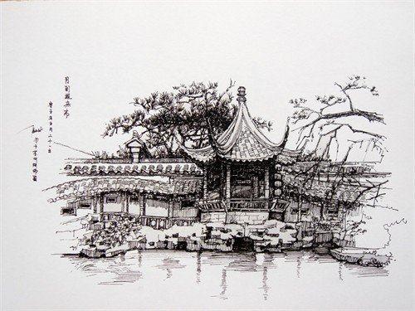
9. *rough adj. 粗略的；大致的
草图
我对这个计划有一个粗略的想法。
I’ve got a rough idea of the plan.
a rough sketch
10. *sketch [C] 速写；概述
画草图；打草稿
画一张你的房子的草图。
Make a sketch of your house.
draw/make a sketch

Slide 10
11. program ① [C]（计算机）程序
拉里编写了一个电脑程序并将它卖给了一家公司。
Larry wrote a computer program and sold it to a company.
②=programme[BrE] [C]
n.（ 戏剧、广播、电视等 的）节目、表演
这是我最喜爱的电视节目。
This is my favorite television program.
n. [重大的]计划，方案
the US space program(me)
注意：在表示“（电脑）程序”时，只能用program, 不能用programme。

Slide 11
12. Add colour to the drawings.
辨析：add…to…与add to
add…to… | 把…加到…上 | 是把前一项内容加到后一项中
add to | 增加，增添 | 其宾语多为困难、欢乐、名望等抽象名词
请往水里加点盐。
Please add some salt to the water.
一加一
Add one and one.
恶劣的天气增加了我们的困难。
The bad weather added to our difficulties．

Slide 12
13. record /ri‘kɔ:d/ v. 录制；录（音）
/ˈrekɔ:d/ n. 唱片；记录；最高纪录
我学会了如何在电脑上录音。
I learned how to record sounds on the computer.
罗杰·金德姆创造了12.92秒的世界纪录。
Roger Kingdom set the world record of 12.92 seconds.

Slide 13
14. *effect [C,U]效果；作用；影响
sound effect 音响效果；声音效果
这部电影的音响效果很好。
The sound effects in this film are quite good.
[拓展]
对…产生作用或影响
我父母的离婚给我带来了很大的影响。
My parents’ divorce had a big effect on me.
生效;开始起作用
have an effect on sb./sth.
take effect

Slide 14
15. First, you need to decide on some basic ideas for a story.
首先，你需要确定故事的一些基本思路。
① need 可用作实义动词
此时，need有人称和时态的变化，变否定形式要用助动词。
我真的需要那本书。(need sth.)
I really need that book.
我需要告诉他不应该去那儿。(need to do sth.)
I need to tell him that he shouldn’t go there.
② need可用作情态动词，后接动词原形；
此时，need无人称和时态的变化，一般用于否定句或疑问句。
不想说话的时候，你可以不说。(need+动词原形)
You needn't talk if you don't want to.

Slide 15
Practice
1. -Must I stay at home this afternoon?
-No, you .
A. don’t B. needn’t C. don’t need
2. Tom get up earlier tomorrow.
A. needs to B. needs C. need to
3. Look! Your shirt is dirty. It .
A. need washing B. need to wash C. needs washing
4. We go to school on Sunday.
A. need B needn’t to C. needn’t
B
need此处为情态动词，用于否定回答must的提问。
A
（某事）需要被做：
sth. need doing
= sth. need to be done
C
C

Slide 16
② decide on 决定；选定
decide on sth.
最后她决定穿黄色的连衣裙，不穿绿色的。
Finally she decided on the yellow dress instead of the green one.
decide on doing sth.
我已经决定要买一辆新车。
I’ve decided on buying a new car.
③basic adj. 基本的；基础的
按时交作业是一项基本要求。
Handing in homework on time is a basic requirement.

Slide 17
16. in the second stage 第二步；在第二阶段
stage ①[C] 段；步；步骤
（某事的）初期阶段
（某事的）最终阶段
每个孩子都要经历一个尴尬的阶段。
All children go through an awkward stage at some time.
② [C] 舞台
appear on (the) stage
the early stages of sth.
the final stages of sth.

Slide 18
17. video camera 摄像机
18. Tim wears glasses, so he looks clever.
wear-wore-worn
wear 意为“穿；戴”，强调“穿”的状态。
be in 和put on 也可以表示“穿；戴”。
be in 强调状态；put on 则强调“穿上”的动作。

Slide 19
Practice
选用wear, put on 或in 填空，注意其形式。
1. I don’t know what to __________ for the
interview.
2. __________ your coat quickly. It’s very cold
today.
3. Our Science teacher often __________ a pair
of big glasses.
4. The man is __________ a blue shirt.
wear
Put on
wears
in / wearing

Slide 20
19. pleasant adj. 友好的；和善的；文雅的
≠unpleasant
她是多么友好的姑娘啊！
____ _____ _____girl she is!
还可指“令人愉快的，惬意的”。
和他们一起工作是一件非常愉快的事情。
Working with them is a very pleasant thing.
What a pleasant

Slide 21
20. *detailed adj. 详细的；细致的
请给我们详细介绍一下你自己。
Please give us a detailed introduction about yourself.
detail [C]细节；细微之处
她把婚礼的所有细节都告诉了我。
She told every detail of her wedding.
详细地
in detail

Slide 22
21. To make the characters and things appear to move, each picture should be made a little different from the one before it.
为了让人物和事物看起来好像在动，每一幅图片较之前一张图片都要有一点区别。
①appear vi. (系动词)显得；看来；似乎
a. appear to be…
这位老人看起来很健康。
The old man appears to be healthy.
似乎又下大雨的迹象。
It seems to be signs of a heavy rain.
(appear to be + adj.
=appear + adj.)
(appear to be + n.)

Slide 23

b. appear to do sth.
你好像经常旅游。
You appear to travel quite a lot.
c. It appears / appeared that…
看起来他会得奖。
It appears that he will win the prize.

Slide 24
【拓展】
seem [系动词]看来，似乎，好像
与appear的用法类似：
他似乎走过不少地方。
He seems / appears to have travelled a lot.
【不同】
seem like …，appear一般无此用法
他看起来像个傻瓜。
He seems like a fool.

Slide 25
Practice
根据中文意思完成句子。
1. 他看起来似乎很有钱，因为他总是在外面
吃饭。
He ______ ______ ______ a lot of money because he always eats out.
2. 他似乎对这本书很感兴趣。
______ ___________ ______ he was very interested in this book.
appears / seems to have
It appeared / seemed that

Slide 26
②be different from 与……不同
the same as 和……一样
狮子和老虎不一样。
A lion is different from a tiger.
我们对待男孩和女孩一样。
We treat boys exactly the same as girls.

Slide 27

22. The actors will do the characters’ voices.
演员们会为这些人物配音。
①actor [C] 演员
actress [C] 女演员
act v. 当演员，演出；行动
② do sb’s voice 为 …配音
=do the voice of ...

Slide 28
Practice
1. 我想请你为汤姆配音。
I want you to _____ _____ _____.
2. I got a chance to do Snow White’s voice in the
play.
I got a chance to _____ _____ _____ _____
Snow White in the play.
do Tom’s voice
do the voice of

Slide 29
23. match v. 与……相配
⚠️当描述A与B相配时，
不要说A matches to B 或 A matches with B
而要说A matches B或 A and B match.
但是可以说 match A with/to B
这幅图和故事很相配。
你的袜子不成双。
你必须言行一致。
The picture matches the story.
Your socks don’t match.
You have to match your words with deeds.

Slide 30

match [C] 比赛，竞赛；火柴
我们队赢了足球赛。
Our team has won the football match.
她用一根火柴点燃了雪茄。
She lit a cigar with a match.
[单数] 强大的对手；婚姻，一对[配偶]
他们是非常般配的一对。
They are a perfect match.

Slide 31
24. separately adv. 单独地；分别地
这两杯咖啡我们想AA制。
We want to pay for the two coffees separately.
separate adj. 不同的；独立的；分开的
这个单词有两种不同的含义。
The word has two separate meanings.
我们的子女想拥有单独的房间。
Our children want to have separate rooms.
separate v. 分开；区分；隔开

Slide 32
25. After everything has been checked, the cartoon is ready to be played for everyone to enjoy.
当一切都检查完毕，这部动画片就可以播放给观众欣赏了。
①everything：不定代词的用法？
② has been checked 已被检查
is ready to be played 准备好播放
现在完成时的被动语态结构为：
have/has been + 动词过去分词
动词不定式的被动语态结构为：
to be + 动词过去分词

Slide 33
Practice
选择最佳答案填空。
( )1. Everything ____ fine with us in the first
three days but later something went
wrong.
A. is B. are C. was D. were
( )2. Someone ____ to see you at the gate.
A. want B. wants
C. will want D. is wanting
C
B

Slide 34

③play v. 播放
他总是在睡觉时放这张CD。
He always plays the CD when he goes to bed.

Slide 35
26. The basic idea of the story must be simple as well as important. (P52-C1)
故事的基本思路必须重要而且简单。
as well as 并且，还
as well as通常不位于句首。它强调的是前一项，后一项只是顺便提及。
as well as连接并列主语时，谓语动词遵循_______ 原则。
就远

Slide 36
她既美丽又聪明。
She is clever as well as beautiful.
他们既卖报纸也卖书。
They sell books as well as newspapers.
不仅你而其你妻子也对我很友好。
Your wife as well as you is friendly to me.

Slide 37
27. I ’ll make the cartoon myself, as I have some basic drawing and computer skills. (P52-C2)
鉴于我有一些画画基础和电脑技巧，我会自己来做这个动画。
as conj.由于；鉴于
引导原因状语从句，表示双方已知的事实或显而易见的原因，或者理由不是很重要，含义与since相同，但语气比较弱。
今天，我由于感冒没去上学。
As I got a cold, I didn’t go to school today.

Slide 38
一、根据句意和所给首字母写出所缺单词。
1. First, you should learn some b______ vocabulary and grammar of this language.
2. She is a p______ girl, for she is always kind to others.
3. Dad, the red tie doesn’t m______ your shirt. I think you should try this one.
4. I don’t know how to p______ the video. Can you show me?
5. What happened to them? They a______ to be unhappy.
6. Mickey Mouse is one of the most famous c______ characters in the world.
asic
leasant
atch
lay
ppear
artoon

Slide 39
二、根据句意，用所给词的适当形式填空。
1. Look at the ________(warn) on the wall. We can’t take photos here.
2. His dream is to be a great ________ (act).
3. David and his parents lived _________ (separate).
4. The sound effects can be ________(record)
later.
5. This ________ (think) made him happy.
warning
actor
separately
recorded
thought

Slide 40
三、根据中文意思完成句子。
1. 这景象使她瞪大了眼睛。
The view made her eyes _____ _____.
2. 我们应该积极思考，决定一项行动计划。
We should think actively and ______ _____ a plan of action.
3. 我们把这些部件组合起来做一个机器人吧。
Let ’s _____ these parts ________ to make a robot.
4. 我们需要加些色彩到这些图片上。
We need to _____ some colours _____ these pictures.
pop out
decide on
put together
add to

