Slide 1
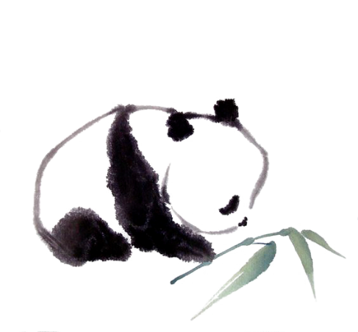

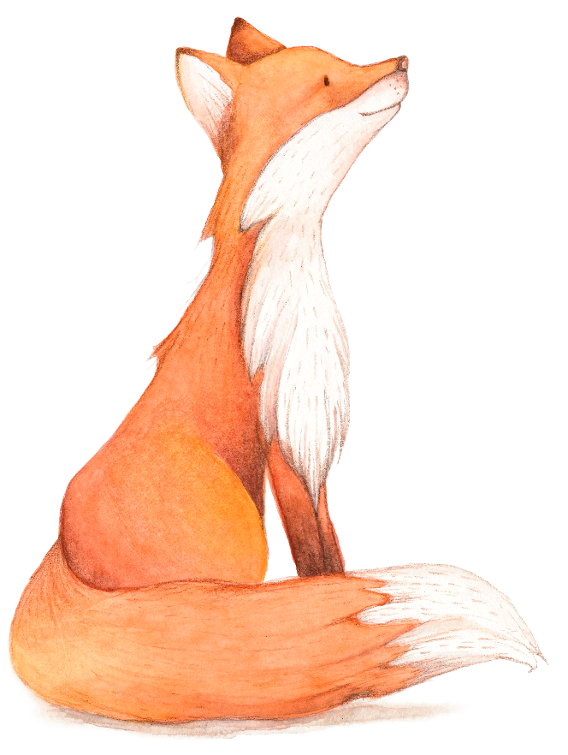
Grammar
Unit 5
Save the
endangered animals

Slide 2

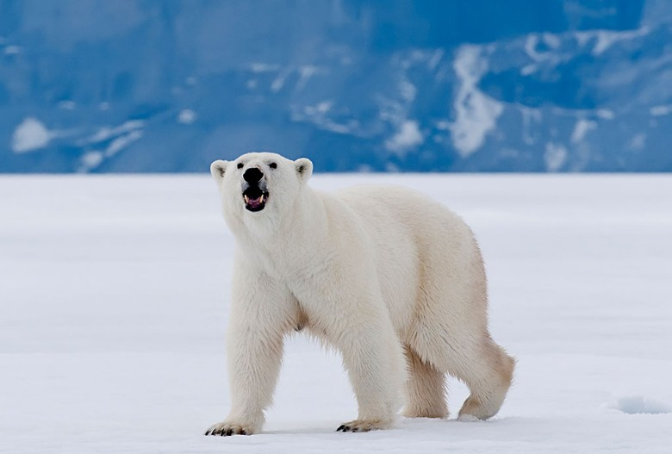
What animals are they?
Guess Game!
1. They are big and white.
2. It is important for people to protect them.
polar bear
3. It is not difficult for them to swim in the sea.
4. They are strong enough to live on the ice.

Slide 3
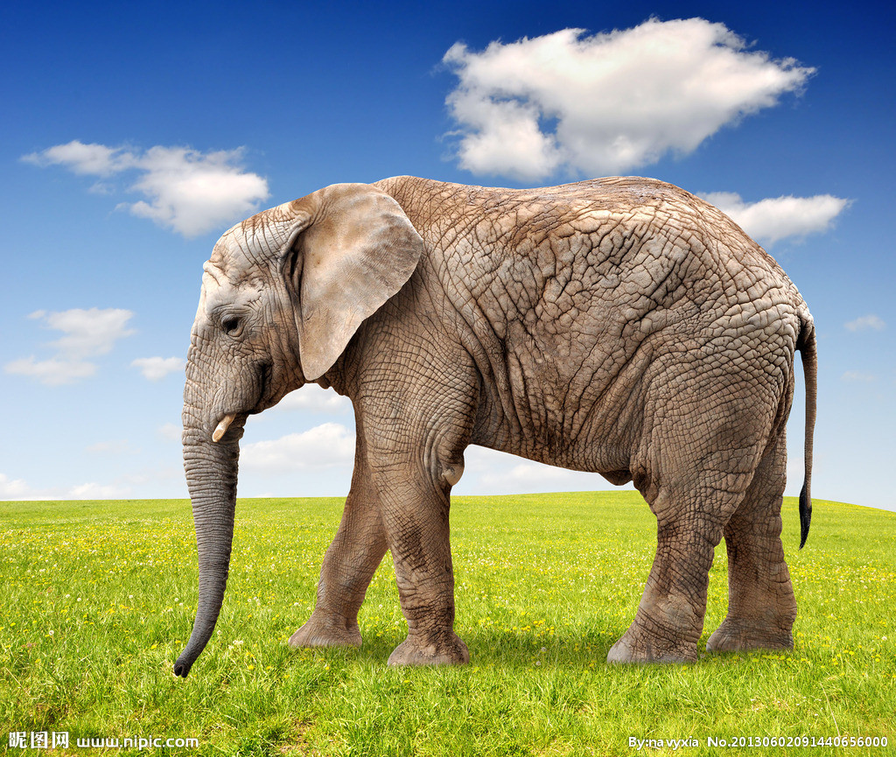
1. They are big and heavy.
2. It is cruel of hunters（猎人） to kill them for money.
3. It is easy for them to carry（托载）people on their back.
4. Their noses are long enough to drink water from the river.
elephant

Slide 4
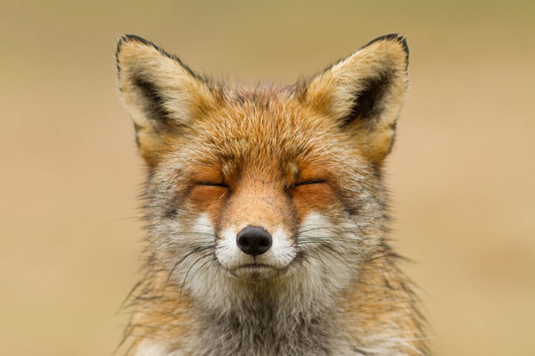
1. They are small and beautiful.
2. It is bad of people to kill them for their fur（皮毛）.
3. It is not difficult for them to hunt（捕食）in the night.
4. They are smart enough to protect themselves.
fox

Slide 5
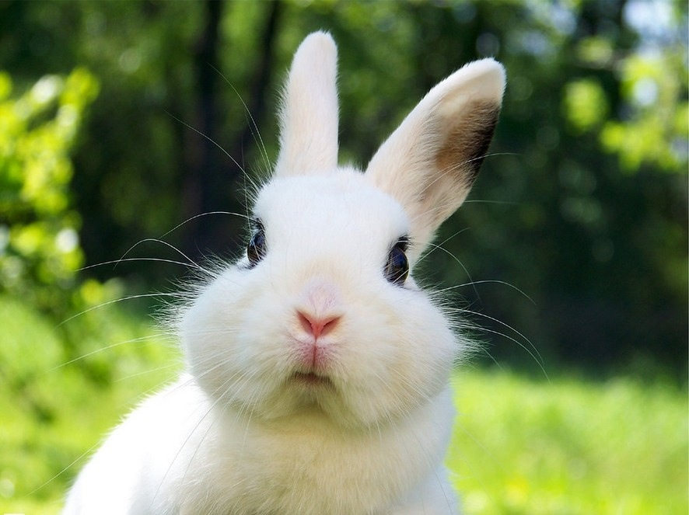
1. They are small and cute.
2. It is dangerous for them to fall（掉进）in the water.
3. They are not strong enough to protect themselves.
4. It is kind of the owner（主人） to give them carrots as food.
rabbit

Slide 6
Objective
Learn to use the following sentence patterns:
It is + adjective + for + noun/pronoun + to + verb
It is + adjective + of + noun/pronoun + to + verb
adjective + enough + to + verb

Slide 7
A Using It is + adjective + for + noun/pronoun + to+ verb
It is adj. for noun/pronoun to+verb
It is | important | for | us | to protect giant pandas.
 | good |  | people | to save endangered animals.
Work out the rule
The adjective in this sentence pattern describes (the person/the action)

Slide 8
Summary
it
（1）在句型“It is + adj. + for + n. / pron. + to + v.”中，_______ 是形式主语，_________是真正的主语。
（2）在此句型中，形容词修饰的对象是动词不定式，表示动作的特征。此句型常用于表达对某人做某件事情的看法，说话时这个动作可能并未完成或表示一般意义上的行为。
eg. It’s important for us to learn English well.
“我们”英语可能尚未学好，但学好英语这件事情很重要。
这一句型的形容词有：
difficult, hard, interesting, common, easy, (un)important, (un)necessary, (im)possible, (un)usual等。
特别注意以下几个：
good(好的，有益健康的), bad(不好的，有害的), right(正确的), wrong(错误的)
to do sth

Slide 9

(p71)Read the notes below. Then write a short notice to remind your classmates about how to protect endangered animals.
Ways to protect endangered animals
learn about endangered animals in the area --- important
buy products made from endangered animals --- wrong
report any hunting of endangered animals--- helpful
protct the homes of endangered animals----right

Slide 10
Protecting endangered animals:
It is important for people / us to
2. It is wrong for people/us to buy products made from endangered animals.
3. It is helpful for people/us to report any hunting of endangered animals.
4. It is right for people/us to protect the homes of endangered animals.
learn about endangered animals in the area.

Slide 11
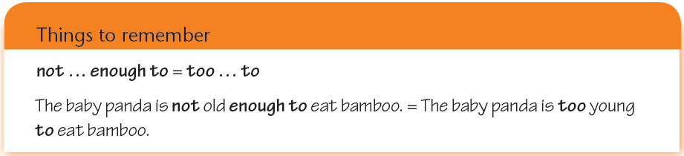
B Using adjective + enough + to + verb
They are strong enough to protect themselves.

Slide 12
Summary
（1）在“adj. + enough + to + v.”结构中enough 为adv.，修饰形容词时放在其后，表示主语所指的对象有足够的能力去做某件事，该句型意为“足够…能…”。
（2）此结构的否定形式为“not + adj. +enough + to + v.”
意为“不够…来…”，可与“too + adj. + to + v.”互换使用。
其中，这两个结构中的形容词为反义词。
他还太小了，不能上学。
He is not old enough to go to school.
=He is too young to go to school.

Slide 13
用括号内所给的词完成下列句子。
fresh enough to eat
When did you buy these cakes? Are they _________________?(fresh/ eat)
This bed is hard. It’s not _________________________.(comfortable/ sleep on)
I’ll start the film now. Is it ___________________________? (loud/ hear)
Janet looks ill. Is she ________________________? (well/ go to school)
This box is heavy. Are you _______________________? (strong/ carry)
I want a book from the top shelf. Are you __________________? (tall/ reach)
comfortable enough to sleep on
loud enough for everyone to hear
well enough to go to school
strong enough to carry it
tall enough to reach it

Slide 14
Simon is talking about his trip to the nature park with Emma. Complete their conversation with the adjectives and verbs in brackets.
Simon: Someone was throwing rocks at a duck in the
park, but I _________________________
(brave/tell) him to stop doing it. I feel really
sorry about it.
Emma: That’s OK, Simon. At least, you’re
____________________ (honest/say) you
were wrong. What happened to the duck then?
was not brave enough to tell
honest enough to say

Slide 15
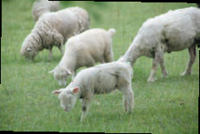
Simon: It flew away from us. I think it came close because
it was hungry. Some other people in the park were
__________________ (kind/give) it some food,
so it was fine.
Emma: Did you see any other animals during your trip?
Simon: Yes, I saw some birds, some horses and some
sheep. I did a lot of walking. I am_______________
(tired/fall) asleep right now!
kind enough to give
tired enough to fall

Slide 16
C Using It is + adjective + of
+ noun/pronoun + to + verb
1) 人类杀熊猫是残忍的。
2) 你真好，试着救这条狗。
It is cruel of human to kill pandas.
It is kind of you to try to save the dog.
It’s adj. + of +sb. to do sth
“某人做了某事，他/她是……”

Slide 17
P73
It is + adj. + of + noun/pronoun + to + verb
It is | cruel | of | them | to kill pandas.
 | kind |  | you | to try to save the dog.
Work out the rule
The adjective in this sentence pattern describes (the person/the action)

Slide 18
Summary
It is + adj. + of + n. / pron. + to+ v.
在该句型中，形容词修饰的对象是句子的逻辑主语，即of后的名词或代词，且大多是描述人物的性格、品质的形容词。而且，在说这句话之前，句中的那个动作通常都已经完成。
eg. It is very nice of you to lend me an umbrella.
“你”已经将雨伞借给我，nice 是对“你”的评价。
（2）常用于此句型的形容词有：
(im)polite, brave, foolish, stupid, silly, clever, careful, careless, nice(善良的), (un)kind, friendly, generous, thoughtful(体贴的), rude, naughty
特别注意以下几个：
good(好心的), bad(善良的), right(正直的，道德的), wrong(不道德的)

Slide 19
What is the difference between the following sentences?
错误的；说话时这个动作可能并未完成或表示一般意义上的行为
It is wrong for people to buy products made from endangered animals.
It is wrong of you to keep laughing at the disabled people.
不道德的；在说这句话之前，句中的那个动作通常都已经完成
正确的；说话时这个动作可能并未完成或表示一般意义上的行为
It is right for people to protect the homes of endangered animals.
It is right of you to report the illegal action to the report.
正直的，有道德的；在说这句话之前，句中的那个动作通常都已经完成

Slide 20
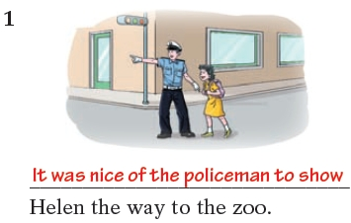
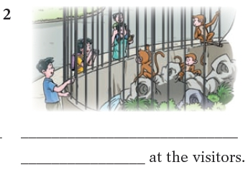
Below are some pictures of Helen's visit to the zoo. Write captions for the pictures.
bad clever careless nice
lose take show wave
It was clever of the monkey to wave

Slide 21
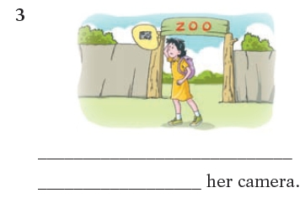
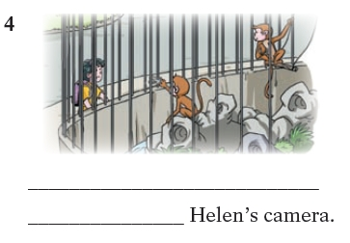
bad clever careless nice
lose take show wave
It was careless of Helen to lose
It was bad of the monkey to take

Slide 22
一、选择最佳答案填空。
( )1. It is wrong ____ him to laught at the little girl.
A. of B. for C. to D. with
( )2. It is uesful ____ us to learn some computer skills.
A. of B. for C. to D. with
( )3. The child is ____ tall ____ get the apples on the
table.
A. not so, that B. too, to
C. enough, to D. not, enough to
( )4. It’s not good for you ____ so many computer
games. It is a waste of time.
A. to play B. play
C. playing D. to playing
A
B
D
A

Slide 23
二、选用for 或of 填空。
1. It’s very kind ____ you to help me.
2. It’s silly ____ you to say such words.
3. It’s very dangerous ____ children to cross busy
streets.
4. It’s difficult ____ us to finish the work.
5. It is good ____ him to send medicine to the sick
boy.
of
of
for
for
of

Slide 24
Thank you!

