Slide 1
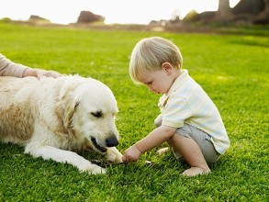


Unit 6 Pets
Vocabulary

Slide 2

respond v.（ 口头或书面）回答；回应 p. 81
*complaint n. 投诉；抱怨 p. 81
v. 抱怨；埋怨 p. 90
cause v. 造成；引起 p. 81
chocolate n. 巧克力 p. 82
*dolphin n. 海豚 p. 82
*click v. 使发出咔哒声 p. 82
reason n. 原因；理由 p. 83
cute adj. 可爱的 p. 83

Slide 3

responsibility n. 责任 p. 83
feed v. (fed, fed) 给（人或动物）食 物；喂养 p.83
according to prep.据（ ⋯⋯ 所说） p. 83
care for 照顾；照料 p. 83
*faithfully adv. 忠实地；忠诚地 p. 83
sofa n. 长沙发 p. 83
noisy adj. 吵闹的 p. 83
nearly adv. 几乎；差不多 p. 83
stranger n. 陌生人 p. 83
what’s more 更有甚者；更为重要的是 p. 83

Slide 4
common adj. 常见的；通常的；普遍的 p. 83
choice n. 选择；抉择 p. 83
have no choice but to do
除了……别无选择 p. 83
run free （动物）四处自由走动；自由自在p.83
lie v. (lay, lain) 躺 p. 86
lie around 无所事事地混日子；懒散度日 p. 86
attention n. 注意力；留心 p. 86
*scare v. 使害怕；使恐惧 p. 90
keep sb. from (doing) sth.
阻止（或防止、阻碍）某人做某事 p.90

Slide 5

DVD 数字影碟 p. 90
excuse me （引起尤其是陌生人的注意） 劳驾 p. 90
right away 立即，马上 p. 90
receipt n. 收据；收条 p. 90
in a moment 一会儿 p. 90
(be) faithful to…对……忠诚的 p. 91
believe v. 相信 p. 91

Slide 6

die of 死于 p. 92
heart n. 心；心脏 p. 92
heart attack n. 心脏病发作p. 92
keep on 继续 p. 92
until conj. 到⋯⋯ 时；直到⋯⋯ 为 止 p. 92

Slide 7

1. respond v.（ 口头或书面）回答；回应
对…做出回应
以…回答
respond to sth.
respond with sth.
回应问题
respond to a question
以微笑表示回答
respond with a smile
response n. 反应；响应
positive response
好评
差评
negative response

Slide 8
2. complaint [C,U] 投诉；抱怨
投诉信
我对他们的服务没有怨言。
I have no complaints about their service.
complain v. 表示不满；抱怨
她对他的粗心很不满。
She complained of/ about his carelessness.
向某人投诉某事
complain to sb. of/ about sth
a letter of complaint

Slide 9
3. cause vt. 造成；引起
The heavy rain caused the flood.
cause sb trouble/problems etc.
你给大家带来了不必要的麻烦。
You have caused us unnecessary trouble.
[C] 原因，起因
+ of 是…的原因
气候干燥是这场火灾的主要原因。
The dry weather is the major cause of the fire.

Slide 10
4. chocolate [U] 巧克力
[C]巧克力糖
一条巧克力
一盒巧克力糖
a bar of chocolate
a box of chocolates
5. *dolphin [C] 海豚
如果他有更多的时间，他就去观看海豚表演。
If he has more time, he will watch the dolphin
show.

Slide 11

6. *click v. ①使发出咔哒声
他对一个经过的侍者打了个响指，侍者赶
紧朝他们走了过来。
He clicked his fingers at a passing waiter, who
hurried across to them.
②[用鼠标]点击，单击
请点击此处以获得更多信息。
Please click here to get more information.

Slide 12
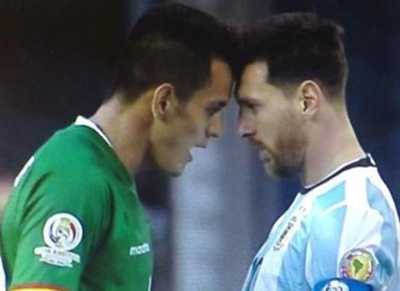
7. head to head 正面交锋；针锋相对
head to head常作为辩论类文章的标题。
go head to head
杰克决定与拉里就这个问题正面交锋。
Jack decided to go head to head with Larry on this issue.
head-to-head adj.正面交锋的；面对面的
这是一场正面战斗。
This is a head-to-head battle.

Slide 13
8. keep pet 养宠物
keep vt. 饲养
我们养了三只狗两只猫。
We keep three dogs and two cats.
raise vt. 饲养，养育，种植
她变得更擅长养丹顶鹤了。
She becomes better at raising red-crowned cranes.

Slide 14
9. reason [C] 原因；理由
[U]（正确或充分的）理由，道理
① the reason why +句子 …的原因
你为什么这样闷闷不乐，告诉我原因好吗？
Can you tell me the reason why you are so unhappy?
② the reason for (doing) sth. (做)…的原因
造成洪水的原因是那场大雨。
The reason for the flood was the heavy rain. =
The cause of the flood was the heavy rain.
③ for some reason 出于某种原因
由于某种原因，他今天不能来。
For some reason, he couldn’t come today.

Slide 15
10. cute adj. 可爱的
多用来指动物的聪明、漂亮及逗人喜爱。
指人时，多指小孩漂亮及逗人喜爱。
他们有一个可爱的宝宝。
They have a cute baby.

Slide 16

11. It’s nice to hold them in our arms, and it’s
wonderful to see them grow up.
1）hold … in one’s arms 把…搂住
hold-
她紧紧地抱着女儿。
She held her daughter in her arms tightly.
held-held

Slide 17
2）see them grow up 看着它们长大
（指看到整个过程）
①see sb. do sth. 看到某人做某事的全过程
②see sb. doing sth. 看到某人正在做某事
昨天我看见他在花园里干活了。
I saw him work in the garden yesterday.
(强调“我看见了”这个事实)
昨天我见他正在花园里干活。
I saw him working in the garden yesterday.
（强调"我见他正干活"这个动作）
（侧重动作的完整性，真实性）
（侧重动作的连续性，进行性 ）

Slide 18
12. Second, we can learn responsibility from keeping dogs.
①second adv. 第二，其次
= secondly
首先，他是一个学生。第二，他很诚实。第三，他不在那里。不可能是他做的。
First, he is a student. Second, he is honest. Third, he wasn’t there. It’s impossible for him to do that.

Slide 19

②learn ... from 从…学习…
我们有些决定是错误的，但是吃一堑长一智。
Some of our decisions were wrong, but you have to learn from your mistakes.
(A fall into the pit, a gain in your wit )
我们可以从阅读中学到很多东西。
We can learn a lot from reading.

Slide 20
Practice
根据中文意思完成句子。
1. 我们可以从养宠物中学到耐心。
We can _____ patience _____ ________pets.
选择最佳答案填空。
( )2. I really hope you can learn something from
_____ care of the old.
A. taking B. taken
C. take D. to take
learn from keeping
A

Slide 21
③responsibility
[U] 责任，义务
责任感
it is one’s responsibility to do sth
It’s your responsibility to look after your own health.
take responsibility for doing sth
承担（做）某事的责任
作为班长，你需要承担起维持班级秩序的责任。
As the monitor, you need to take responsibility for keeping the class in good order.
a sense of responsibility

Slide 22

③responsibility
[C] (各自的)职责;任务
My responsibilities include answering the phone and dealing with customer complaints.
responsible
adj.负有责任的；有责任心的
pl. responsibilities

Slide 23
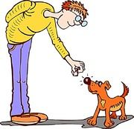
13. feed vt. 给（人或动物）食物；喂养
feed –
Have you fed the cat?
feed sth. to sb./sth
feed sb./sth. on/with sth
我们经常喂羊吃草。
We often feed the sheep on grass.
= We often feed grass to the sheep.
吃得好的/吃得不好的
well-fed/poorly-fed
fed-fed
用…喂…
把…喂给某人/物

Slide 24
14. according to prep.
①据（ ⋯ 所说）
按照警方说法，他被利刃所杀。
According to the police, he was killed by a sharp weapon.
②取决于，根据
You will be paid according to the amount of work you do.

Slide 25
15. care for 照顾；照料
= take care of = look after
我去上海时请帮我照顾我的宠物狗。
Please care for my pet dog when I go to Shanghai.
16. *faithfully adv. 忠实地；忠诚地
他忠心耿耿地为这一家人服务了四十年。
He served the family faithfully for 40 years.

Slide 26
17. So I think it’s a good idea to keep pet dogs.
所以我觉得养宠物是一个好主意。
it’s a good idea to do sth 做某事是一个好主意
18. sofa [C] 长沙发
我的女儿在沙发上睡着了。
My daughter was asleep on the sofa.

Slide 27
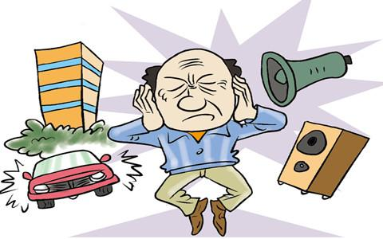
19. noisy adj. 吵闹的
这个地方很喧闹，我们找个安静的地方吧。
This place is very noisy. Let's find a quiet place.
noise n. 噪音，嘈杂声，响声
一般[U]，但当表示“某种声音”时，则[C]。
制造噪音
噪音污染
这课堂太吵了。
There is too much noise in this class.
响声把他吵醒了。
A noise woke him up.
make a noise
noise pollution

Slide 28
20. Nearly all dogs bark at strangers.
几乎所有的狗都朝陌生人吠叫。
① nearly adv. 几乎；差不多
=almost
已经快8点钟了。
It was nearly 8 o’clock.
⚠️not可以置于nearly之前，但不能置于almost之前。
但是nearly之后不能用否定意义的词。
他长得一点都没有他弟弟好看。
He’s not nearly as good-looking as his brother.
他几乎什么都没做。
He has almost done nothing.

Slide 29
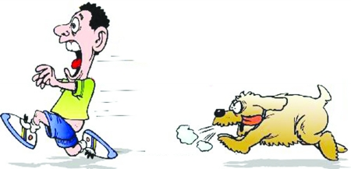
20. Nearly all dogs bark at strangers.
② bark at （狗）对……吠叫
狗总是对着陌生人汪汪叫。
Dogs always bark at strangers.
③stranger [C] 陌生人
strange adj. 奇怪的
那个孩子看见陌生人便跑掉了。
The child ran off when he saw a stranger.
be no stranger to sth.
有过很多某事的经历，对某事不陌生
他的计算机很在行。
He is no stranger to computers.

Slide 30
20. all night 整夜；通宵
她整夜未睡，满脑子都想着她的未来。
She spent all night thinking about the future.
21. This stops people from getting any sleep.
stop / keep /prevent sb. from doing sth.
阻止某人做某事
任何事都阻挡不了我们到那里去。
Nothing will stop / keep / prevent us from going there.

Slide 31
22. Not all dogs are friendly.
not all 不全是；并非所有都
表示部分否定
不是所有的学生都喜欢这部戏剧。
Not all students like this play.
= All students do not like this play. （not all= all … not）
⚠️此处也是部分否定，不要翻译成“所有的学生都不喜欢这部戏剧”，如果要表示全部否定，应该这样说：
None of the students like this play.

Slide 32
【拓展】
英语中表达“全体”意义的代词有all, both, everyone,
everybody, everything 等，当它们与not连用时，表示
部分否定。
不是每个人都通过了这次考试。
Not everyone passed this exam.
= Everyone does not pass the exam.
(not everyone = everyone … not…)
每个人都没有通过这次考试。
No one passed the exam.

Slide 33
Practice
根据中文意思完成句子。
1. 并不是所有的狗都喜欢这种食物。
_____ _____ _____ _____this food.
2. 并不是每件事情都很完美。
_____ __________ is perfect.
Not all dogs like
Not everything

Slide 34
23. a number of 若干；很多
少量的；小部分的
大量的；大部分的
只有少数学生喜欢这本书。
Only a small number of students are fond of the book.
a small number of
a large/great number of

Slide 35
24. what’s more 更有甚者；更为重要的
表示递进，独立使用，可放句首，也可放句末。
更为重要的是，他是我们队最重要的一员。
What’s more, he is the most important one in our
team.

Slide 36
25. common adj. 常见的；普遍的；共同的
老百姓
the common people
感冒在冬天很常见。
Cold is common in winter.
我们拥有一个共同的家。
We all have a common home.
n. have sth in common (with sb)
与某人有共同之处
我发现我和我的好朋友有许多共同之处。
I find that I have a lot in common with my good friend.

Slide 37

26. run free
（动物）四处自由走动；自由自在
不要让狗在繁忙的街上乱跑。
Don't let the dog run free on the busy street.

Slide 38
26. choice n. 选择；抉择
have no choice but to do 除了…别无选择
根据中文意思完成句子。
1. 没办法，我们只有回去。
We _____ _____ _____ _____ _____ _____ back.
2. 迈克别无选择，只好把家庭作业重做了一遍。
Mike _____ _____ _____ _____ _____ _____ his homework again.
have / had no choice but to go
had no choice but to do

Slide 39
have no choice but to do sth
除了做某事之外，别无办法/别无选择
=can/could do nothing but do sth
一般情况下，在含介词but(除了)的句型中，but前有
do，则but后的不定式不能带to；相反，but前若
无do，则but后的不定式要带to。
除了搬走，我们别无选择。
We had no choice but to move away.
=We could do nothing but move away.
（有do无to，有to无do）

Slide 40
Practice
根据中文意思完成句子。
1. 没办法，我们只有回去。
We _____ _____ _____ _____ _____ _____ back.
2. 迈克别无选择，只好把家庭作业重做了一遍。
Mike _____ _____ _____ _____ _____ _____ his homework again.
have / had no choice but to go
had no choice but to do

Slide 41
Thank you!

