Slide 1
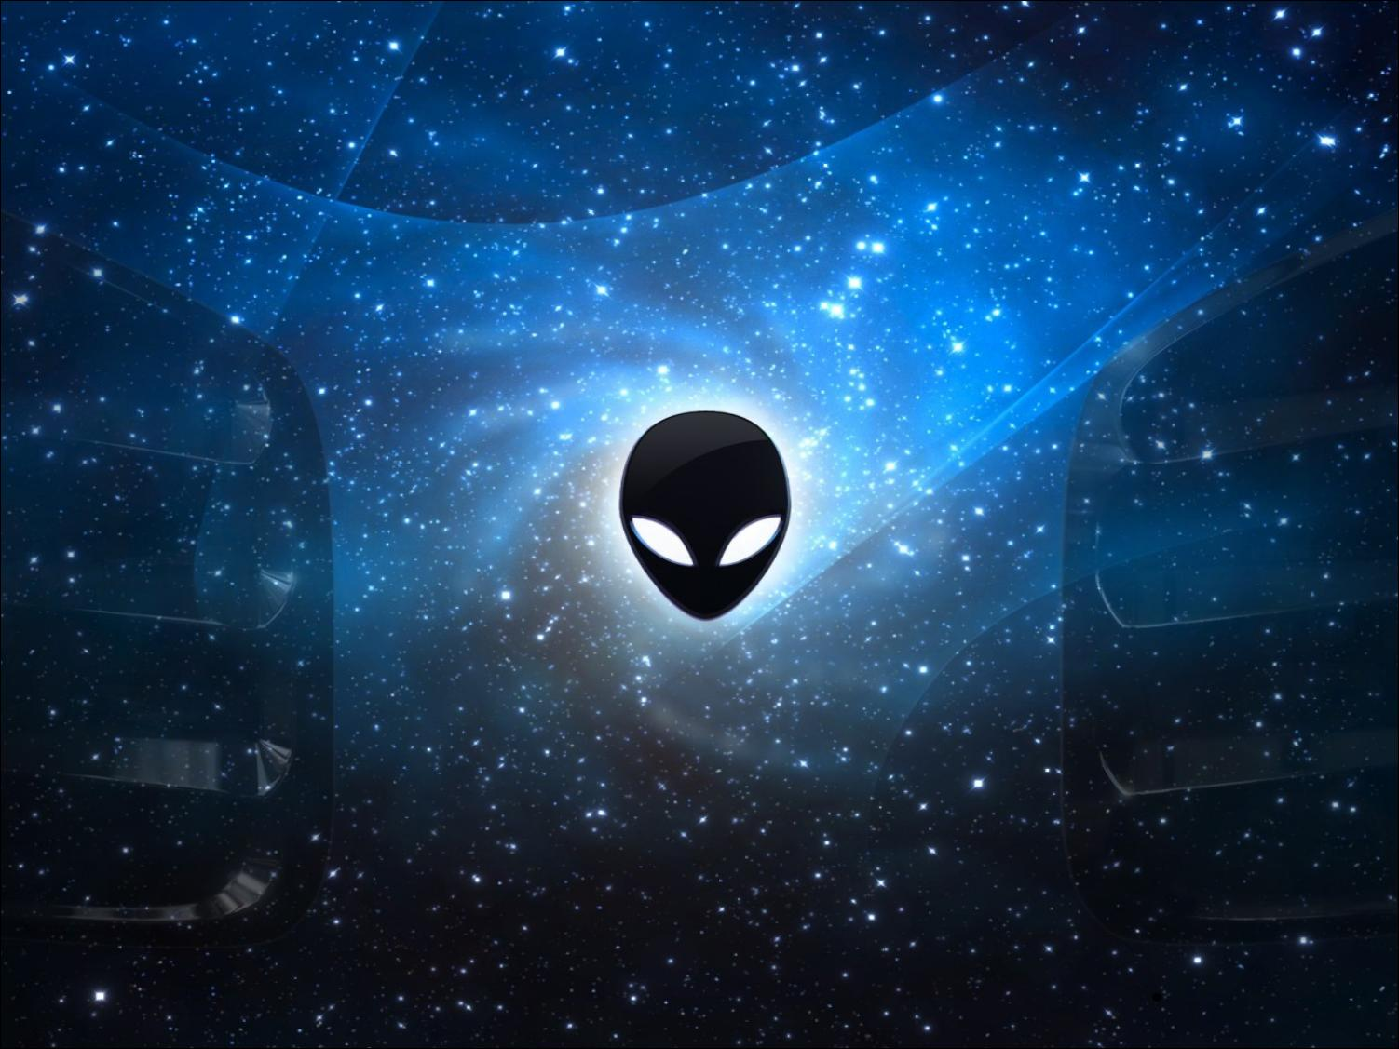
Unit 7 The unknown world
Writing

Slide 2
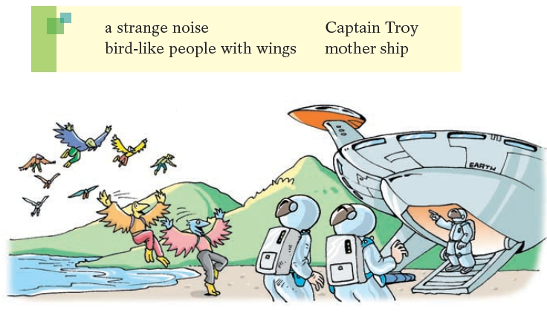
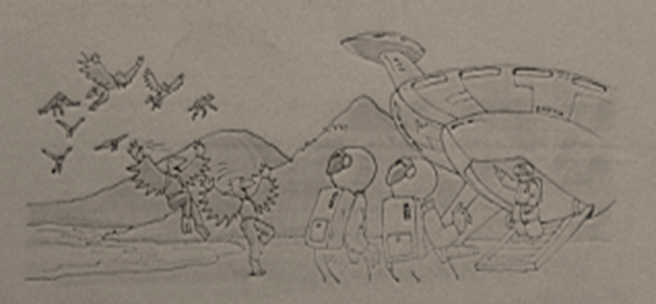
Meeting the people of Bird World
Liz and Gus finally arrived at the landing site of their mother ship. However, something strange happened.
a strange noise 一个奇怪的声音
Captain Troy 特洛伊上尉
bird-like people with wings 像鸟一样的翅膀的人
mother ship 母船

Slide 3
Pair work
1.Who was in the mother ship?
Captain Troy.
2.What appeared in the sky?
Some bird-like people.
3.What may they want to do?
They may want to stop them from leaving this planet.
4.What may happen?
They may have a fight.
5.What should they do？
They should...

Slide 4
B Liz wanted to make friends with the people of Bird
World. Discuss what she might do with your classmate.
Use the ideas from the box and the example below to
help you.
dance for the people of Bird
smile
sing
draw some pictures for them
give them something

Slide 5
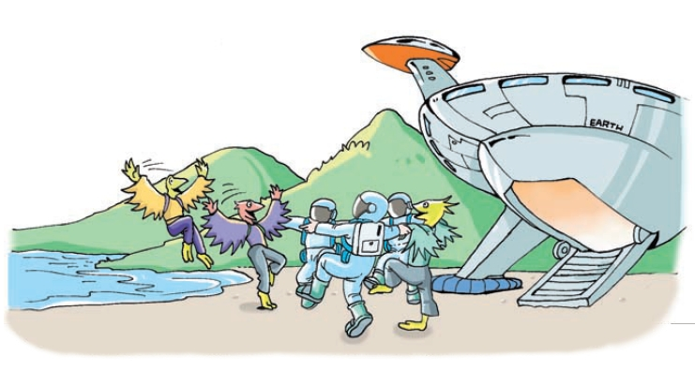
So what did they do?
Why?

Slide 6
No one knew what to do. Then Liz had a
good idea. She started to sing as she
wanted to show the people of Bird World
that she was friendly. Liz had a beautiful
voice. Because the people of Bird World
liked her song, they started to sing too.
They were happy.

Slide 7
Part II While-Learning

Slide 8
C Write the story of Liz and Gus with your ideas from A and B.
Liz and Gus finally reached the landing site and saw Captain Troy. “Liz! Gus! Welcome back!” said Captain Troy. “I’m very pleased to see you. Now let’s get on the mother ship and…”
Suddenly_________________________________________________________________________________________________________________________________________________________
they all heard a strange noise. They looked up into the sky. Some bird-like people with wings were flying in the air. Many of them landed near the mother ship.

Slide 9
No one knew what to do. Then Liz had a good idea. ________________________________________________________________________________________________________________________________________________________________________________________________________ And so the people from the Earth and Bird World became friends!
She smiled at them and started to dance as she wanted to show the people of Bird World that she was friendly. She danced beautifully. Everybody from Bird World liked her dancing very much. They started dancing too. They were happy.

Slide 10
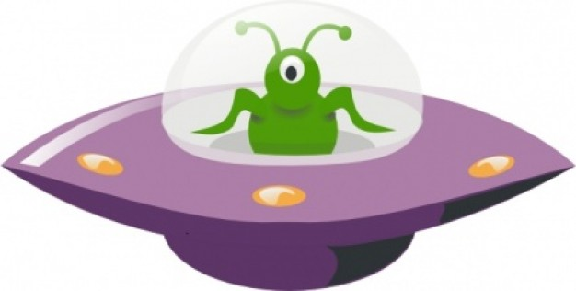
New words and expressions
P107-108
pleased adj. 高兴；满意；愉快 p. 108

Slide 11
Notes 107-108
1. However, something strange happened.
然而，一些奇怪的事情发生了。
something strange 奇怪的事情
形容词修饰不定代词或不定副词时，须置于
其所修饰的词之后。例如：
我有一些重要的事情要告诉你。
I have something important to tell you.
这里太吵了。我想去个安静的地方。
It’s too noisy here. I want to go somewhere
quiet.

Slide 12
Practice
选择最佳答案填空。
( )1. There is ____ with my watch. It doesn’t
work.
A. nothing wrong
B. anything wrong
C. wrong something
D. something wrong
D

Slide 13
2. pleased adj. 高兴；满意；愉快
be pleased with sb./ sth. 对某人/某物感到满意
be pleased to do sth. 高兴、乐意做某事
be pleased + that 高兴、乐意……
我对自己的考试成绩不太满意。
I wasn't very pleased with my exam results.
见到你很开心。
（I am）pleased to meet you.
如果我们可以做什么，我们会很乐意帮忙。
If there is anything we can do, we would be pleased to help.
你觉得好些了，我很高兴。
I am pleased that you’re feeling better.

Slide 14
Thank you!

Slide 15

假如你有一次遇见UFO 和外星人的经历，
请根据下面的内容提示用英文讲述此次经历。词数80左右，开头已给出，不计入总词数。

Slide 16
【内容提示】
时间 | 昨晚
地点 | 公园的树林里
经过 | 1. 散步期间看到飞船降落； 2. 外星人会说英语，来自月球； 3. 飞船因为撞击受损而降落地球； 4. 告诉他们尽快离开。
感受 | ……（自由发挥）

Slide 17
Step 1: 激活词汇
你能想起与短文有关的学过的词汇吗？试一下吧！
1. 降落
2. 散步
3. 保持安静
4. 来自
5. 因为
6. 尽快
land in / on
2. take a walk
3. keep quiet / silence
4. come / be from
5. because / because of / since / as
6. as soon as possible

Slide 18
Step 2: 精彩结构
1. make sb do sth意为“使/让某人做某事”。
【例】爸爸让我马上停止玩电脑游戏。
Dad made me stop playing computer
games at once.
【译】这使他们降落在地球上。
This / It made them land on the Earth.

Slide 19
2. tell sb to do sth意为“告诉某人做某事”。
【例】妈妈告诉我睡觉前要关灯。
Mum tells me to turn off the light before I go to sleep.
【译】我告诉他们尽快离开。
I told them to leave as soon as possible.

Slide 20
Step 3: 谋篇布局
本篇短文主要描述自己遇见外星人的经历，主语应用_______人称单数形式，时态要用____________ 。构建内容时要注意运用所学过的单词、短语和句型。
第一
一般过去时

Slide 21
Step 4: 小试身手
I had an unforgettable experience last night. When I was taking a walk in the park, I heard a loud noise and saw a red light in the sky. A spaceship landed in the forest. Two aliens came out of it. They were tall
and thin, with three eyes and a big mouth. I was in fear, so I kept quiet. But the two aliens found me and talked to me in English. They said they came from the Moon.
Their spaceship was damaged because of a crash. It made them land on the Earth. I told them to leave as soon as possible in order not to be discovered by others. I hope to see them again and play with them one day.

Slide 22
Part IV Review

Slide 23
用英语翻译下列句子。
1. 空姐(air hostess)告诉我们要保持安静。
Air hostesses told us to keep quiet.
2. 她尽可能快地为他做了急救措施。
(give sb first aid)
She gave him first aid as soon as possible.
3. 有些人不同意他（的想法）。
Some people disagreed with him.

Slide 24
Thank you!

