Slide 1

精
读
改
变
从
开
始
，

Slide 2


让精读成为一种习惯
《高中英语阅读6+1》高一A版第1周 星期一
精进思变 读出心裁

Slide 3

Teaching Aims
to master some useful words and phrases
to raise awareness of topic vocabulary
to train the students’ reading and writing skills

Slide 4

Teaching Procedures
Ⅰ
Pre-reading
Activate topic vocabulary
Ⅱ
Fast-reading
Get the general idea of a passage
Ⅲ
Careful-reading
Get some detailed information
Ⅳ
Post-reading
Do deliberate practice

Slide 5

Ⅰ
Pre-reading
Activate topic vocabulary

Slide 6
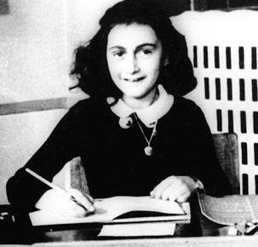
高一A第1周 星期一： Friendship
upset
grateful
lonely
dislike
get / be tired of
fall in love
…
classmate diary
…
friend
feeling
private
set down
…
Friendship
lasting
get along with
face to face
…
company
concern
help
go through
…
share

Slide 7
Ⅱ
Fast-reading
Get the general idea of a passage

Slide 8


Read the passage in 6 minutes
What is the main idea of the passage?
What did the author do before meeting her soul mate?
How did the author get to know her soul mate?
What do we know about the author and her soul mate?
Why is the author thankful for the hard times?
(P1)

Slide 9

What is the main idea of the passage?
A close friendship between two girls.

Slide 10
Circle the topic vocabulary
Para 1
Two years ago I was very lonely and didn’t talk with anyone about my feelings. At the time I didn’t have many friends. I wanted someone to share my experiences and secrets with. I wanted someone to understand me. I started to imagine this friend. Often I imagined our conversations and what we would do, but I didn’t give my imagination a face.

Slide 11
Circle the topic vocabulary
Para 2
Some weeks later we started a new project in school and I was working with one of my schoolmates. We had never worked together before but we got along well. After the project we started to spend some time together in school. One day we decided to take a walk. Ever since that walk we’ve been best friends. We listened and really understood each other.

Slide 12
Circle the topic vocabulary
Para 3
I had wished for a best friend, but the universe gave me so much more. I have met one of my soul mates (挚友). We can sense each other, and it just takes one look and we know what the other is thinking. I didn’t think our friendship could grow much stronger. But now we have known each other for two years and our friendship is growing all the time.

Slide 13
Circle the topic vocabulary
Para 4,5
It hasn’t only been easy. We have gone through both easy and hard times. But I’m grateful for the hard times, because they have forced me to grow and taught me a lot. My best friend has changed me. She has made me believe in myself. And I am now focusing on achieving one of my biggest dreams. Without her I wouldn’t even have realized what my biggest dream is.
I know there are soul mates out in the world for you. I am so grateful to have met one of mine. Believe in them, and your paths will cross!

Slide 14

Answer the following questions
1. What did the author do before meeting her soul mate?
A. She chose to stay alone.
B. She spent time with other friends.
C. She told others about her feelings.
D. She pictured a friend in her mind.
2. How did the author get to know her soul mate?
A. By taking a walk.
B. By attending a party.
C. Through a school project.
D. Through a friend’s introduction.
√
√
(P1)

Slide 15
Answer the following questions
3. What do we know about the author and her soul mate?
A. Their friendship is still developing.
B. She is the author’s only soul mate.
C. They are trying hard to realize their dreams.
D. She has little confidence in their friendship.
4. Why is the author thankful for the hard times?
A. She got to know her best friend.
B. She has learnt a lot from them.
C. They have changed her.
D. They have made her dream come true.
√
√
(P1)

Slide 16
Ⅲ
Careful-reading
Get some detailed information

Slide 17

Important and difficult points
Para 1
网络激活：lone, alone
lonely 强调feeling
lone (只用于名词前)
强调the only person / thing “孤零零的”
alone(不用语名词前)
强调by oneself “独自”
Two years ago I was very lonely and didn’t talk with anyone about my feelings. At the time I didn’t have many friends. I wanted someone to share my experiences and secrets with. I wanted someone to understand me. I started to imagine this friend. Often I imagined our conversations and what we would do, but I didn’t give my imagination a face.
词性：adj.
(人) 孤独的，寂寞的
(地方) 人迹稀少的，偏僻的

Slide 18
Important and difficult points
Para 1
Two years ago I was very lonely and didn’t talk with anyone about my feelings. At the time I didn’t have many friends. I wanted someone to share my experiences and secrets with. I wanted someone to understand me. I started to imagine this friend. Often I imagined our conversations and what we would do, but I didn’t give my imagination a face.
emotions 情感
宾语从句
构词法：imagine

Slide 19
Important and difficult points
Para 2
Some weeks later we started a new project in school and I was working with one of my schoolmates. We had never worked together before but we got along well. After the project we started to spend some time together in school. One day we decided to take a walk. Ever since that walk we’ve been best friends. We listened and really understood each other.
熟义： a carefully planned piece of work
计划，工程，项目
学校的“学科计划或项目”
生义：a piece of school work about a subject
(学校的)课题，专题研究

Slide 20
Important and difficult points
Para 2
Some weeks later we started a new project in school and I was working with one of my schoolmates. We had never worked together before but we got along well. After the project we started to spend some time together in school. One day we decided to take a walk. Ever since that walk we’ve been best friends. We listened and really understood each other.
get along / on (with) 与……相处融洽
拓展：
We can’t get along without your help.
How are you getting along / on with your essay?
过活，应付
进展

Slide 21
Important and difficult points
Para 2
Some weeks later we started a new project in school and I was working with one of my schoolmates. We had never worked together before but we got along well. After the project we started to spend some time together in school. One day we decided to take a walk. Ever since that walk we’ve been best friends. We listened and really understood each other.
时态：现在完成时
ever since
动词虚化：“make / have / take a(n) + 名词”结构代替动词，表示完成一次动作。
take a bath, make a joke, have a look

Slide 22
Important and difficult points
Para 3
I had wished for a best friend, but the universe gave me so much more. I have met one of my soul mates (挚友). We can sense each other, and it just takes one look and we know what the other is thinking. I didn’t think our friendship could grow much stronger. But now we have known each other for two years and our friendship is growing all the time.
名词动化：感觉到，意识到，觉察出
We can sense each other…
意译：心有灵犀

Slide 23
Important and difficult points
Para 3
I had wished for a best friend, but the universe gave me so much more. I have met one of my soul mates (挚友). We can sense each other, and it just takes one look and we know what the other is thinking. I didn’t think our friendship could grow much stronger. But now we have known each other for two years and our friendship is growing all the time.
基本义到衍生义；精准的汉语释义
基本义：强壮
衍生义：感情“强壮”
深厚

Slide 24
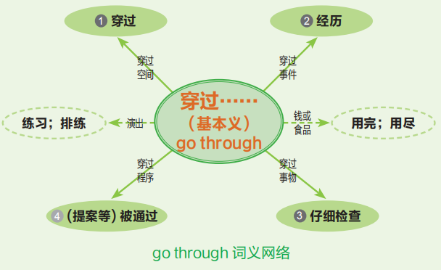
Important and difficult points
Para 4,5
It hasn’t only been easy. We have gone through both easy and hard times. But I’m grateful for the hard times, because they have forced me to grow and taught me a lot. My best friend has changed me. She has made me believe in myself. And I am now focusing on achieving one of my biggest dreams. Without her I wouldn’t even have realized what my biggest dream is.
I know there are soul mates out in the world for you. I am so grateful to have met one of mine. Believe in them, and your paths will cross!

Slide 25
Important and difficult points
Para 4,5
It hasn’t only been easy. We have gone through both easy and hard times. But I’m grateful for the hard times, because they have forced me to grow and taught me a lot. My best friend has changed me. She has made me believe in myself. And I am now focusing on achieving one of my biggest dreams. Without her I wouldn’t even have realized what my biggest dream is.
I know there are soul mates out in the world for you. I am so grateful to have met one of mine. Believe in them, and your paths will cross!
同义替换：thankful
同义替换：realizing
学术词【AW】：achieve

Slide 26
Important and difficult points
Para 4,5
It hasn’t only been easy. We have gone through both easy and hard times. But I’m grateful for the hard times, because they have forced me to grow and taught me a lot. My best friend has changed me. She has made me believe in myself. And I am now focusing on achieving one of my biggest dreams. Without her I wouldn’t even have realized what my biggest dream is.
I know there are soul mates out in the world for you. I am so grateful to have met one of mine. Believe in them, and your paths will cross!
虚拟语气：would / should / could / might have done

Slide 27

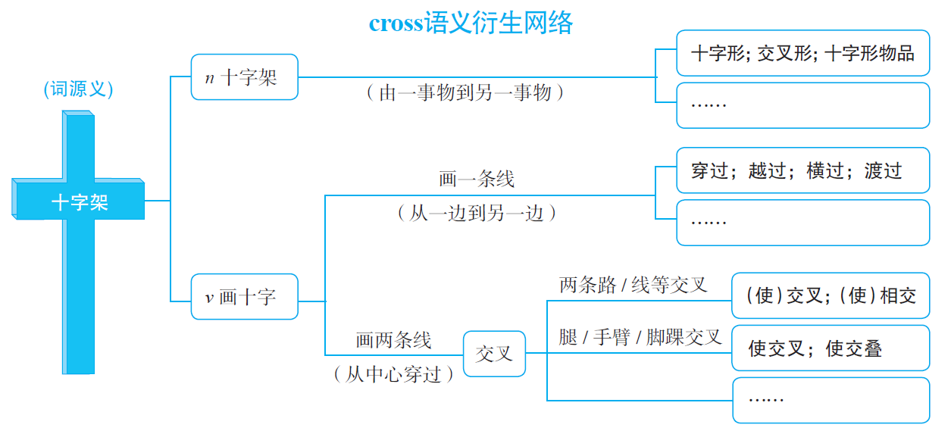

Important and difficult points
Para 4,5
It hasn’t only been easy. We have gone through both easy and hard times. But I’m grateful for the hard times, because they have forced me to grow and taught me a lot. My best friend has changed me. She has made me believe in myself. And I am now focusing on achieving one of my biggest dreams. Without her I wouldn’t even have realized what my biggest dream is.
I know there are soul mates out in the world for you. I am so grateful to have met one of mine. Believe in them, and your paths will cross!
sb’s paths cross不期而遇，邂逅

Slide 28
Ⅳ
Post-reading
Do deliberate practice

Slide 29

Deliberate practice
“意识培养”：词汇网络化
用括号内所给词的正确形式填空 (lone, lonely, alone)
(1) Julie _______ knew the truth.
(2) He is a(n) ________ wolf and has few friends.
(3) She lives _________ but she doesn’t feel _______.
(4) There is a(n) ________ beach near my house and
only a few people would come to visit.
(5)The flower, a(n) ________ dandelion (蒲公英)
standing against the bright blue sky, inspired me.
（12 湖南阅读）
alone
lone
alone
lonely
lonely
lone
(P7)

Slide 30
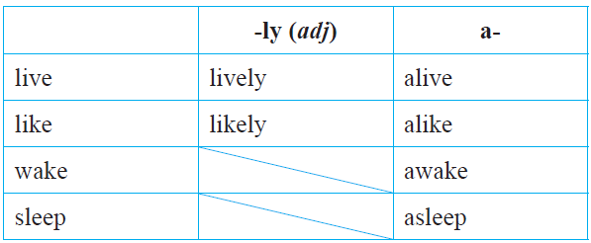
Deliberate practice
“意识培养”：词汇网络化
根据所给提示完成下列句子
(1) Not until two days after the earthquake did she find her mother ________ (live). （11 湖北完成句子）
(2) After years of construction, this town is as ________
(live) now as it used to be before the earthquake.
（13 上海翻译句子）
(3) It is _________ (like) that you could suffer from bad
health if you keep smoking.
(4) Great minds think __________ (like).
alive
lively
likely
(P7)
alike

Slide 31
Deliberate practice
“意识培养”：词汇网络化
根据所给提示完成下列句子
(5) Drinking only a cup of coffee will keep me ________
(wake) all night. （09 上海翻译句子）
(6) Last night I _________ (wake), shaking with fear.
（外研⑥-5）
(7) I ________(sleep) badly and found it hard to keep my
mind on the teacher’s words.
(8) The lecture was so boring that I almost fell _________
(sleep) after the first 30 minutes.
awake
woke
slept
(P7)
asleep

Slide 32
Deliberate practice
“意识培养”：词汇网络化
根据所给提示完成下列句子
(5) Drinking only a cup of coffee will keep me ________
(wake) all night. （09 上海翻译句子）
(6) Last night I _________ (wake), shaking with fear.
（外研⑥-5）
(7) I ________(sleep) badly and found it hard to keep my
mind on the teacher’s words.
(8) The lecture was so boring that I almost fell _________
(sleep) after the first 30 minutes.
awake
woke
slept
(P7)
asleep

Slide 33
Deliberate practice
“意识培养”：动词虚化
根据所给提示， 用“make / have / take a(n) + 名词”结构完成下列句子
Although badly hurt in the accident, the driver was
still able to _________________ (phone call).
(2) I used to ________________ (bath) twice a day last
year, morning and night.
(3) You should _______________ (plan) before you do
everything.
make a phone call
take / have a bath
(P7)
make a plan

Slide 34
Deliberate practice
“意识培养”：动词虚化
根据所给提示， 用“make / have / take a(n) + 名词”结构完成下列句子
have a think
(4) I’ll _______________ (think) and let you know what I
decide.
(5) It’s impolite of you to ______________ (joke) about
others’ appearance.
(6) Here, ________________ (look) at the list of the poor
families in our school who most need help.
make a joke
(P7)
have / take a look

Slide 35
Deliberate practice
“意识培养”：基本义
根据cross基本义“（画）十字架” ，写出画线部分在下面语境中的汉语意思。
(1) Put a cross after each wrong answer. ____________
(2) Several thoughts crossed my mind as I watched him
work. ___________
(3) Owen crossed the ball for Cole to head into the goal.
___________
叉号
（想法、思想等）从脑中掠过
(P8)
横传（足球、曲棍球等）

Slide 36
Deliberate practice
“意识培养”：基本义
根据cross基本义“（画）十字架” ，写出画线部分在下面语境中的汉语意思。
(4) Cross Dave’s name off the guest list — he can’t come.
____________
(5) She was sitting on the floor with her legs crossed.
____________
(6) I phoned him up and got a crossed line.
____________
(7) Believe in them, and your paths will cross!
_____________
划掉；删除
盘（腿）
(P8)
串线
你们将不期而遇；邂逅

Slide 37

Deliberate practice
“能力提升”：同义替换
一、写出能替换画线部分的单词或短语
( P1-1) 1. I started to picture this friend in my mind.
___________
( P1-4) 2. I’m thankful for the hard times.
___________
( P1-4) 3. I am now focusing on realizing one of my
biggest dreams.
___________
imagine
grateful
(P9)
achieving

Slide 38
Deliberate practice
“能力提升”：语用意义
二、写出下列句子中画线部分的汉语释义
( P1-1) 1. Two years ago I was very lonely and didn’t talk
with anyone about my feelings.
___________
( P1-2) 2. Some weeks later we started a new project in
school and I was working with one of my
schoolmates. ___________
情感
(P9)
课题；专题研究

Slide 39
Deliberate practice
“能力提升”：汉英对比
三、根据汉语，写出单词的正确形式
( P1-3) I didn’t think our friendship could grow much
____________ (更深厚).
stronger
(P9)

Slide 40
Deliberate practice
“能力提升”：词法、句法、语法
四、在空白处填入1个适当的单词或括号内单词的正确形式
( P1-1) 1. Often I imagined our conversations and what we
would do, but I didn’t give my _____________
(imagine) a face.
( P1-2) 2. Ever since that walk we ______________(be)
best friends.
imagination
have been
(P9)

Slide 41
Deliberate practice
“能力提升”：词块
五、根据所给汉语，完成下列句子
( P1-2) 1. We had never worked together before but
_________________ (我们相处融洽).
( P1-3) 2. _____________________ (我们心有灵犀), and it
just takes one look and we know what the other is
thinking.
we got along well
We can sense each other
(P10)

Slide 42
Deliberate practice
“能力提升”：词块
五、根据所给汉语，完成下列句子
( P1-4) 3. We have _________________________________
(同甘苦共患难).
( P1-4) 4. The hard times have forced me to grow and
______________ (教会我很多).
gone through both easy and hard times
taught me a lot
(P10)

Slide 43
Deliberate practice
“能力提升”：话题微写作
话题： “Friendship”
形式： 单句；文段；短文（任选其一）
要求：必须用到下列词汇 lonely, share, sense, upset, ignore,
go through, get tired of
______________________________________________________
______________________________________________________
______________________________________________________
_____________________________________________________

Slide 44
第1周重难点词汇汇总

Slide 45
Read & Translate
单词
lonely, alone, share, sense(v), force, achieve, picture(v), afford, confidence, advanced, previously, comfort, needy, service, postpone, swap, marriage, typical, likely, lasting, provide, consider, reliable, upset, ignore
词块
go through, focus on, people’s paths cross, come true, hang out, go by, run into, to say the least, have got to, turn to, get tired of, make a decision

Slide 46



让精读成为一种习惯
精进思变
读出心裁

