Slide 1
Unit 37
空间存在与特征

Slide 2
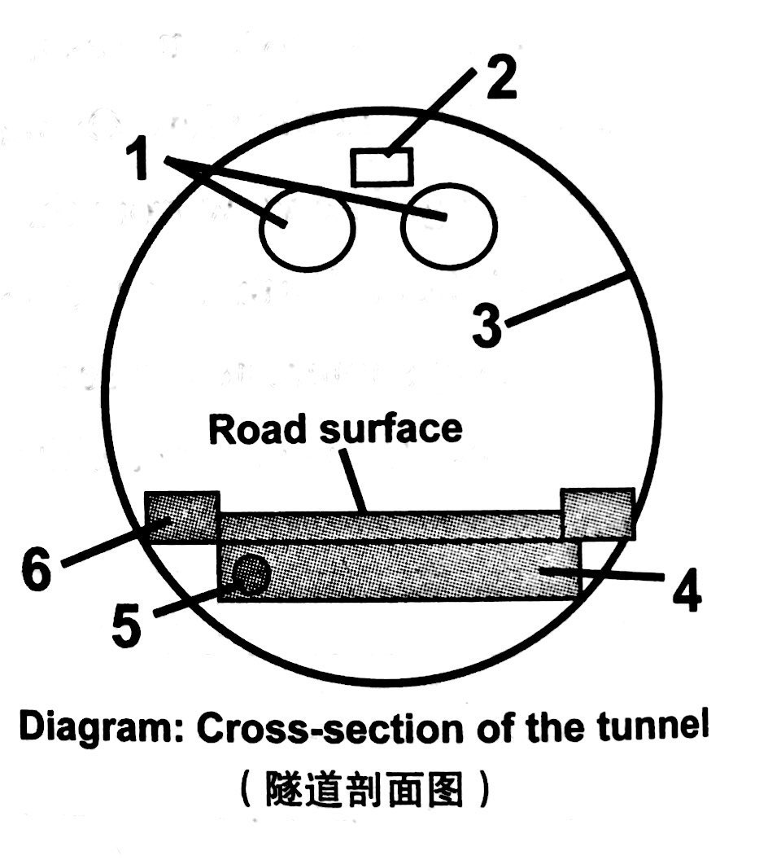
Part I Daily reading
lighting
air-conditioning pipes
Task 1 Reading comprehension
1. Each of the tunnels under construction is __________________.
2. Which part of the tunnel in the diagram is used to pipe out extra water?
wall
D. four kilometres long and six metres wide
C. 5.
fire main
base
消防水管
drainage system
“In the event of fire, the fire main, which is made of steel, pipes water to many fire hydrant stations at regular intervals along the length of the tunnel.”

Slide 3
3. Driving in the tunnel, one can know the traffic conditions ahead through _________________.
4. The base on which the road surface lies is made of __________________.
5. The passage is mainly about ______________________.
“…under construction”; “…are being built”
Para 2 & 3 talk about inner structure.
“other systems will include emergency phones”
B. the electronic signs
B. concrete and steel
D. the design of two tunnels

Slide 4
Task 2 When we introduce a place, what aspects should be included?
Each tunnel is roughly round and the lower part of the tunnel is somewhat flat.
shape
place
It is expected to carry 20,000 trucks and cars a day, which greatly reduces the overcrowded traffic in the centre of the city.
purpose / function

Slide 5
Task 2 When we introduce a place, what aspects should be included?
history
location
population
places of interest
place
area
transport
surroundings
purpose / function

Slide 6
1) Guangzhou, the capital of Guangdong, is located in the middle of Guangdong province. (_______________)
2) It covers a total area of 7434.4 square kilometers. (_______________)
3) The history of the city dates back to the Tang Dynasty. (_______________)
4) Because it is warm and flowery all the seasons, it is also called “Flower City” and “Five Goats” is the symbol of it. In 1982, Guangzhou was named as one of the first historical and cultural cities. (___________________)
location
area
history
places of interest

Slide 7
5) Surrounded by mountains on three sides, the small village faces a clear river on the east. (_______________)
6) The best way to experience the city life is to take a bus tour. (_______________)
7) With a rapid increase in population, our city is becoming more and more crowded. (_______________)
8) A walk around is a feast for the mind as well as the eyes. (____________________)
9) Tourists from home and abroad are attracted to Guangzhou by its beautiful scenery. (___________________)
surroundings
transport
population
places of interest
places of interest

Slide 8
Task 3 position
表示方位的词汇表达
In the centre of the city, below the central area of the city, to the south, below the surface, upper part, inside the tunnel, at the top of the tunnel, at its highest point, ahead, on the inside of the tunnel, lie on, on one side, at the side of the tunnel, at the level of the road surface

Slide 9
in
1. Nanjing lies ______ the south of Jiangsu.
2. We are sailing ________ the direction of east by north.
3. China faces the Pacific ______ the east.
4. Suzhou lies 50 miles ______ the west of Shanghai.
5. The Ming Tombs are located about 50 km _______ the northwest of Beijing.
in
on
to
to

Slide 10
to
6. He was directed ______ the table beside the window.
7. There was a loud scream _________ the direction of the children’s pool.
8. Julia placed a wine cup on the table __________ her reach.
9. A small plane crashed into a hillside five miles ______ the east of the city, killing all four people on board.
10. The Well Hotel sits in a quiet place ___________ the main road at the far end of the lake.
11. He suddenly saw Sue across the room. He pushed his way ___________ the crowd of people to get to her.
from
within
to
off / near
through

Slide 11
Task 4 Vocabulary focus
1. base
①At the base of the cliff was a rocky beach.
②He used the notes as a base for his lecture.
③He used the house as a base for his printing business.
④The new organization will be based in Dallas.
⑤The book is based on a true story.
⑥What are you basing this theory on?
[C] 底部；根基 (= bottom)
[C] 基础；依据 (= basis)
[C] 总部；基地
vt. 以…为基地；基地设在…
base …on…以…为…的基础 / 根据

Slide 12
2. “In the event of fire, the fire main, which is made of steel, pipes water to many fire hydrant stations at regular intervals along the length of the tunnel.”
in the event of __________________________
e.g. In the event of an accident, call this number.
pipe n.____________
e.g. hot and cold water pipes________________;
a burst pipe____________
pipe vt. ___________________________________
e.g. Water is piped from the reservoir(水库) to the city.
The speech was piped over a public address system.
at regular intervals________________________
Buses to the city leave at regular intervals.
in case of; when sth happens
水管；管道
热水管和冷水管
破裂的管道

Slide 13
Part II Error correction
My old classroom was interesting because three side of the classroom were made from glass. I enjoyed sit close to the windows and looking at the view. On the left-hand side of the class, I could easy see the football field. In the mornings, it was full of students exercising. The view from the back of the classroom is also splendid. Close to the school there was a beautiful park with many trees around them. Farther in the distance, I could not enjoy the view of snowy mountains. On the right side of the class was the road. I was always interested to see the drivers in hurry in the morning. The position of the classroom with its view made me felt like I was dreaming. If I was only a child when I studied in that classroom, I will never forget it.

Slide 14
Part II Error correction
My old classroom was interesting because three side of the classroom were made from glass. I enjoyed sit close to the windows and looking at the view. On the left-hand side of the class, I could easy see the football field. In the mornings, it was full of students exercising. The view from the back of the classroom is also splendid. Close to the school there was a beautiful park with many trees around them.
sides
of
sitting
easily
was
it

Slide 15
Part II Error correction
Farther in the distance, I could not enjoy the view of snowy mountains. On the right side of the class was the road. I was always interested to see the drivers in hurry in the morning. The position of the classroom with its view made me felt like I was dreaming. If I was only a child when I studied in that classroom, I will never forget it.
∧
a
feel
Though / Although
“The view from the back of the classroom is also splendid”

Slide 16
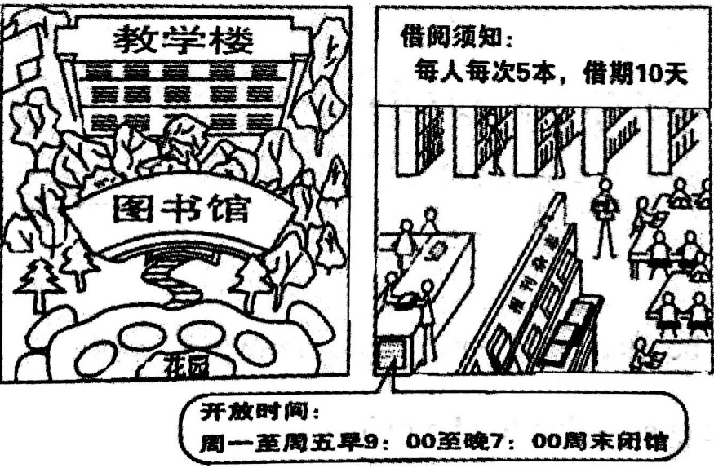
Part III Writing
假定你是李华。应英国朋友Bob的要求，写一封短信介绍你校图书馆的基本情况。内容须包括下面两幅图中的相关信息。

Slide 17
Task 1 Complete the following letter.
Dear Bob,
Thank you for your last letter asking about our library.
Our library 1._________________________________(位于学校的中心). There is a beautiful garden 2.____________________(在它的前面) and our classroom building 3.__________________(正好在它的后面). The library is big. 4.___________________(当你进到里面), you will see many shelves full of books on different subjects. 5.______________________________(还有许多报纸和杂志). We borrow books and do some reading in the library. According to the rule, 6.___________________________________________________(每个学生每次借阅可达5本，借期10天). It is open from 9 a.m. to 7 p.m. from Monday to Friday and closed on weekends.
Task 2 Polish and better your writing.
is located / situated in the center of the school
in front of it
is right behind it
when you get inside
There are also many newspapers and magazines
Every student can borrow up to 5 books each time and keep them for 10 days.

