Slide 1
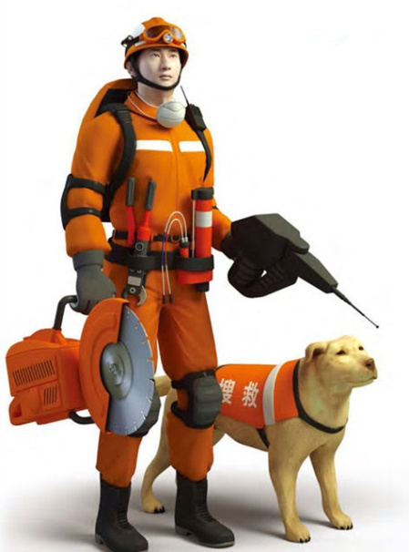

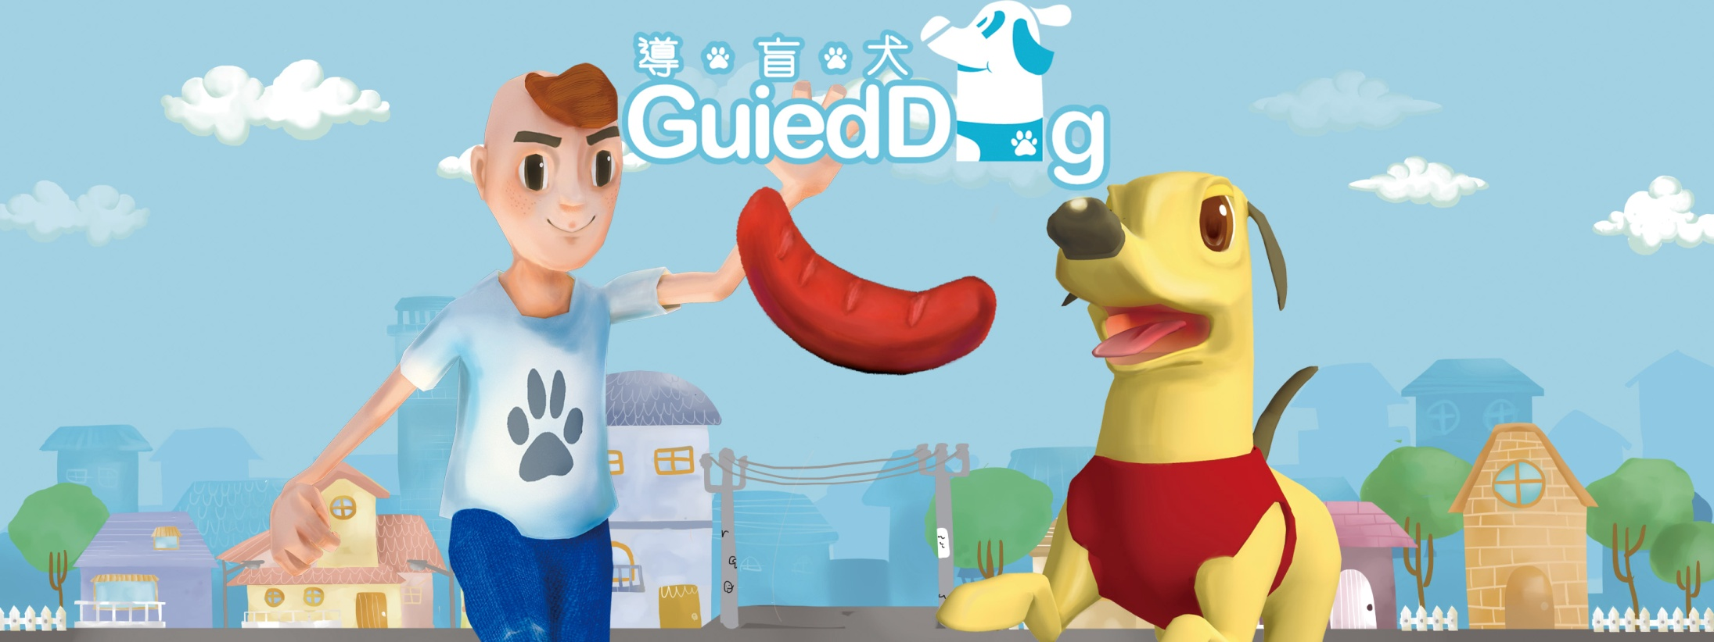
Unit 3 Our animal friends
Grammar

Slide 2
目录
Lead-in
1
Pre-Learning
2
3
While-Learning
Post-Learning
4
5
Review

Slide 3
Part I Lead-in

Slide 4

Reflexive pronouns
反身代词

Slide 5

myself
I finish the work by ______.

Slide 6
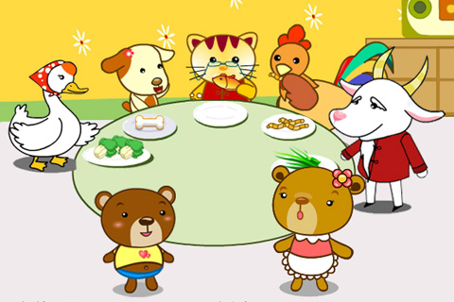
Help _______ to some fish.
yourself

Slide 7

Little Tom can dress _______.
himself

Slide 8
Part II Pre-Learning

Slide 9
反身代词的定义:
Reflexive pronouns
反身代词是一种表示反向或强调的代词。
通过反身代词指代主语或施行者自己本身的代词。

Slide 10
Part III While-Learning

Slide 11
我自己
我们自己
你自己
你们自己
他自己
她自己
它自己
他们自己
反身代词共有8个
1.myself
2.ourselves
3.yourself
4.yourselves
5.himself
6.herself
7.itself
8.themselves
用oneself
指代所有的
反身代词

Slide 12
Reflexive pronouns
反身代词
人称 | 第一人称 | 第二人称 | 第三人称
单数
复数
数
himself
herself
itself
myself
yourself
ourselves
yourselves
themselves

Slide 13
We use a reflexive pronoun as the object to refer back to the subject of a sentence.
He blames himself for the mistake.
She made herself a cup of tea.
We should not think only of ourselves.
We can also use a reflexive pronoun to emphasize that someone does something without help.
He did the homework himself.
We can clean the kitchen ourselves.

Slide 14
We form reflexive pronouns like this
Subject pronoun
I
you (singular)
you (plural)
we
they
he
she
it
Reflexive pronoun
myself
yourself
yourselves
ourselves
themselves
himself
herself
itself
-selves

Slide 15
Work out the rule
Singular reflexive pronouns have the ending ______.
Plural reflexive pronouns have the ending ______.
-self
-selves

Slide 16
反身代词的固定习语
有些词与反身代词一起构成了固定搭配。例如：
(all) by oneself 靠自己
hurt oneself 伤着自己
teach oneself 自学
dress oneself 自己穿衣
enjoy oneself 玩得开心
look after oneself 自己照顾自己
help oneself (to) 请随便（取、吃）

Slide 17
反身代词用法小结:
反身代词表自身
动介之后露身份
若表强调一功能
主宾之后作同位
说起表语这功能
记住跟着 后面
be

Slide 18
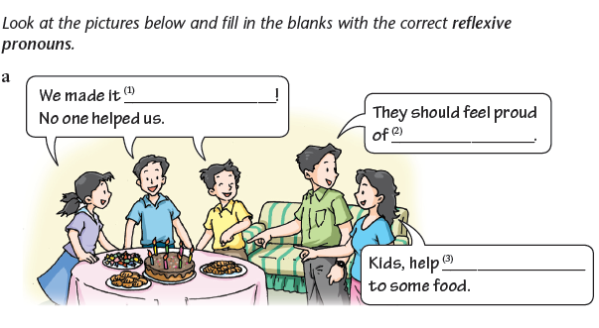
Grammar exercise
ourselves
themselves
yourselves

Slide 19
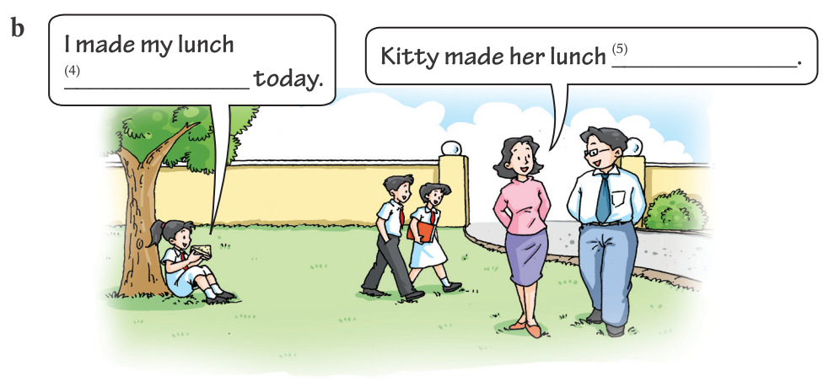
herself
myself

Slide 20
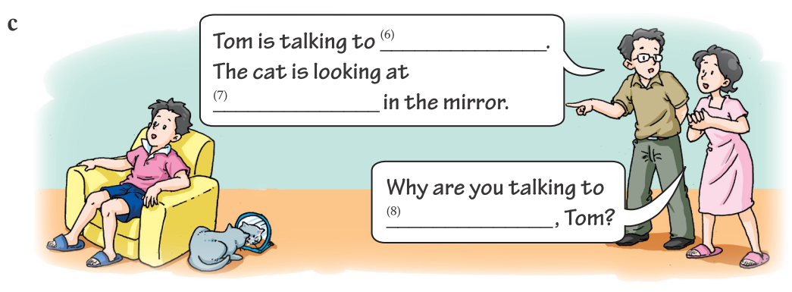
himself
itself
yourself

Slide 21
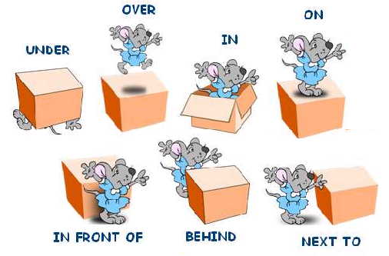
Prepositions of position
方位介词

Slide 22

-Where’s the soccer ball?
-It’s … the box.
on the box
in the box
under the box

Slide 23
-Where’s the soccer ball?
-It’s _____ the box.
near
-Where’s the soccer ball?
next to
-It’s ________ the box.

Slide 24
-Where’s the soccer ball?
in front of
-It’s _________ the box.
-Where’s the soccer ball?
behind
-It’s _________ the box.

Slide 25
-Where is the soccer ball?
-It’s ___________ the box.
across from

Slide 26
Prepositions of position
1. in 在……里面
2. on 在……上面 (有接触面)
3. above 在……上方 (但不一定是正上方)
4. over 在……正上方 (垂直的上方)
5. beside 在……旁边
6. below 在……下方(不一定是正下方 反义 词above)
7. under 在……正下方 (反义词是over)

Slide 27
8. in front of 在(事物外部)的前面 (反 义词是behind)
in the front of 在(事物内部)的前面
9. behind 在……后面
10. between 在……之间（用于两者 between …and …）
11. near 在…附近
12. next to 紧靠…的旁边;贴近

Slide 28
13. behind 在……之后
14. across from 在…….对面
15. between …and… 介于…和…之间
16. in the middle of 在---中间
17. on the right/left 在右/左边

Slide 29
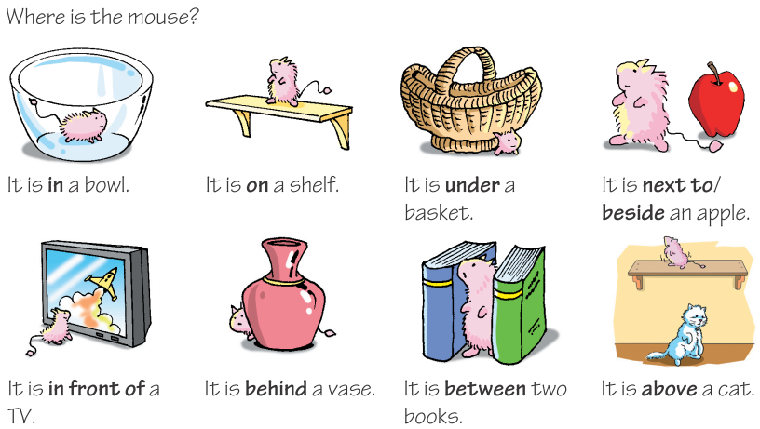

Slide 30
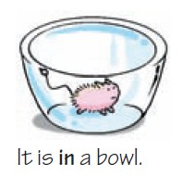
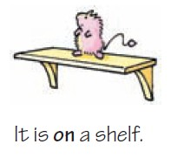
It is in a bowl.
It is on a shelf.

Slide 31


It is under a basket.
It is next to / beside an apple.

Slide 32
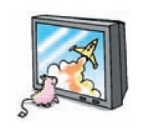

It is in front of a TV.
It is behind a vase.

Slide 33

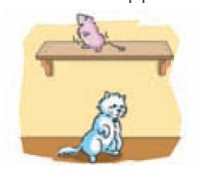
It is between two books.
It is above a cat.

Slide 34
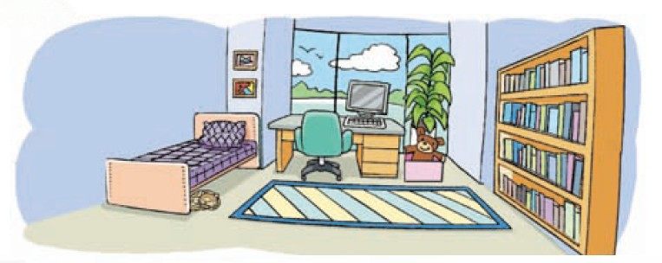
Jason is describing his bedroom. Help him complete his description with the correct prepositions.

Slide 35
My bedroom is a big room with a big window.
There is a desk ________ the window. There is a
computer ______ the desk and a box ______
the desk. There is a toy bear _____ the box and a
pot of plant ______the box. My bed is on the other
side of the desk. There are some pictures ______
the bed. My cat, Gigi, likes sleeping ______ the
bed. I have a new carpet ______ the floor ______
my bed and the bookshelves.
in front of
on
next to/beside
in
behind
above
under
on
between

Slide 36
Part IV Post-Learning

Slide 37

Use prepositions of position to talk about
what is in your living room.

Slide 38
Work in pairs. Talk about the picture like this:
A: Where is the …?
B: It’s in/on/under/…
A: Where are the …?
B: They’re …

Slide 39
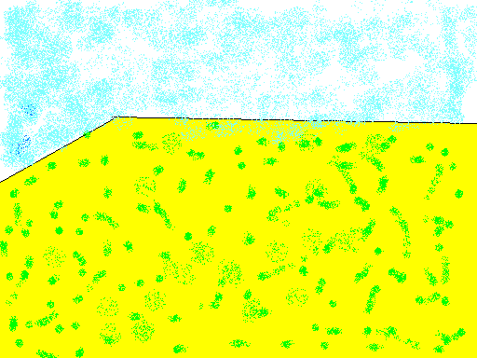

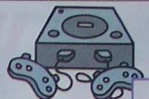

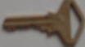





Slide 40
Part V Review

Slide 41
一、选择最佳答案填空。
( )1. — Peter and John, did you enjoy ____
on Children's Day?
—Yes, we did.
A. yourself B. yourselves
C. himself D. ourselves
B

Slide 42
B
( )2. — I made the cake by ____. Help____
to it, Tom.
— Thanks, Jane.
A. ourselves, yourself
B. myself, yourself
C. myself, yourselves
D. ourselves, yourselves

Slide 43
A
( )3. I think you can do the job ____, John.
A. yourself B. myself
C. himself D. yourselves
( )4. — Did she go to school when she was young?
— No, she taught ____ at home.
A. her B. herself
C. hers D. she
B

Slide 44
二、根据句意，从方框中选择合适的介词
或介词短语填空（每个词语限用一次）。
1. Jim likes lying ________ his bed and reading a comic book.
2. The new shop is ________ my house. It only takes me ten minutes to walk there.
3. Emily sits in front of Amy, but she sits ________ Betty.
near, on, below, in front of, between, behind
on
near
behind

Slide 45
near, on, below, in front of, between, behind
4. Look out of the window! A plane is flying ________ the clouds.
5. Mike, don’t stand ________ me. I can’t see the blackboard.
6. I sit ________ Mary and Sally.
below
in front of
between

Slide 46
Thank you!

