Slide 1
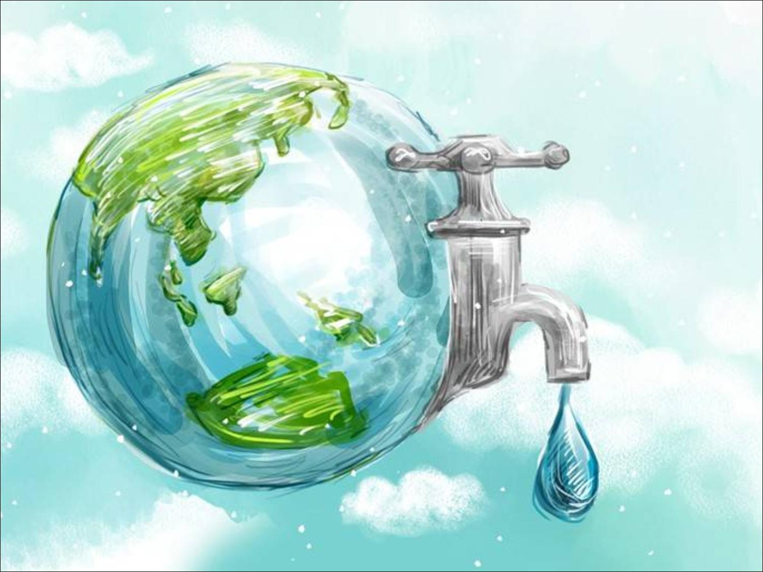
Unit 5 Water
Grammar

Slide 2
目录
Lead-in
1
Pre-Learning
2
3
While-Learning
Post-Learning
4
5
Review

Slide 3
Part I Lead-in

Slide 4
Discuss
可数名词：apples, oranges, eggs, onions, pancakes, biscuits, potatoes
不可数名词：milk, flour, beef, yogurt, orange juice, cheese, jam, honey

Slide 5
S1: I have a lot of bananas. (Countable noun)
S2: I have a few bananas.
S3: Do you have many bananas?
S4: No, I have no bananas./ I don’t have many
bananas.
S1: I have a lot of cooking oil. (Uncountable noun)
S2: I have a little cooking oil.
S3: Do you have much cooking oil?
S4: No, I have no cooking oil./ I don’t have much
cooking oil.

Slide 6
Part II Pre-Learning

Slide 7
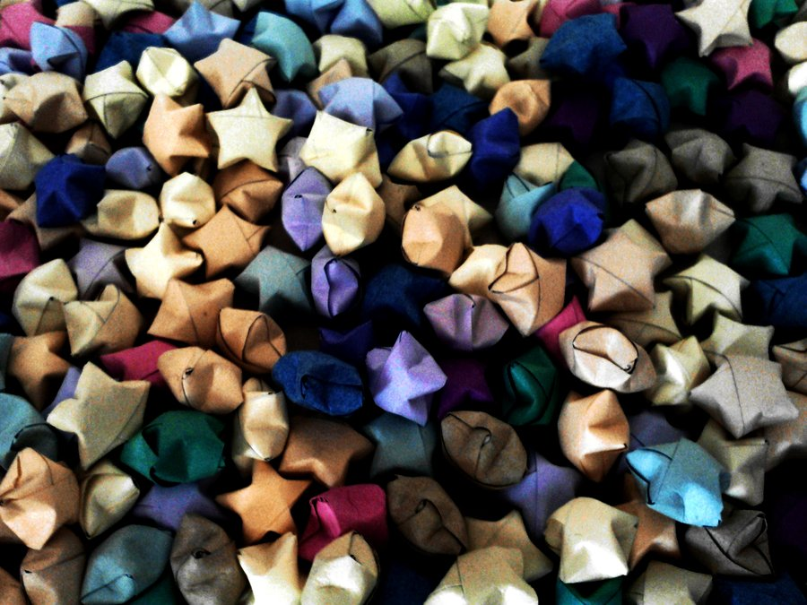
Grammar
Talking about quantities

Slide 8
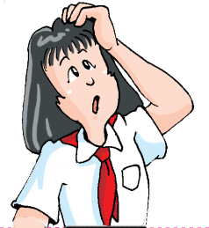
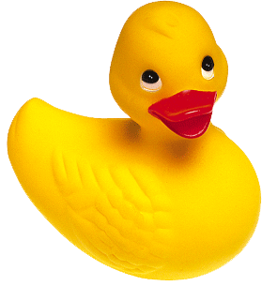
Do you know the differences between
a lot of, a little, a few, (not) much, (not) many, and no?

Slide 9
Read the following sentences to understand “a lot of”, “a little”, “(not) much” and “how much”.
    How much water is there on Earth?
    There is a lot of water on Earth.
    How much water is drinkable?
    Only a little water is drinkable.
    There is not much fresh water.

Slide 10

Answer the following questions about quantities.
1. How many books are there in your school?
There are a lot of books.
2. How many exercise books are there in your schoolbag?
There are a few (not many)
exercise books.

Slide 11
Part III While-Learning

Slide 12
We can use a lot of, a little, a few, (not) much, (not) many and no to talk about quantities.
我们用a lot of, a little, a few, (not) much, (not) many 和 no 谈论数量
There is/’s a lot of/a little/not much/no
water in this bottle.
There are a lot of/many/a few/not many/no
bottles of water in the fridge.

Slide 13
We use how many and how much to ask about
quantities.
How much water is there in this bottle?
How many bottles of water are there in
the fridge?
我们用how many 和 how much询问数量

Slide 14
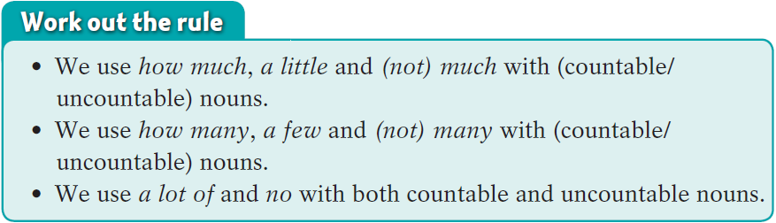
Work out the rule
how much, a little和(not) much修饰不可数名词
how many, a few和(not) many修饰可数名词
a lot of 和 no修饰可数和不可数名词

Slide 15
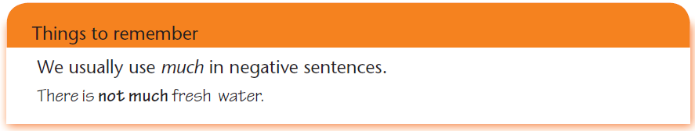
Things to remember
much通常出现在否定句中。

Slide 16
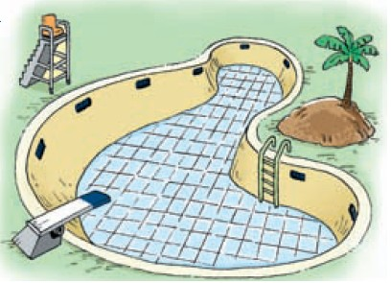
Look at the pictures below and on page 64. Then complete the questions and answers.
Q: Is there a lot of water in the pool?
A: No, there’s (1)
_______________.
no water in the pool

Slide 17
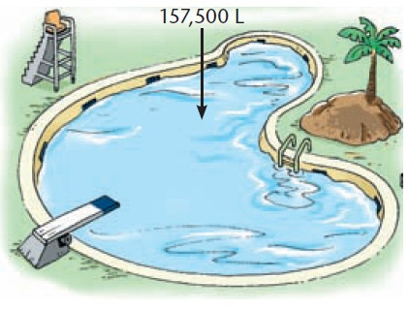
Q: Is there a lot of water in the pool?
A: Yes, there’s (2)
_______________.
Q: (3) ________ water
is there in the pool?
A: There are 157,500
litres of water in the
pool.
a lot of water in the pool
How much

Slide 18
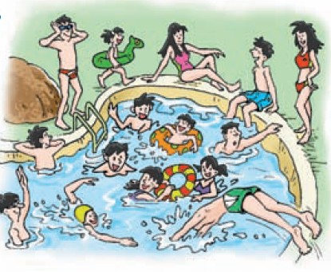
Q: Are there many people in the pool?
A: Yes,(4)_________
________________.
Q: (5)____________
people are there in
the pool?
A: There are 10 people in the pool.
there are
many people in the pool
How many

Slide 19
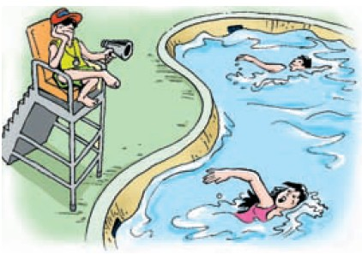
Q: Are there many people in the pool?
A: (6)_____________
________________.
Q:(7)_____________________________
A: There are only two people in the pool.
No, there aren’t many people in the pool
How many people
are there in the pool?

Slide 20
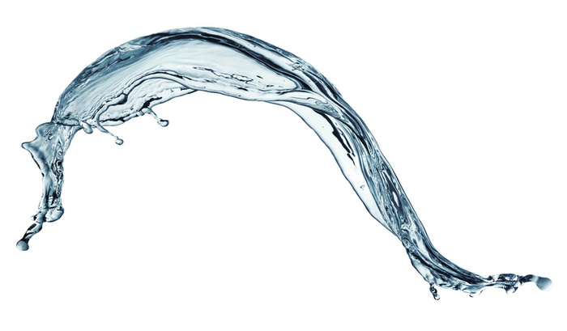

Learn about
too much, too many, too little, too few and (not) enough.

Slide 21
We can use too much, too many, too little, too
few and (not) enough to talk about quantities.
我们用too much, too many, too little, too
few 和 (not) enough no 谈论数量
Quantities | Examples
more than enough | too much water | too many oranges
not enough | too little milk | too few eggs
just right | enough salt | enough onions

Slide 22
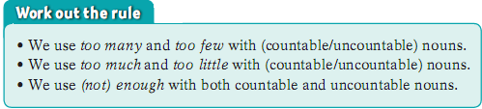
Work out the rule
too many和too few修饰可数名词
too much和too little修饰不可数名词
not enough修饰可数和不可数名词

Slide 23
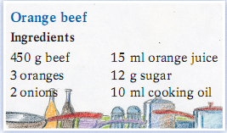
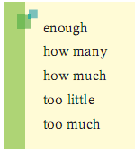
B Dora and Jane want to cook orange beef. They are checking whether they have enough ingredients. Complete their conversations.

Slide 24
Dora: Do we have (1)________beef,
Jane?
Jane: No, we don’t. We only have
200 grams.
Dora: We need to buy some more
beef. (2)___________ onions
do we have?
Jane: We don’t have any!
Dora : Let’s buy two onions then.
enough
Dora and Jane have:
orange juice 20 ml
sugar 5 g
cooking oil 100 ml
onions 0
beef 200 g
oranges 1
How many

Slide 25
Dora: (3)_________ cooking oil do we have?
Jane: We have 100 millilitres. That’s more than
enough. We shouldn’t add (4)_______
cooking oil.
Dora: Do we need to buy any sugar?
Jane: Yes, we do. We only have five grams. The dish
will be too sour if we add (5)______ sugar. By
the way, we have (6)______ orange juice.
Dora: Great! Let’s go to the supermarket now!
How much
too much
too little
enough

Slide 26

Let’s learn the useful expressions.

Slide 27
Notes P63-65
work out the rule 找出规律
work out 找出，想出
计算，解决
We must work out a way to have a cheap
holiday.
我们必须想出一个省钱度假的办法。
I can’t work out this math questions.
我算不出这个数学题。

Slide 28
2. enough adj. 足够的 （修饰名词， 常放名词前）
adv. 足够地（修饰形容词、 副词或动词，放在其后）
I don’t have enough time for reading.
我没有足够的时间读书。
John is old enough to go to school.
约翰足够大，可以上学了。

Slide 29
Part IV Post-Learning

Slide 30
Summary
 | 描述数量 | 提问数量
修饰可数 名词 | (not) many， a great / large / small number of，a few，few， too many，too few | how many
修饰不可 数名词 | (not) much，a great deal of，a great / large / small amount of，a little，little，too much，too little | how much
既可修饰可数名词， 也可修饰不可数名词 | a lot of，lots of，plenty of，some， any，no，(not) enough

Slide 31
a few，few，a little 和little 描述数量很少或几乎没有，数量的差别主要是主观上的，而不是实际数据上的。具体用法区别如下：
 | 表示肯定 | 表示否定
意义 | “一些；少许的” | “几乎没有的”
修饰可数 名词 | a few | few
修饰不可数名词 | a little | little

Slide 32
如：
There are a few people in the room.
房间里有几个人。（强调还有一些人）
There are few people in the room.
房间里没有几个人。（强调几乎没有人）
I have a little money.
我有一点点钱。（强调还有少许钱）
I have little money.
我快没钱了。（强调几乎没有钱）

Slide 33
too many，too few，too much，too little 和enough 描述数量是否足够。具体用法区别如下：
意义 | “太多的” | “足够的” | “太少的”
修饰可数名词 | too many |  | too few
修饰不可数名词 | too much |  | too little
既可修饰可数名词， 也可修饰不可数名词 |  | enough

Slide 34
如：
There are too many books on the shelf.
架子上有太多书了。
There is too little bread in her fridge.
她的冰箱里面包太少了。
She doesn’t have enough pens.
她没有足够的钢笔。

Slide 35
some和any用在不同的句型中。具体用法区别如下：
some | 接可数名词复数形式或不可数名词 | 一般用于肯定句或提建议的句子中
any | 接可数名词或不可数名词 | 一般用于否定句或疑问句中
如：
Would you like some milk?
你想要些牛奶吗？
I never make any promises.
我从来不做任何承诺。

Slide 36
enough 意为“足够的；足够地”，可用于
可数名词复数形式或不可数名词之前，也
可用于动词、形容词或副词之后。如
足够的钱
吃得足够多
足够深
足够快
enough money
eat enough
deep enough
fast enough

Slide 37
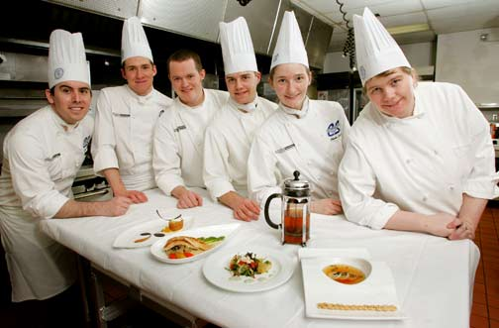
Using the conversation between Dora and Jane as an example, choose a recipe and make a similar conversation.

Slide 38
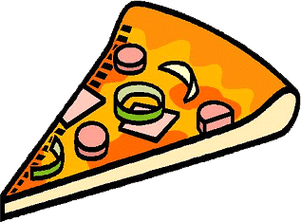
Ingredients for pizza toast
a few pieces of bread
three sausages
a piece of cheese
two green peppers
a tin of tomato sauce
You and your friend have:
a bag of bread
two sausages
two pieces of cheese
ten green peppers
no tomato sauce

Slide 39
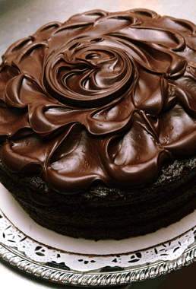
Ingredients for cake
100 g sugar
200 g flour
100 g butter
100 g icing sugar
two eggs some milk
some chocolate powder
You and your friend have:
sugar 50g
flour 400g
butter 0
icing sugar 200g
eggs 10
milk 0
chocolate
powder a packet

Slide 40
Part V Review

Slide 41
I. 选用much、many、few、a few、little或a little填空。
1. There are ________ buses in London.
2. I haven’t got ________ time for study
in recent days.
3. Please don’t make so ________noise.
many
much
much

Slide 42
4. There is still ___________ water in the
bottle. It’s enough for me to drink.
5. I don’t like ________ butter on my
bread. Just a little is OK.
6. Bob said that he had ________ money,
so he could not go anywhere.
much / a little
much
little

Slide 43
7. There are just very ________ films of
this sort.
8. There is only ________ tea left in the
teapot. I’ll go and make some.
9. Jane gave me ________ help with my
work. She is very kind.
few
little
much

Slide 44
few
10. There are ____ vegetables in the fridge.
Let’s go and buy some peas, carrots and
cabbages.
11. How ________ kids are there in your
family?
12. How ________ juice is there in that
bottle?
many
much

Slide 45
II. 选择最佳答案填空。
( )1. Drinking ____ tea is bad for your health.
A. too much B. too many
C. a few D. a little
( )2. You spent ____ time on the meanings of
the words so that you couldn’t understand
the whole passage.
A. too many B. too much
C. enough D. too little
A
B

Slide 46
( )3. Positive (积极的) thinking alone is ____ to
turn your life around and you should do it
at the same time!
A. too much B. too many
C. enough D. not enough
( )4. There are ____ posts for so many people
this year! We must fire some people.
A. too little B. too many
C. too few D. too much
D
C

Slide 47
( )5. Would you like ____water?
A. some B. many C. any D. much
( )6. They don’t have ＿＿idea!
A. some B. many C. any D. a few
A
C

Slide 48
Thank you!

