Slide 1
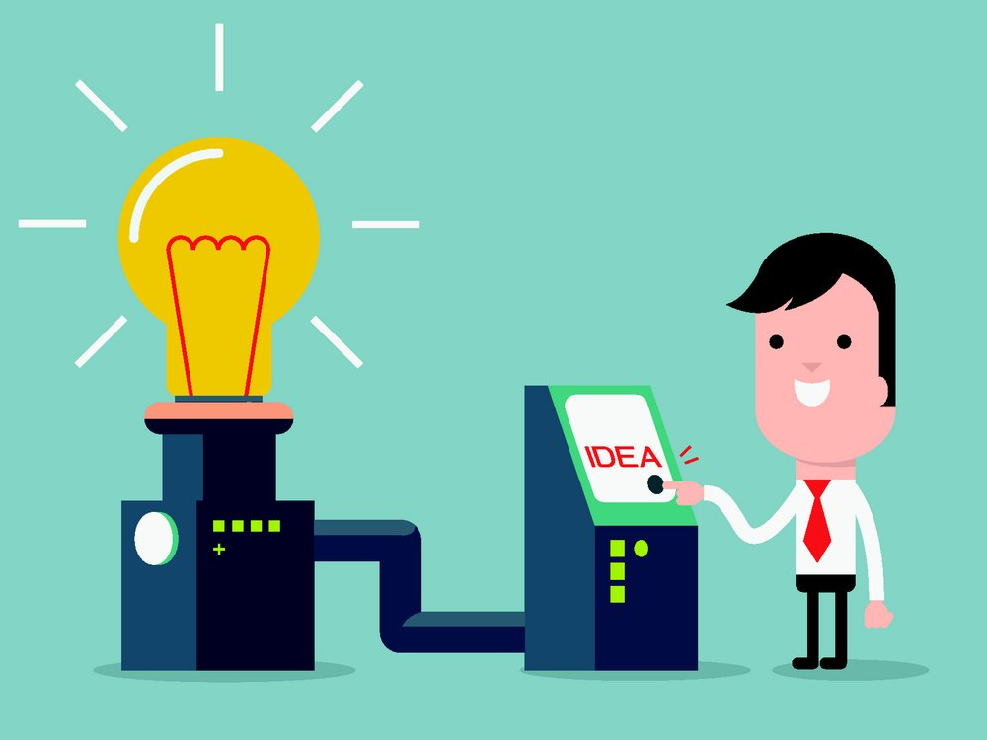
Unit 6 Electricity
Grammar

Slide 2
目录
Lead-in
1
Pre-Learning
2
3
While-Learning
Post-Learning
4
5
Review

Slide 3
Part I Lead-in

Slide 4
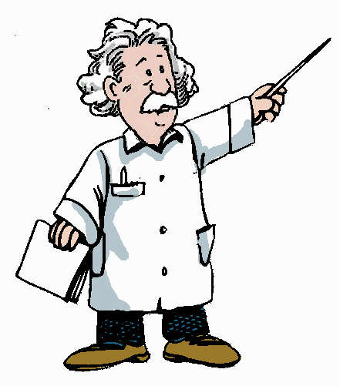

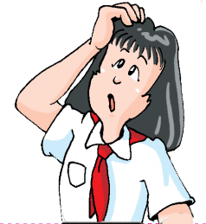
I can spell all the words we have learnt. Can you do that?
Yes, I can.
No, I cannot/can’t.

Slide 5
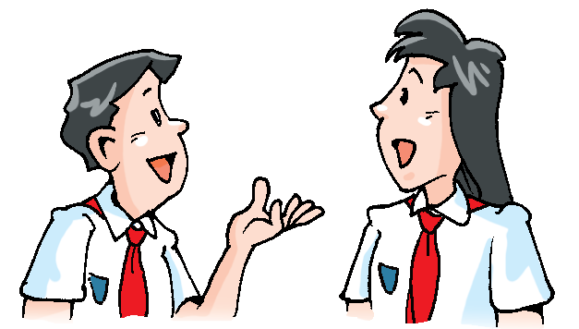
Game time
What can you do? Tell the student behind you and ask if he/she can do it. The next student should repeat this with another student.
Example:
No, I can’t.
I can sing.
Can you sing?
I can swim. Can you swim?
Yes, I can.
I can …
Can you …?

Slide 6
Part II Pre-Learning

Slide 7
Modal verbs情态动词
can
cannot(can’t)
may
may not
must
must not

Slide 8
情态动词具有一定的词义，但不能独立存在，须与动词原形一起构成谓语，表示说话人对动作的观点，如意愿、需要、可能或怀疑等。情态动词有时态的变化，但没有人称和数的变化（have to 除外）。

Slide 9
Part III While-Learning

Slide 10
Modal verbs情态动词
A can and cannot
We use can and cannot (can't) to say we are able or unable to do something.
We can use electricity to do many things.
We cannot/ can’t see electricity.
Can you think of an example?
Yes, I can./No, I cannot/ can't.

Slide 11
情态动词can的用法
can
① be able to “能”，表示能力
I can/am able to sing an English song.
我可以唱一首英语歌曲。
②表示许可或请求对方允许，意为“可以”
Can I use your dictionary?
我可以用你的字典吗？
③ 过去式：could
我十年前就能做到那样。
I could do that 10 years ago.
④否定式： cannot = can’t

Slide 12
Peter can speak English.
否定→
Peter can’t/cannot speak English.
一般疑问句→
Can Peter speak English?
(一般疑问句，提前情态动词)
特殊疑问句→
What can Peter speak?

Slide 13
⑤could 是can 的过去式，但表示请求许可时，could 和can 不表示时态的区
别，只是could 的语气更加委婉，用could 提出的请求要用can来回答。

Slide 14
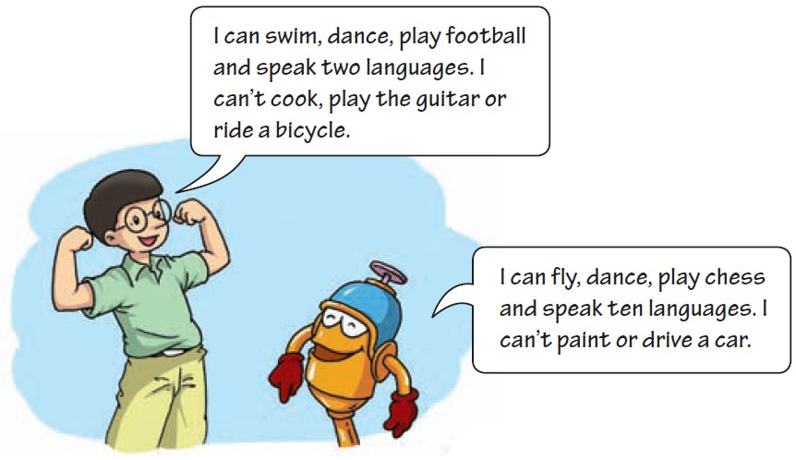
Hi and Lo are talking about themselves. What are they saying? Read their conversation and then complete the statements below with can or cannot.

Slide 15
can
1. Hi _____ play football.
2. Lo _____ paint.
3. Hi _____ speak as many languages as Lo.
4. Both Hi and Lo _____ dance.
5. Lo _____ drive a car, but he _____ play
chess.
6. Hi ____ swim, but he _____ play the
guitar.
cannot
cannot
can
cannot
can
can
cannot

Slide 16
A game:
what would you say?
You will be given several situations. After reading the descriptions and looking at the pictures, decide what you would say in these situations.

Slide 17
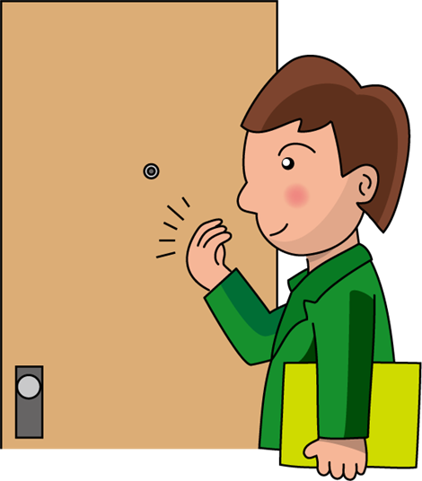
1. A man is going to see his boss. He is standing at the doorway.
May I come in?

Slide 18

2. A student is going to ask the teacher a question.
May I ask you a question?

Slide 19
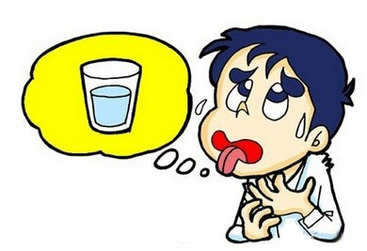
3. A boy is thirsty. He is asking his mother for something.
May I have some water?

Slide 20
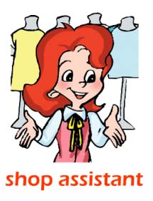
4. A shop assistant is serving
a customer.
May I help you?

Slide 21
B may and may not
We use may and may not to ask for and give permission (许可). We also use can and cannot (can‘t) for the same purpose（目的）.
May/Can I use your mobile phone？
Yes, you may/can.
No, you may not/can't.
You may/can turn on the TV.
You may not/cannot play in the kitchen.

Slide 22
情态动词may的用法
may
①表示允许may 表示许可或请求对方允许，
意为“可以”，相当于can。
两者的区别在于：表示请求许可时，may
更能表示礼貌或敬意。
— May I watch TV now, grandma?
— No, you may not.
—— 外婆，我现在可以看电视吗？
—— 不，你不可以。

Slide 23
②否定式： may not 意为“不可以”。
③may构成的一般疑问句及其回答形式如
下：
— May I ...?
— (肯定回答) Yes, you may / can.
— (否定回答)
No, you may not / can’t /mustn’t.
(注：mustn’t 的语气最强，表示禁止)

Slide 24
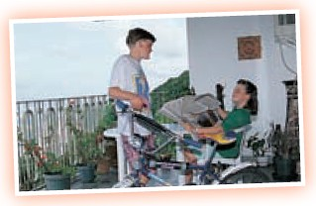
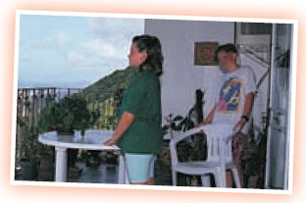
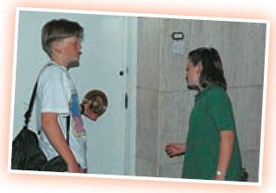
Daisy is not feeling well today. Benny is at home with her. Read their conversation below. Fill in the blanks with may or can.

Slide 25
Benny: How are you feeling, Daisy?
Daisy: Not very well.
Benny: _________ I get you a chair?
Daisy: Yes, thanks.
Benny: I’m going out. _____ I borrow your bicycle,
Daisy?
Daisy: Yes, you may. Before you go to meet your friends,
can you come and see the doctor with me?
Benny: Yes. I ____. ______ I carry your bag for you?
Daisy: Yes, that’s very kind of you, Benny.
I’m ready to go.____ you open the door for me?
Benny: Yes, I can.
Daisy: Thanks.
May/Can
May
Can
May
Can

Slide 26
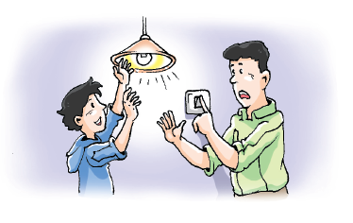
C must and must not

Slide 27

What do these signs mean?
（You mustn’t smoke here.）
（You mustn’t climb this ladder.）
（You mustn’t swim here.）
（You mustn’t use your mobile
phone here.）

Slide 28
C must and must not
We use must and must not (mustn't) to tell people what to do or what not to do.
You must not/ mustn’t do that, Benny!
We must always be careful with electricity.
They must not/mustn’t play near the heater.

Slide 29
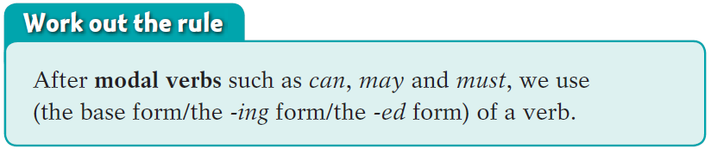
情态动词后使用动词的原形

Slide 30
情态动词must的用法
must
①表示规定、命令、强制，意为“必须；一
定”。
如：
You must do your homework first.
你必须先做作业。
You mustn’t smoke here.
你不许在这里吸烟。

Slide 31
②must 的否定式为must not / mustn’t，意为
“禁止；不准”
③must 构成的一般疑问句及其回答形式如下：
— Must I ...?
— (肯定回答) Yes, you must.
— (否定回答) No, you needn’t.

Slide 32
④辨析must和have to
 | 意义 | 用法
must | “必须；一定” | 强调客观上必须做某事
have to | “ 不得不；必须” | 强调主观上不得不做某事

Slide 33
Daisy saw a doctor. The doctor told her what to do and what not to do. Help her write down the doctor’s instructions.
drink more water go to bed early
eat cold food share cups with others
go out alone take the medicine on time
I must drink more water.
______________________________
______________________________
I must not _____________________
______________________________
______________________________
I must go to bed early.
I must take the medicine on time.
eat cold food.
I must not go out alone.
I must not share cups with others.

Slide 34

Let’s learn the new words and expressions.

Slide 35
Notes P77-79
I can’t cook, play the guitar or ride a bicycle.
我不会做饭、弹吉他和骑自行车。
①play the guitar 弹吉他
play与西洋乐器名词连用时，乐器名词
前要加定冠词the。
②or在否定句中 表示“和”的意思.如:
我不喜欢面包、米饭和粥。
I don’t like bread ,rice or porridge.

Slide 36
2. Hi can’t speak as many languages as Lo.
Hi会说的语言不如Lo多。
1）as + many +可数名词复数+ as ...
2）as + much +不可数名词+ as ...
两个都表示“和……一样多的……”。
若其用于否定句中，则意为“……不
如……多”。如：
I have as many toys as you.
我有和你一样多的玩具。
You don’t drink as much water as I every day.
你每天喝的水不如我多。

Slide 37
Practice
1. 选择最佳答案。
( )You made _____ I.
many as mistakes as
B. as many mistakes as
C. as many mistakes like
D. mistakes many as
2. 根据中文意思完成句子。
我弟弟的钱不如我的多。
My brother ______ have __ _____ _____ __
I.
B
doesn’t as much money as

Slide 38
3. — How are you feeling, Daisy?
— Not very well.
黛西，你现在感觉怎么样？
身体不是很舒服。
1）How is sb feeling 某人现在感觉怎么样
（侧重于询问对方的身体状况）
回答这句话可以用：
I’m feeling well. （我身体很好）
I’m not feeling well / Not (very) well.
（我身体不舒服）
Much better. （好多了）
2）well adj. 健康的；身体好的

Slide 39
Practice
根据中文意思完成句子。
当医生询问这位病人感觉怎么样时，他
说他感觉好点了。
When the doctor asked the patient
____ ___ ___ ______, he said that he _____ _____ _____.
2. 我今天身体不舒服。
I _____ _____ _____ _____today.
how he was feeling
felt much better
am not feeling well

Slide 40
4. I’m ready to go. 我准备好出发了。
ready adj. 准备好的
常用的句型有：
be ready to do sth 准备好做某事
be ready for sth 为某事做好准备 如：
I am ready to do the work.
我准备好做这项工作了。
I am ready for the work.
我为这项工作做好准备了。

Slide 41
Practice
1. 选择最佳答案。
( )Let’s be ready _____ the competition!
A. to B. for C. of D. with
2. 根据中文意思完成句子。
看！学生们都准备好回答问题了。
Look! The students ___ _____ __ ______.
the questions.
你为这次旅行做好准备了吗？
_____ you _____ _____ the trip?
B
are ready to answer
Are ready for

Slide 42

5. take the medicine on time 按时吃药
on time 按时
6. go out alone 独自外出

Slide 43
7. share cups with others 与别人合用杯子
share sth with sb 与某人合用/分享 某物
Lucy shares a bedroom with Lily.
露西和莉莉合用一间卧室。

Slide 44
Part IV Post-Learning

Slide 45
Summary
原形
情态动词后接动词______，没有人称和数的
变化， ______（能/不能）单独作谓语，要
与后面的______共同作谓语。其否定形式
是在其后面直接加______ 。
情态动词can 的用法：表示能力。构成一般
疑问句时，需把can 移到______（句首/
中）。肯定回答为“Yes,主语+ ______”；否
定回答为“No,主语+ ____________”。
不能
动词
not
句首
can
can’t / cannot

Slide 46
情态动词may 的用法：表示允许。may在表
达这个意思时可以与can 互换使用。由may
引起的一般疑问句，其否定回答用_______，
___________ 或 ________ 。
表示请求时，could 和can 不表示时态的区别，
只是could的语气更加委婉。
may not
can’t / cannot
mustn’t

Slide 47
情态动词must 的用法：表示必须/一定。
其否定形式mustn’t 表示______。由must
引起的一般疑问句，其否定回答要用
______ 。
禁止
needn’t

Slide 48
Part V Review

Slide 49
一、用本单元所学的情态动词填空。
1. — Kate, you have won the English competition!
— Oh, it _______ be true. I made a lot of
mistakes in it.
2. You ________ talk to your grandparents like that. It’s impolite.
3. We _______ wash our hands before meals. It is good for our health.
can’t
mustn’t
must

Slide 50
4. Excuse me, ____ you tell me the way to the
nearest park?
5. You ________ go with us to the zoo if you
want to.
6. I ____ speak Chinese very well, but I ____
speak French at all.
can
can /may
can
can’t

Slide 51
二、翻译下列句子。
1. 门锁了。他不可能在家。
The door is locked. He _____ be at home.
2. 我的手表停了，肯定有毛病。
My watch doesn’t work. There _____ be something wrong with it.
3. — 我可以借用你的尺子吗？
— 当然可以。但是你必须明天还给我。
— ____ I borrow your ruler?
— Of course. But you _____ return it to me
tomorrow.
can’t
must
May
must

Slide 52
三、选择最佳答案填空。
( )1. If you feel tired, you ____ sit on this chair
and have a rest.
A. must B. can C. need D. can’t
( )2. — ____ I watch TV now, Mum? I finished
my homework.
— Yes, you ____.
A. Must, need B. May, can
C. Need, need D. May, must
B
B

Slide 53
( )3. He ____ see the words on the blackboard
because he sits far away.
A. mustn’t B. may not
C. can’t D. needn’t
( )4. — ____ I do all the housework now?
— No, you ____. You can do it later.
A. Must, mustn’t B. Must, can’t
C. Must, may not D. Must, needn’t
C
D

Slide 54
Thank you!

