Slide 1

Unit 8 From hobby to career
Grammar

Slide 2
目录
Lead-in
1
Pre-Learning
2
3
While-Learning
Post-Learning
4
5
Review

Slide 3
Part I Lead-in

Slide 4
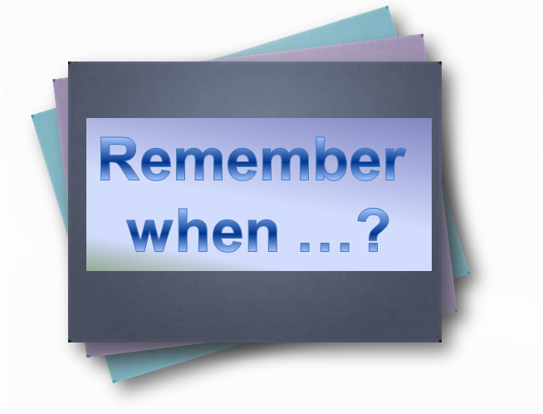
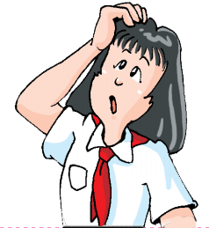
Grammar A
Adverbial clauses of time (when)
时间状语从句(when)

Slide 5
When did Patrick get a book about the stars?
何时
当……时
When he was eight, he got a book about the stars.
adverbial clauses of time
时间状语从句
main clause 主句

Slide 6
Part II Pre-Learning

Slide 7
Look and think
Look at the following sentences and answer the questions.
When he was eight, he got a book about the stars.
He got a book about the stars when he was eight.
Do the sentences have different meanings?
What is the difference between the two sentences?
What change has been made in punctuation?
(标点符号)

Slide 8
Part III While-Learning

Slide 9
A Adverbial clauses of time (when)
时间状语从句(when)
We can use the conjunction when to form an
adverbial clause of time. It links two clauses
into one sentence.
连词when引导时间状语从句。
When I was eight, I got a book about stars.
When the girl got older, she sailed the boat herself.

Slide 10
We can put an adverbial clause of time at the beginning or the end of a sentence.
时间状语从句可以在句首，也可以在句末。
When he was eight, he got a book about the stars.
He got a book about the stars when he was eight.
时间状语从句位于主句之前时，要用逗号将从句和主句隔开；位于主句之后时，则不需用逗号。

Slide 11
Things to remember
We can also use before, after, while,
as soon as and until to form adverbial
clauses of time.
连词before, after, while, as soon as 和 until也可以引导时间状语从句。

Slide 12
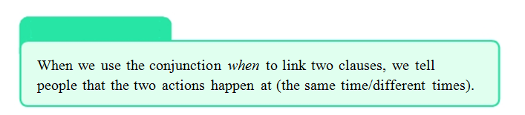
Work out the rule
连词when连接两个句子时，这两个动作是同时发生的。

Slide 13
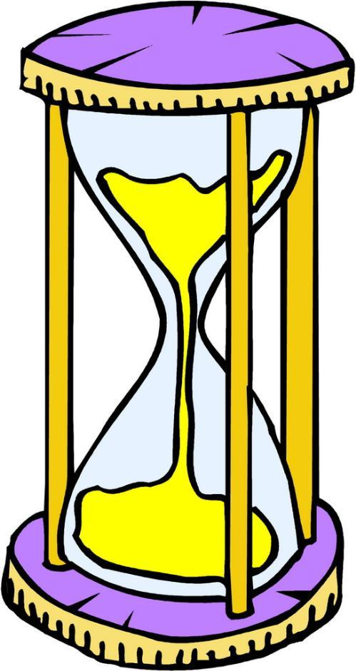
时间状语从句的用法
时间状语从句用于说明主句动作发生或进行的时间。
时间状语从句位于主句之前时，要用逗号将从句和主句隔开；位于主句之后时，则不需用逗号。

Slide 14
由when引导的时间状语从句的意义和时态
意义 | 表示从句的动作与主句的动作同时发生。
时态 | 当表示现在的时候，主句和从句同用 现在时态； 当表示过去的时候，主句和从句同用 过去时态； 当表示将来的时候，主句用一般将来 时，从句用一般现在时表将来

Slide 15
如：
When the bell rings, he gets into the classroom.
当铃声响起时，他进入教室。
When you were out, Jack called in.
你出去的时候，杰克来了。
I will tell her the news when I meet her.
当我见到她时，就会把这个消息告诉她。（从句用一般现在时表示将来发生的动作）

Slide 16
拓展
时间状语从句的引导词除了when 之外，常用的还有：
before 在……之前
after 在……之后
while 当……时
as soon as 一……就……
until 直到
since 自从
once 一旦
as 随着

Slide 17
如：
I have breakfast at home before I go to school.
在我上学之前，我在家里吃早餐。
While my dad is reading, my mum is cooking.
我爸爸在看书时，我妈妈在做饭。
I fell asleep as soon as I lay in bed last night.
昨晚我一躺在床上就睡着了。
Once you learn to swim, you will like this sport.
As I grow older, my memory gets worse.
随着年岁的增长，我的记忆力变差了。
一旦你学会游泳，你会喜欢这种运动。

Slide 18
Practice
一、选择最佳答案。
_____ I decide to do something, I will never
give up.
A. Once B. Though C. And D. Before
2. We were watching TV _____ someone
knocked at the door.
A. why B. where C. when D. what
3. Daisy always turns on the TV _____ she
comes home.
A. because B. as soon as
C. though D. then

Slide 19
4. I _____ him the book when he _____ back.
A. will give, will come
B. give, comes
C. will give, comes
D. give, will come
5. Tom _____ into the house when no one was
looking.
A. slipped B. is slipping
C. slip D. slips

Slide 20
二、将下列句子翻译成英文。
我上学时总是看到这只狗。
When I go to school, I always see the dog.
/ I always see the dog when I go to school.
2. 昨天下雨时，汤姆待在家里。
When it rained yesterday, Tom stayed at home.
/ Tom stayed at home when it rained yesterday.
3. 当你取得进步时，我会给你买一份礼物。
When you make progress, I will buy you a
present.
/ I will buy you a present when you make progress.

Slide 21
Match the clauses in column A with those in column B to make complete sentences with when. Then rewrite each sentence with the adverbial clause at the beginning.
A |  | B
1 She always brings a present 2 He sits on the floor 3 He stayed in bed 4 She takes a basket |  | A. he was ill. B. she goes shopping. C. she visits her friends. D. he watches TV.
when

Slide 22
She always brings a present when she visits her friends.
1 __________________________________
__________________________________
__________________________________
__________________________________
2 __________________________________
__________________________________
When she visits her friends, she always brings a present.
He sits on the floor when he watches TV.
When he watches TV, he sits on the floor.

Slide 23
3 __________________________________
__________________________________
4 __________________________________
__________________________________
He stayed in bed when he was ill.
When he was ill, he stayed in bed.
She takes a basket when she goes shopping.
When she goes shopping, she takes a basket.

Slide 24
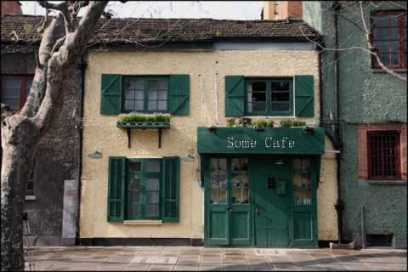
Grammar B
used to/did not use to

Slide 25
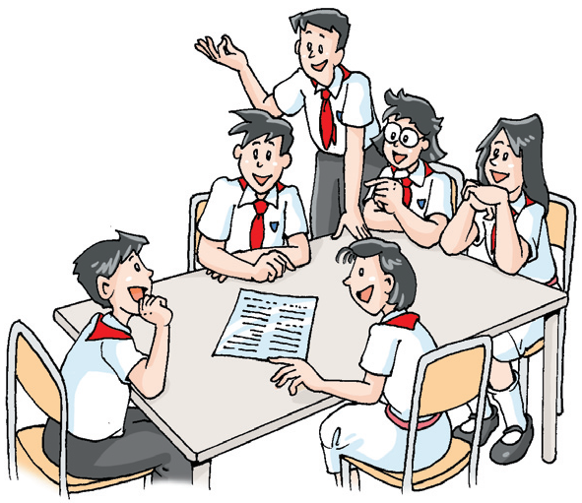
Group presentation
In groups of four, make sentences with “used to” and “did not use to”, and then present those sentences to the class.
used to/did not use to
Meaning?
Examples?
Pay attention to?
…

Slide 26
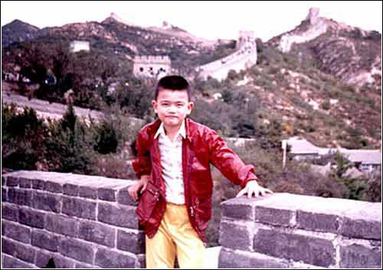
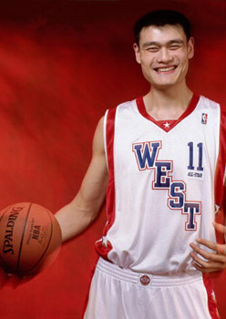
used to/ did not use to
Yao Ming used to be short, but now he is very tall.
He didn’t use to play basketball well, but now he is one of the most popular basketball players.

Slide 27
We use used to to talk about something we often did in the past. Its negative form is did not use to/ didn’t use to.
I used to go outside with my mum on clear nights and look at the sky.
When did her dad use to take them for trips on his boat?
I didn’t use to have much money.
used to表示过去经常做某事，否定形式为did not use to/ didn’t use to

Slide 28
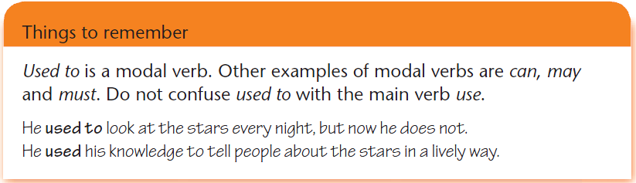
used to 是一个情态动词。其他的情态动词还有can, may和must。
used to do sth 过去常常做某事
use 使用

Slide 29
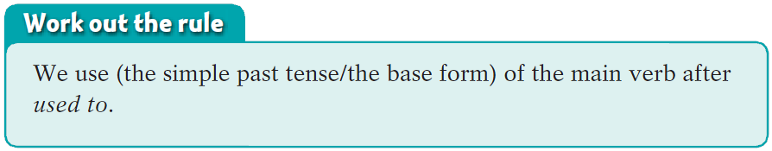
used to后面使用动词的原形。

Slide 30

时间状语从句的用法
used to do sth 过去常常做某事
表示过去经常发生的动作或存在的状态，而现在此动作已不再发生或此状态已不存在。
这个结构含有今昔对比之意。
其否定式为：
did not / didn’t use to do sth
其疑问式为：
did ... use to do sth

Slide 31
如：
I used to swim in this river when I was young.
我小时候常常在这条河里游泳。
They didn’t use to be good friends.
他们以前不是好朋友。
What did you use to do?
你过去常常做什么？

Slide 32
Past | Now
Short hair | Long hair
Short | Tall
Careless | Careful
Like running | Like swimming
Sad | Happy
pair work
A: Did you use to have short hair?
B: Yes. I used to have short hair. But now I have long
hair.
A: Did you use to be tall?
B: No. I didn’t use to be tall. But now I’m tall.

Slide 33
Practice
一、根据题目要求，完成下列句子。
1. Rose used to watch TV a lot.
(改为一般疑问句)
_____ Rose _____ _____ watch TV a lot?
2. Peter used to draw pictures. (改为否定句)
Peter _____ _____ _____ draw pictures.
3. Eric used to be very fat. (就划线部分提问)
What _____ Eric _____ _____ be like?
Did use to
didn’t use to
did use to

Slide 34
二、根据中文意思完成句子。
1. 他过去不常喝咖啡。
He _____ _____ _____ _____ coffee.
2. 我爸爸过去常常吸烟。
My father _____ _____ ______.
didn’t use to drink
used to smoke

Slide 35
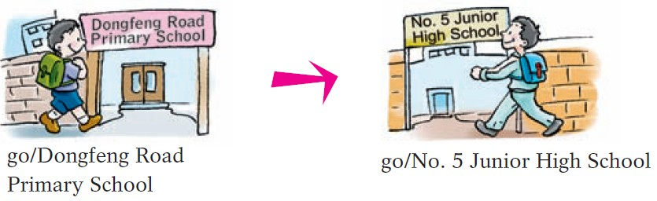
Grammar exercise
Look at the pictures of Mike at primary school and Mike now. What did he use to do and what does he do now? Use the example below to help you.
Mike used to go to Dongfeng Road Primary School.
Now he goes to No.5 Junior High School.

Slide 36
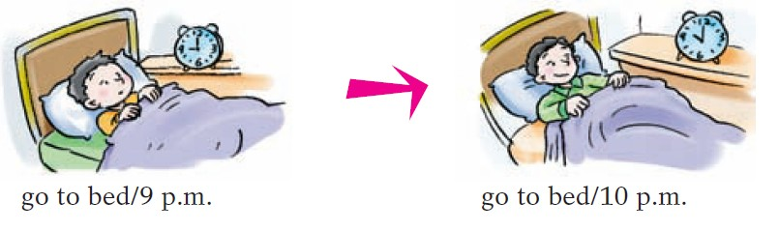
Mike used to go to bed at 9 p.m.
Now he goes to bed at 10 p.m.

Slide 37
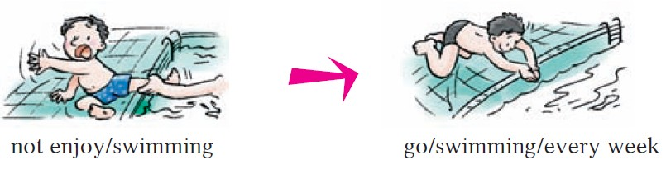
Mike didn't use to enjoy swimming.
Now he goes swimming every week.

Slide 38
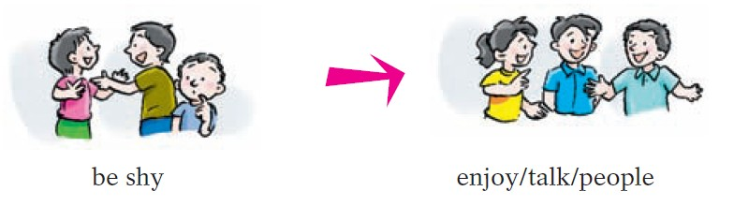
Mike used to be shy.
Now he enjoys talking to people.

Slide 39

Let’s learn the new words and expressions.

Slide 40
Notes P109-111
1. by the way 顺便说一句
顺便说一句，我是你的头号粉丝。
By the way, I'm your number-one fan.

Slide 41
Notes P109-111
2. make good progress 取得大的进步
我很高兴取得了很大的进步。
I’m glad I’m making good progress.

Slide 42
Part IV Post-Learning

Slide 43
The beginning of your hobby
Talk about the beginning of your hobby with an adverbial clause of time. You can start it like this:
When I ……
That was the beginning of my hobby.
For example:
When I got my first singing prize, I decided to become a better singer.
That was the beginning of my hobby.

Slide 44
Part V Review

Slide 45
一、选择最佳答案填空。
( )1. I was doing my homework alone in the
classroom ____ I heard the song.
A. because B. when
C. though D. after
( )2. He was at the table ____ someone knocked at
the door.
A. why B. where C. when D. what
( )3. ____ I was a child, I wanted to be a doctor.
A. When B. After
C. Until D. Before
B
C
A

Slide 46
( )4. Tom ____ into the house when no one was
looking.
A. slipped B. was slipping
C. slip D. slips
( )5. I ____ him the book when he ____ back.
A. will give, will come
B. give, comes
C. will give, comes
D. give, will come
A
C

Slide 47
二、连词成句。
1. get up, when, you, wake me up, please
When you get up, please wake me up.
2. she, was ill, she, when, stayed, at home
She stayed at home when she was ill.
3. when, grows up, he, wants, he, to be a doctor
He wants to be a doctor when he grows up.
4. I, used to, when, I, be, thin, was young
When I was young, I used to be thin.
5. he, swim, used to, in the river, when, was a child, he
He used to swim in the river when he was a child.

Slide 48
Thank you!

