Slide 1

Unit2
Grammar

Slide 2
Gerunds [ˈdʒerənd]
动名词（p23）
Gerunds are nouns ending in -ing. These nouns refer to actions and activities.
动名词是以-ing结尾的名词。这些名词描述动作和活动
Communicating is more than just speaking.
He tried smiling at people.
动名词的肯定形式：
doing sth
动名词的否定形式：
not doing sth

Slide 3
动名词由动词原形加-ing形式构成（形式上与现在分词相同）。动名词兼具动词和名词的特征。因此，
动名词可以像动词那样，有自己的宾语:
Debbie loves reading poems.
又可以像名词一样，在句中充当主语、宾语、表语、定语、状语等成分。
注：动名词不能作谓语，因此动名词为非谓语动词。

Slide 4
How to form the gerund?
1.在一般情况下，在动词原形后直接加词尾 –ing。
go – going do – doing ask – asking
2.在以不发音的e 结尾的动词后，去掉e，再加- ing。
live – living dance – dancing make – making
3.以重读闭音节结尾的动词，双写最后一个辅音字母，再加 –ing.
sit – sitting run – running begin – beginning
4.在少数几个以 –ie 结尾的动词后，须将–ie 变作y，再加- ing。(这些动词词典一般均注明)
die – dying tie – tying lie – lying

Slide 5
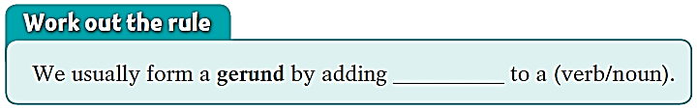
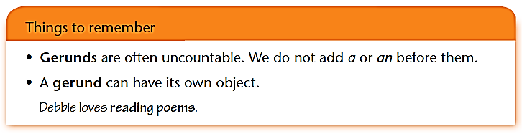
我们通常通过在动词后加-ing来构成动名词。
-ing
动名词通常都是不可数的，不能在前面加a或an.
动名词可以有自己的宾语。

Slide 6
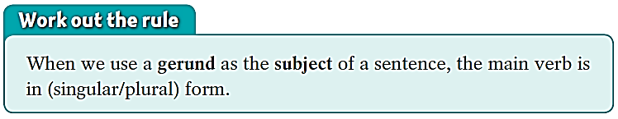
as subjects主语 (p24)
Gerunds
We can use a gerund as the subject of a sentence.
Smiling shows that you are happy.
Ballet training usually starts at an early age.
Dancing is her favourite hobby.
subject

Slide 7
▲ 动名词作主语时，谓语用单数：
Communicating is not just speaking.
▲ 两个或多个动名词作主语，谓语动词视具体情况而定。
若是语义不一致（不同的事情），谓语动词用复数：
Playing computer games and playing basketball are my hobbies.
若是语义一致（描述的事情属于同一个概念），谓语动词用单数：
Going to bed early and getting up early is a good habit.

Slide 8
(p24) In pairs, ask and answer questions about the pictures. Follow the example.
S1: What can shaking your closed hand show?
= Shaking your closed hand can show what?
S2: Shaking your closed hand can show that you are angry.
S1: act out the body language
before you ask the Q.
shake your closed hand/angry

Slide 9

rest your head on your hand/bored
S1: What can resting your head on your hand show?
S2: Resting your head on your hand can show that
you’re bored.

Slide 10
S1: What can sighing show?
S2: Sighing can show that you’re sad.
sigh/sad

Slide 11
S1: What can closing your eyes show?
S2: Closing your eyes can show that you’re thinking.
close your eyes/thinking

Slide 12
[用法补充]
Arguing about it is a waste of time.
辩论这事是浪费时间
=It is a waste of time arguing about it.
动名词作主语时，放在句子前面，但如果动名词短语较长时，为了使句子保持平衡，常用it作形式主语，动名词作真正的主语放在句末。
类似的用法有：it做形式主语，动词不定式作真正主语放在句末。
It is + adj. + (for/of sb.) + to do sth.

Slide 13
动名词作真正的主语的常用句型：
It is a waste of time doing ...
It is no good doing ...
It is no use doing ...
It is worth doing …
动名词作主语可用于there be 句型，There is no + doing …
做某事不….样
做…是浪费时间的
做…是不好的/没有好处的
做…是没用的
做…是值得的

Slide 14
It is no use crying over spilt milk .
（谚）覆水难收。
It is no good learning without practice.
学而不实践是没好处的。
It is no use talking about it with him.
和他谈这件事是没用的。
It’s a waste of time arguing about it.
辩论这事是浪费时间
It’s worth discussing the problem.
讨论这个问题是值得的。

Slide 15
There is no point doing such a silly thing.
做这样一件傻事毫无意义。
There is no joking about such matters.
这种事开不得玩笑。
There is no stopping him.
无法阻止他。

Slide 16
as objects宾语 (p25)
Gerunds
We can also use a gerund as the object of a sentence.
Debbie enjoys smiling and always looks friendly.
Simon tried smiling at people.
object

Slide 17
动名词作宾语，可用于及物动词、动词短语、以及介词后作宾语。
We often use gerunds after these verbs.
下列动词后面常跟动名词
P25：enjoy(享受), imagine(想象), practice(锻炼), finish(完成),
mind(介意), advise(建议), avoid(避免), admit(承认),
consider, delay(延迟、延误), deny(否认), keep(保持),
miss(错过/思念), resist(抗拒), risk(冒险), suggest(建议)

Slide 18
sunbathe[‘sʌnbeɪð]v. 沐日光浴
enjoy sunbathing['sʌnbeɪðɪŋ]
Many people on the beach in summer.
夏季，很多人喜欢在沙滩日光浴。
I it in a different way.
我建议用另一种方法做这件事。
I can’t so much money.
我无法想象赢那么多钱。
suggest doing
imagine earning

Slide 19
b. We often use gerunds after these phrasal verbs.
be busy doing
be worth doing sth
can’t help
give up
keep on /carry on
feel like
put off
insist on
get down to
look forward to
be/get used to
succeed in doing
feel like(想要) doing
忙于做某事
值得做某事
情不自禁做某事
放弃做某事; 戒除…(如抽烟)
继续做某事
想要做某事
推延做某事
坚持做某事
开始认真做某事
期待做某事
习惯做某事
成功做某事
想要做某事
下列动词短语后面常跟动名词

Slide 20
be tired of doing sth.
厌烦做某事

Slide 21
feel like eating
He's not very well; he doesn’t .
  他不太舒服，不想吃东西
I am busy .
  我在忙着写作业。
You are in .
  你的身体如此不健康，应该马上戒烟！
  =You are .
doing my homework
such bad health that you should give up smoking at once
so unhealthy that you should give up smoking at once

Slide 22
Complete the sentences using the verbs in the box in the -ing form.
breathe do hear organize smoke take use walk
breathing
1 She is tired of ________ the dirty air in the city centre.
2 She keeps on ________ to school instead of ______ a bus.
3 He finally gave up ________.
4 She is used to ________ a handkerchief instead of a tissue.
5 She was interested in ________ the puzzle.
6 She looks forward to ________ from her new e-friend.
7 She is good at __________ party activities.
walking
taking
smoking
using
doing
hearing
organizing

Slide 23
注意：下列动词want, require, need后跟动名词作宾语时，主动形式表被动意义。若后跟动词不定式作宾语，则还是用被动形式。
花儿需要每天浇水。
The flowers need watering every day.
= The flowers need to be watered every day.
这个问题需要认真研究。
The problem requires studying carefully.

Slide 24
[注意] 动词不定式与动名词作宾语的用法区别
有些动词后只能加动词不定式，有些动词后只能加动名词。还有一些动词后两者都可以。
1. 在begin, start, continue, love, like, hate, prefer后用动名词和用不定式作宾语均可，意义没有多大区别。

Slide 25
2. 动名词和不定式用在某些动词之后作宾语，意义区别较大：
to do
将要发生的动作
forget
regret
remember
doing
已经发生的动作

Slide 26
go on doing
go on to do
继续做同一件事情
继续做另一件事情
stop doing
stop to do
停止做某事
停下来做另一件事
mean doing
mean to do
意味着做某事
打算做某事

Slide 27
try doing
try to do
试着做某事
努力做某事
be used to doing
be used to do
习惯做某事
被用来做某事
can't help doing
can't help to do
情不自禁做某事
不能帮助做某事

Slide 29
3. 根据中文意思写出相应词组。
allow/permit doing sth.
允许做某事
allow/ permit sb. to do sth.
允许某人做某事
advise doing sth.
建议做某事
advise sb. to do sth.
建议某人做某事
forbid doing sth.
禁止做某事
forbid sb. to do sth.
禁止某人做某事

Slide 30
在allow, advise, forbid, permit后，直接跟动名词作宾语；
但如果还有名词或代词，
则要用allow/permit/advise/forbid sb. to do sth. 的形式。
我们不允许在这里抽烟。
We don't allow smoking here．
我们不允许任何人在这里抽烟。
We don’t allow anybody to smoke here．

Slide 31
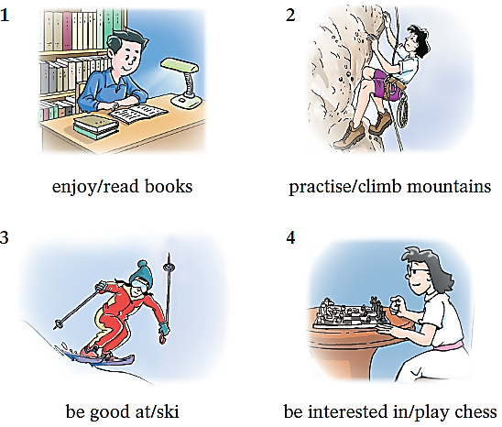
In pairs, ask and answer questions about the pictures. Follow the example.
S1: What does the boy enjoy?
S2: He enjoys reading books.
S1: What is the girl practising?
S2: She is practising climbing mountains.

Slide 32
S1: What is the girl good at?
S2: She is good at skiing.
S1: What is the girl interested in?
S2: She is interested in playing chess.

Slide 33
动名词作表语
His hobby is collecting stamps.
Her job is looking after the old.
注意：
这时，主语和表语可以互换位置

Slide 34
动名词作定语
动名词作定语时一般前置，表用途。
阅览室
游泳池
餐车
候车室
reading room
swimming pool
dining car
waiting room

Slide 35
选择最佳答案填空。
( )1. Mum suggested ____ for a walk.
A. to go B. going C. go D. to going
( )2. My brother gave up ____ after the car accident.
A. drinking B. drink C. to drink D. to drinking
( )3. I don’t mind __ by bus, but I am afraid of ___ in
the crowded people.
A. to travel; standing B. to travel; to stand
C. travelling; to stand D. travelling; standing
( )4. Remember __ the newspaper when you finish__ it.
A. putting away; to read B. to put away; to read
C. to put away; reading D. putting away; reading
B
A
D
C

Slide 36
Thank you!

