Slide 1
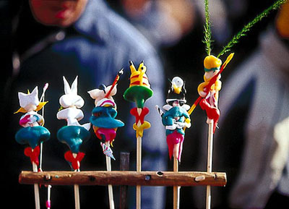
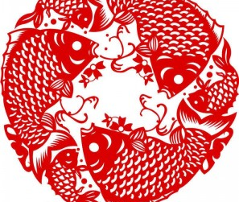
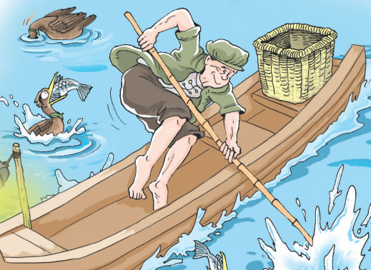
Unit 3
Traditional Skills
writing
Notes:
Today we are going to learn about a man who is good at a traditional Chinese skill.

Slide 2
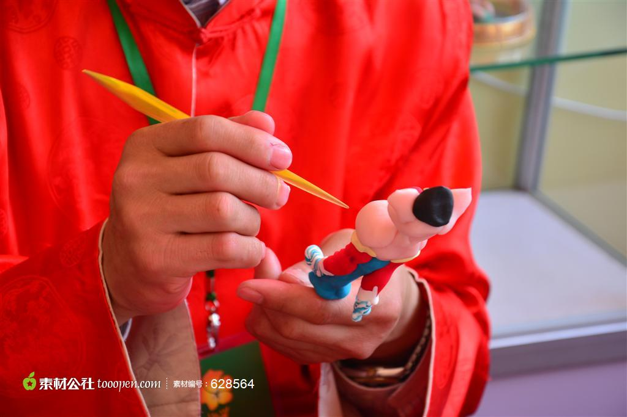
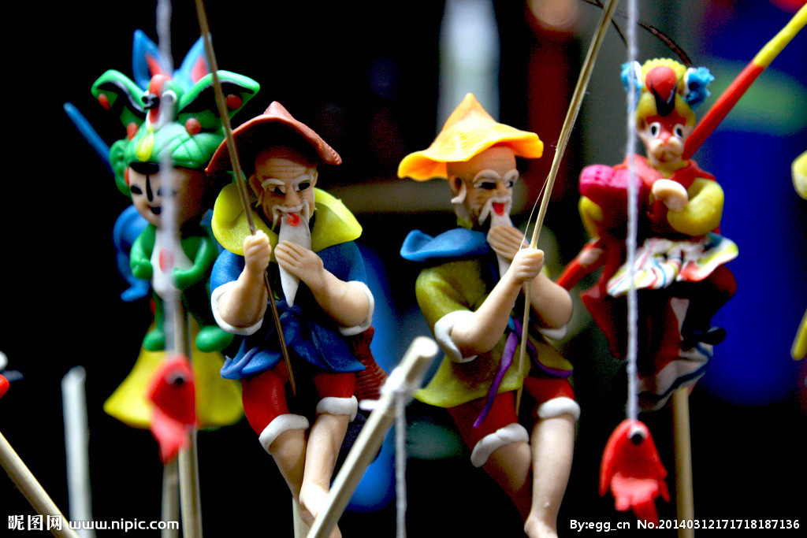
Notes:
Can you guess what is he good? Making dough toys.

Slide 3
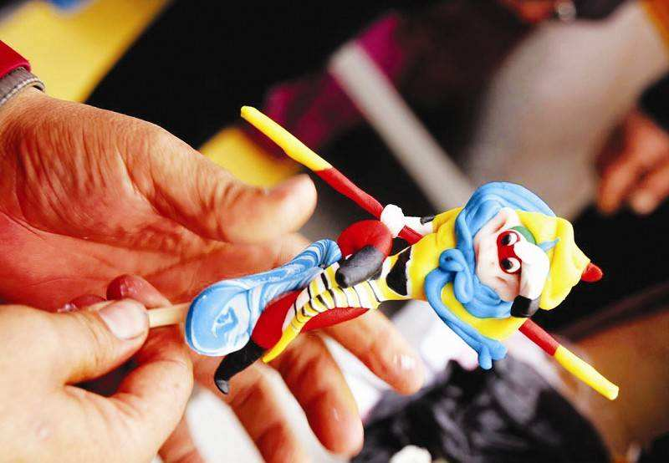
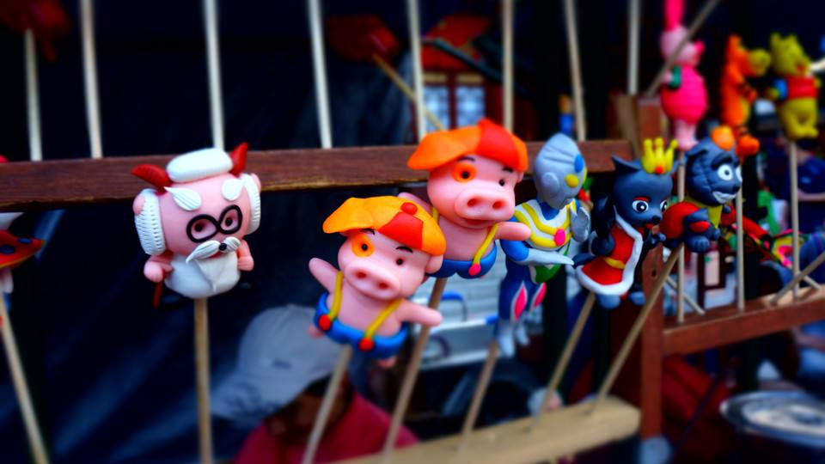
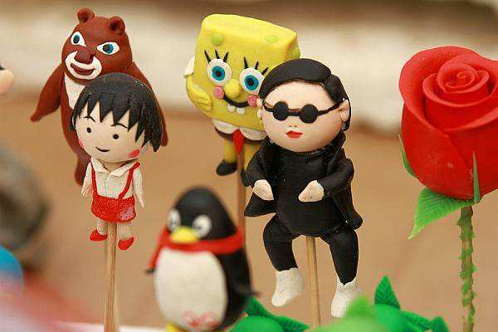
Turn the dough into different characters

Slide 4
What is required to make a dough toy?
Video about making Monkey King
A small piece of dough and some simple tools.

Slide 5
A person with a traditional skill
A. Mark wrote an article about Mr Chen. Read the article and answer the questions below. （P44)
Mr Chen makes toys from dough. He is over 50 years old now. His hands are rough because he works with dough all
the time.

Slide 6
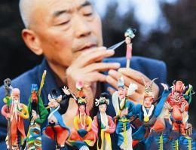
How does Mark describe Mr Chen?
He is over 50 years old now. His hands are rough because he works with dough all the time.

Slide 7
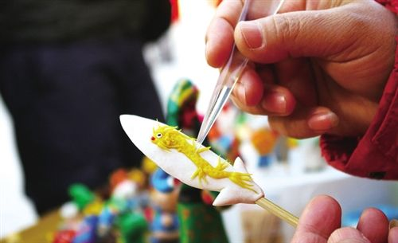
2. How does Mark describe Mr Chen’s work?
Mr Chen makes dough toys of different sizes. Only a small piece of dough and some simple tools are required. He uses his hands to turn the dough into different characters.

Slide 8
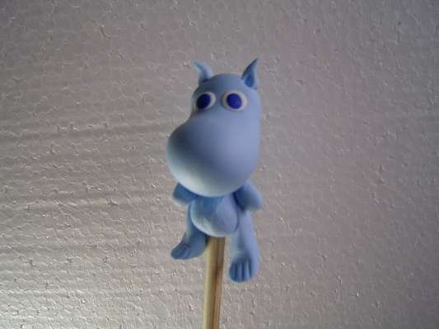
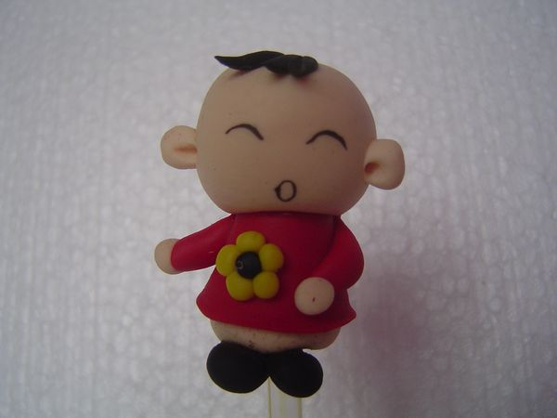
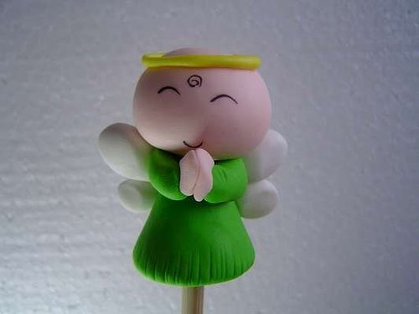
3. What does Mark think of Mr Chen’s
dough toys?
He thinks that they are very lovely.

Slide 9
Read the article again and match each paragraph with its general idea.
Describes the person’s work and the tools needed for his/her work.
Paragraph 1
Paragraph 2
Paragraph 3
Gives an opinion about the person and his/her skill.
Describes the person.

Slide 10
B. Write a short article about a person with a traditional skill. Use the example in A and the outline below to help you.
Paragraph 1.
Describe the person.
(Who is he/she? What does he/she look like?)
Paragraph 2.
Describe the person’s work and the tools needed for his/her work. You may also describe the important steps in his/her work.
Paragraph 3.
Give your opinion about the person and his/her skill.
(What do you think of his/her skill? Would you like to learn his/her skill?)
[学评P59页作文]

Slide 11
Notes P44
*dough [U]n. 生面团
[U] 大小、尺寸、体积
2. size
这本书同那本书的大小一样。
This book is .
我想看看不同号码的鞋。
I want to look at the shoes .
[C] 衣服、鞋等的尺码、号
the same size as that one
of different sizes
….-sized/size: adj. “….大小的、规模的”
大的/中等的/像口袋一样小的
large-sized/medium-sized/pocket-size

Slide 12
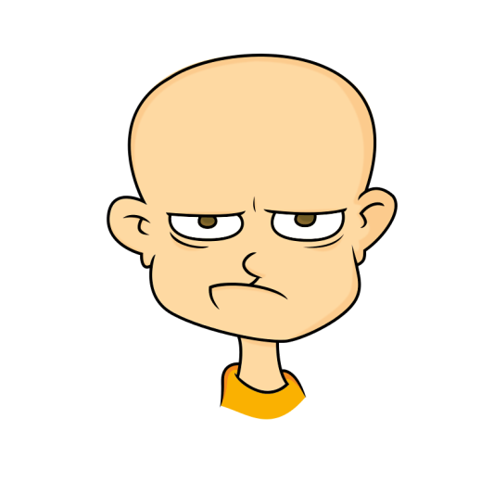
3. all the time
（ 在某段时间内）一直 ；始终
如：
Why does he keep such a long face all the time?
为什么他总是拉长着脸？

Slide 13
4. simple adj. 简单的
simply adv. 仅仅，只，简单地
这台机器使用起来很简单。
The machine is quite simple to use.
这些数学练习题太简单，任何人都会做。
The math exercises are simple enough for anyone to work out.
让我简单地介绍一下他。
Let me introduce him simply.

Slide 14
5. Mr Chen uses his hands to turn the dough into different characters.
陈先生用手把这些面团变成不同的人物造型。
turn ... into ... 把……变成……
他们把这栋旧楼改成了图书馆。
They turned the old building into a library.
这场战斗有可能变成一场战争。
The fighting may turn into a war.

Slide 15
Practice
根据中文意思完成句子。
1. 让我们把这片地改成花园吧。
Let’s ______ this area ______ a garden.
2. 她正成为一位伟大的音乐家。
She ______ ______ ______ a great musician.
3. 仙女把那个小孩变成了一只兔子。
The fairy _______________ the child ______ a rabbit
turn into
is turning into
turned into

