Slide 1

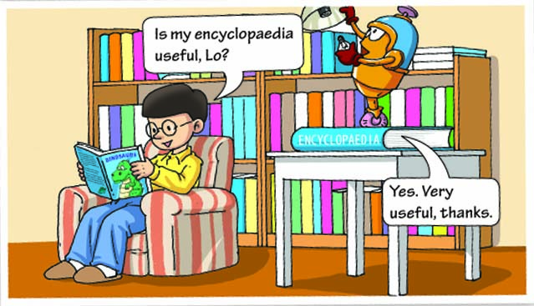
1
Getting ready
Look at the cartoon and answer the questions.
What does Hi think Lo is probably doing?
In fact, what is Lo doing?
What will Hi probably feel when he learns that Lo is standing on his encyclopaedia?
He thinks that Lo is probably reading his encyclopaedia/is looking for some information in his encyclopaedia.
He is standing on the encyclopaedia to change a light bulb.
He will probably feel angry/unhappy.

Slide 2

an encyclopaedia
An encyclopaedia is a collection (usually a book or set of books) of information about things humans know.

Slide 3


subject
all kinds of subjects
Encyclopaedia Britannica

Slide 4
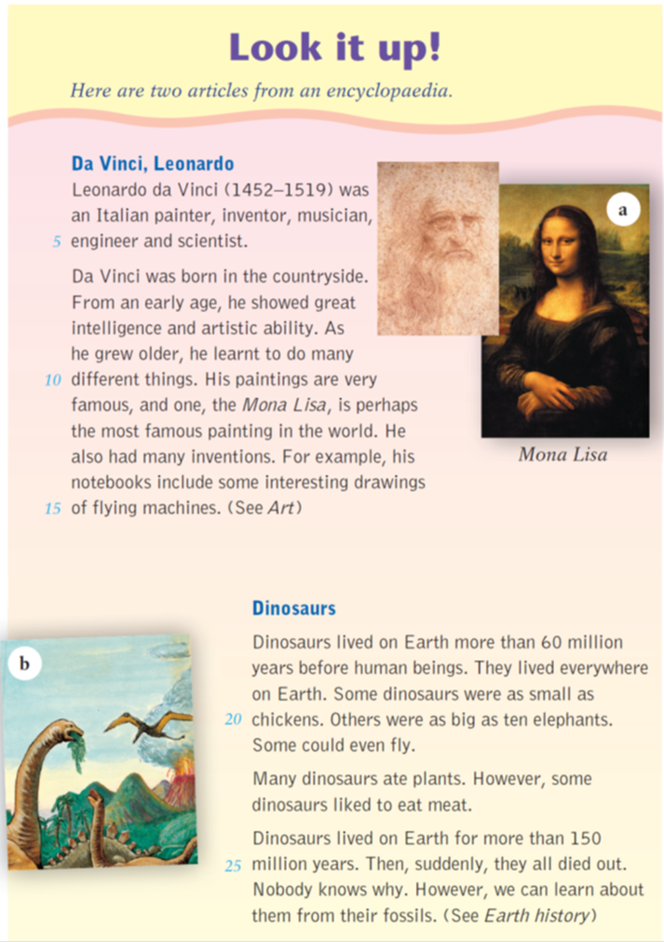
Read the title and the introduction on page 3. Then answer the questions.
In the title, what does the phrase “look up” mean?
What does the pronoun “it” in the title refer to?
It means to look for information about something in a dictionary or an encyclopaedia.
It refers to information.

Slide 5
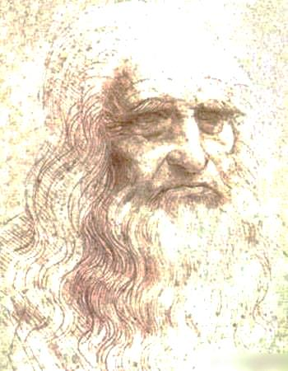



3
About Da Vinci
Read the first article and complete the spidergram.
1452
1519
year of birth
year of death
painter
countryside,
Italy
inventor
birthplace
achievements
Leonardo
da Vinci
musician
childhood
engineer
scientist
adulthood
showed great intelligence and artistic ability
contributions
many inventions
learnt to
do many different things
famous paintings

Slide 6
In pairs, talk about Da Vinci according to the spidergram.
1452
1519
year of birth
year of death
countryside, Italy
painter
inventor
birthplace
achievements
Leonardo
da Vinci
musician
childhood
engineer
scientist
adulthood
showed great intelligence
and artistic ability
many inventions
contributions
learnt to do many different things
famous paintings

Slide 7
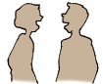
Homework
Look it up!
Who else do you want to know about? Look up the information in the encyclopaedia and discuss it with your classmates.

Slide 8
A great composer — Beethoven
I learn about Beethoven from an encyclopaedia . Now let me tell you something about him.
Ludwig van Beethoven was a famous German musician, pianist and composer. He was born on December 16, 1770. He showed great musical ability from an early age. He could play the piano at the age of four. When he was in his twenties, he began to lose his hearing. But he didn’t give up. He created lots of beautiful music in his life.
In my opinion Beethoven is a great person. We should all learn from him and never give up hope when we meet difficulties.

