Slide 1
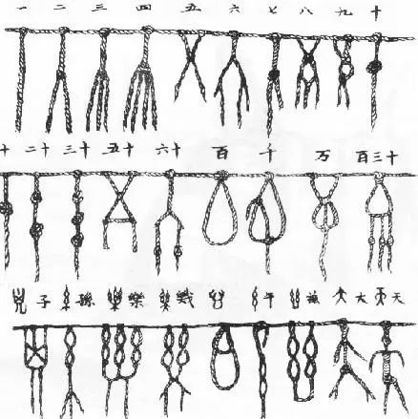
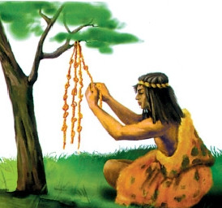
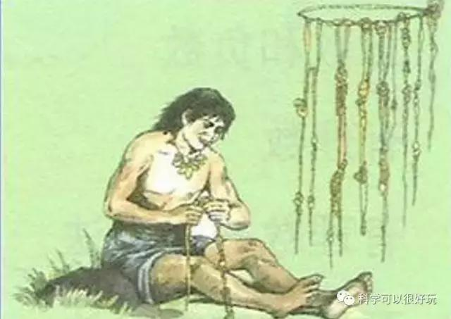
Counting before numbers
Who knows the earliest counting?
Tying knots

Slide 2
First reading
What did ancient people use to count before numbers?
fingers
...
toes
count
count
systems
marks
tokens

Slide 3
First reading
1. Make the title more specific(具体的）
The history of counting before numbers
2. How to retell or remember history
Flow chart
Time line
Linking words

Slide 4
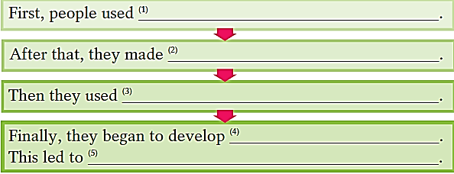
Finish the flow chart of history on counting before numbers.

Slide 5
Discuss the advantages and disadvantages of each invention on counting
Group work
fingers
...
toes
count
systems
marks
tokens

Slide 6
Homework
1. Write down advantages and disadvantages.
2. Book review.

