Slide 1

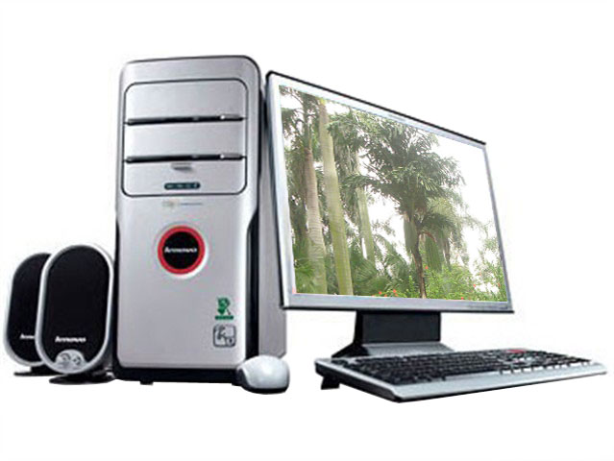
Oxford English
Unit
3
Module 2 Science and technology
Computers Reading
Notes:
Class begins. Good morning, class. Today we are going to learn about Unit 3 computers.

Slide 2
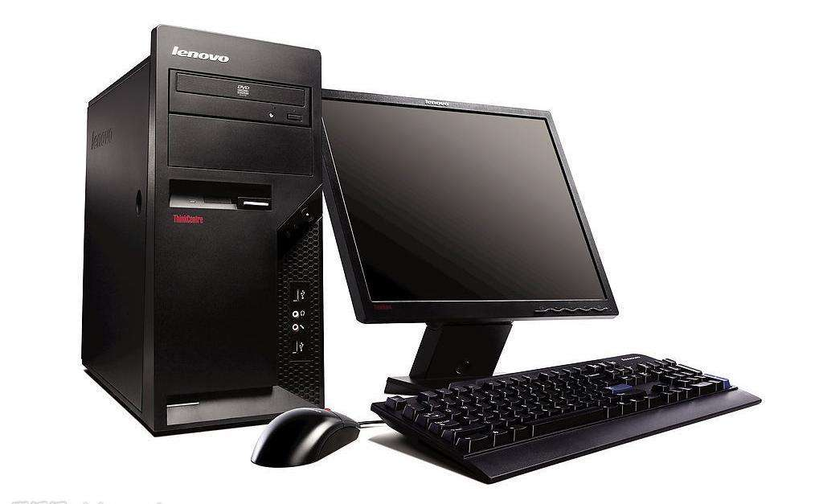
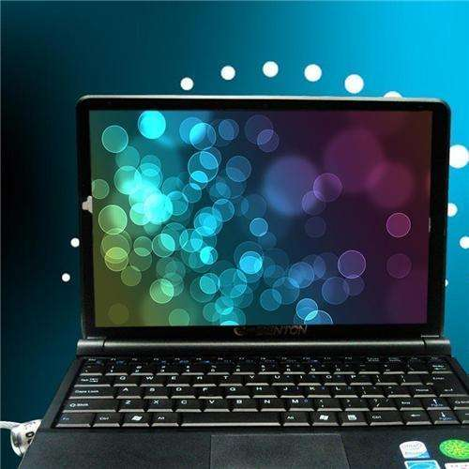
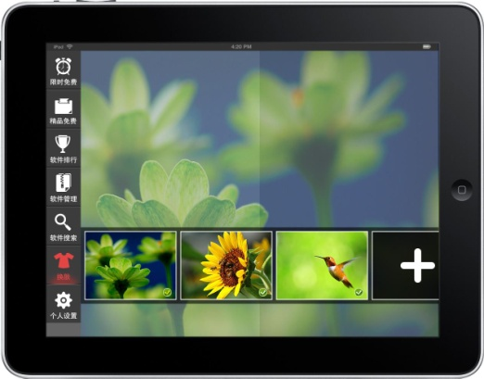
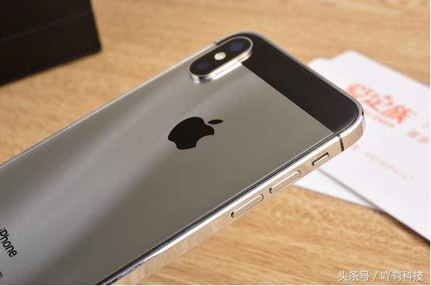
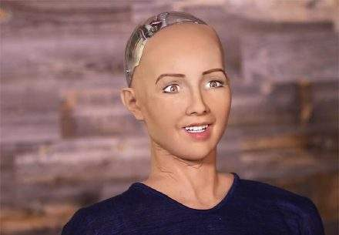
Where can you find computers? How many kinds of them can you name?
A tablet
(An iPad)
A desktop
A laptop
A smartphone
(An iPhone)
A robot
(Sophia)
Notes:
So, please think about this question: where can you find computer? How many kinds of them can you name? Ok, the first one is a desktop, what about the second one, yes, a laptop. This is the third one. What is it? Yes, a tablet. For example, an Ipad. What about this one? An iphone, a smartphone. Yes, a robot. You can find a computer inside a robot, right？ This robot is named Sophia.

Slide 3
Sophia:
created in 2015
became a citizen of Saudi Arabia in 2017
video
Reading
Computer facts
Notes:
Sophia is a kind of computer. She is created in 2015 and then became a citizen of Saudi ['saʊdɪ] Arabia[əˈreibjə] in 2017. Now, let’s watch a video about this amazing robot.
So do you think Sophia. Yes. She is so smart because of the computer in the head. Right? So computers are very powerful. So do you think computers can make lives better? To answer this question, we need to know more about computers. So, now let’s go on to read the article: computer facts.

Slide 4
First reading
1. What is the type of this passage?
A. story B. expository C. speech D. news
2. How many parts is the text divided into?
3 parts.
3 sub-headings.
Tell the topics
3. What is the use of a sub-heading?
Clarify the passage
Make passage clear and organized
Notes:
So, now let’s read the text. How many parts are the text divided into? 3 parts. How do you know？ Because there are three subheading. So here is another reading tip for you: What is the use of a sub-heading? A sub-heading usually tells us the topic of the paragraph below it.

Slide 5
Pay attention to sub-headings
and fill in the blanks with one word only.
Part 1
appearance
The __________ of computers in different times
Computer facts
Part 2
The _____of computers in daily life
uses
development
The ___________ of computers
in the future
Part 3
Notes:
This exercise is in your handout, can you find it? Good. Can you fill in the blank. Any different ideas? Ok. The first computers were very big. And now computers are smaller. So what does it talk about？ Type of computers or size of computers? Very good. Part 2： how to fill in the blank. Pay attention to the sub-heading. “What can we do with computers”. We use computers to talk about a lot of things. So this part is about the uses of computers. Part 3: Yes, the relationship.(要去巡视，问学生知不知道。。)

Slide 6
Detailed reading
Part 1: Smaller and better
_____________ cars
The first computers in the 1940s
bigger than
smaller and better
tiny: very small
There is probably a
inside
tiny computer
your TV or washing
machine.
Computers nowadays
You more than you realize.
depend on：rely on
depend on computers
Notes:
Now, please read the first carefully.

Slide 7
Part 2: What can we do with computers?
At a speed.
faster
1.
calculate
Never give .
wrong answers
calculate: v.计算
operate: v. to use or control a machine操作，控制
2. type
and draw things
railways
Operating .
3. do
important jobs
machines
Flying .
Notes:
Now, please read the second part and then complete the table below.

Slide 8
Part 3: Is a computer cleverer than me?
  1. Is a computer cleverer than you? Why?
No, it isn’t. Because the human brain can produce new ideas but computers cannot.
  2. What problem will we probably face if computers (technology)
  can do all our jobs?
?
Read an article and discuss what may happen to our life?

Slide 9
Group work
?
With the development of technology,
what may happen to our life?
Notes:
This exercise is in your handout, can you find it? Good. Can you fill in the blank. Any different ideas? Ok. The first computers were very big. And now computers are smaller. So what does it talk about？ Type of computers or size of computers? Very good. Part 2： how to fill in the blank. Pay attention to the sub-heading. “What can we do with computers”. We use computers to talk about a lot of things. So this part is about the uses of computers. Part 3: Yes, the relationship.(要去巡视，问学生知不知道。。)

