Slide 1
The present perfect tense
现在完成时
-What did he do at home just now?
-He did my homework.
He cleaned the floor.
He cooked the dinner for you.
Why are you playing computer games again?
-I have done my homework.
I 've cleaned the floor.
I 've cooked the dinner for you.
have/has+done
've/'s+done

Slide 2

现在完成时
( present perfect tense)
past
present(now)
future
do my homework

Slide 3
done过去分词 (pp)变化规则
1. 规则动词：与过去时变化相同。
(1) 一般+-ed
work---worked---worked
(2) 以“ e ”结尾, + - d 。
live---lived ---lived
(3) “辅音字母 + y” 结尾，y 变 i, + -ed。
cry---cried---cried
(4) 重读闭音节结尾(辅元辅)，双写后+-ed 。
drop---dropped--dropped
2 、不规则动词，见不规则表（p120）

Slide 4
不规则动词：
一、 原形、过去式和过去分词相同的动词
（A、A、A型）
cost—cost—cost
cut—cut—cut
hit—hit—hit
hurt—hurt—hurt
let—let—let
put—put—put
read—read—read

Slide 5
不规则动词：
二、 过去式与过去分词相同的动词
（A、B、B型）
bring--brought --brought
buy—bought—bought
meet—met—met
say—said—said
sell—sold—sold

Slide 6
三、 过去分词与动词原形相同的动词
（A、B、A型）
become—became－become
come—came—come
run—ran—run
四、 过去时与原形相同的动词
（A、A、B型）
beat—beat—beaten

Slide 7
五、 原形、过去式和过去分词都不相同的动词
（A、B、C型）
begin—began—begun
blow—blew—blown
break—broke—broken
choose—chose—chosen
do—did—done
go—went—gone
grow—grew—grown

Slide 8
Write down past tense and past participle of the following verbs. （写出下例动词的过去时和过去分词）
work
rain
love
change
stop
plan
drop
study
carry
read
teach
see
feel
build
leave
think
write
do
worked worked
read read
rained rained
taught taught
loved loved
saw seen
changed changed
felt felt
stopped stopped
built built
planned planned
left left
dropped dropped
thought thought
studied studied
wrote written
carried carried
did done

Slide 9
I have already posted the letter .
He hasn’t done his homework yet.
They have just left.
Have you ever been to Beijing ?
I have never seen him .
Have you seen the film before?
I’ve worked in the school since 1999.
He’s lived in Shenzhen for 6 years.
in the past several days / weeks/ years
I have not written to my parents recently.
So far she has learned 5 English songs.

Slide 10
现在完成时的代言词
已经（肯定）
还未（否定）
刚刚
曾经
从未
自从
长达...
already
yet
just
ever
never
since
for+时间段
recently 最近
in the past several years
在过去的这几年

Slide 11
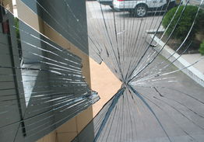
break-broke-broken
Someone ____already _____ the window.
has broken

Slide 12

lose-lost-lost
have lost
I ____ already ______ the key.

Slide 13

read-read-read
We ____ already_____ that book .
have read

Slide 14

wash-washed-washed
has washed
She ______ just _______ her hands.

Slide 15
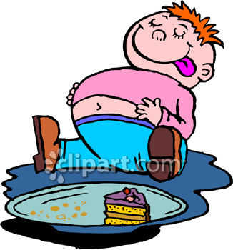
have-had-had
has had
He _____ ____ a big breakfast.

Slide 16
have gone to
VS
have been to

Slide 17
1. -Hello, may I speak to Mr. Zhang ?
-Oh, sorry! He has gone to Gui Yang.
2. John knows the way very well.
He has been to Hong Kong before.

