Slide 1

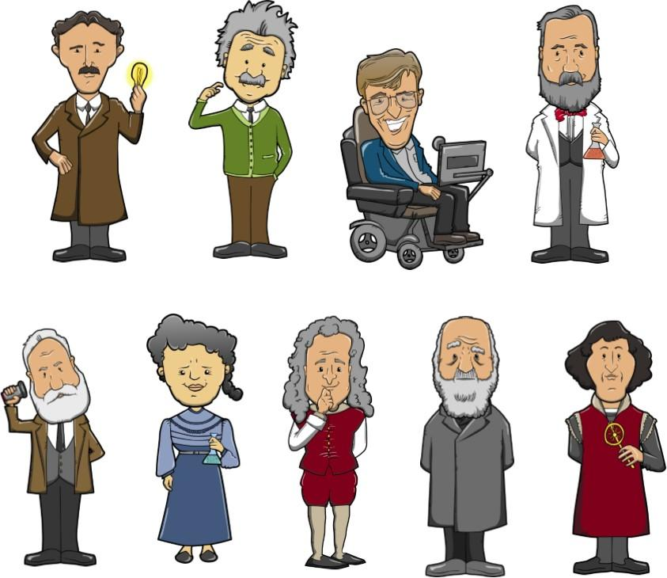
Unit 2
Great minds
Grammar

Slide 2
Review: What is an infinitive?
动词不定式是一种非谓语动词形式，其结构为“to＋动词原形”
（注意：在这里to不是介词，而是动词不定式的符号，后面的动词原形则是动词不定式）
动词不定式没有人称和数的变化。
动词不定式的肯定形式___________
否定形式______________
An infinitive is the (base/ -ing/ -ed) form of a verb.
to do sth
not to do sth

Slide 3
Things to remember
动词不定式在句子中除不能担当谓语外，可以
充当其他任何成分，如：主语，宾语，表语，
定语，状语等。

Slide 4
Observe the following sentences. What’s the use of infinitives in each sentence?
infinitives as subjects(主语)
To do that sort of thing is foolish.
I want to see you this evening.
All you have to do is to finish it quickly.
We found a house to live in.
She came here to study English.
I warned the patient not to eat cold water after the operation.
infinitives after verbs (宾语)
✅
infinitives after the verb to be (表语)
infinitives after nouns (定语)
infinitives of purpose (目的状语)
✅
✅
infinitives after objects (宾语补足语)

Slide 5
A Infinitives after nouns
To give more information about nouns, we can use infinitives after the nouns.
观察下列例句，归纳动词不定式的用法。
1. Einstein often received invitations to explain his theories at different universities.
2. I have a dream to become a fashion designer.
3. We need someone to help with the work.
【梳理】
动词不定式作定语一般都是作（前置/后置）定语，
用来修饰前面的（名词/动词/代词/介词），
来解释某一事物的功能或用途。

Slide 6
Observe the following sentences. Which one is correct?
✅
I give her a newspaper to read.
I give her a newspaper to read it.
Things to remember 1:
如果动词不定式所修饰的名词或代词是动词不定式的宾语，动词不定式后不加宾格代词。
I am looking for a room to live in.
I need a piece of paper to write.
There is nothing to worry.
✅
to write on.
to worry about.
Things to remember 2:
如果动词不定式所修饰的名词或代词是动词不定式的宾语（动宾关系），若该动词是不及物动词，其后应加上相应的介词。

Slide 7
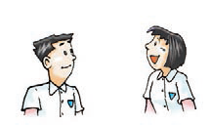
A1 Jim is telling May about his dream. Complete their conversation with the words from the box.
be become help make start
1. I’ve made a decision.
________________ a
genius.
2. I’ve got an ability.
__________________a
great doctor.
A decision to do
_____________ what?
You can’t be serious.
A decision to become
An ability to do
_____________ what?
I don’t believe it!
An ability to become

Slide 8
be become help make start
___________ what?
You’ll probably fail.
3. I’ve made a plan.
____________ life
better for everyone.
A plan to do
A plan to make
____________what?
You must be joking.
4. I’ve decided to find a way.
_____________people live to be 1,000 years old.
A way to do
A way to help

Slide 9
be become help make start
___________ what?
I will give you some advice.
5. So now is the time.
_____________ work.
The time to do
The time to start
6._______________
what?
The advice to do
To stop dreaming!

Slide 10
A2 Complete the paragraph below with the words from the box.
become a scientist go to university do Maths try again
to do Maths
At school, Einstein’s ability (1)___________ surprised his teachers, but he was bored with other subjects. At the age of 15, he was given the chance (2)________________, but he did not do well enough in the exam.
to go to university
He did not lose heart, however, and he
had a wish (3)_____________ the next year. This time, he succeeded. He kept trying, so he achieved his dream (4)___________________.
to try again
to become a scientist

Slide 11
Rewrite the sentences with the words in brackets. Do not change the meaning of each sentence.
1. He decided to leave school. (decision)
= He made a decision to leave school.
2. He is able to do it. (ability)
= He has the ability to do it.
3. I plan to visit Paris next year. (plan)
= I make a plan to visit Paris next year.

Slide 12
根据汉语意思完成句子。
1. 你有去度假的想法吗？
Have you got an idea to go on a holiday?
2. 他们已经找到一个省钱的方法。
They have found a way to save money.
3. 我不相信你有独自穿越森林的能力。
I don’t believe you have the ability to go
through the forests by yourself.
4. 这里是一个野餐的好地方。
It is a good place to have a picnic.

Slide 13
B Infinitives as subjects
We can use an infinitive as the subject of a sentence.
观察下列例句，归纳动词不定式的用法。
1. To tell the truth is important.
2. It’s a pleasure to drive a genius like you, Dr Einstein.
3. It takes me 30 minutes to walk to school.
【梳理】
1.动词不定式可以在句中作_____（如例句1）。此时，谓语动词用______.
2.在例句2和例句3中，_____ 是形式主语，真正的主语是后面的___________。
主语
单数
It
动词不定式

Slide 14
In most cases, we use it at the beginning of the sentence as an empty subject(形式主语) to refer to the infinitive.
It’s a pleasure to drive a genius like you, Dr Einstein.
It was good to have a friend like Einstein.
It was easy for Einstein to answer the question.

Slide 15
Things to remember
it 作形式主语时，主要有三种情况：
常用形容词作表语。It is + adj. + for/of + n./pron. to do sth.
eg. It’s important for us to keep the water clean.
It’s very kind of you to say so.
接名词作表语。
It must be great fun to fly to the Moon in a spaceship.
It is a pleasure to work with you.
It is a pity to miss the professor’s lecture.
c. It takes/took/will take sb. some time to do sth.
eg. 昨天晚上我花了一个多小时完成家庭作业。
It took me more than an hour to do my homework last night.

Slide 16
(p25) Hans once drove another scientist, Dr Green, from the airport to a university. Complete their conversation with infinitives and words in brackets.
Dr Green: Hello, Hans.
Hans: Hello, Dr Green. How long did it take
you to get here by plane?
Dr Green: ______________________________
______(take / two hours) How long
will it take to get to the university?
Hans: _______________________________
(take / 20minutes)
Dr Green: Well, that’s not very long. Hans,
you’re a very good driver. Is it difficult to drive a car?
It took me two hours to get here by plane.
It will take 20 minutes to get there.

Slide 17
Hans: No. _________________________
(easy /drive)
Dr Green: Maybe I’ll learn to drive some day, but __________________________
_____ (difficult / for me / learn) right now. I’m too busy. Do you like your job, Hans?
Hans: Yes, I like it a lot. I meet many great
people because I’m a driver. _____________________________
(lucky/for me/have/job)
It’s easy to drive a car.
it’s difficult for me to learn to
drive.
It’s lucky for me to have the job.

Slide 18
根据汉语意思完成句子。
1. 你这样盯着别人看是不礼貌的。
It is impolite of you to stare at others.
2. 独自一个人穿越森林是很危险的。
It’s dangerous to go through the forests alone.
3. 坐飞机去那里要花三个半小时。
It takes 3.5 hours to go there by plane.
4. 作为一个警察，保护人民的生命财产是他的职责。
As a policeman, it’s a duty to protect people’s lives and property.

Slide 19
C Infinitives after the verb to be
We also use infinitives after the verb to be.
观察下列例句，归纳动词不定式的用法。
1. My wish is to be like Einstein.
2. Jane’s dream is to become a scientist.
【梳理】
动词不定式可以跟在be动词的（前面/后面）
作 ，用来补充说明主语的具体内容或表示目的、计划或打算等。
表语

Slide 20
Things to remember
动词不定式作表语，主语通常为：
a. dream， aim ，hope，idea，plan，purpose，suggestion，wish等表示目的、计划或打算的词。
His wish/dream is to become an astronaut.
My plan is to persuade him to buy me a car.
b. work，job，task，duty或function。
The man’s job was to give advice to the king.
The function of an adjective is to describe a noun.

Slide 21
Put the words in the correct order to make sentences. Add other words if necessary.
1 do the work/the most important thing/well
_______________________________________
2 in a year/Mr White’s plan/have a small shop _______________________________________
3 attract the students/my idea/by making a poster _______________________________________
4 children/her job/take care of _______________________________________
The most important thing is to do the work well.
Mr White’s plan is to have a small shop in a year.
My idea is to attract the students by making a poster.
Her job is to take care of children.

Slide 22
【自测题】
根据汉语意思完成句子。
1. 史密斯的计划是一年内在城里买一套公寓。
Smith’s plan is to buy a flat in the city in a year.
2. 我的工作是帮助这些贫穷的孩子学习语文。
My job is to help the poor children learn Chinese.
3. 他们的梦想是成为成功的生意人。
Their dreams are to become successful businessmen.
4. 现在最重要的事情是把这个事实告诉警察。
The most important thing now is to tell the police the truth.

Slide 23
Exercise
一、选择最佳答案填空。
( )1. Disneyland is a good place _____ fun.
A. to have B. have C. having D. has
( )2. — _____ a volunteer is great.
— I think so. Some of us want _____
volunteers for the London Olympics.
A. Being; being B. To be; being
C. To be; to be D. Be; to be
A
C

Slide 24
D
( )3. My plan for the next term is _____
my Maths and physics.
A. improve B. will improve
C. improved D. to improve
( )4. My main job is _____ care of the
children in this school.
A. takes B. to take C. took D. to taking
( )5. I’m thirsty, Shirley. Please give me
something _____.
A. drink B. to drink C. drinking D. drank
B
B

Slide 25
二、根据汉语意思完成句子。
1. 我表弟有一个去月球旅行的梦想。
My cousin has a dream to travel to the Moon.
2. 节约水资源是很重要的。
It is important to save water resource.
3. 我父亲每天花十五分钟走路去地铁站。
It took my father 15 minutes to the metro
station every day.

Slide 26
4. 学习英语最好的方法就是加入一个英语俱
乐部。
The best way to learn English is to join an
English club.
5. 要做一个蛋糕，首要的事情就是要买一些
面粉。
To make a cake, the first thing is to buy some
flour.

