Slide 1
I met my best friend Tom at the station yesterday.
↓
主语
↓
谓
语
↓
定语
↓
宾
语
↓
同位语
↓
状
语

Slide 2
Sentence elements
主语 subject
谓语 predicate/verb
宾语 object
补语 complement
定语 attribute
状语 adverbial
句子的主干成分
[ˈpredɪkeɪt]
[ˈkɒmplɪment]
句子的次要成分
[əˈtrɪbjuːt , ˈætrɪbjuːt]
[ædˈvɜːbiəl]

Slide 3
五种基本句型：
1
主+谓
2
主+系+表
3
主+谓+宾
4
主+谓+间宾+直宾
5
主+谓+宾+宾补

Slide 4


Subject
主语位于句首，是一个句子所叙述的主体,表示句子所说的是
“什么人”或“什么事物”
What can be used as a subject?
Gina is from Australia.
She often goes to the movies.
Three is enough.
Doing the work is hard for him.
To see is to believe.
What he said isn’t true.
-名词
-代词
-数词
-动名词
-不定式
-Wh-引导的成分
Notes:
结合例句说一下充当主语的通常是什么

Slide 5
挑出下列句中的主语
The students got on the school bus.
2.His job is to train swimmers.
3.We often speak English in class.
4.When we are going to have an English test has not been decided.
5.It is necessary to master a foreign language.
empty subject
subject

Slide 6



Predicate
(verb)
谓语常位于主语之后，表示主语所做的动作，说明主语“做什么” 或“怎么样”, 谓语通常是动词。
They enjoyed playing computer games.
He looked after two boys.
We have finished reading this book.
助动词和情态动词须和实义动词一起构成谓语
They can speak English well.

Slide 7
A. 简单谓语：
由一个动词或动词短语构成。
He practices running every morning.
He reads newspapers every day.
can/will/may should do
be doing
have/has done
don’t/doesn’t/didn’t do
B. 复合谓语
①由情态动词或其他助动词加动词构成。
1.You may keep the book for two weeks.
2. He didn’t attend the meeting yesterday.
②由系动词加表语构成。系动词不能单独作谓语，要和表语一起作谓语。
We are students.
Your idea sounds great.
注意：在每一个正确的句子中都必须存在“谓语”部分。

Slide 8
挑出下列句中谓语
1.You may keep the book for two weeks.
2. My sister is crying over there.
3. I have been waiting for you all the time.
4. I would stay at home all day.
5. Has he come back?
6. He managed to finish the work in time

Slide 9
基本句型 一
Ｓ（主语） + Ｖ（谓语，vi）
1. Time 2. The sun 3. The man 4. Everybody | flies. rises. cooked. laughed．
此句型中的谓语动词都是不及物动词(vi.)，可以单独使用，能表达完整意思，后面不需要加宾语。
此时，主语可有定语来修饰，谓语可有状语来修饰。
The red sun rises in the east.

Slide 10

Object
宾语是动作的承受者。
宾语由名词,代词,短语,不定式,动名词,从句充当。
宾语位于及物动词和介词之后。
位于及物动词之后的宾语, 称为动词宾语。
位于介词之后的名词或代词, 称为介词宾语。

Slide 11
Mark the object in each sentence.
I like fruits.
Everybody knows her.
---How many chairs do you want?
---I want four.
We should help the old and the injured.
名词
代词
数词
名词化的形容词

Slide 12
  动词不定式
I’d like to have some coffee.
I enjoy working with you.
I think you are right.
I really don’t know what to do next.
动名词
宾语从句及复合宾语
思考：
一个句子中若可以存在宾语，其谓语动词应该具备什么特点呢？

Slide 13
基本句型 二
Ｓ（主语） | +Ｖ（谓语，vt.） | +Ｏ(宾语)
1. Who 2. She 3. I 4. I 5. I | knows laugh at want don’t know enjoy | the answer? her. to have a cup of tea. what to do. living here.
此句型中的谓语动词都是及物动词，必须跟一个宾语，才能使意思完整，而宾语成分的多样化使这一结构相对复杂。

Slide 14
及物动词和不及物动词
及物动词（transitive verb）是后面可以直接跟宾语的动词:
I saw him last week.
She smiled happily.
She look at the blackboard carefully.
不及物动词(intransitive verb)是后面不可以直接跟宾语的动词:
如果要加宾语,就要靠一个介词来帮助:
有的动词既可作及物动词，又可作不及物动词。
The driver stopped the bus.
The bus stopped.
He opened the door.
The door opened.

Slide 15
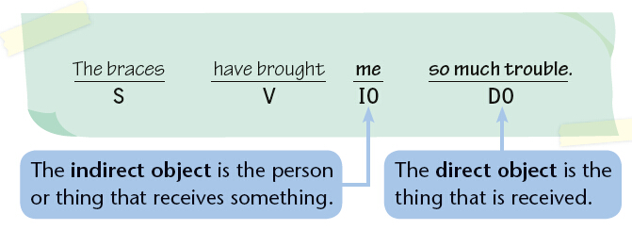
直接宾语(Direct Object)和间接宾语（Indirect Object）
Sentences with verbs such as give, bring, buy and send can have a direct object (DO) and an indirect object (IO).
部分及物动词bring, buy, cost, give, leave, lend, offer, pay, sell, send, show, teach, tell等后可接两个宾语。
被给、被送、被买等的东西称为直接宾语（direct object），接受东西的人称为间接宾语（indirect object）。
间接宾语表示动作是对谁或为谁做的，一般是人
直接宾语是谓语动词的承受者，一般是物

Slide 16
Things to remember
When the indirect object comes after the direct object, to or for is used.
The braces have brought so much trouble to me.
S V DO IO
当间接宾语位于直接宾语后时，需要加上to或for。
下列动词后用to：bring，feed，….?
give，hand，lend，offer，pass，pay，post，sell，send，show，take，teach，tell，write
下列动词后用for：book，buy，…?
choose，cook，fetch，leave，make，order，pick，reserve，save

Slide 17
Fill in the correct prepositions.
Give these papers ______ my secretary.
Could you make some coffee ______ me?
Book a flight ______ me, will you?
Can you post this cheque ______ the hotel?
Don’t show these plans ______ anyone.
Leave a message ______ my secretary.
Fetch the file ______ me, will you?
Write a memo ______ all the managers.
to
for
for
to
to
for
for
to

Slide 18
基本句型 三
Ｓ +Ｖ + IO + DO（主＋谓＋间宾＋直宾）
Ｓ | Ｖ（及物） | IO（多指人） | DO（多指物）
1. I 2. He | showed bought | him me | my pictures. a beautiful skirt.
此句型中的谓语动词必须有两个宾语才能表达完整的意思。这两个宾语一个是动作的直接承受者（多指物），另一个是动作的间接宾语（多指人）。
若要先说出直接宾语，后说间接宾语，则要借助与介词to 或for
He bought me a beautiful skirt.
He bought a beautiful skirt for me.

Slide 19
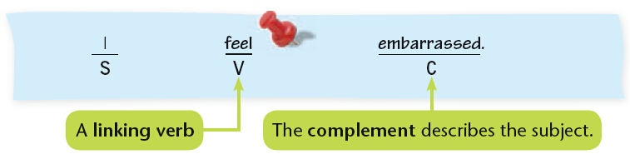
4 Some sentences have a linking verb followed by a complement (C).
连系动词后必须加上表明主语身份或状态的成分，才能表达完整的意思。
主语补足语（表语）
（补充说明主语）
连系动词
embarrassed在此句中即为主语补足语（Subject complement），又称为表语(Predicate)，这类成分常跟在系动词之后，用来描述主语的状态。

Slide 20
基本句型 四
Ｓ（主语） + Ｖ（系动词） + SO/Ｐ（主语补足语/表语）
He The dinner The weather | is smells became
tall and strong.
good.
warmer.
此句型中谓语动词为系动词，单独使用不能表达一个完整的意思，必须加上主语补足语（表语），才能表达完整的意思。

Slide 21
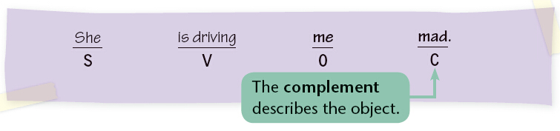
Some sentences have an object followed by a complement (C).
有些句子的宾语后必须加上补语才能表达完整的意思。
宾语补足语
（补充说明宾语）
此处的补语称为宾语补足语（Object Complement），跟在及物动词和宾语之后，用来进一步说明宾语。

Slide 22
基本句型 五
Ｓ +Ｖ +Ｏ +Ｃ（主＋谓＋宾＋宾补）
Ｓ | Ｖ（及物） | Ｏ（宾语） | OC（宾语补足语）
1. We 2. They 3. We 4. I | keep call asked saw | the table supper him them
clean.
dinner.
to come back
getting on the bus.
此句型中谓语动词除了跟一个宾语外，还需跟一个补充成分来不足宾语，才能使意思完整。

Slide 23
Things to remember
Verbs such as find, keep and make often use the above pattern.
find, keep和make常常使用S + V + SC（主语+连系动词+主语补足语），或S + V + O + OC（主语+谓语+宾语+宾语补足语）这两种形式。
He found the door unlocked.
He kept silent.
I try to keep the room tidy.
She makes me angry.

Slide 24
挑出下列句中的宾语补足语
1. His father named him Xiaoming.
2. They painted their boat white.
3. Let the fresh air in.
4. You mustn’t force him to lend his money to you.
5. We saw her entering the room.
6. We found everything in the lab in good order.
7. We will soon make our city what your city is now.
（名词）
（形容词）
（介词）
（不定式短语）
（现在分词）
（介词短语）
（从句）

Slide 25
注意：用 it 做形式宾语，而将真正的宾语放到
宾语补足语的后面，是英语常用句型。
I found it very pleasant to be with your family.
常用于此句型的动词有:
think, believe, consider, suppose, find, feel

Slide 26
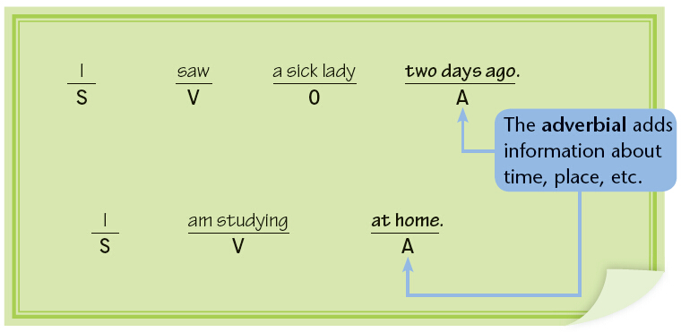
5.Adverbial（状语）
状语往往由副词、介词短语或名词短语等充当，表达时间、地点、原因、目的、方式等不同信息。

Slide 27
Read the sentences and underline the two adverbials in each sentence.
1. Prince Charles opened a new sports centre
in Stoke yesterday.
2. He also spoke with several young people.
3. The sports centre was first planned in 1994.
4. Naturally, the local council could not finance
the project without help.
5. Luckily, they managed to get money from the
National Lottery.

Slide 28
指出下列画线部分属于什么状语
1.How about meeting again at six?
2.Mr. Smith lives on the third floor.
3.Last night she didn’t go to the dance party because of the rain.
4. She put the eggs into the basket with great care.
时间状语
地点状语
原因状语
方式状语

Slide 29
5.She came in with a dictionary in her hand.
6.In order to catch up with the others, I must work harder.
7.To make his dream come true, Tom becomes very interested in business.
8.The boy needs a pen very much.
伴随状语
目的状语
目的状语
程度状语

Slide 30
9.He was so tired that he fell asleep immediately.
10. She works very hard though she is old.
11. I am taller than he is.
结果状语
让步状语
比较状语

Slide 31
Think and tell which sentence element the underlined part is.
We’re having a great time.
The weather is fine.
We really enjoy camping.
It’s great fun.
We saw many sheep on the farm.
We like this place.
Let’s make the world more beautiful.
O
S
V
C
A
O
C

Slide 32
Read the sentences and match them with the sentence structures.
a S + V
b S + V + O
c S + V + O + C
d S + V + A
That job drove me crazy.
I agree.
She will come at 10 p.m.
I had some meat.
c
a
d
b

Slide 33
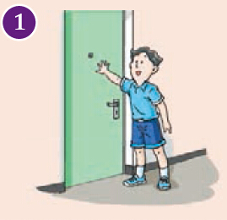
Grammar exercise
Look at the pictures below. Complete the sentences with the words in brackets. Add other words if necessary.
① Tom is a junior high school student.
(Tom, junior high school student, be) He __________________________________. (best friends, visit, every weekend) One of them is a boy called Alex.
visits his best friends every weekend

Slide 34
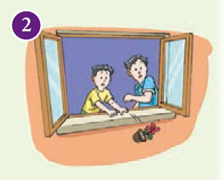
② Last weekend,_________________________
_____________________________________.
(Alex, some new books, showed, Tom, in his
flat) Suddenly Alex knocked a flowerpot out
of his window by accident. This
___________________.
(them, made, worried)
Alex showed some new books to Tom in his flat
made them worried

Slide 35
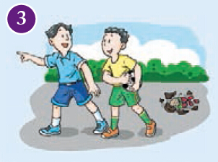
③ Luckily, no one was hurt by the flowerpot.
Then______________________________.
(for, went out, an hour, Alex and Tom)
Alex and Tom went out for an hour

Slide 36
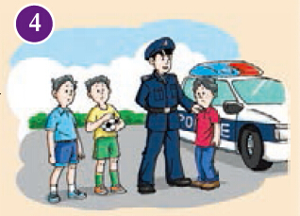
④Alex and Tom ______________________________________.
(later that afternoon, returned) They saw a
policeman questioning a boy about the broken
flowerpot. They ____________________(very bad, felt), but they did not know what to do.
returned later that afternoon
felt very bad

Slide 37
Exercises
一、指出下列句子中的划线部分是什么句子成分：
1. The students got on the school bus.
2. He handed me the newspaper.
3. I shall answer your question after class.
4. What a beautiful Chinese painting!
5. They went hunting together early in the morning.
S.
Attribute
O.
V.
Adverbial
Attribute
Adverbial

Slide 38
二、选择最佳答案填空
( ) 1. ____ will leave for Beijing.
A. Now there the man B. The man here now
C. The man who is here now
D. The man is here now
( ) 2. The weather ____.
A. wet and cold B. is wet and cold
C. not wet and cold D. were wet and cold
( ) 3. The apple tasted ____.
A. sweets B. sweetly
C. nicely D. sweet
C
B
D

Slide 39
( ) 4. He got up ____ yesterday morning.
A. lately B. late
C. latest D. latter
( ) 5. The actor ______at the age of 70.
A. dead B. died
C. dyed D. dying
( ) 6. ____ were all very tired, but none of
____ would stop to take a rest.
A. We, us B. Us, we
C. We, our D. We, we
B
B
A

Slide 40
( ) 7. He found the street much ______.
A. crowd B. crowding
C. crowded D. crowdedly
( ) 8.I think _____necessary to learn English
well.
A. its B. it
C. that D. that is
( ) 9. The dog ____ mad.
A. looks B. is looked
C. is being looked D. was looked
C
B
A

Slide 41
Thank you!

