Slide 1

突破语法1 动词的时态和语态
动词的时态和语态概述
动词的时态和语态详解
1.动词的时态
目录
2.动词的语态
突破积累练
Ⅰ单句语法填空
Ⅱ 单句改错
Ⅲ 单句写作

Slide 2
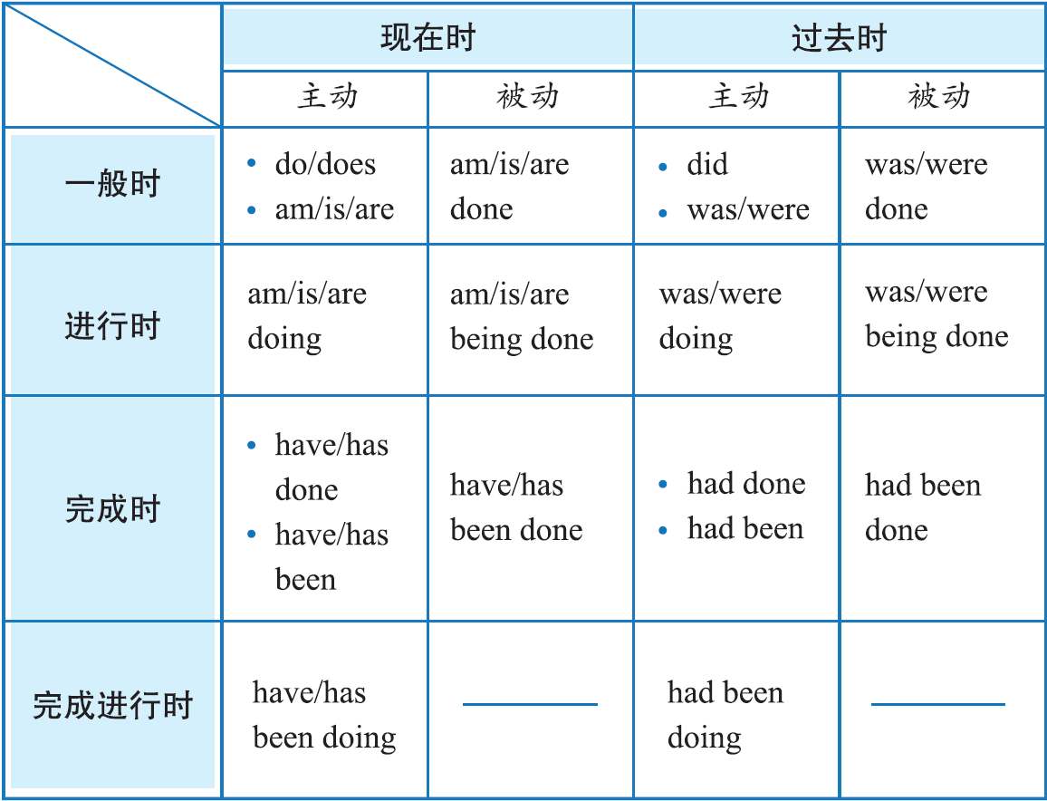
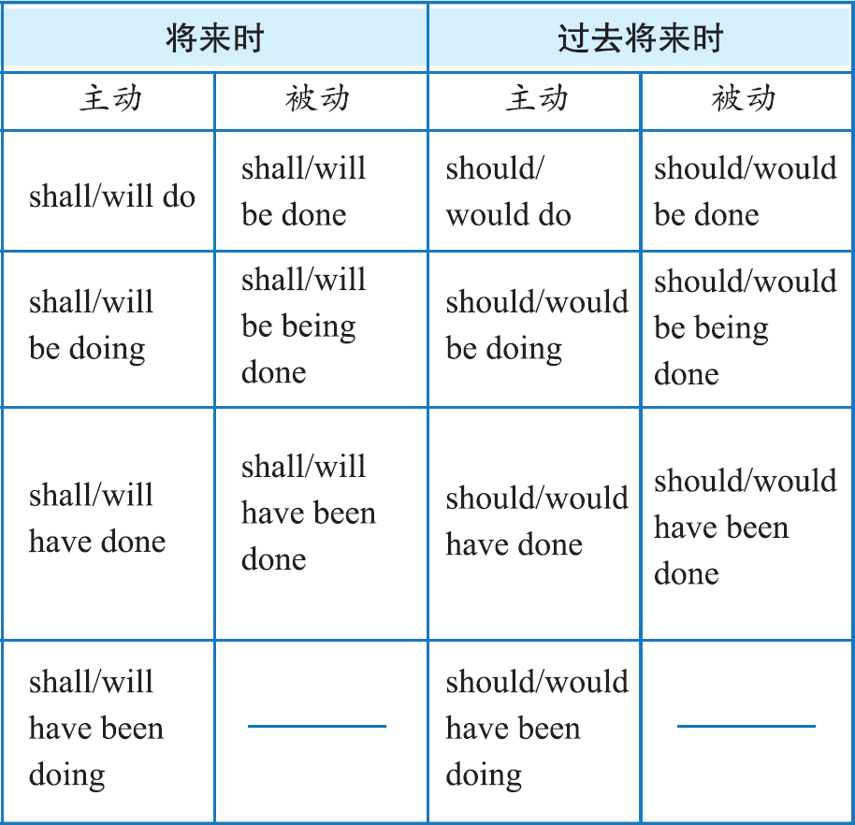

动
词
的
时
态
和
语
态
概
述
动词
突破语法1
P284

Slide 3

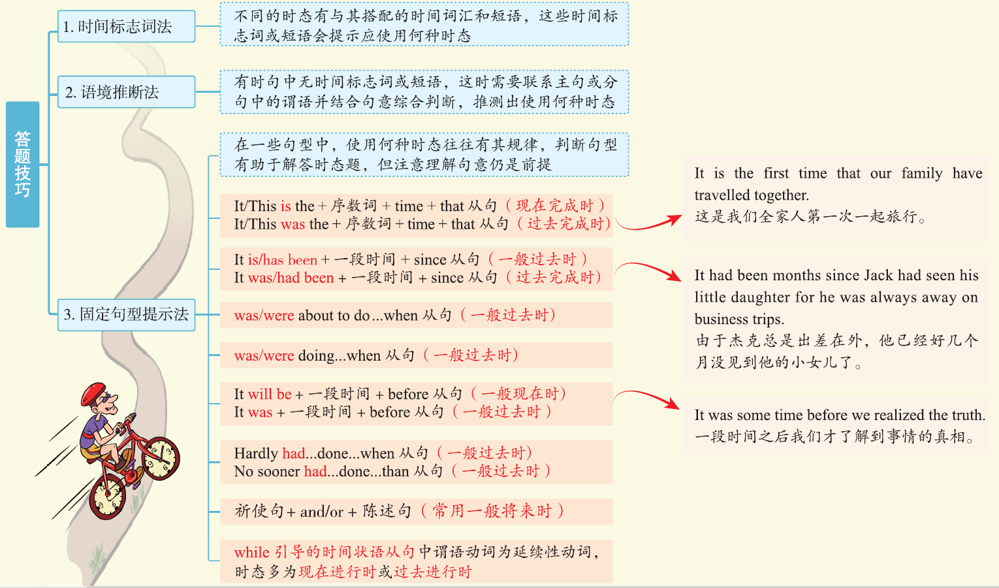
动词
突破语法1
P284

Slide 4
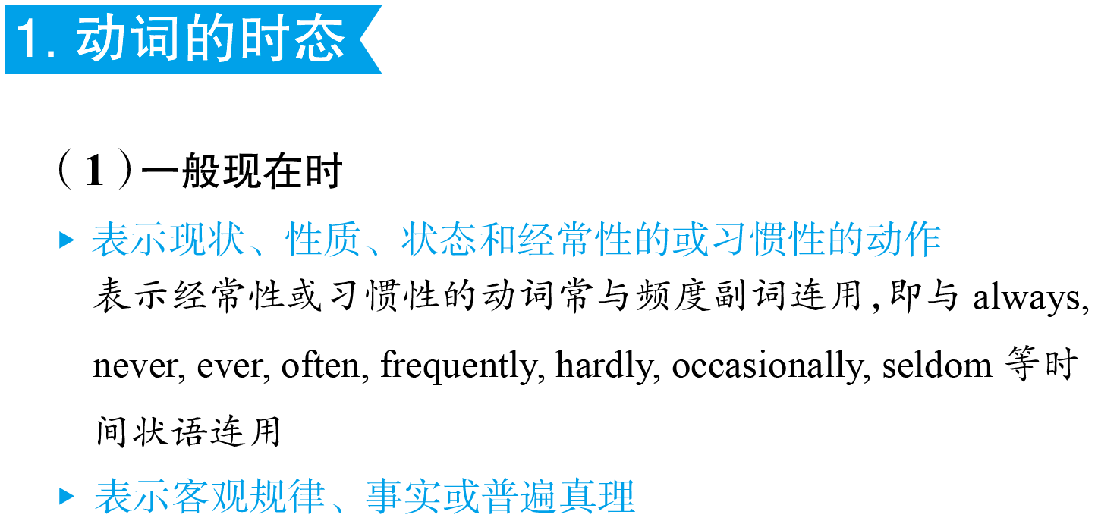
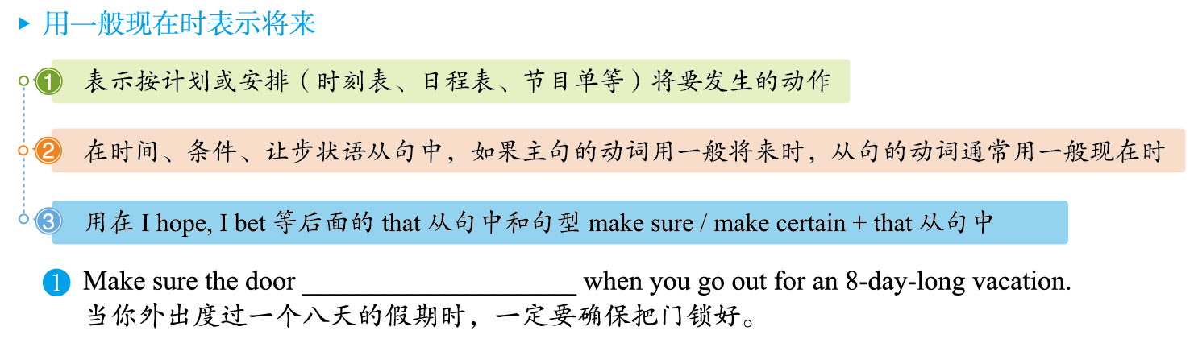
动
词
的
时
态
和
语
态
详
解
动词
突破语法1
P284
is locked

Slide 5
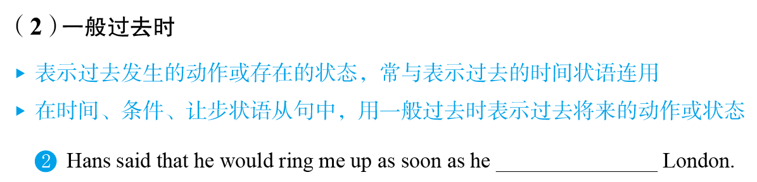

arrived in/reached/got to
动词
突破语法1
P285

Slide 6
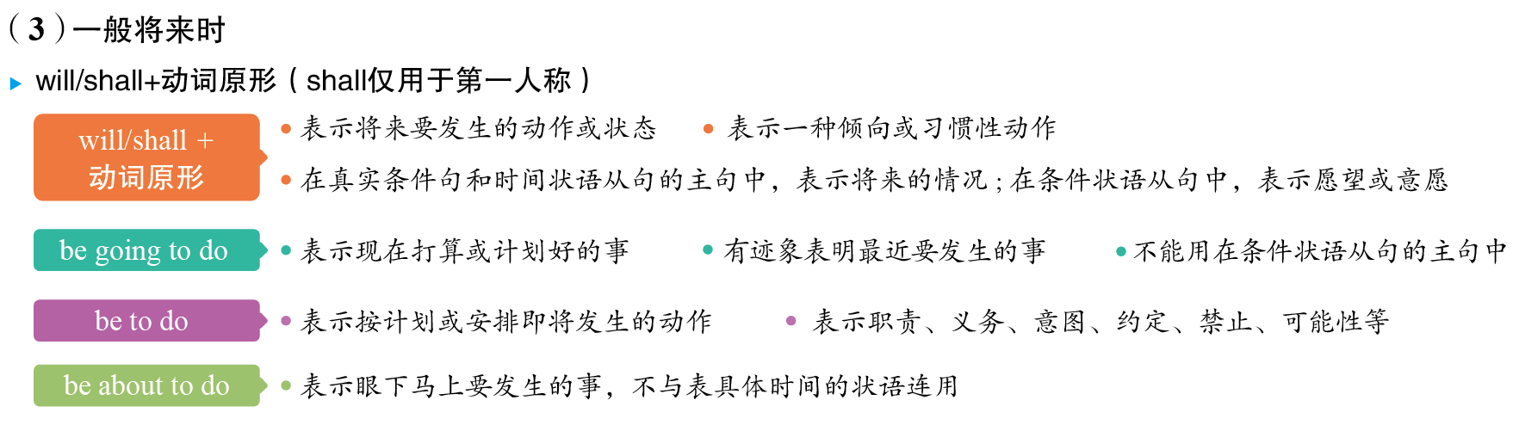
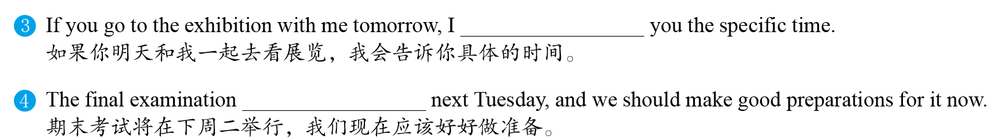
动词
突破语法1
P285
will tell
will be held/is going to be held/
is to be held

Slide 7
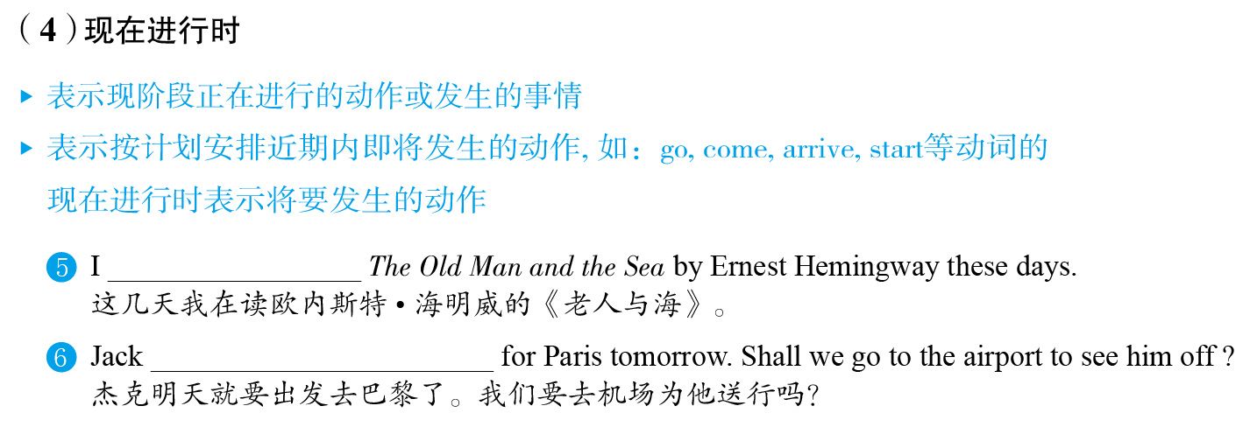
动词
突破语法1
P285
am reading
is leaving

Slide 8

小积累
动词
突破语法1
P285

Slide 9
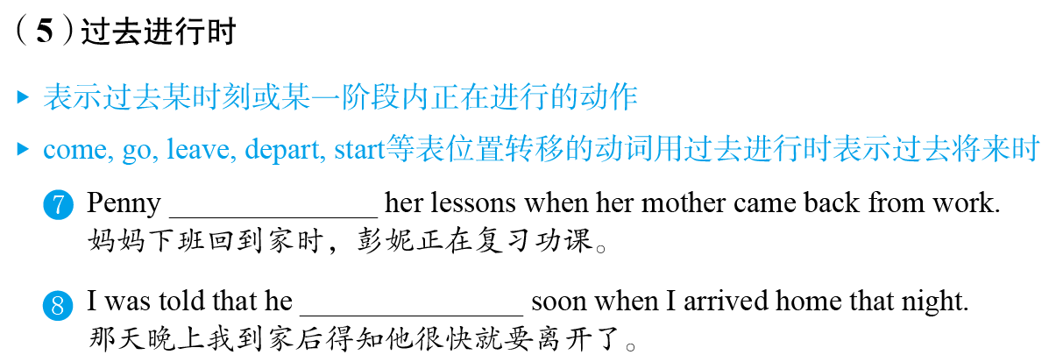
动词
突破语法1
P285
was reviewing/
going over
was leaving

Slide 10
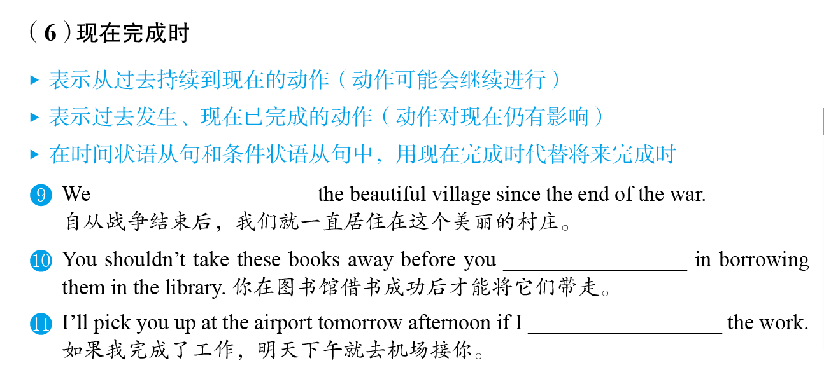
have lived in
动词
突破语法1
P285
have succeeded
have finished

Slide 11
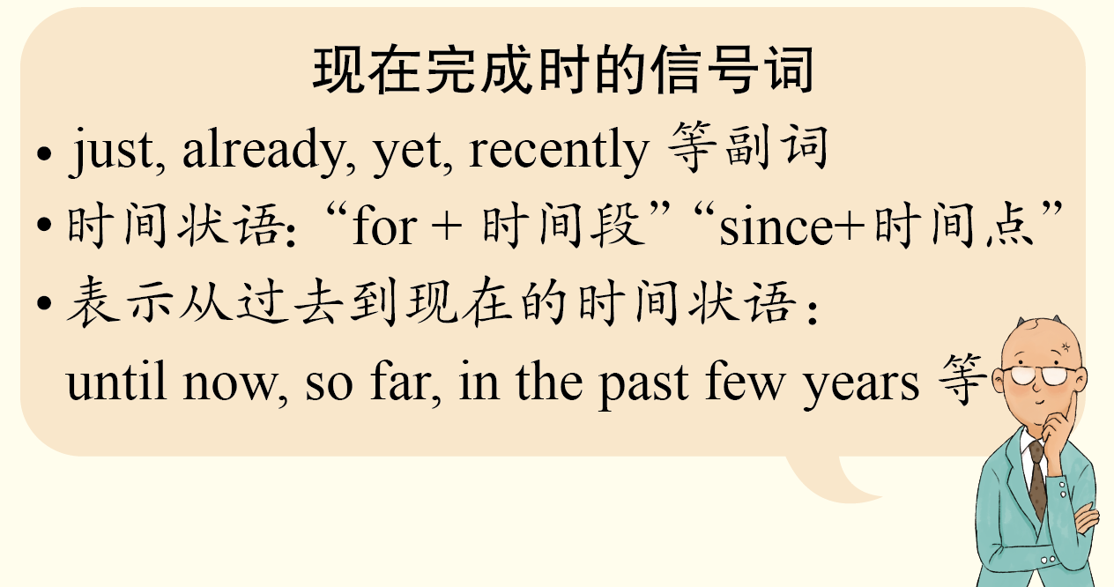
小提示
动词
突破语法1
P285

Slide 12
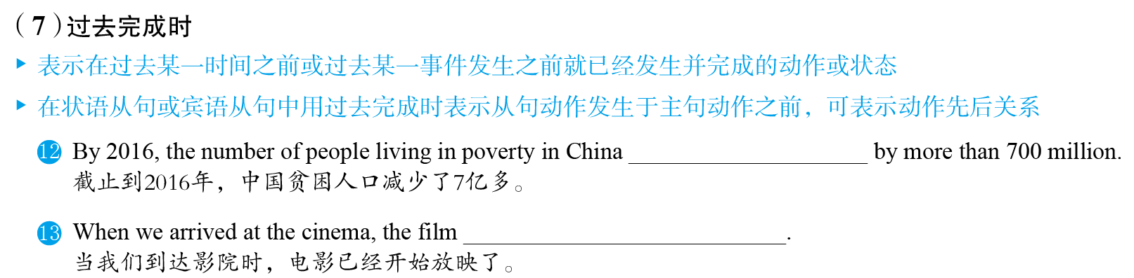
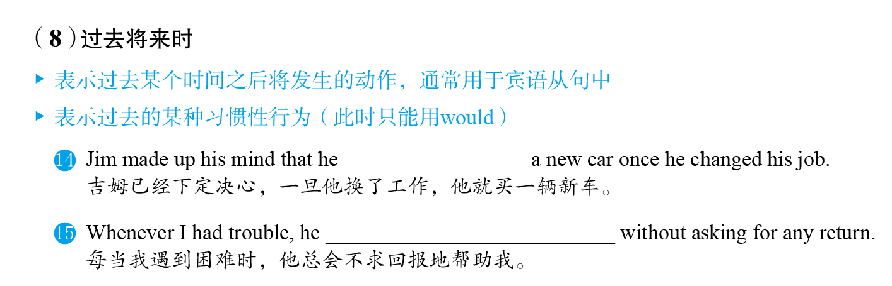
had decreased
had already begun
动词
突破语法1
P286
would buy
would help me

Slide 13
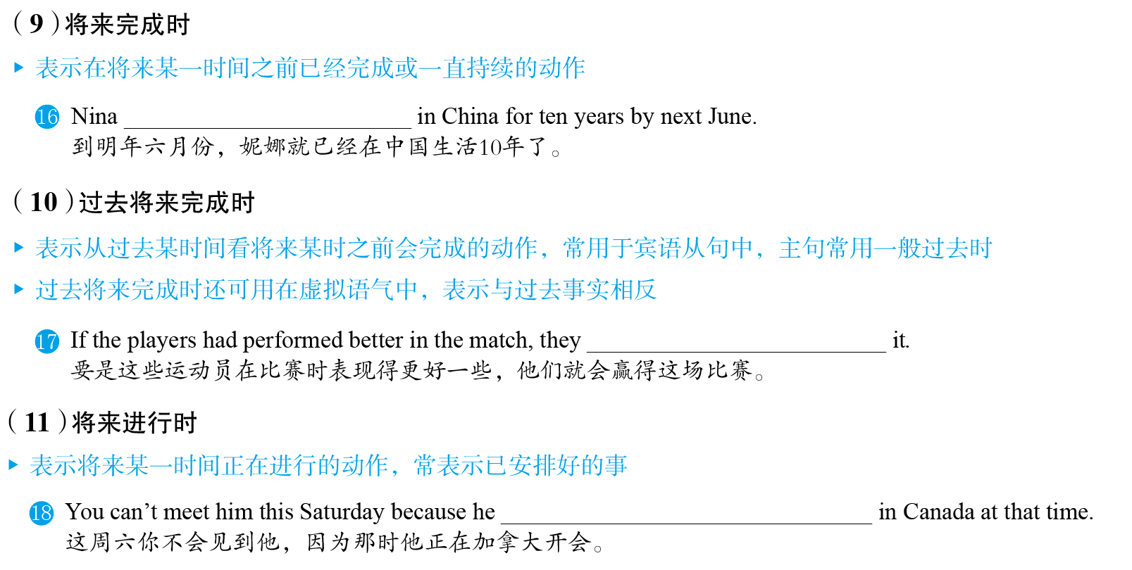
will have lived
动词
突破语法1
P286
would have won
will be having a meeting

Slide 14
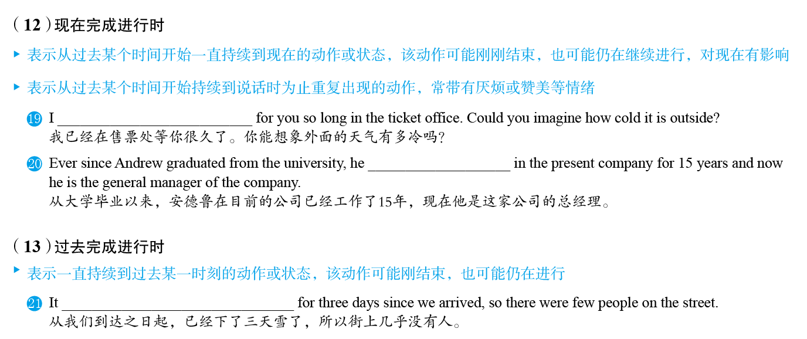
have been waiting
has been working
动词
突破语法1
P286
had been snowing

Slide 15
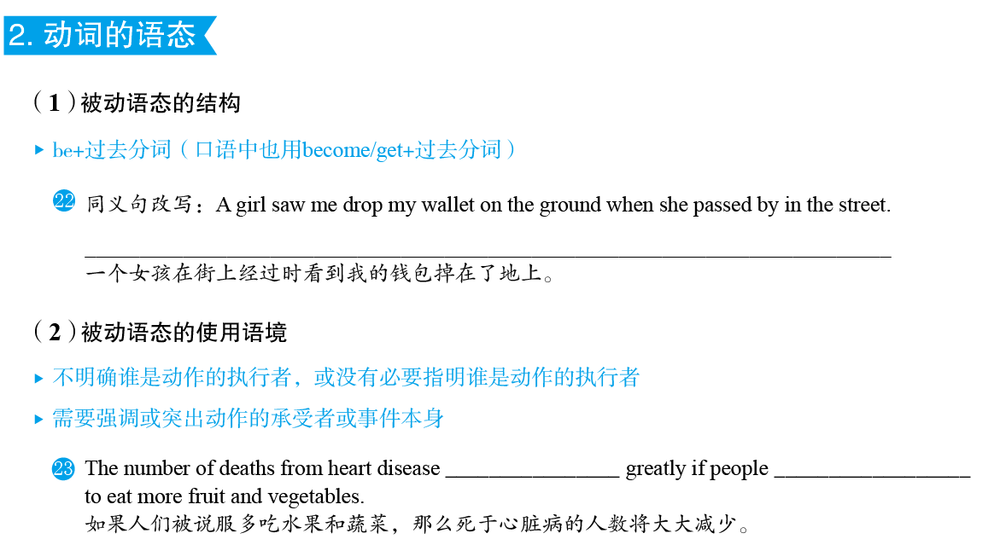
I was seen to drop my wallet on the ground by a girl when she passed by in the street.
动词
突破语法1
P286
My wallet was seen to drop on the ground by a girl when she passed by in the street.

Slide 16
动词
突破语法1
P286
will be reduced
are persuaded

Slide 17
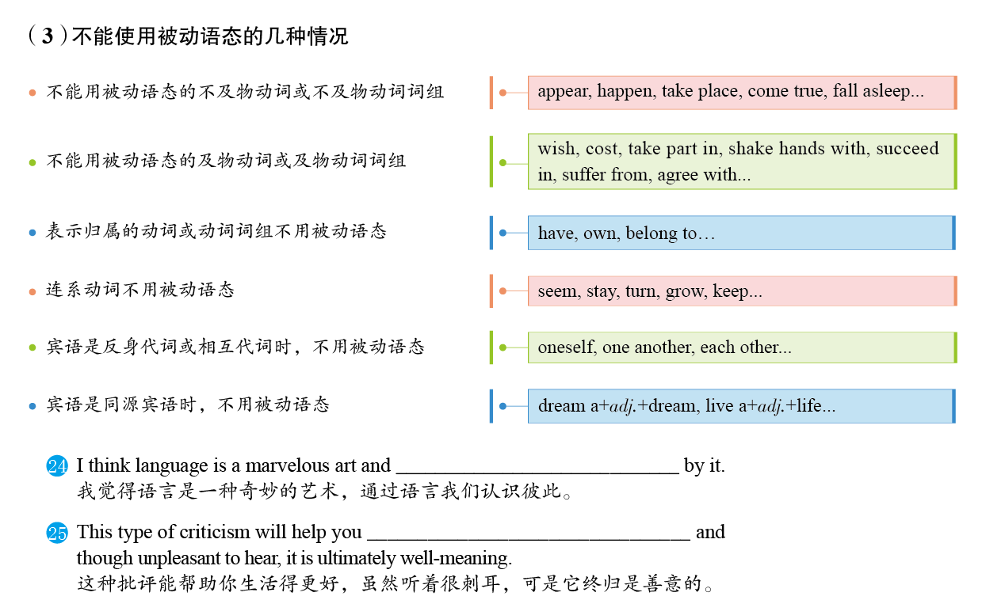
动词
突破语法1
P287
we know each other
live a better life

Slide 18
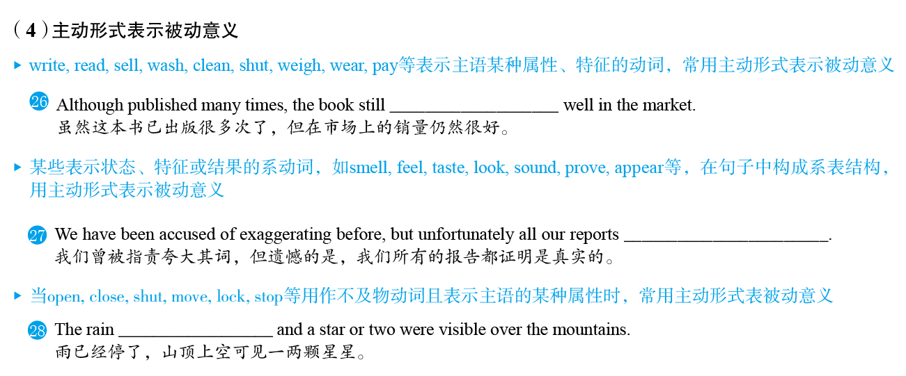
sells
proved (to be) true
动词
突破语法1
P287
had stopped

Slide 19
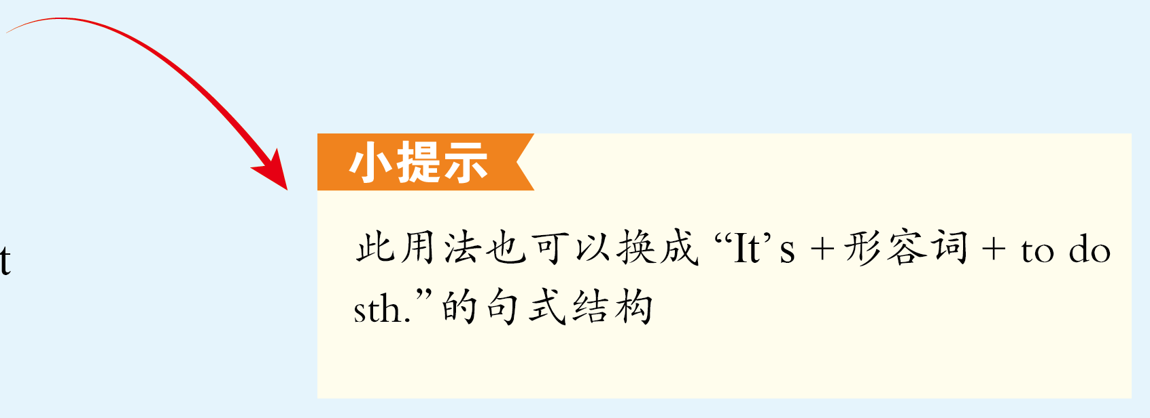
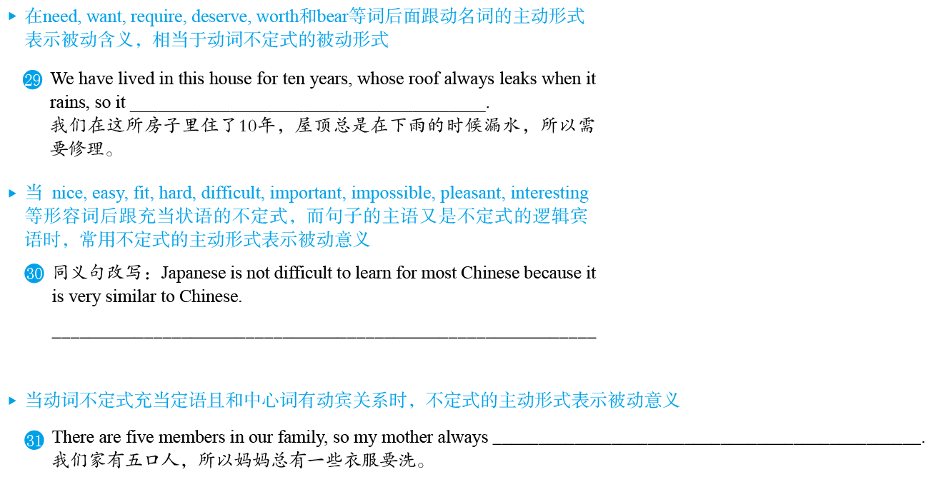
needs repairing/needs to be repaired
动词
突破语法1
P287
It is not difficult to learn Japanese for most Chinese because it is very similar to Chinese.
has some clothes to wash

Slide 20
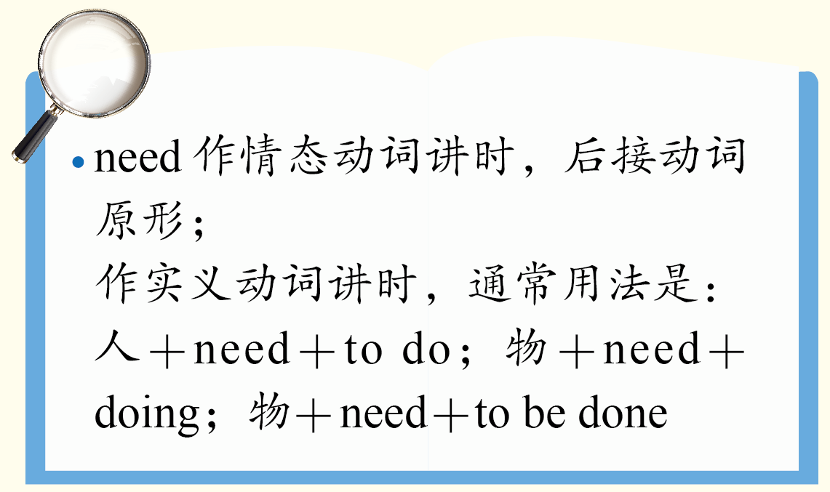
提分点
动词
突破语法1
P287

Slide 21
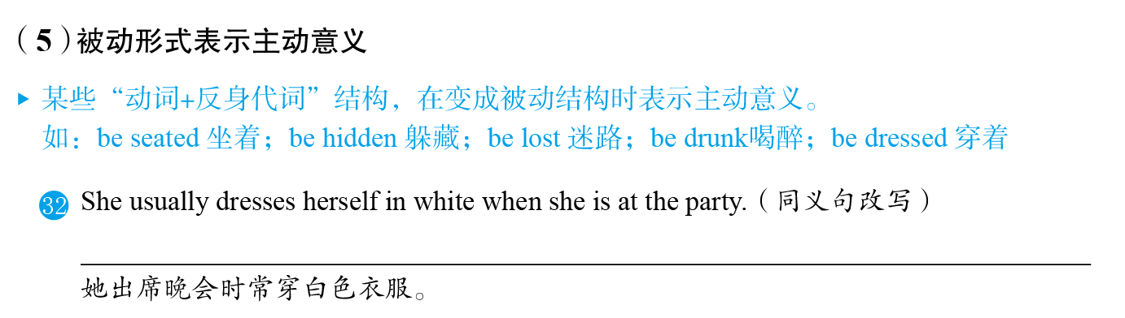
动词
突破语法1
P288
She is usually dressed in white when she is at the party.

Slide 22
Ⅰ 单项填空
突
破
积
累
练
I ________ down to London when I suddenly found that I was on the wrong road.
(2017•天津卷)
1.
A
A. was driving B. have driven
C. would drive D. drove
动词
突破语法1
突破积累练
P288
be doing…when…
正在做某事时，突然……
我正开车前往伦敦时，突然发现自己走错路了。

Slide 23
Ⅰ 单项填空
—Hi, I'm Peter. Are you new here？I haven't seen you around.
—Hello, Peter. I'm Bob. I just ________ on Monday.
(2018•北京卷)
2.
C
A．start B．have started
C．started D．had started
动词
突破语法1
突破积累练
P288
解析：
on Monday表示过去的具体时间，在句中作状语，句子的时态应用一般过去时，故选C项。句意：——嗨，我是彼得。你是新来的吗？我没有见过你。——你好，彼得，我是鲍勃。我周一才来。

Slide 24
Ⅰ 单项填空
3.
—Excuse me, which movie are you waiting for?
—The new Star Wars. We ________ here for more than two hours.
(2016•北京卷)
D
A．waited B．wait
C．would be waiting D．have been waiting
动词
突破语法1
突破积累练
P288
解析：*have been doing sth 一直在做某事
表示从过去开始一直持续到现在的动作，而且有可能还将持续下去，应用现在完成进行时。句意：——打扰了，你们在等着看哪部电影呢？——新版的《星球大战》。我们已经在这里等了两个多小时了。

Slide 25
Ⅰ 单项填空
4.
I ________ half of the English novel, and I'll try to finish it at the weekend.
(2016•北京卷)
B
A．read B．have read
C．am reading D．will read
动词
突破语法1
突破积累练
P288
解析：
根据句中的“…and I'll try to finish it at the weekend”可知，前半句表示“我已经读完了一半”，因此用现在完成时。句意：这本英文小说我已经读完一半了，这个周末我会尽量把它读完。

Slide 26
Ⅰ 单项填空
Hopefully in 2025 we will no longer be e­mailing each other, for we ________ more convenient electronic communication tools by then.
(2016•北京卷)
5.
C
A．have developed B．had developed
C．will have developed D．developed
动词
突破语法1
突破积累练
P288
解析：*by +将来时间点，用will have done sth
句尾的“by then”指的是by 2025，表示到将来某个时间为止所出现的情况，时态应用将来完成时，故选C项。句意：希望到2025年，我们将不再互相发电子邮件，因为届时我们已经研发出更方便的电子通信工具。

Slide 27
Ⅰ 单项填空
B
6.
More efforts, as reported, ___ in the years ahead to accelerate=speed up加速 the supply-­side structural reform.
A．are made B．will be made
C．are being made D．have been made
动词
突破语法1
突破积累练
P288
in the years ahead = in the next few years “今后几年”
*make an effort to do sth 努力去做某事
*is/are being done现在进行时的被动语态
句意：据报道，为加快供给侧结构性改革，在未来几年里人们将会付出更多的努力。

Slide 28
Ⅰ 单项填空
C
7.
My washing machine ____ this week, so I have to wash my clothes by hand. (2018•天津卷)
A．was repaired B．is repaired
C．is being repaired D．has been repaired
动词
突破语法1
突破积累练
P288
空格后面的时间状语“this week”常与现在进行时连用，表示这一阶段正在发生的事情；主句主语“my washing machine”与空格处谓语动词之间为被动关系，需用被动语态，故选C项。句意：我的洗衣机这周正在被修理，所以我不得不用手洗衣服。

Slide 29
Ⅰ 单项填空
8.
I know little about the accident because not much ________ about it up to now.
(2019•新编)
B
A．has said B．has been said
C．had said D．had been said
动词
突破语法1
突破积累练
P288
up to now= up till now = so far迄今为止：have/has done sth; sth have/has been done
现在完成时，much与say之间为被动关系，应使用现在完成时的被动语态，故选B项。句意：我对这起事故知之甚少，因为到目前为止，关于这件事的议论还不多。

Slide 30
Ⅰ 单项填空
9.
When walking down the street, I came across David, whom I ________ for years.
(2016•天津卷)
C
A．didn't see B．haven't seen
C．hadn't seen D．wouldn't see
动词
突破语法1
突破积累练
P288
解析：
came across =ran into = met with 偶遇
*had done sth“过去的过去”，过去完成时。
句意：沿街走路时，我偶然遇到了多年不见的大卫。

Slide 31
Ⅰ 单项填空
10.
In the 1950s in the USA, most families had just one phone at home, and wireless phones _____ yet.
D
A．haven't invented
B．haven't been invented
C．hadn't invented
D．hadn't been invented
动词
突破语法1
突破积累练
P288
*had been done 过去完成时的被动语态
wireless phones与选项中的invent为被动关系，谓语动词需用被动语态；又由yet可知，要用完成时，因此用过去完成时，故选D项。句意：在20世纪50年代的美国，大多数家庭只有一部电话，当时还没有发明无线电话。

Slide 32
Ⅰ 单项填空
D
11.
I'm sure you will do better in the test because you________ so hard this year.
(2019•新编)
A．studied B．had studied
C．will study D．have been studying
动词
突破语法1
突破积累练
P288
解析：
分析句意可知，主句表示“我确信你会考得很好”，空格所在句表示这个结果的原因。结合时间状语“this year”可知，空格处应使用现在完成进行时，表示动作从过去开始一直持续到现在，并且可能仍然进行下去，故选D项。句意：我确信你会考得更好，因为你今年一直都在刻苦学习。

Slide 33
Ⅰ 单项填空
12.
It is reported that fifty volunteers who are at least 18 years old chosen from all over the globe ________ to the Mars by the end of 2020.
(2019•新编)
A
A．will have been sent B．will have sent
C．will be sent D．will have been sending
动词
突破语法1
突破积累练
P288
解析：
分析句意并结合时间状语“by the end of 2020”可知，空格处应使用将来完成时，主语fifty volunteers 与谓语动词send之间是被动关系，应使用将来完成时的被动语态，故选A项。句意：据报道，从世界各地选出的18岁以上的50名志愿者将在2020年年底前被送往火星。

Slide 34
Ⅰ 单项填空
I'd hold on to that house for the time being; house prices ________ sharply at the moment. (2019•新编)
13.
D
A．rise B．have risen
C．will rise D．are rising
动词
突破语法1
突破积累练
P288
解析：
由时间状语“at the moment”可知，空格所在句表示“目前房价正在急剧上涨”，应用现在进行时，表示目前所处的状态。句意：我会暂时保留那所房子。目前房价正在急剧上涨。

Slide 35
Ⅰ 单项填空
Please put your laundry in the bag and we ________ someone to pick it up in a few minutes.
(2019•新编)
14.
A
A．will send B．have sent
C．sent D．send
动词
突破语法1
突破积累练
P288
解析：
分析句意并结合时间状语“in a few minutes”可知，第二个分句应使用一般将来时，表示“几分钟后我们会派人去取”，故选A项。句意：请把你待洗的衣服放在袋子里，几分钟后我们会派人去取。

Slide 36
Ⅰ 单项填空
Food supplies in the flood­-stricken area ________ soon.We must act immediately.
(2019•新编)
15.
B
A．have run out B．are running out
C．have been run out D．are being run out
动词
突破语法1
突破积累练
P288
解析：
run out是不及物动词短语，不能用于被动语态，排除CD两项；由句中的soon可知，run out是将要发生的动作，应用将来时。are running out是进行时表将来，故选B项。注意：如果主语是人，则用sb.run out of sth.。句意：供应给洪灾地区的食物不久就要用完了。我们必须立刻采取行动。

Slide 37
Ⅱ 单句语法填空
阅读下面句子，用所给词的适当形式填空。
Leonard was so tired because he _______________ (study) physics since five o'clock.
(2019•新编)
1.
had been studying
动词
突破语法1
突破积累练
P288
解析：
分析句子结构可知，主句使用一般过去时，空格处study这一动作应发生在was之前，故应使用过去完成进行时，表示这一动作从过去的过去发生，一直持续到过去，并且还有可能继续持续下去。句意：伦纳德太累了，因为他从五点开始就在学习物理。

Slide 38
Ⅱ 单句语法填空
2.
While regularly eating out seems to ___________(become) common for many young people in recent years, it's not without a cost.
(2018•浙江卷)
have become
动词
突破语法1
突破积累练
P288
解析：
根据时间状语“in recent years”可知，不定式描述的是从过去持续到现在的动作，因此不定式应用完成时态，故填have become。句意：近年来，经常外出就餐对许多年轻人来说似乎已经司空见惯，但这也不是没有代价的。

Slide 39
Ⅱ 单句语法填空
3.
The Chinese Ministry of Agriculture finds that between 2005—when the government __________(start) a soil­-testing program which gives specific fertilizer recommendations to farmers—and 2011, fertilizer use dropped by 7.7 million tons.
(2018•浙江卷)
started
动词
突破语法1
突破积累练
P289
解析：
提示词所在句描述的是2005年的情形，表示的是过去所发生的动作，因此应用一般过去时，故填started。句意：中国农业部发现，从2005年中国政府启动一项土壤测试项目、向农民提供具体的肥料建议开始，直到2011年，中国的化肥使用量减少了770万吨。

Slide 40
Ⅱ 单句语法填空
4.
They believed that by using computers their factory ____________ (become) flourishing.
(2019•新编)
would become
动词
突破语法1
突破积累练
P289
解析：
从believed可知主句为过去时，宾语从句相应地要用过去的某一时态。语境为将来之意，空格处应用过去将来时的主动语态。故填would become。句意：他们相信，通过使用电脑，他们厂将会变得欣欣向荣。

Slide 41
Ⅱ 单句语法填空
5.
Rainforests ___________ (cut) and burned at such high speed that they will disappear from the earth in the near future.
(2019•新编)
are being cut
动词
突破语法1
突破积累练
P289
解析：
主语Rainforests与所给提示动词之间为被动关系，谓语动词需用被动语态。由介词短语at such high speed可知，cut的动作正在发生，因此本句需用现在进行时。故答案为are being cut。句意：人们正在以如此快的速度砍伐和燃烧雨林，在不久的将来它们会从地球上消失。

Slide 42
Ⅲ 单句写作
根据所给提示完成句子。
1.
我们将更加关注那些生活处于混乱状态的留守儿童。(fix on)
(2019•新编)
More attention _____________ the stay­-at­-home children, whose lives seem to be in disorder.
will be fixed on
动词
突破语法1
突破积累练
P289
2.
那天晚上被要求加班，因此我错过了一部精彩的电影。(ask)
(2019•新编)
____________________________________________________， I missed a wonderful film.
Having/Because I had been asked to work overtime that evening

Slide 43
Ⅲ 单句写作
3.
在简到家之前她的父母将已飞往北京去参加一个会议了。(fly)
(2019•新编)
By the time Jane gets home, her parents ______________________．
will have flown to
Beijing to attend a meeting
动词
突破语法1
突破积累练
P289
4.
我正打算出去购物，这时莉莉突然前来造访。(shop)
(2019•新编)
I___________________________when Lily dropped in.
was about/going to go shopping

Slide 44
Ⅲ 单句写作
5.
在开车之前，你必须把车洗干净。(require; wash)
(2019•新编)
Before driving, ________________________________．
you are required to get your car washed
动词
突破语法1
突破积累练
P289
6.
战争结束后乔治回到家，结果被告知妻子已经离开了他。(tell)
(2019•新编)
George returned after the war, ________________________________.
only to be told that his wife had left him

Slide 45
Ⅲ 单句写作
7.
如今，骑行与慢跑、游泳一起被认为是最全面的运动形式之一。(regard)
(2017•天津卷改编)
Nowadays, cycling, along with jogging and swimming, ___________ one of the best all­-round forms of exercise.
is regarded as
动词
突破语法1
突破积累练
P289
8.
在过去的几年里，中国在环保方面取得了很大的成就。(achievement)
(2019•新编)
In the last few years, China
________.
has made great achievements in environmental
protection

Slide 46
Ⅲ 单句写作
9.
那时玛丽将身穿白色西装站在候车室，你可以很容易认出她。(wear)
(2019•新编)
Mary_______________________ standing in the waiting room then and you can recognize her easily.
will be wearing a white suit
动词
突破语法1
突破积累练
P289
10.
停下来休息一下吧。整个上午你一直在修理这辆汽车。(repair)
(2019•新编)
Please stop to have a rest.You_______________________the whole morning.
have been repairing the car

