Slide 1

突破语法2 定语从句
1.限制性定语从句与非限制性定语从句
2.关系代词
3.介词+关系代词
目录
4.关系副词
5.使用定语从句的主意事项
突破积累练
Ⅰ单项填空
Ⅱ 单句语法填空
Ⅲ 单句写作

Slide 2
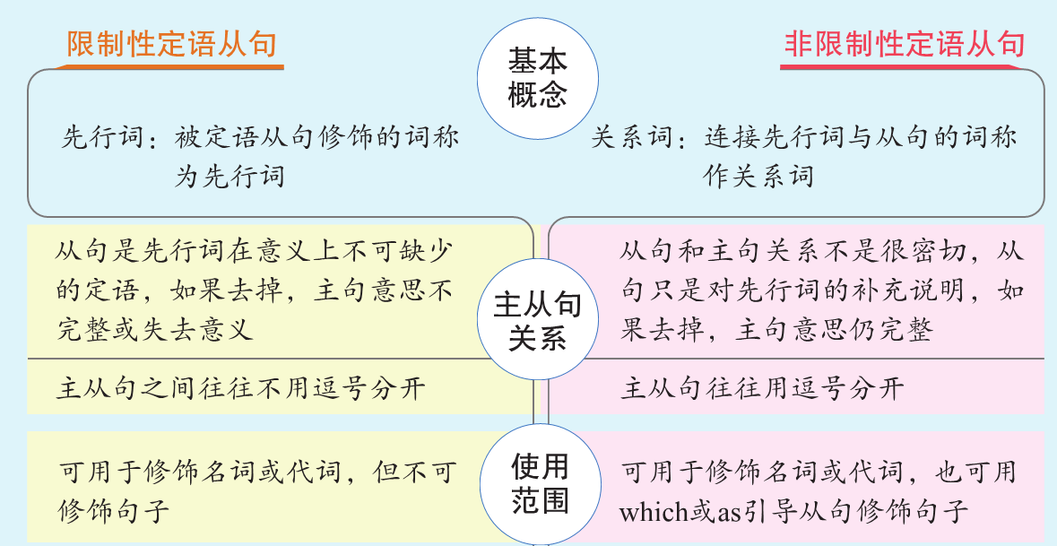

突破语法2 定语从句
P290

Slide 3
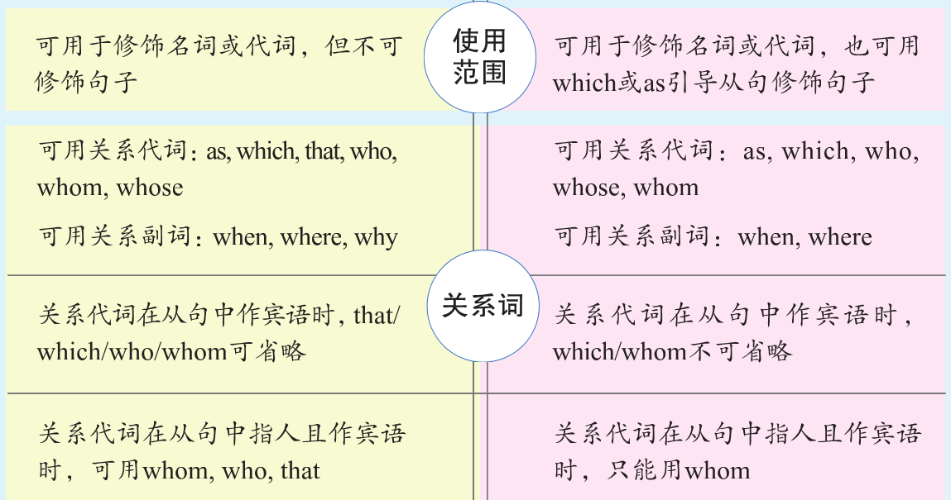
突破语法2 定语从句
P290

Slide 4
（1）I was the only person in my office _________________（被邀请
的人）.
（2）Football, _____________________（它非常有趣）, is played all
over the world.
that/who was invited
which is very interesting
突破语法2 定语从句
P290

Slide 5
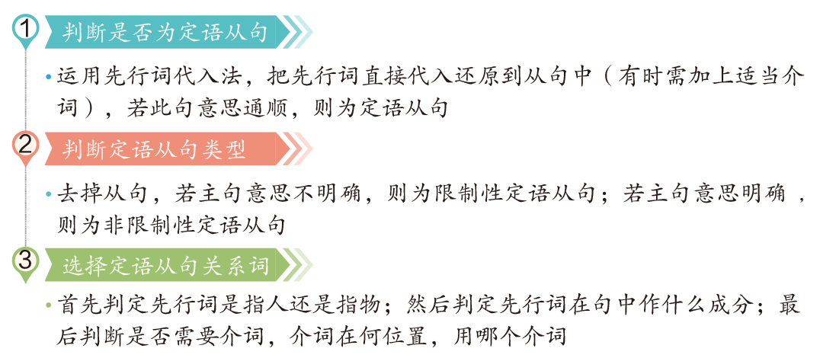
定语从句解题技巧
突破语法2 定语从句
P290

Slide 6

 | as | which | that | who | whom | whose
从句中可作成分 | 主语、宾语、表语 |  |  |  | 作宾语 | 作定语
 | 指代人/物 | 指代物 | 指代人/物 | 指代人 | 指代人 | 指代人/物
在限制性定语从句中的注意事项 | 先行词前有such, so, the same, as修饰时，从句都用as引导。但注意： such/so…that引导结果状语从句而非定语从句； the same…that表示同一个人或物，而the same…as表示同种类的事物 | ① 用which不用that的情况： 先行词本身是that或those时 关系词后有插入语时 ② 用that不用which的情况： 先行词是anything, nothing, all, none, much, little 等不定代词时 先行词前有序数词、形容词最高级或the only, the very等修饰时 先行词既有人又有物时 主句是以which开头的特殊疑问句时 ③ 用that不用who的情况： 主句是以who开头的特殊疑问句时 ④ 用who不用that的情况： there be句型中先行词指人时 先行词指人且是anyone, those, one, someone, everyone等词时 |  |  | 前面无介词且作宾语时，可用who和that替代 前面有介词构成“介词+关系代词”结构时，只能用whom | 相当于： of whom/ of which
突破语法2 定语从句
P290

Slide 7
 | as | which | that | who | whom | whose
从句中可作成分 | 主语、宾语、表语 |  |  |  | 作宾语 | 作定语
 | 多指代句子 | 词/短语/句子 | / | 指代人 | 指代人 | 指代人/物
在非限制性定语从句中的注意事项 | ① 从句位置：as引导的从句可以 放在句首、句中、句末，多用 于惯用语as we all know, as is well known, as we expected, as is mentioned above等；which只放 在被修饰的词、短语或句子之 后 ② 含义不同：as一般意为“正如； 正像”；which 意为“这一点，这件事” ③ 关系不同：主从句之间存在逻 辑上的因果关系时，关系词往 往只用which |  | that不能用于引导非限制性定语从句 | who引导的非限制性定语从句： This notebook was left by Tom, who was here a moment ago. whom引导的非限制性定语从句： Cathy, whom you met in London, is now back in China. whose引导的非限制性定语从句： The factory, whose workers are all women, is closed for part of the school holidays.
突破语法2 定语从句
P290

Slide 8
（3）The book __________ you are reading was bought by a friend of
mine.
（4）We were deeply impressed by the outstanding teachers
___________ we had visited there.
（5）Your mother is the only person ________ knows more about you
than you know about yourself.
（6）He talked about the factories and workers __________ he had
visited during the journey.
which/that
who/that/whom/不填
突破语法2 定语从句
P291
that/who
that/不填

Slide 9

（7）I wish to thank Miss Li, without _______ help I would never have
got this far.
A. Who B. whose C. which D. whom
（8）Because of my hard work, I got such a good grade _______ my
parents expected.
（9）_______ has been announced, we will have our final exams next
month.
A. As B. That C. What D. It
（10）Tom was late for school again and again, __________ made his
teacher very angry.
as
突破语法2 定语从句
P291
which

Slide 10




当关系代词在定语从句中作介词的宾语时，通常用“介词＋关系代词”引导定语从句：
关系代词用whom（指人），which（指物），whose（表所有格），不用who和that
关系代词不可省略
介词来源于定语从句中谓语动词或先行词习惯搭配的需要或是句意的需要
突破语法2 定语从句
P291

Slide 11
（11）Mark asked the policeman _______ he worked to contact him
whenever there was an accident.
A. with whom B. with him
C. who D. whom
（12）The company produces half a million pairs of glasses every year,
_______ are sold to Africa.
A. which most of B. most of whom
C. most of that D. most of which
突破语法2 定语从句
P291

Slide 12
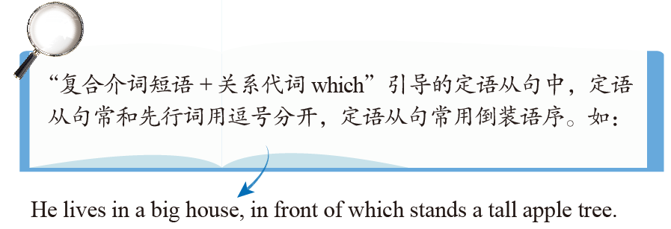
体现整体与部分关系时，常用介词of，常见表达有：some/none/neither/several/a few/a little/many/most of + whom/which
突破语法2 定语从句
P291

Slide 13


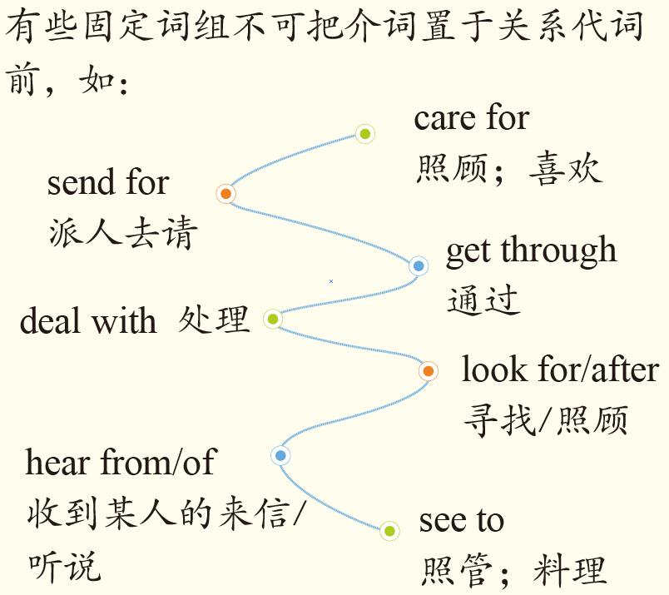
(whom/who/that) my mother is looking after
（13）The old woman ___________________________________（我
的妈妈正在照顾的）in the house is my grandmother.
突破语法2 定语从句
P291

Slide 14

why的用法
why（=for which）指代原因（reason），在从句中作原因状语
why不可引导非限制性定语从句
（14）The reason __________ I don’t trust her is that she often tells
lies.
when的用法
when（=介词on/in/at/during+which）指代时间，在从句中作时间状语
（15）We are living in an age _________ many things are done on
smartphones.
why/for which
突破语法2 定语从句
P291
when/in which

Slide 15
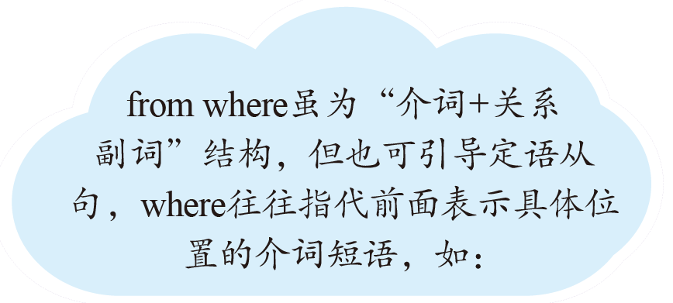


where的用法
where（=in/on/at/to which）指代具体地点、抽象地点（condition, point, position, activity, case, situation, atmosphere等），在从句中作地点状语
突破语法2 定语从句
P291
Wesley stood on top of the mountain, from where he could see the whole city.（where指代 on top of the mountain，指的是山顶的位置，而不是指“山”）

Slide 16
（16）If the shopping mall has a chair _______ women can park their
men, women will spend more time there.
A. which B. when C. where D. that
（17）There are a number of cases _______ English beginners fail to
use the language properly.
A. which B. as C. why D. where
（18）Beijing, ___________________________, is a big city with a
long history.
中国的首都北京是一个有着悠久历史的大城市。
which is the capital city of China
突破语法2 定语从句
P291
当表示地点、时间或原因的名词在定语从句中作主语、宾语或表语时，用关系代词that/which引导。

Slide 17

way作先行词
①从句中缺少主语、宾语时，用that/which，作宾语时可省略关系词
（19）The way _________ she explained to us was quite difficult.
②从句中缺少方式状语，用in which/that或省略关系词
（20）The lazy boy is expecting a way he can get
through the exams without hard work.
that/which/不填
突破语法2 定语从句
P292
in which/that/不填

Slide 18
time作先行词
①表示“时间”，定语从句用when或at/during which引导
（21）I’ll never forget the time we studied together.
②表示“次数”，定语从句用that引导，that可以省略
（22）This is the third time the president has visited the
country.
定语从句中的主谓一致
当引导定语从句的关系代词在从句中作主语时，定语从句的谓语动词在人称、数的方面应与先行词保持一致
（23）I don’t think he is the right person, who __________ (be) not
only not qualified for this job but also lacks enthusiasm.
when/during which
that/不填
突破语法2 定语从句
P292
is

Slide 19
（24）Pride and Prejudice is one of the books in my bookcase which
__________ (be) read more than three times.
（25）Jack is the only one of the students who __________ (come)
from abroad in my class.
have been
comes
突破语法2 定语从句
P292
先行词若是“one of the+复数名词（短语）”的形式，谓语动词通常用复数；若是“the only/very one of the+复数名词（短语）”，谓语动词通常用单数。

Slide 20
定语从句的分隔现象
有时由于修辞或表达次序的需要，定语从句和它所修饰的先行词被谓语、状语、插入语等成分隔开，此时只有分清句子成分，找准先行词，才能准确理解句意
（26）The days are gone _________ physical strength was all you needed to make a living.
when
突破语法2 定语从句
P292

Slide 21
区分定语从句和同位语从句
①从词类上区分
同位语从句前面的名词只能是belief, doubt, explanation, hope, idea等有一定内容的抽象名词；而定语从句的先行词可以是名词、代词、主句的一部分或整个主句。
突破语法2 定语从句
P292
The doctor whom you are looking for is in the room.
你找的那位医生在这个房间里。（定语从句）
The interviewer asked me a question whether I dared to say “no” to the boss if I had a different opinion.
面试官问了我一个问题：如果我有不同的观点，是否敢对老板说“不”。（同位语从句）

Slide 22
②从性质上区分
同位语从句是对前面抽象名词的进一步解释和说明，属于名词性从句；定语从句是对其先行词进行修饰或限制，属于形容词性从句。
The news that our team has won the game is true. 我们队赢了比赛的消息是真的。（同位语从句，对news的具体内容进行说明）
The news that he told me yesterday is true. 他昨天告诉我的那个消息是真的。（定语从句，对news进行修饰）
突破语法2 定语从句
P292

Slide 23

③从引导词上区分
有些引导词如how, whether, what可以引导同位语从句，但不能引导定语从句。
I have no idea what has happened to him. 我不知道他发生了什么事。（同位语从句）
突破语法2 定语从句
P292

Slide 24

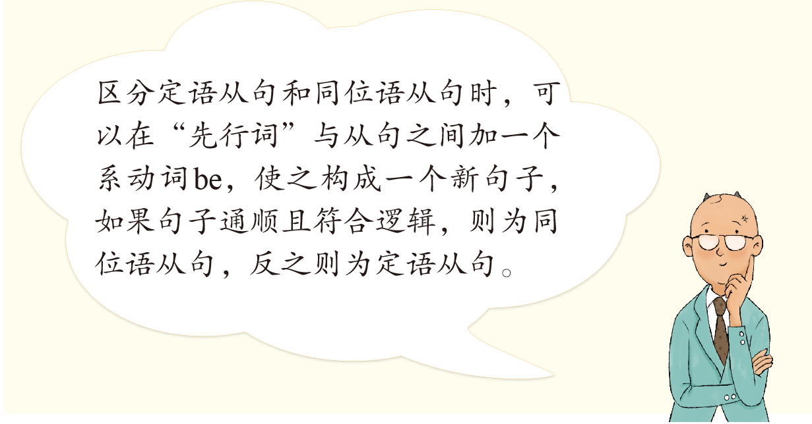
突破语法2 定语从句
P292

Slide 25
（27）（改错）The inner thoughts of the two young persons are revealed in
the book, what both of them fail to express.
（28）（选择正确的引导词）He grabbed his suitcase and gave the
impression ___________ (that/which) he was boarding the Tokyo plane.
将what改为which
that
突破语法2 定语从句
P292

Slide 26
突
破
积
累
练
定语从句
Ⅰ 单项填空(共10小题；每小题1分，满分10分)
从每题所给的A、B、C、D四个选项中，选出可以填入空白处的最佳选项。
1. The little problems ________ we meet in our daily lives may be
inspirations for great inventions. (2017·北京卷)
A.that B.as C.where D.when
突破语法2 定语从句
P293
解析：
分析句子结构可知，“________ we meet in our daily lives”为定语从句，修饰先行词problems，且关系词在从句中作meet的宾语，指物，故用that。句意：我们在日常生活中遇到的小问题可能就是伟大发明的灵感来源。

Slide 27
2. In 1963 the UN set up the World Food Programme, one of ________
purposes is to relieve worldwide starvation.(2017·江苏卷)
A.which B.its C.whose D.whom
解析：
分析句子结构可知，空格处所填词引导非限制性定语从句，the World Food Programme为先行词，句子还原后的表达是one of its purposes is to relieve worldwide starvation，此处把作定语的形容词性物主代词its改为whose，引导定语从句并在从句中作定语，表示“其目的之一是……”，故应选whose。句意：联合国在1963年成立了世界粮食计划署，其目的之一是减轻世界各地的饥饿问题。
突破语法2 定语从句
P293

Slide 28
3. The boss of the company is trying to create an easy atmosphere
________ his employees enjoy their work. (2015·天津卷)
A.where B.which C.when D.who
解析：
分析句子结构可知，“________ his employees enjoy their work”为定语从句，修饰先行词atmosphere，且先行词在从句中作地点状语。此句中的atmosphere表示抽象地点名词，应用关系副词where引导从句，故选A项。句意：这家公司的老板正努力营造一种轻松的氛围，员工可以在这种氛围中享受他们的工作。
突破语法2 定语从句
P293

Slide 29
4. As the smallest child of his family, Alex is always longing for the time
________ he should be able to be independent. (经典题)
A.whic B.where C.whom D.when
解析：
分析句子结构可知，“________ he should be able to be independent”为定语从句，修饰先行词the time，且定语从句中缺少时间状语，应用关系副词when引导，故选D项。句意：作为家里最小的孩子，亚历克斯总是渴望能够独立的那一天。
突破语法2 定语从句
P293

Slide 30
5. I live next door to a couple ________ children often make a lot of
noise. (2016·北京卷)
A.whose B.why C.where D.which
解析：
分析句子结构可知，“________ children often make a lot of noise”为定语从句，a couple为先行词，children与a couple为所属关系，表示“他们的孩子”，应用whose引导该定语从句，故选A项。句意：我的隔壁住着一对夫妇，他们的孩子经常制造出很多噪音。
突破语法2 定语从句
P293

Slide 31
6. Some experts think reading is the fundamental skill upon ________
school education depends. (经典题)
A.it B.that C.whose D.which
解析：
介词upon被提到了定语从句的引导词之前，引导词在定语从句中作宾语；介词被提前，定语从句的引导词一般只能用which或whom，此句中先行词skill指物，故用which。句意：一些专家认为，阅读是学校教育所依赖的基本技能。
突破语法2 定语从句
P293

Slide 32
7. The number of smokers, ________ is reported, has dropped by 17
percent in just one year. (2015·江苏卷)
A.it B.which C.what D.as
解析：
此处关系代词指代主句“The number of smokers has dropped by 17 percent in just one year.”， as和which在非限制性定语从句中都可以指代句子，但as有“正如；正像”之意，而which没有。还可以利用as is reported这一常用结构解题，故选D项。句意：据报道，烟民的数量仅在一年内就下降了17%。
突破语法2 定语从句
P293

Slide 33
8. Self­driving is an area ________ China and the rest of the world are on
the same starting line. (2018·江苏卷)
A.that B.where C.which D.when
解析：
分析句子结构可知，空格所在句是定语从句，先行词是an area，定语从句中不缺少句子成分，因此不能用关系代词that或which，排除A项和C项；分析语境可知，“an area”是“China and the rest of the world”所处的领域，先行词为定语从句的逻辑地点状语，因此应用关系副词where引导定语从句，故选B项。句意：在自动驾驶领域，中国和世界其他国家都处于同一起跑线。
突破语法2 定语从句
P293

Slide 34
9. Opposite is St.Paul's Church, ________ you can hear some lovely
music. (2015·北京卷)
A.which B.that C.when D.where
解析：
分析句子结构可知，“________ you can hear some lovely music”为定语从句，先行词为St.Paul's Church，且先行词在从句中作地点状语，应用关系副词where，故选D项。句意：对面是圣保罗教堂，在那里你能听到一些美妙的音乐。
突破语法2 定语从句
P293

Slide 35
10.Kate, ________ sister I shared a room with when we were at college,
has gone to work in Australia. (2018·天津卷)
A.whom B.that C.whose D.her
解析：
分析句子结构可知，空格所在句为非限制性定语从句，修饰先行词Kate；关系词在从句中需作定语修饰sister，whose符合句意，故选C项。句意：凯特是我大学时室友的妹妹，她已经去澳大利亚工作了。
突破语法2 定语从句
P293

Slide 36
Ⅱ 单句语法填空(共5小题；每小题1.5分，满分7.5分)
阅读下面句子，在空白处填入适当的关系词。
1. Stephen Hawking believes that the earth is unlikely to be the only
planet ________ life has developed. (2019·新编)
where
解析：
分析句子结构可知，“________ life has developed”为定语从句，修饰先行词the only planet，空格处所填词引导从句，替代先行词并在从句中作地点状语，故用关系副词where。句意：史蒂芬·霍金认为，地球不可能是唯一一个演化出生命的行星。
突破语法2 定语从句
P293

Slide 37
who
2. Sarah, ________ has taken part in shows along with top models, wants
to prove that she has brains as well as beauty. (2017·全国Ⅲ卷)
解析：
分析句子结构可知，空格处所填词引导非限制性定语从句，指代先行词Sarah并在从句中作主语，且指人，故填who。句意：与超级模特一起参加过演出的莎拉想要证明她是智慧与美貌并存的。
突破语法2 定语从句
P293

Slide 38
when
3. The film brought the hours back to me ________ I was taken good
care of in that faraway village. (2019·新编)
解析：
分析句子结构可知，“________ I was taken good care of in that faraway village”为定语从句，修饰先行词the hours，且先行词在从句中作时间状语，故应用when引导。句意：这部电影让我回想起当年在那个边远山村被精心照顾的时光。
突破语法2 定语从句
P293

Slide 39
4. The experiment turned out to be a great success, ________ we hadn't
expected at all. (2019·新编)
which
解析：
分析句子结构可知，空格处所填词引导非限制性定语从句，指代前面整个句子“The experiment turned out to be a great success”，且引导词在从句中作宾语，指事物，故填关系代词which。句意：试验结果是非常成功的，这是我们之前根本没有想到的。
突破语法2 定语从句
P293

Slide 40
5. She showed the visitors around the museum, the construction of
________ had taken more than five years. (2019·新编)
which
解析：
分析句子结构可知，“the construction of______ had taken more than five years”为定语从句，修饰先行词the museum，the construction与the museum之间是所属关系，故需用“介词of＋关系代词”来引导，而先行词the museum为物，故填which。
突破语法2 定语从句
P293

Slide 41
Ⅲ 单句写作(共10小题；每小题2分，满分20分)
根据所给提示完成句子。
1. 桌上的书是给我们的奖励，那些书的封面闪闪发。(whose)
(2015·四川卷改编)
The books on the desk，____________________，are prizes for us.
2. 他们班总共有54名学生，其中有一半学生戴眼镜。(whom)
(2019·新编)
In their class there are altogether 54 students, .
3. 你知道他昨天没参加会议的原因吗？ (why/for which) (2019·新编)
Do you know
whose covers are shiny
突破语法2 定语从句
P293
half of whom wear glasses
the reason why/for which he didn't attend the meeting
yesterday
.

Slide 42
4. 您能给我推荐一个在城镇中心的旅馆吗？ (that/which)
(2019·新编)
Could you recommend me a hotel ?
5. 约翰带着这些游客参观了那所三年前建造的学校。 (that/which)
(2019·新编)
John showed the visitors around the school .
6. 我与好几位去年在英语演讲比赛中结识的同学成了好朋友。
(who/whom/that) (2019·新编)
I've become good friends with several students
that/which is/lies in the centre of the town
突破语法2 定语从句
P293
that/which had been
constructed three yearsbefore
.
(who/whom/that) I met
in the English speech contest last year
.

Slide 43
7. 我们大家都知道，书籍是知识的源泉，通过读书能受益良多。 (as)
(2019·新编)
, books are the source of knowledge
and we can benefit a great deal from reading.
8. 你读这本书时，在你有疑问的地方做个标记。 (where)
(2019·新编)
When you read the book, make a mark at the place
As we all know/As is known to us all
突破语法2 定语从句
P293
.
where you have
any question
.

Slide 44
9. 我们生活在一个比以前更容易获得信息的时代。 (which)
(2019·新编)
We live in an age ___________________________________ than ever
before.
10. 她是能胜任这项工作的员工之一。 (who)
(2019·新编)
She is one of the employees__________________________.
in which the information is easier to get
突破语法2 定语从句
P293
who are qualified for the job

