Slide 1

突破语法4 状语从句
状语从句
1.时间状语从句
2.地点状语从句
3.原因状语从句
4.目的状语从句
5.结果状语从句
6.条件状语从句
目录
7.让步状语从句
8.比较状语从句
9.方式状语从句
突破积累练
Ⅰ单项填空
Ⅱ 单句语法填空
Ⅲ 单句写作

Slide 2

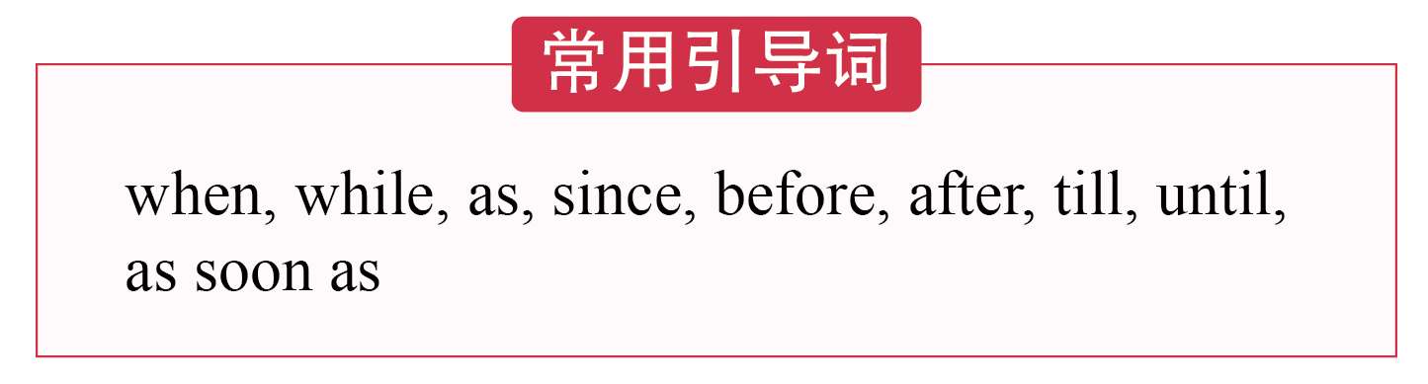
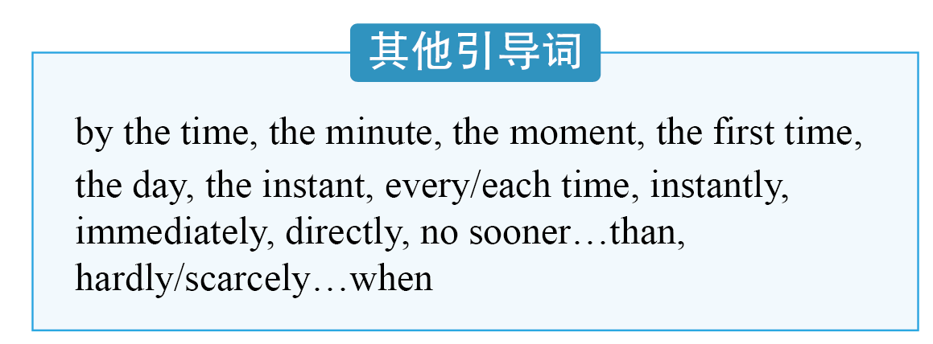

突破语法4 状语从句
突破语法4 状语从句
P298

Slide 3
突破语法4 状语从句
区别 | when | while | as
从句中谓语动词的延续性 | when, as引导的从句中，谓语动词既可以是延续性的，也可以是瞬时性的；while引导的从句中，谓语动词必须是延续性的。 如果主句表示的是短暂动作，而从句用延续性动词的进行时态时，when, while和as可互换。主从句主语一致且从句谓语中含有be动词时，可将时间状语从句中的主语和be动词省略。
突破语法4 状语从句
P298

Slide 4
突破语法4 状语从句
区别 | when | while | as
其他差异性 | when还有“这时，那时”之意，常用于以下句式： sb. be doing sth. when... 某人正在做某事，就在这时…… sb. be about to do sth. when… 某人正打算做某事，就在这时…… | while还可以作并列连词，意为“然而，却”，表示对比。如： He likes coffee, while she likes tea. 他喜欢喝咖啡，而 她却喜欢喝茶。 | as多用于主从句动作同时发生的情况，常意为“一边……一边……”
突破语法4 状语从句
P298
1
When/While/As I was sleeping
___________________________, my parents went out to buy books for me.
在我睡觉的时候，我的父母出去给我买书了。

Slide 5
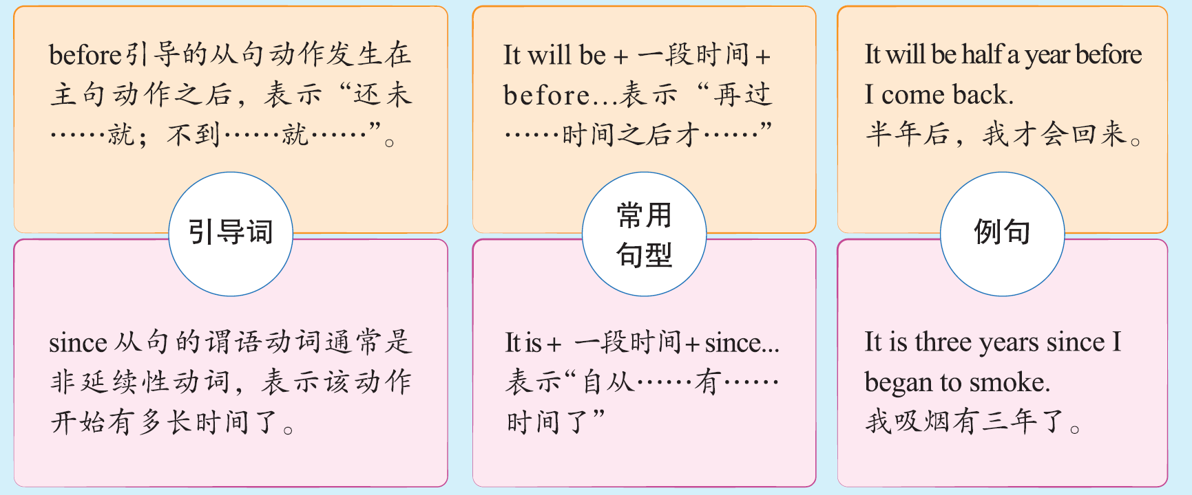
突破语法4 状语从句
突破语法4 状语从句
P298

Slide 6
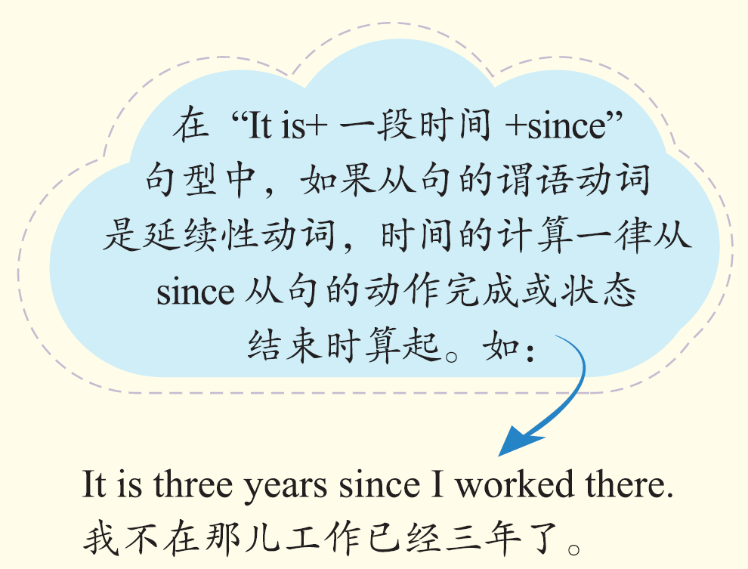
小提示
突破语法4 状语从句
P298

Slide 7
突破语法4 状语从句
since she graduated from
2
She has been working in this company________________________
Peking University. 从北京大学毕业后，她就一直在这家公司工作。
before
After
3
We had finished the work ________ we went home. = ________ we had finished the work, we went home.
完成工作之后，我们回家了。
突破语法4 状语从句
P298

Slide 8
突破语法4 状语从句
till与until的意义和用法相同，意为“直到”。till多用于口语中，且只能用于肯定句中；until既可用于肯定句中，也可用于否定句中。位于句首一般用until，而不用till；not until位于句首时，主句需部分倒装。常见考点如下：
till与until
用法
突破语法4 状语从句
P298
主句 | 从句 | 含义 | 例句
主语+谓语 （肯定式，用延续性动词） | till/until+句子 | 某动作一直延 续到某时间点 才停止 | She remained there till/until he arrived. 她一直在那儿，直到他来。
主语+谓语 （否定式，用瞬时性动词） | until+句子 | 某动作直到某时间才开始 | He didn’t come back until the sun had set. 直到太阳落山以后他才回来。

Slide 9
突破语法4 状语从句
4
When I was little, my mother used to sit by my bed, telling me stories _____________________________.
小时候,妈妈常常坐在我的床边给我讲故事，直到我睡着。
until/till I fell asleep
5
I didn’t notice the news that he was admitted to Tsinghua University until yesterday. （将此句改为强调句，强调yesterday）
____________________________________________________________________________________________________
直到昨天，我才注意到他被清华大学录取的消息。
突破语法4 状语从句
P298
It was not until yesterday that I noticed the news that he was admitted
to Tsinghua University.
Not until recently ____________ what he had done.
直到最近我才知道他所做的事。
6
did I know

Slide 10
突破语法4 状语从句
as soon as, immediately, directly, instantly, the moment, the instant, the minute, no sooner…than…, hardly/scarcely…when...等，表示一个动作一发生，另一个动作马上就发生。
as soon as
7
I think that __________I am offered a good position, I will resign at
once.
我觉得一有好职位，我就会立刻辞职。
突破语法4 状语从句
P299
8
同义句改写：Mo Yan had no sooner stepped on the stage than the audience broke into thunderous applause. （no sooner位于句首）
_____________________________________________________________________________________
莫言刚一上台，观众就报以雷鸣般的掌声。
No sooner had Mo Yan stepped on the stage than the audience broke
into thunderous applause.

Slide 11
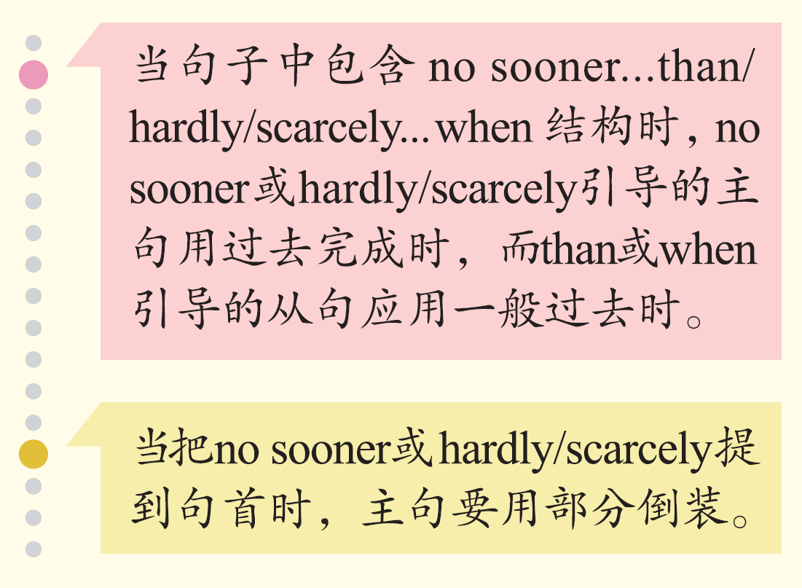
小提示
突破语法4 状语从句
P299

Slide 12
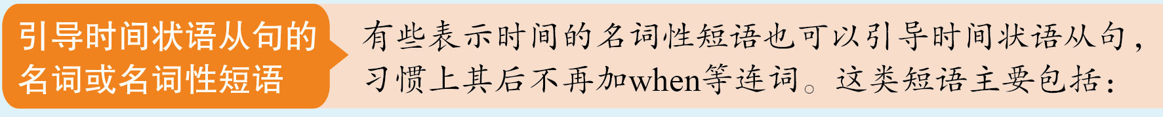
突破语法4 状语从句
the instant/moment/minute/day/year, the first time, each/every/next/any time等。
突破语法4 状语从句
P299
9
单句改错：He argued back at every time I expressed an opinion.
____________________________________________________
每次我表达观点，他都会驳回。
去掉at

Slide 13


突破语法4 状语从句
where you are
10
If you happen to get lost in the wild, you’d better stay ____________
and wait for help. 如果你碰巧在荒野迷路了，你最好待在原地等待救援。
突破语法4 状语从句
P299
In peacetime, too, the Red Cross is expected to send help ________
there is human suffering. 在和平时期，红十字会也被期待着在人类遭受苦难的任何地方提供帮助。
11
wherever
_________ he went, he was introduced as the current United States champion.
无论他到哪里，他都会被介绍为当前的美国冠军。
12
Wherever

Slide 14
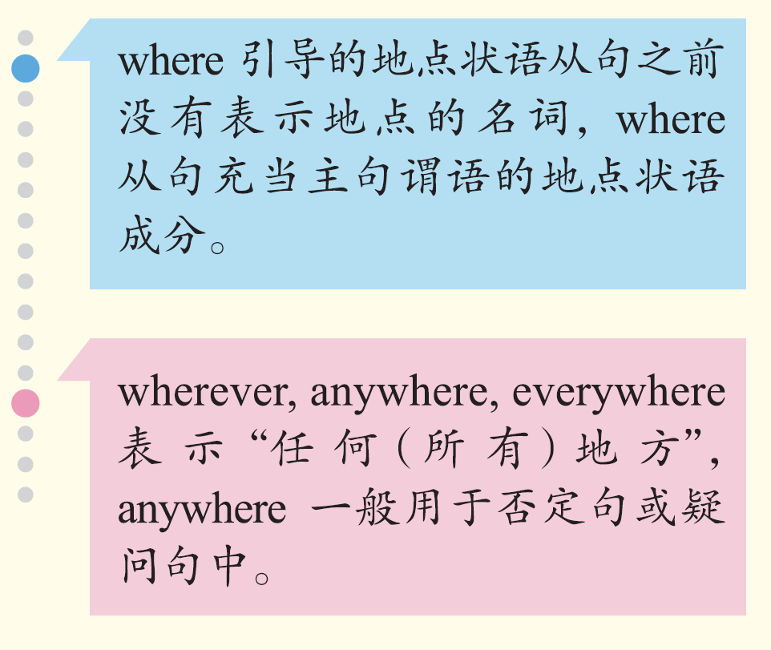
小提示
突破语法4 状语从句
P299

Slide 15

突破语法4 状语从句
突破语法4 状语从句
P299

Slide 16
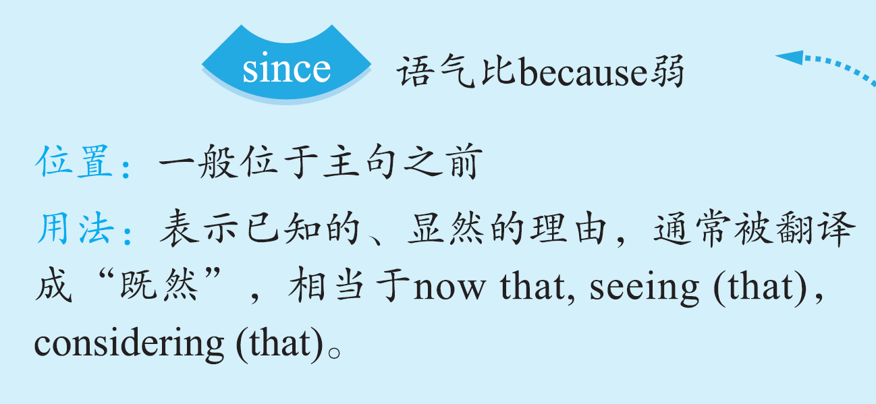

突破语法4 状语从句
表示原因的连词的用法区别
突破语法4 状语从句
P299

Slide 17
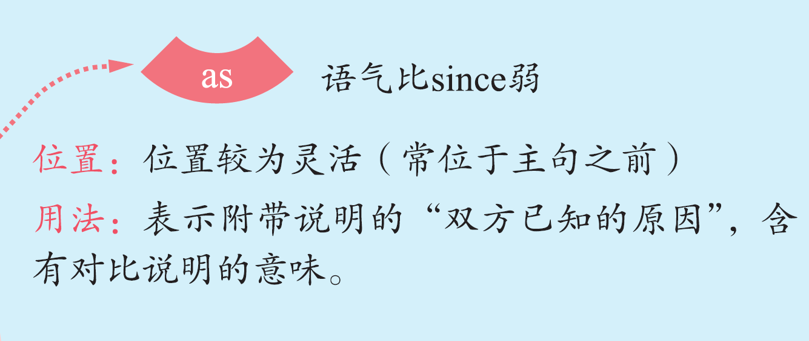

突破语法4 状语从句
表示原因的连词的用法区别
突破语法4 状语从句
P299

Slide 18
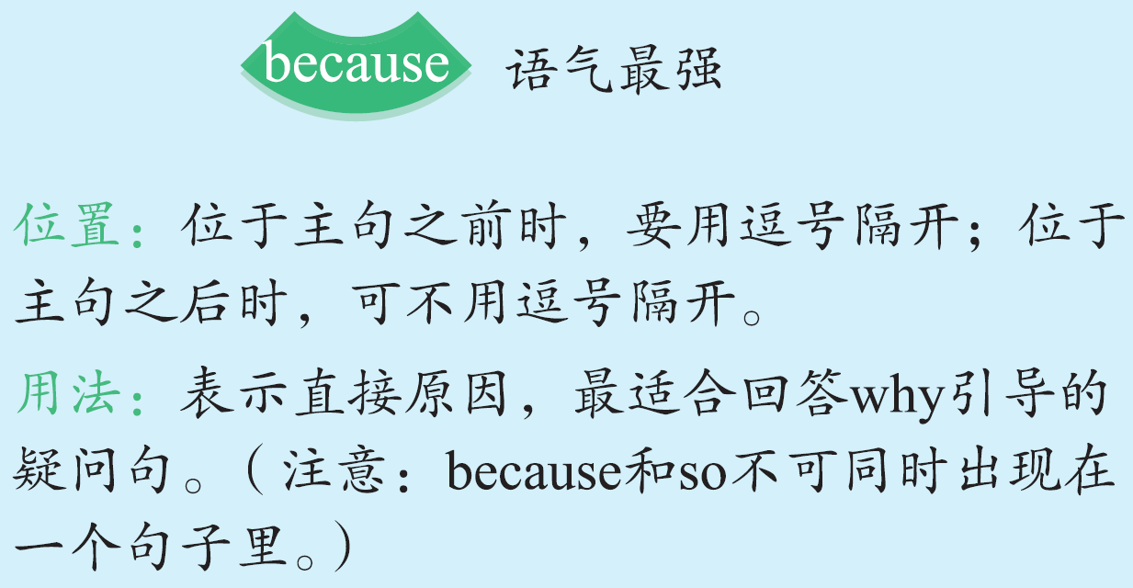
突破语法4 状语从句
表示原因的连词的用法区别
突破语法4 状语从句
P299

Slide 19
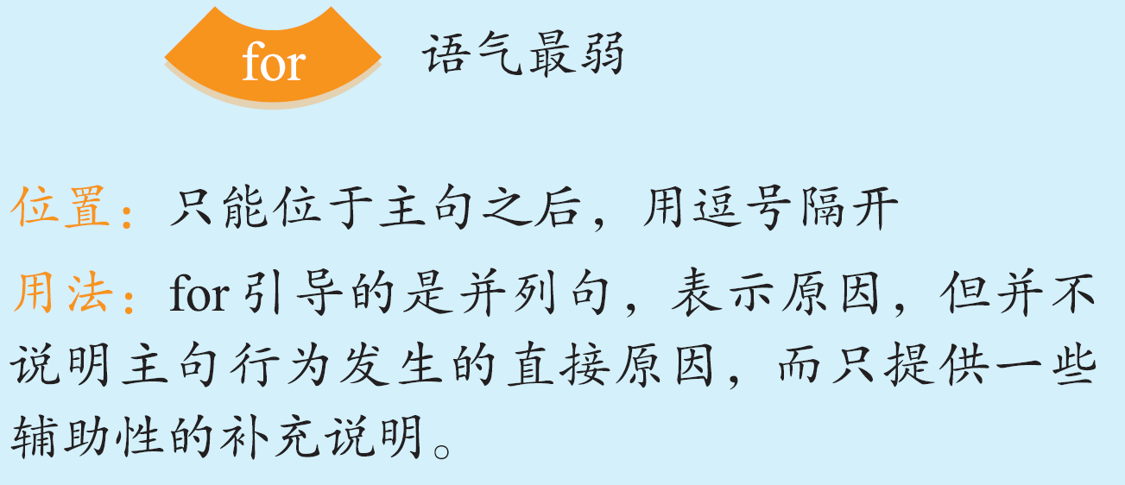
突破语法4 状语从句
表示原因的连词的用法区别
突破语法4 状语从句
P299

Slide 20
突破语法4 状语从句
I really enjoy listening to music ________it helps me relax and takes my mind away from other cares of the day.
我真的喜欢听音乐，因为它使我放松，并把我的注意力从一天中的其他烦扰里转移出来。
13
because
突破语法4 状语从句
P299
Since/Now that/Considering (that)/Seeing (that)/In that
14
______________________________________________ you can’t answer the question, I’ll ask someone else.
既然你回答不出这个问题，我就问别人了。

Slide 21
突破语法4 状语从句
____ the wage of the job was low, there were few applicants for it.
由于这份工作的工资很低，所以应聘的人很少。
15
As
for
16
It must have rained last night, ____ the ground is wet in the morning.
昨天夜里肯定下雨了，因为今天早上地面是湿的。
突破语法4 状语从句
P299

Slide 22

突破语法4 状语从句
引导词 | 语气 | 释义
so that, in order that | 肯定 | 为了……；以便……
for fear that, in case, lest | 否定，相当于 so that...not... 或in order that...not... | 唯恐……；以免……
突破语法4 状语从句
P300

Slide 23
突破语法4 状语从句
They’ve moved to a different house _________________ their children can attend a better school.
他们搬进了另一处房子，以便孩子们能上更好的学校。
17
so that/in order that
18
____________ he could get a good result in the final examination, he decided to study harder than before.
为了能在期末考试中取得好成绩，他决定比以前更加努力学习。
In order that
突破语法4 状语从句
P300
19
John doesn’t dare to learn hip-hop _______________ he may get hurt.
约翰不敢学街舞，唯恐自己会受伤。
for fear that/lest

Slide 24
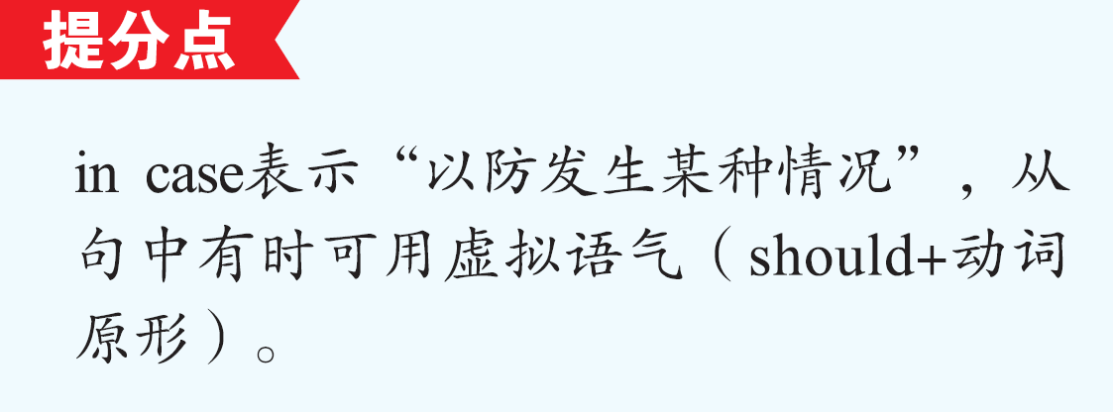
突破语法4 状语从句
I’ll take some sandwiches, just _______ we (should) get hungry on the journey.
我要带一些三明治，以防我们在旅途中饿着。
20
in case
突破语法4 状语从句
P300

Slide 25
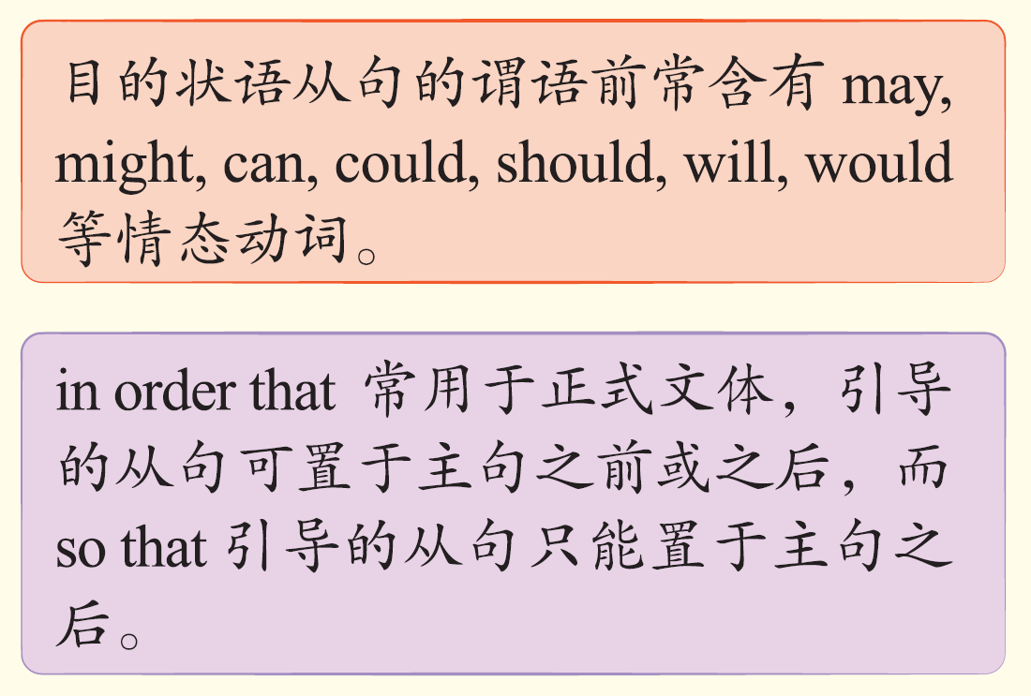
小提示
突破语法4 状语从句
P300

Slide 26
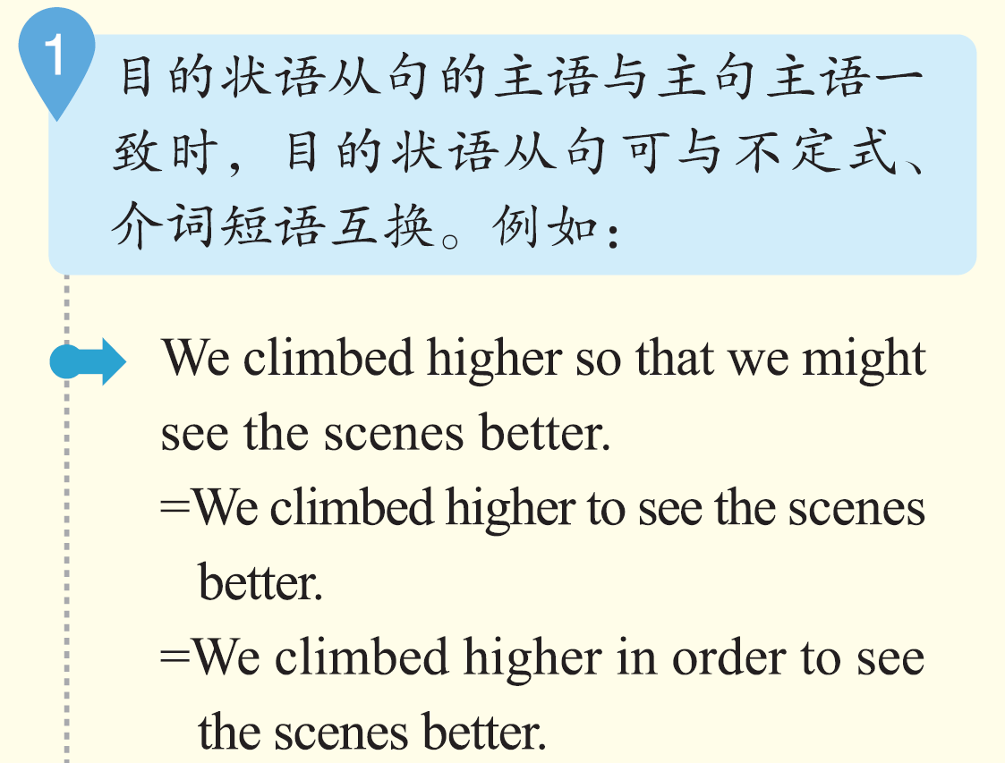
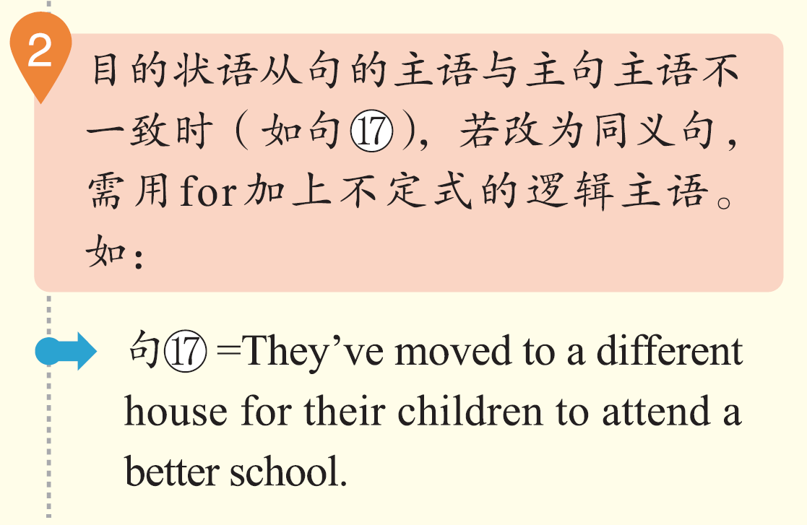
小提示
突破语法4 状语从句
P300

Slide 27

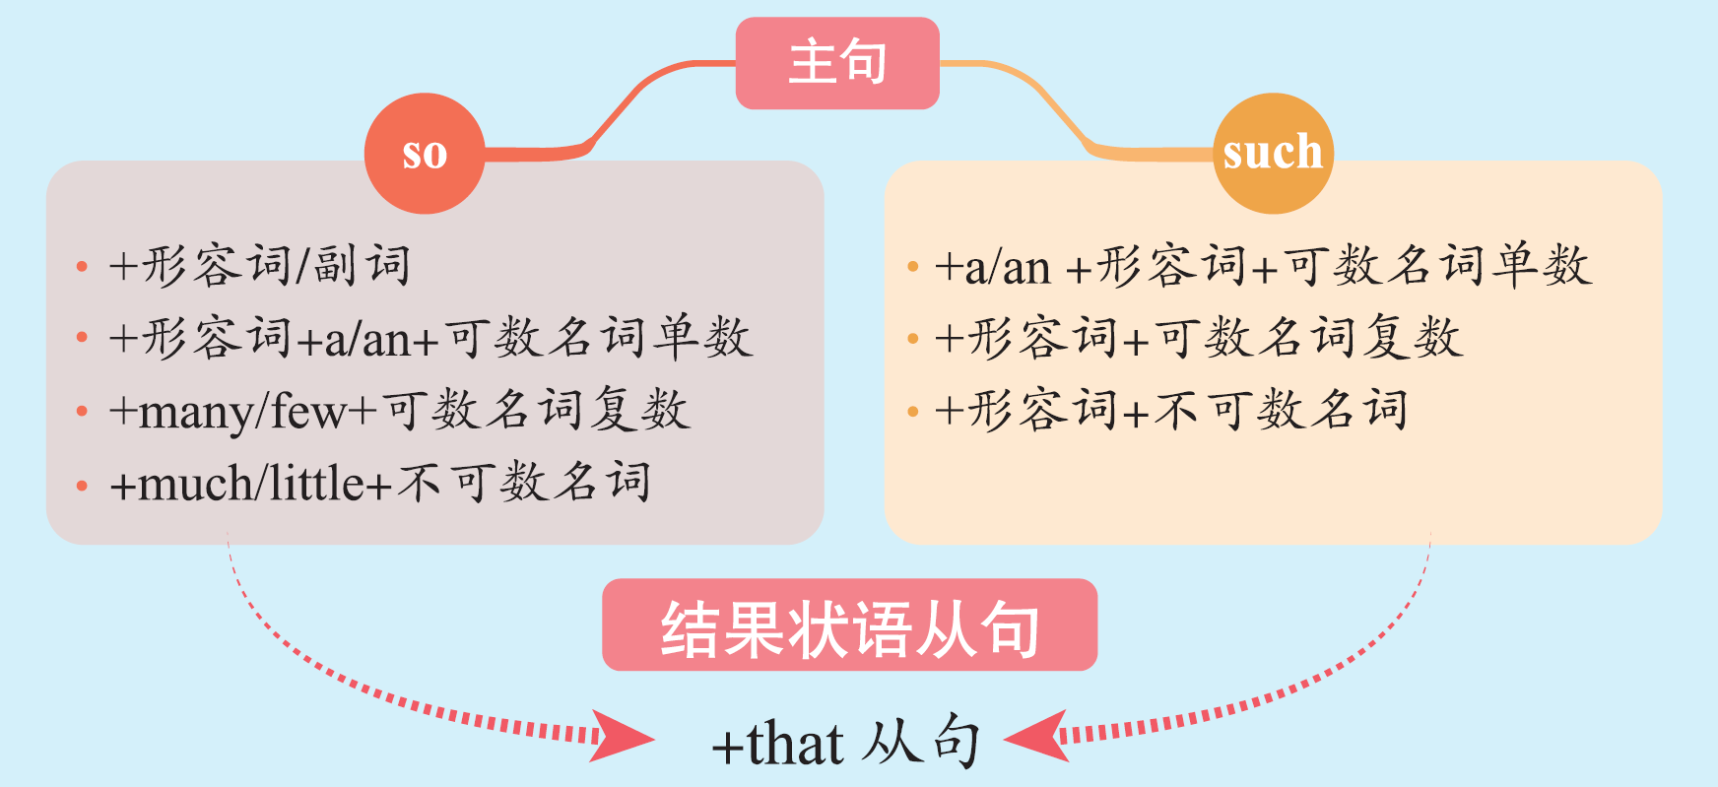
突破语法4 状语从句
突破语法4 状语从句
P300

Slide 28

突破语法4 状语从句
I got up ____ early in the morning ______ I caught the first bus.
= I got up early in the morning, _____ I caught the first bus.
我早上起得很早，所以赶上了第一班公共汽车。
21
so
that
so
突破语法4 状语从句
P300

Slide 29
突破语法4 状语从句
so
that
22
He is ______ fine a teacher ______ we all hold him in great respect.
= He is ______ a fine teacher _____ we all hold him in great respect.
他是非常好的老师，我们对他极为尊敬。
such
that
突破语法4 状语从句
P300
so
She made ______ few friends ______ she often felt lonely.
她交的朋友太少，所以经常会感到孤独。
23
that

Slide 30

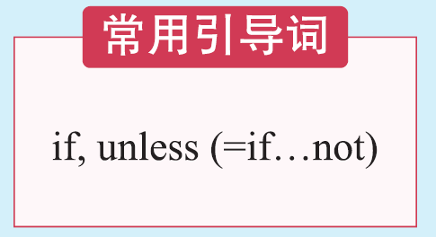
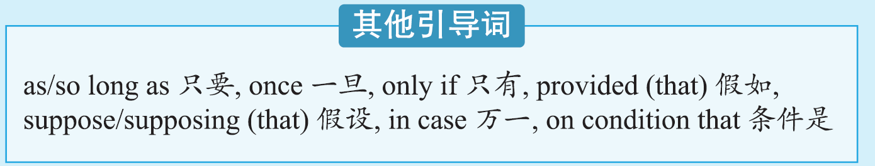
突破语法4 状语从句
突破语法4 状语从句
P300
As long as/If
24
________________ weather permits, we’ll fly to London tomorrow.
只要/如果天气允许，我们明天就乘飞机去伦敦。
Once
25
_________ the damage is done, it will take many years for the farmland
to recover.
一旦遭到破坏，农田将需要数年时间才能恢复。

Slide 31
突破语法4 状语从句
Provided (that)/Suppose (that)/Supposing (that)
26
____________________________________________ it rains, shall we continue the sports meeting?
倘若下雨，我们还要继续举行运动会吗？
I can tell you the truth ____________________ you promise to keep it secret.
我可以告诉你真相，条件是你答应保密。
27
on condition that
突破语法4 状语从句
P300

Slide 32
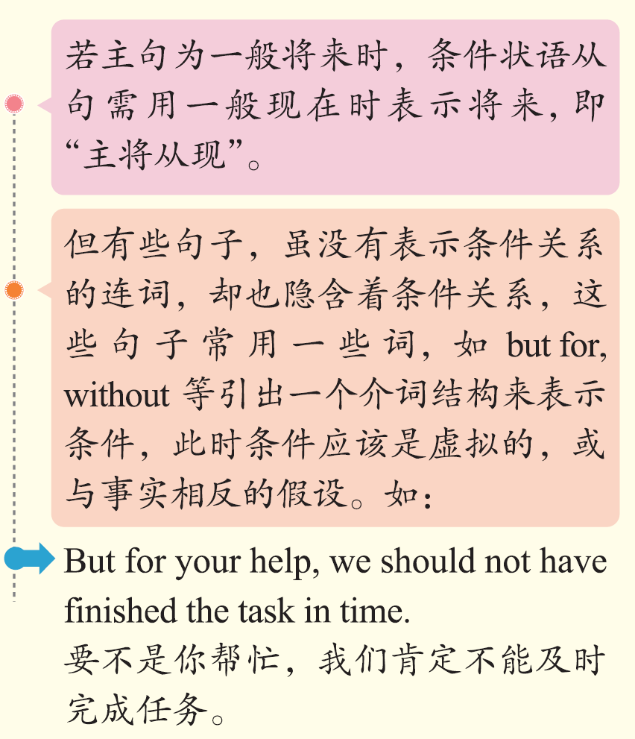
小积累
突破语法4 状语从句
P300

Slide 33

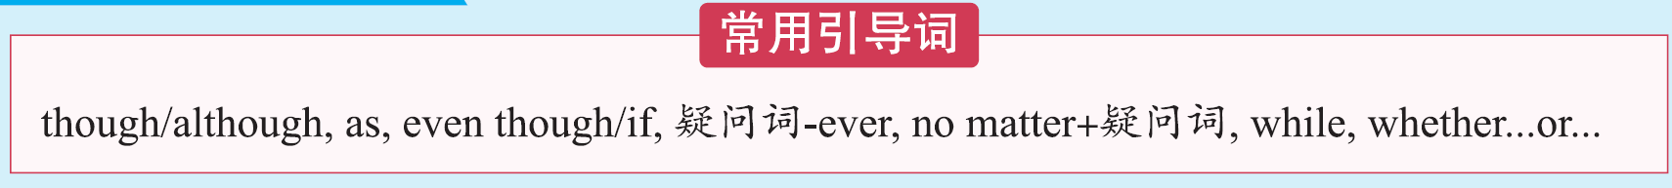

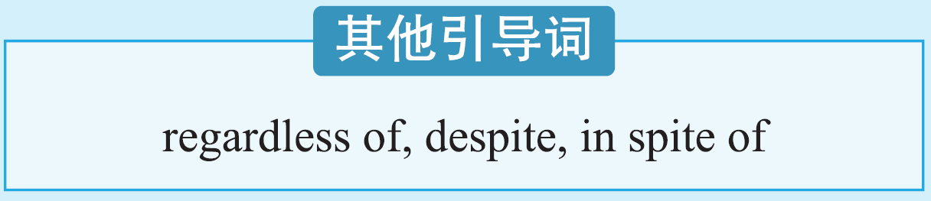
突破语法4 状语从句
突破语法4 状语从句
P301

Slide 34
突破语法4 状语从句
引导词 | 释义 | 用法提示
though/ although | 虽然， 即使，尽管 | 搭配：主句可与yet“还是”、nevertheless“然而”或still“仍然”连用，增强对比性，但不可与but连用。 位置：although引导的让步状语从句位于主句之前的情况较多；though引导的让步状语从句可位于主句之前或主句之后，且可用于倒装结构。
as |  | as表让步时常用倒装，倒装时名词前若有冠词则需省去冠词，与though的用法一致。让步状语从句的倒装结构： v./n./adj./adv./不定代词+as/though+主语+谓语
突破语法4 状语从句
P301

Slide 35
突破语法4 状语从句
引导词 | 释义 | 用法提示
even though/ even if | 即使，尽管 | 表示语气更强的让步。even though强调对“既成事实”的让步；even if强调对“假设”的让步。
whether (…) or not/ whether…or… | 不管 …… 还是 …… | whether...or...引导的让步状语从句旨在说明正反两方面的可能性都不会影响主句的意向或结果，所以它的语气比较强烈，从而也更加坚定了主句的内容。
疑问词-ever/no matter+疑问词 | 无论 …… | 引导让步状语从句时，“疑问词-ever”可换作“no matter+疑问词”；引导名词性从句时，只能用“疑问词-ever”。如： It is generally considered unwise to give a child whatever (≠ no matter what) he or she wants. （whatever引导宾语从句）一般认为孩子要什么就给他（她）什么是不明智的。
突破语法4 状语从句
P301

Slide 36
突破语法4 状语从句
Although/Though/While
28
_____________________ the job takes a significant amount of time, most students agree that the experience is worth it.
尽管这项工作花费了大量的时间，但大多数学生都认为这段经历是值得的。
突破语法4 状语从句
P301
_____________________, he knew what was the right thing to do.
（用倒装结构）尽管他是个孩子，但他知道什么是该做的事情。
29
Child as/though he was
even if/even though/
30
My grandfather still plays tennis now and then, ___________________
_________________he’s in his seventies.
尽管我爷爷七十多岁了，但他仍然会时不时地打打网球。
although/though

Slide 37
突破语法4 状语从句
However/No matter how serious a problem
31
____________________________________ may be, you should gather your courage to face the challenge.
无论问题多么严重，你都应该鼓起勇气面对挑战。
突破语法4 状语从句
P301
While/Although/Though
32
_____________________ I understand what you say, I can’t agree with you.
虽然我理解你的意思，但我还是不同意。

Slide 38

小积累
突破语法4 状语从句
P301

Slide 39

突破语法4 状语从句
突破语法4 状语从句
P301
as suddenly as
33
He woke up _________________ he had fallen asleep.
他醒来和入睡时一样突然。

Slide 40
突破语法4 状语从句
not as/so expensive
34
In my view, London’s ____________________ in price as Tokyo but Tokyo is more organized in traffic.
在我看来，伦敦的物价没有东京高，但是东京的交通更有秩序。
there is nothing better than/nothing
35
As a student, I can tell you that ______________________________ _____________ I can be praised by my teacher before my classmates. 作为一名学生，我可以告诉你，没有什么比我的老师在同学们面前表扬我更好的了。
is better than
突破语法4 状语从句
P301
The more
___________ careful you are, ____________ mistakes you will make.
你越细心，你犯的错误就会越少。
36
the fewer

Slide 41
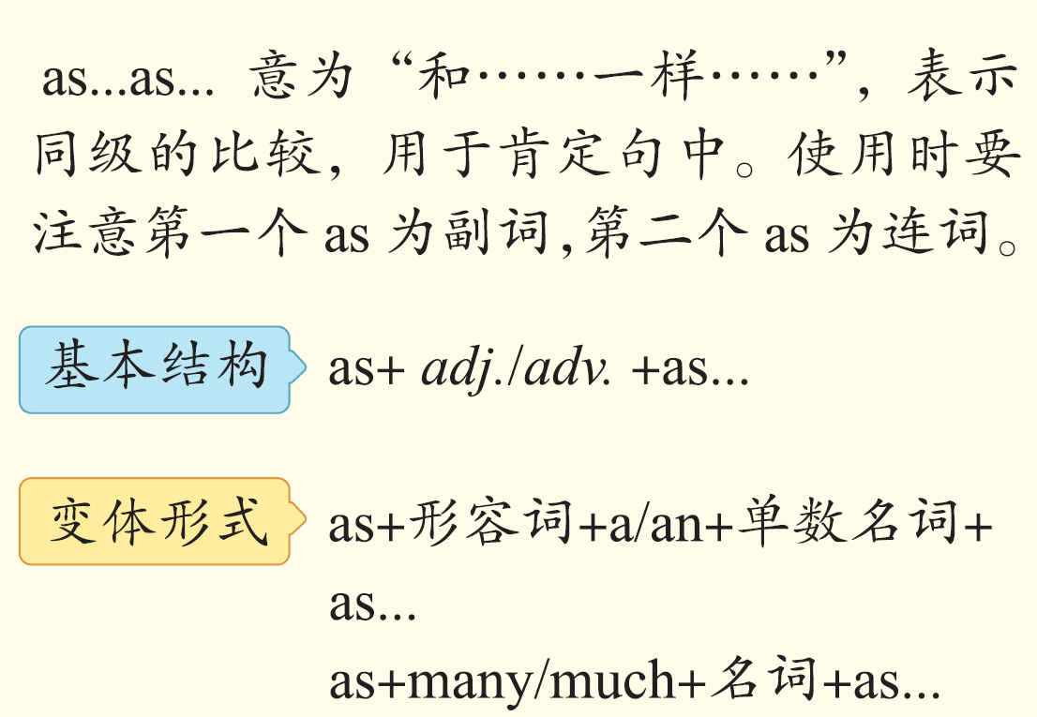
小积累
突破语法4 状语从句
P301

Slide 42



突破语法4 状语从句
__________ a single word can change the meaning of a sentence, a single sentence can also change the meaning of a paragraph.
正如一个词可以改变一个句子的意思一样，一个句子也可以改变一个段落的意思。
37
As/Just as
突破语法4 状语从句
P301
as if/though they never existed
38
They completely ignore these facts ____________________________.（与事实相反，从句用虚拟语气）
他们完全忽略了这些事实，就仿佛它们不存在似的。

Slide 43
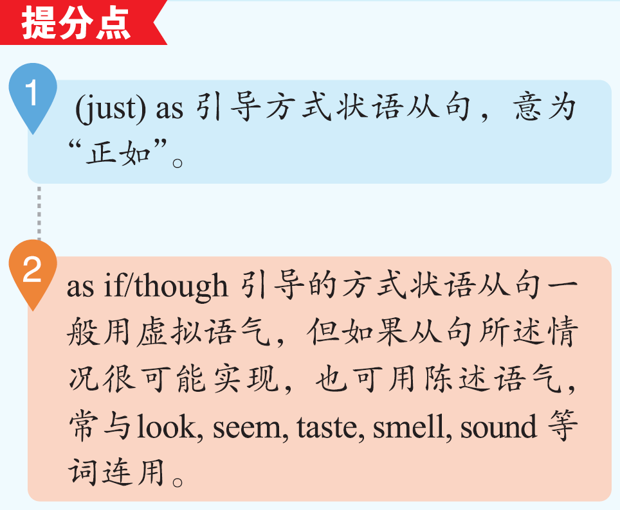
突破语法4 状语从句
as if/though she was waiting for someone
39
She stood at the door ___________________________________.（所说情况可能为事实，从句用陈述语气）
她在门口站着，好像在等谁似的。
the way
40
I shall do the work _______ my father did.
我将像我父亲那样做这份工作。
突破语法4 状语从句
P301

Slide 44

Ⅰ 项目填空
突
破
积
累
练
从每题所给的A、B、C、D四个选项中，选出可以填入空白处的最佳选项。
1. ________ birds use their feathers for flight, some of their feathers are
for other purposes.
(2017·北京卷)
A. Once B. If C. Although D. Because
突破语法4 突破积累练
P302
解析：
前半句意为“鸟儿们用羽毛来飞翔”，后半句意为“它们的一些羽毛还有其他的用途”，由此可看出前后两句为让步转折关系，故选C项，although意为“尽管”，符合句意。

Slide 45
Ⅰ 项目填空
2. If you don't understand something, you may research, study, and talk to
other people ________ you figure it out.
(2017·北京卷)
A. because B. though C. until D. since
突破语法4 突破积累练
P302
解析：
此题可采用排除法。though意为“尽管”，引导让步状语从句；because和since都可表示原因，引导原因状语从句；since也可引导时间状语从句，但其意为“自……以来”，不符合此处句意，故A、B、D三项均可排除。until引导时间状语从句，意为“直到……为止”，符合此处语境。句意：若你无法理解某项事物，你可能会研究、学习或与他人探讨，直到弄清楚为止。

Slide 46
Ⅰ 项目填空
3. —Peter, please send us postcards ________we'll know where you have
visited.
—No problem.
(2017·北京卷改编)
A. but for B. otherwise C. seeing that D. so that
突破语法4 突破积累练
P302
解析：
由对话语境可知，对方是让彼得寄明信片，而空格后的部分指寄明信片的目的，所以空格处应是引导目的状语从句的连接词，so that意为“以便于”，符合语境，故选D项。句意：——彼得，请寄给我们一些明信片，这样我们就能知道你去哪里旅游了。——没问题。

Slide 47
Ⅰ 项目填空
4. Located ________ the Belt meets the Road, Jiangsu will contribute
more to the Belt and Road construction.
(2017·江苏卷)
A. why B. when C. which D. where
突破语法4 突破积累练
P302
解析：
分析句子可知，空格处所填词引导地点状语从句。“be located in＋地点名词”表示“位于/坐落于某地”，where在此处相当于“介词＋which”，故选D项。句意：位于“一带一路”交汇处的江苏省将会对“一带一路”建设做出更大的贡献。

Slide 48
Ⅰ 项目填空
5. ________， his idea was accepted by all the people at the meeting.
(2019·新编)
A. It might sound strange B. As it might sound strange
C. As strange it might sound D. Strange as it might sound
突破语法4 突破积累练
P302
解析：
分析句子可知，此句为让步状语从句的倒装。as引导让步状语从句时，从句需用倒装语序，通常将形容词、名词等置于as之前，故选D项。句意：尽管听起来很奇怪，但他的想法在会议上被所有人接受了。

Slide 49
Ⅰ 项目填空
6. __________ we don't stop climate change, many animals and plants in the world will be gone.
(2018·北京卷)
A. Although B. While C. If D. Until
突破语法4 突破积累练
P302
解析：
分析句子结构和句意可知，前半句“我们不阻止气候变化”是后半句“世界上的许多动植物会消失”的条件，应用if 来引导条件状语从句，故选C项。句意：如果我们不阻止气候变化，世界上的许多动植物就会消失。

Slide 50
Ⅰ 项目填空
7. You won't find paper cutting difficult ________ you keep practicing it.
(2015·北京卷)
A. even though B. as long as C. as if D. ever since
解析：
前一个分句意为“你不会觉得剪纸很难”，后一个分句意为“你不断地练习”。由此判断前后两个分句为条件关系。句意：只要你不断地练习，你就不会觉得剪纸很难。选项中，even though意为“虽然，即使”，as if意为“仿佛，好像”，ever since意为“迄今；从那时起(一直)”，均不符合此处句意。as long as意为“只要”，符合语境，故选B项。
突破语法4 突破积累练
P302

Slide 51
Ⅰ 项目填空
8. Let's not pick these peaches until this weekend __________ they get
sweet enough to be eaten.
(2018·天津卷)
A. ever since B. as if C. even though D. so that
解析：
分析句子结构并结合句意可知，空格所在句为目的状语从句。ever since意为“自从，自……以后”；as if 意为“好像”；even though意为“即使；虽然”，以上均不符合句意；so that意为“以便；结果”，符合句意，故选D项。句意：我们到周末再摘这些桃子，以便它们吃起来足够甜。
突破语法4 突破积累练
P302

Slide 52
Ⅰ 项目填空
9. __________ you can sleep well, you will lose the ability to focus, plan
and stay motivated after one or two nights.
(2018·江苏卷)
A. Once B. Unless C. If D. When
解析：
分析选项，once意为“一旦”；unless意为“除非；如果不”；if意为“如果”；when意为“当……时候”。根据句意可知，unless符合语境，即“除非你睡得好”，故选B项。句意：除非你睡得好，否则一两个晚上后，你会失去专注、计划和保持积极性的能力。
突破语法4 突破积累练
P302

Slide 53
Ⅰ 项目填空
10. You should operate the machine ________ the worker has shown you.
(2019·新编)
A. like B. although C. as D. who
解析：
like不能用于连接句子，因此可将A项首先排除。although“尽管”引导让步状语从句；who作关系代词时，先行词应为人，B、D均不符合题意。as在此处作方式状语从句的连接词，意为“正如；按照”，符合此处表达，故选C项。句意：你应该像工人给你演示的那样操作机器。
突破语法4 突破积累练
P302

Slide 54
Ⅱ 单句语法填空
阅读下面句子，在空白处填入适当的连接词。
1. _________ I began my own personal weight program, I was filled with
the fear that I would run into the same difficulties that beat me before.
(2017·天津卷改编)
As/When
解析：
前半句意为“我开始我的个人减肥计划”，后半句意为“我充满了恐惧，担心遇到曾经打败我的同样的困难”。由此可看出，前半句为后半句事件开始的时间点，故应填As或When，引导时间状语从句。
突破语法4 突破积累练
P302

Slide 55
Ⅱ 单句语法填空
2. There is only one more day to go ________ your favorite music group
play live.
(2015·四川卷改编)
before
解析：
空格前句意为“还剩下一天”，空格后句意为“你最喜欢的乐队现场表演”。由句意可推断，此句为时间状语从句，表示“距离现场表演还剩下一天”，故填时间状语从句连接词before。句意：再过一天，你最喜欢的乐队的现场表演就开始了。
突破语法4 突破积累练
P302

Slide 56
Ⅱ 单句语法填空
3. Some social apps were popular among the children aged from 8 to 12
__________________ they supposedly require users to be at least 13.
(2018·江苏卷改编)
even though/though
解析：
空格前句意为“一些社交应用程序很受8至12岁孩子的欢迎”，空格后句意为“他们要求用户至少满13周岁”。由此判断前后两句为让步转折关系，故空格处可填让步状语从句连接词even though或though。
突破语法4 突破积累练
P302

Slide 57
Ⅱ 单句语法填空
4. It is so cold that you can't go outside____________ fully covered in
thick clothes.
(2015· 江苏卷改编)
unless/if not
解析：
分析句子结构可知，空格处所填词引导的是省略了主语和be动词的条件状语从句。结合句意可知，空格后句为空格前句的否定条件，故选择条件状语从句连接词unless或if not。句意：天气太冷了，除非你全身裹上厚厚的衣服，否则你不能外出。
突破语法4 突破积累练
P302

Slide 58
Ⅱ 单句语法填空
5. __________________ scientists have learned a lot about the universe,
there is much we still don't know.
(2015·安徽卷改编)
Though/Although
解析：
逗号前句意为“科学家们已经获悉了很多关于宇宙的信息”，后句意为“仍然有很多我们不知道的事情”，逗号前后两句在语义上存在让步转折的关系，故应填让步状语从句连接词Though或Although。
突破语法4 突破积累练
P302

Slide 59
Ⅲ 单句写作
根据所给提示完成句子。
1. 申请材料需精心准备，这样你心仪的学校才会对你的能力有全面、准确的了解。 (in order that)
(2015·上海卷改编)
The applications should be carefully prepared____________________
________ can have an overall and accurate knowledge of your abilities.
in order that the school
突破语法4 突破积累练
P302
you like
2．虽然经常跑步并不能让你长命百岁，但这篇报告称，跑步比步行、骑自行车或游泳更能延长寿命。(while)
(2018·全国I卷改编)
___________________________________________，the review says
it is more effective at lengthening life than walking, cycling or swimming.
While running regularly can't make you live forever

Slide 60
Ⅲ 单句写作
3. 不管这个故事多有趣，我必须把它放在一边，将注意力集中在本
周的学习上。 (however)
(2019·新编)
___________________________， I have to put it away and focus my
attention on study this week.
However interesting the story is
突破语法4 突破积累练
P302
4. 我相信，一旦你认识了其他所有人，你将会在这里过得很愉快。
(once)
(2015·陕西卷改编)
I believe you will have a wonderful time here ____________________
________________________.
once you get to know
everyone else

Slide 61
Ⅲ 单句写作
5. 既然他不听我们戒烟的劝告，那我们也就没必要再白费唇舌了。
(now that)
(2017·北京一模卷)
___________________________________________________， we
needn't waste our breath any more.
Now that he wouldn't accept our advice on giving up smoking
突破语法4 突破积累练
P302
6. 多希望我们能像鸟那样，每个冬季从这里定期迁徙！ (as)
(2019·新编)
I wish we could migrate from here every winter, ___________________!
as the birds do

Slide 62
Ⅲ 单句写作
7. 如果每个人都能在他人有困难时伸出援手，世界将会变得更加美
好。(if)
(2019·新编)
_________________________________________， the world will be
better.
If everyone can reach out and help those in need
突破语法4 突破积累练
P302
8. 她一看完那个关于已灭绝物种的电视节目，就立志加入野生动物保
护组织。 (no sooner)
(2019·新编)
__________________________________________________________
____________than she made up her mind to join the wildlife protection
organization.
No sooner had she/She had no sooner watched the TV program on the
extinct species

Slide 63
Ⅲ 单句写作
9. 我们今天很早就出发了，所以有更多的时间在图书馆里阅读和挑
选书籍。 (so that)
(2019·新编)
We set out early today ______________________________________
_________________________________.
so that we had more time to read and select
books in the library
突破语法4 突破积累练
P302

