Slide 1

突破语法1 冠词
不定冠词
定冠词
零冠词
目录
易混词组提醒
突破积累练
Ⅰ单句语法填空
Ⅱ 单句改错
Ⅲ 单句写作

Slide 2
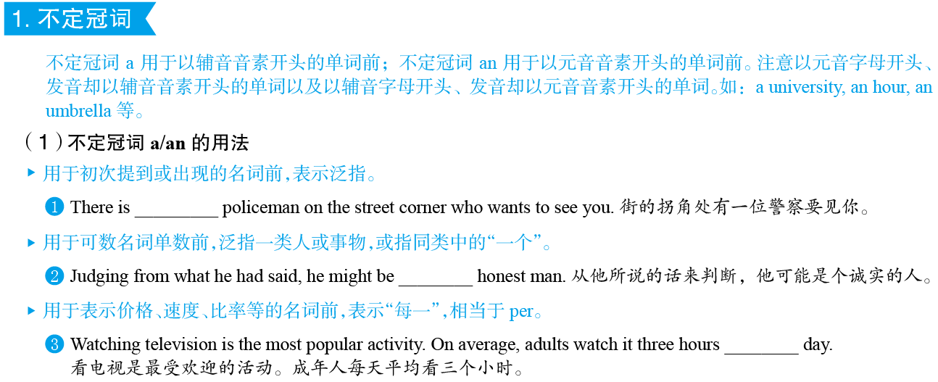

a
突破语法1
冠词
P284
an
a

Slide 3
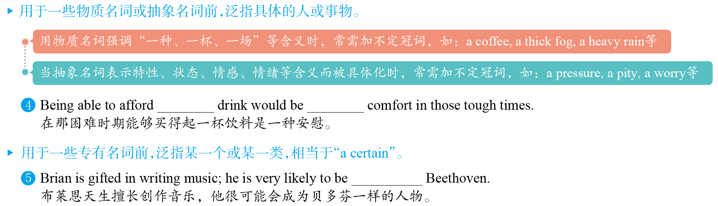
a
a
突破语法1
冠词
P284
a

Slide 4
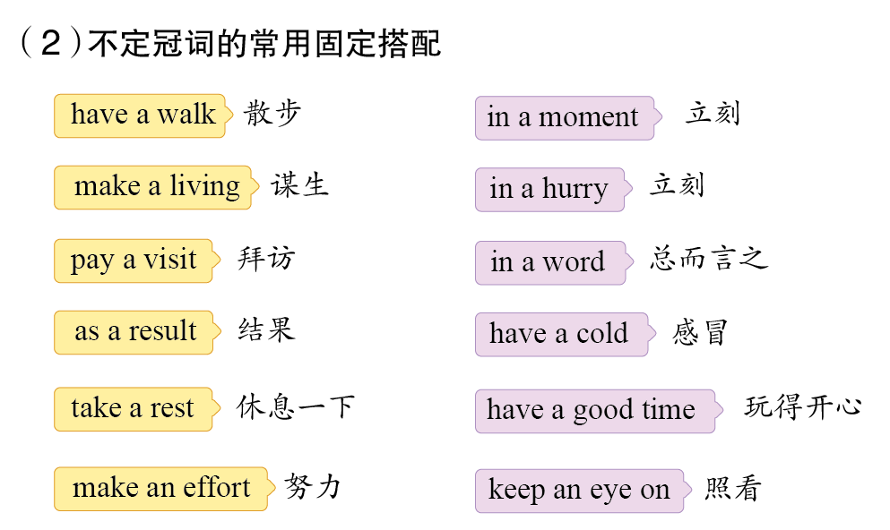
突破语法1
冠词
P284

Slide 5
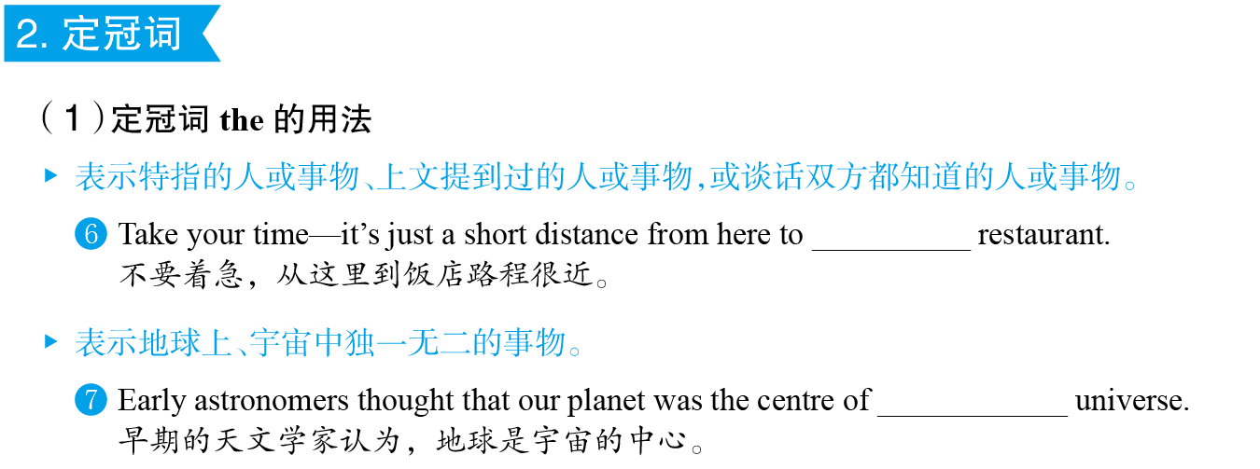
the
突破语法1
冠词
P284
the

Slide 6

突破语法1
冠词
P284

Slide 7
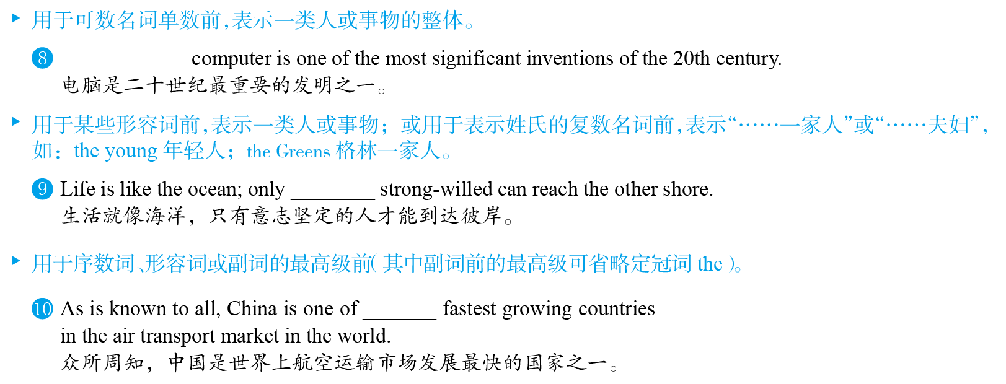
The
the
突破语法1
冠词
P284
the

Slide 8
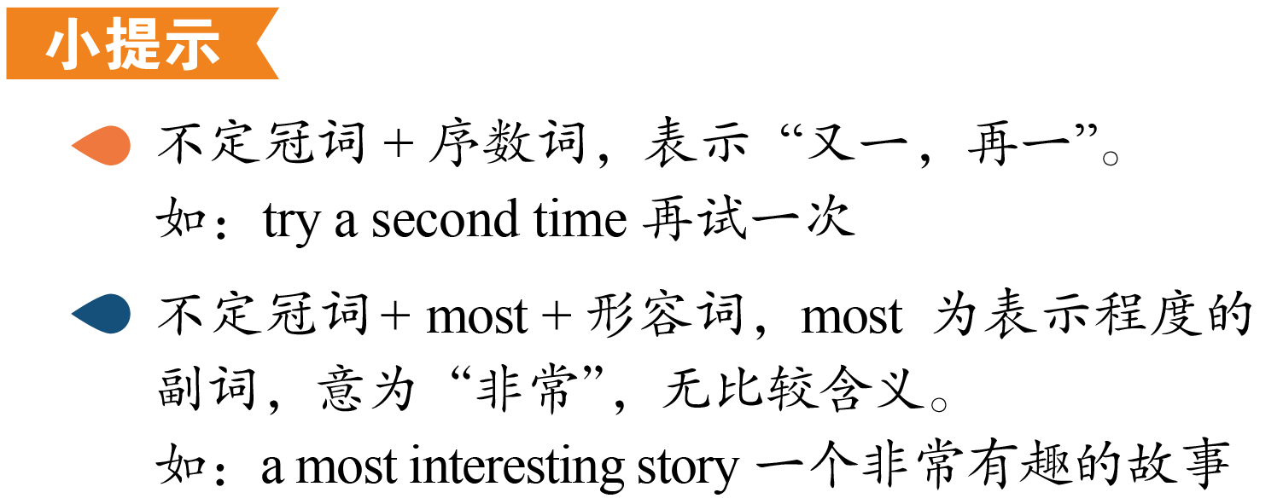
突破语法1
冠词
P284

Slide 9
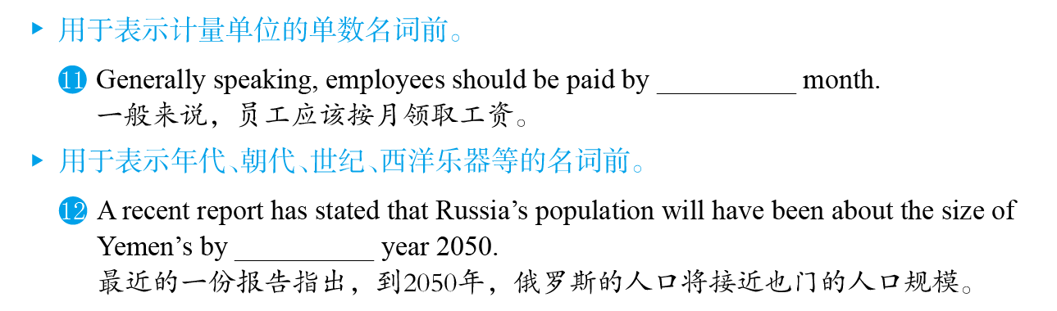
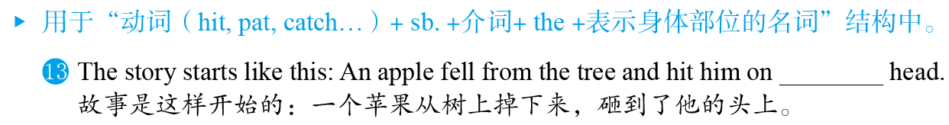
the
突破语法1
冠词
P284
the
the

Slide 10
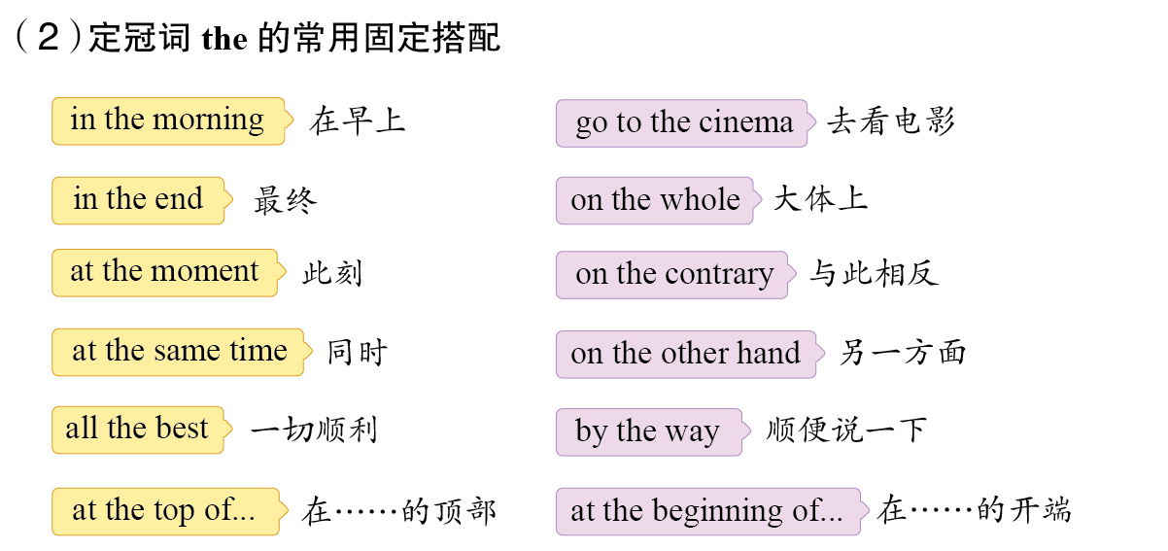
突破语法1
冠词
P285

Slide 11
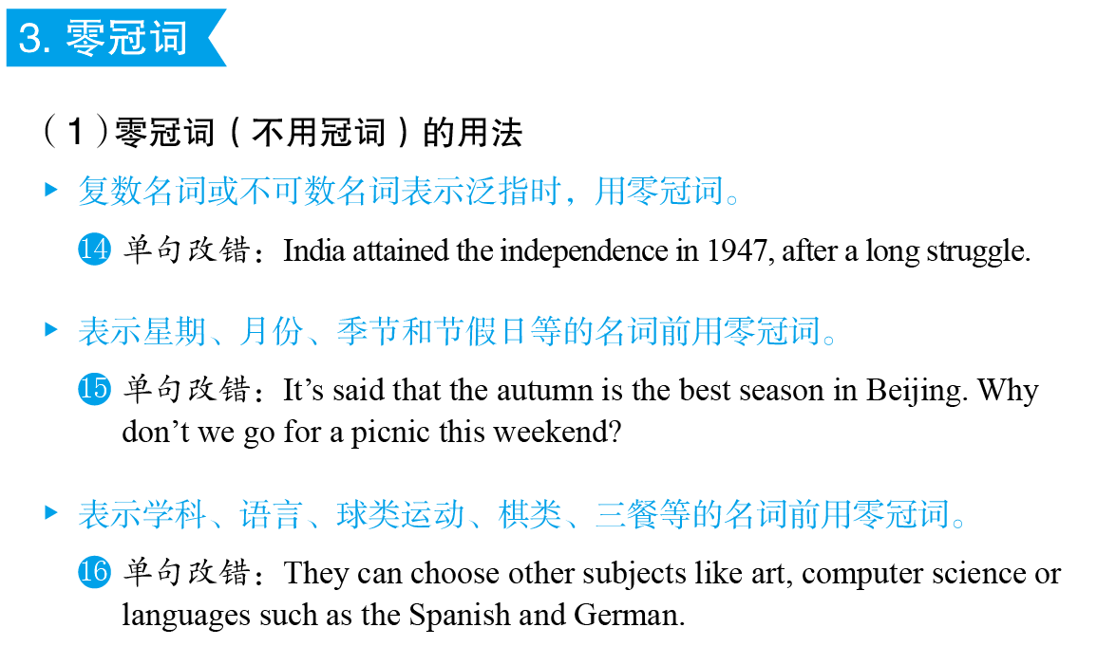
\
突破语法1
冠词
P285
\
\

Slide 12
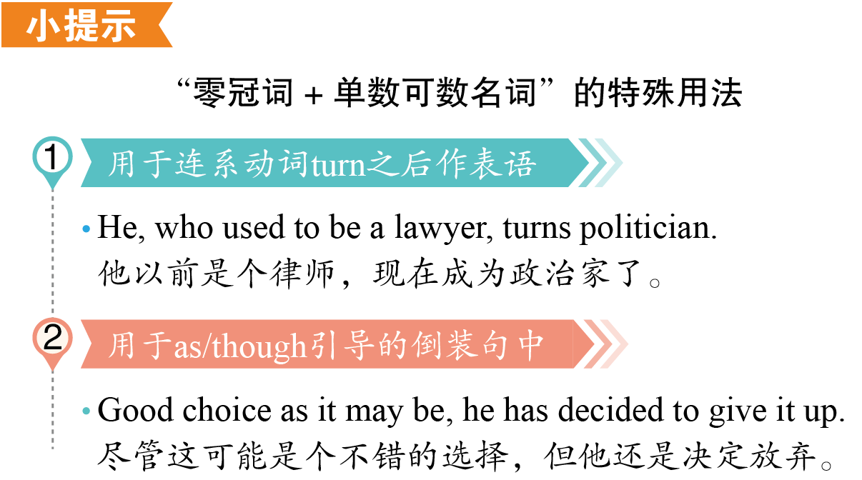
突破语法1
冠词
P285

Slide 13
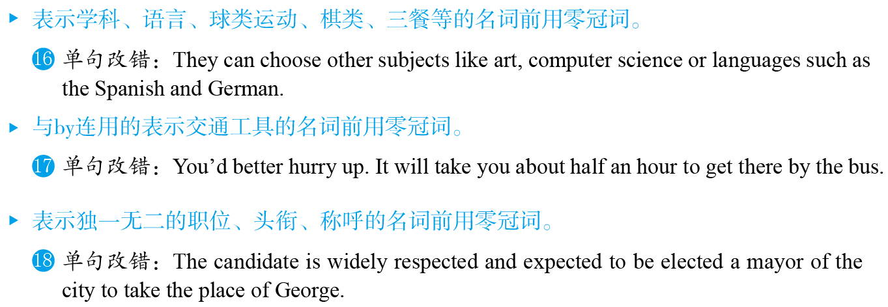
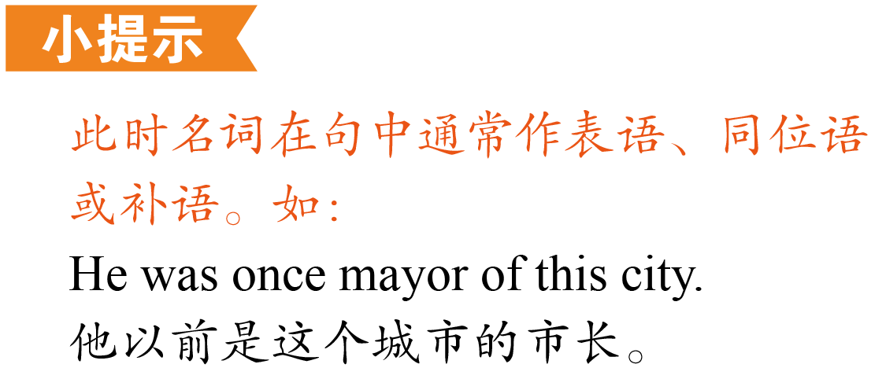
\
\
\
突破语法1
冠词
P285

Slide 14
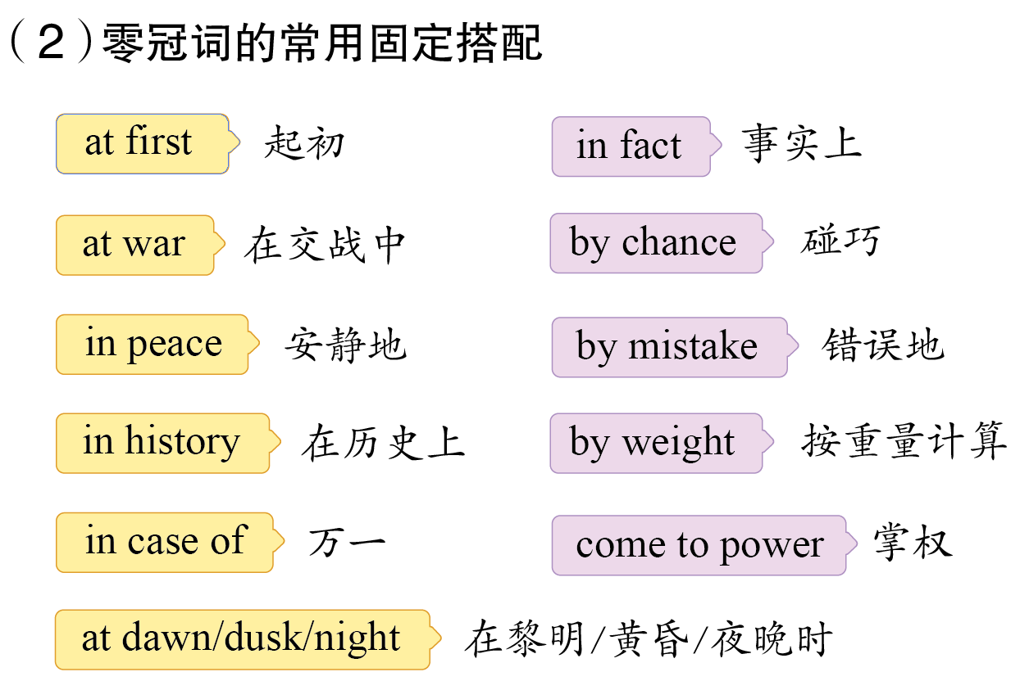
突破语法1
冠词
P285

Slide 15
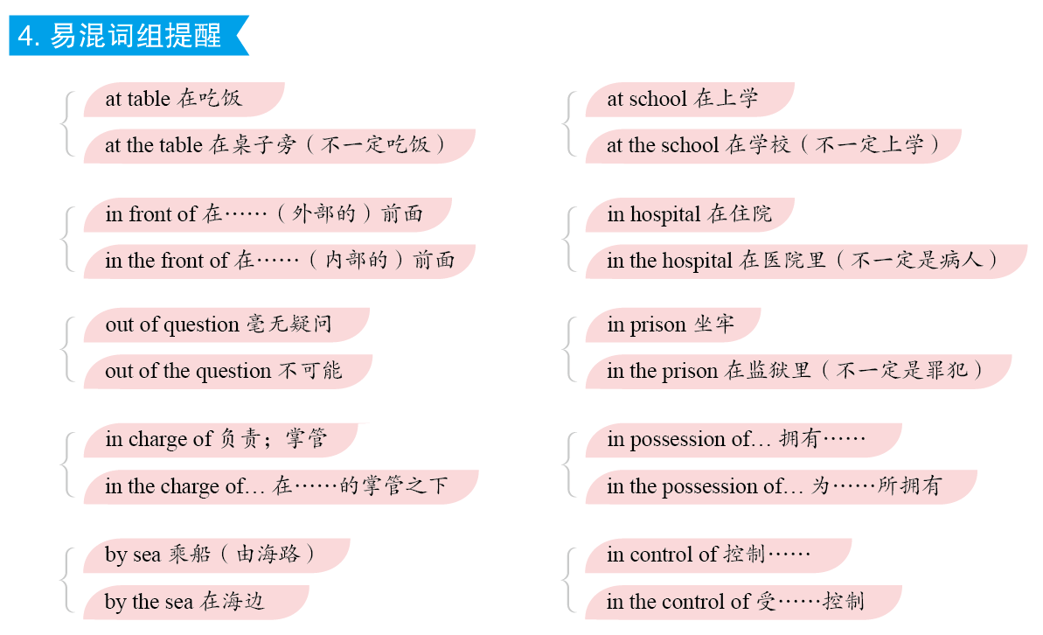
突破语法1
冠词
P285

Slide 16
Ⅰ单句语法填空
突
破
积
累
练
阅读下面句子，填入合适的词。
the
1.
War is a mirror,which can help us better appreciate value of peace.
(2019•新编)
突破语法1
突破积累练
P288
突破语法1
突破积累练
P286
解析：
the value of…为固定搭配，意为“……的价值”，此处的the value of peace表示“和平的价值”，故填the。句意：战争是一面镜子，能让人更好地认识到和平的意义。

Slide 17
Ⅰ单句语法填空
2.
He didn’t understand the moral of the story and began to read it through second time.
(2019•新编)
a
解析：
结合语境及句意可知，空格处应该表示“再读一遍”；不定冠词加序数词作定语表示“又一，再一”。句意：他不明白故事的寓意，因此又读了一遍。
突破语法1
突破积累练
P286

Slide 18
Ⅰ单句语法填空
a
3.
If we sit in the front of the bus, we will have better view of the roadside scenery.
(2019•新编)
突破语法1
突破积累练
P286
解析：
have a good view of… 为固定搭配，意为“清楚看到……；好好欣赏……”，故填a。句意：如果我们坐在公交车的前面，我们将能更好地欣赏沿路的风景。

Slide 19
Ⅰ单句语法填空
4.
Corn production has jumped nearly 125 percent over past few years, while rice has increased only 7 percent.
(2018•全国Ⅱ卷)
the
突破语法1
突破积累练
P286
解析：
over the past few years为固定搭配，意为“在过去的几年中”，故填the。句意：在过去的几年间，谷物产量增长了近125%，而水稻产量仅增长了7%。

Slide 20
Ⅰ单句语法填空
The illegal hunting of Tibetan antelope used to be serious problem in the 1990s.
(2016•北京卷)
5.
a
解析：
根据句意可知，空格处应用不定冠词表示泛指，且serious是以辅音因素开头的单词，故填a。句意：对藏羚羊的非法捕猎在20世纪90年代曾是一个严重的问题。
突破语法1
突破积累练
P286

Slide 21
Ⅰ单句语法填空
6.
The Belt and Road Initiative proposed by President Xi Jinping has drawn public attention to oldest and longest trade route—Silk Road.
(2019•新编)
the
突破语法1
突破积累练
P286
解析：
形容词最高级前应用定冠词the修饰，故填the。句意：国家主席习近平提出的“一带一路”战略引起了公众对最古老、最长的贸易路线——丝绸之路的关注。

Slide 22
Ⅰ单句语法填空
7.
Unexpectedly, I’m face-to-face with the gorilla（大猩猩）, who begins screaming at top of her lungs.
(2018•全国Ⅲ卷改编)
the
突破语法1
突破积累练
P286
解析：
at the top of…为固定搭配，意为“在……顶端”，此处表示“高声地；放声地”。句意：出人意料的是，我和这只大猩猩面对面地遇上了。她看到我后便开始声嘶力竭地叫喊。

Slide 23
Ⅰ单句语法填空
8.
On my way out, the manager handed me a bunch of mixed flowers. He did not say anything, just holding flowers out to me.
(2019•新编)
the
突破语法1
突破积累练
P286
解析：
结合语境可知，空格处特指前句提到的鲜花，故填定冠词the。句意：在我外出的路上，经理递给了我一束混合鲜花。他什么也没说，只是把花递给了我。

Slide 24
Ⅰ单句语法填空
In Chinese culture, each year is related to Chinese animal according to the 12-year animal cycle.
(2019•新编)
9.
a
突破语法1
突破积累练
P286
解析：
结合语境可知，每一年都与一只中国的动物有关，故填a ，此处表泛指。句意：在中国文化中，根据12年一周期，每一年都与一只中国的动物有关。

Slide 25
Ⅰ单句语法填空
If neighbour suffers an illness, offer to collect newspapers or do the grocery shopping.
(2018•浙江卷改编)
10.
a
突破语法1
突破积累练
P286
解析：
空格处表示泛指“一位邻居”，且neighbour是辅音因素开头的单词，故填a。句意：如果一个邻居生病了，可以主动去帮邻居收报纸或去杂货店买东西。

Slide 26
Ⅱ 单句改错
下列各句中均有一处错误，请改正。
1.
As the kid, I loved to watch cartoons, but no matter how many
times I asked to watch them, my parents would not let me.
(2018•全国Ⅱ卷)
a
突破语法1
突破积累练
P286
解析：
此处泛指一个孩子，应用不定冠词，且kid是以辅音因素开头的单词，故将the改为a。句意：作为一个孩子，我喜欢看动画片，但无论我要求多少次，父母都不允许我看。

Slide 27
Ⅱ 单句改错
2.
I am more than happy to know you have got a first prize in the speech contest.
(2019•新编)
the
突破语法1
突破积累练
P286
解析：
序数词first表示顺序时，其前应用定冠词，故将a改为the。the first prize意为“第一名”。句意：知道你在演讲比赛中得了一等奖我很高兴。

Slide 28
Ⅱ 单句改错
3.
They live far from the school, and it takes them about a hour and a half to go to work every day.
(2017•全国Ⅱ卷改编)
an
突破语法1
突破积累练
P286
解析：
hour是以元音音素开头的单词，应用不定冠词an修饰，故将a改为an。句意：他们住在离学校很远的地方，每天上班大约需要一个半小时。

Slide 29
Ⅱ 单句改错
4.
During the last winter holiday, I went to countryside with my father to visit my grandparents.
(2018•全国Ⅰ卷)
∧
the
突破语法1
突破积累练
P286
解析：
the countryside意为“乡下”，故在countryside前加the 。句意：去年寒假，我和父亲一起去乡下看望我的祖父母。

Slide 30
Ⅱ 单句改错
5.
My uncle says that he never dreams of becoming rich in the short period of time.
(2016•全国Ⅰ卷)
a
突破语法1
突破积累练
P286
解析：
in a short period of time为固定搭配，意为“在短时间内”，故将the改为a。句意：我叔叔说他从来没有梦想过在短时间内致富。

Slide 31
Ⅱ 单句改错
6.
Zhang Wei was watching TV while his father was busy preparing dinner in the kitchen on an evening of January 9th.
(2019•新编)
the
突破语法1
突破积累练
P286
解析：
根据语境可知，此处特指1月9日那个晚上，故将an改为the。句意：在1月9日那天晚上，张伟正在看电视，而他的父亲正忙着在厨房准备晚餐。

Slide 32
Ⅱ 单句改错
7.
As is known to all, nowadays the Internet is playing more and more important part in our daily life.
(2019•新编)
∧
a
突破语法1
突破积累练
P286
解析：
play a… part in为固定搭配，意为“扮演……角色”，故应在playing后加冠词a。句意：众所周知，现在互联网在我们的日常生活中扮演着越来越重要的角色。

Slide 33
Ⅱ 单句改错
8.
Perhaps some people will go to the moon for the holiday, and
some people may live under the sea or in space.
(2019•新编)
a
突破语法1
突破积累练
P286
解析：
go to somewhere for a holiday为习惯用法，表示“去某地度假”，故将the改为a。句意：也许有些人会去月球度假，有些人可能生活在海底或太空中。

Slide 34
Ⅱ 单句改错
9.
There has been some violence after the football match, but the police are now in the control of the situation.
(2019•新编)
\
突破语法1
突破积累练
P286
解析：
in control of… 为固定搭配，意为“控制……”，而in the control of…意为“受……的控制”。句意：这场足球比赛后发生了一些暴力事件，但是现在警方已控制了局势。

Slide 35
Ⅱ 单句改错
\
10.
Try to write to me in Chinese the next time.Have a good vacation.
(2019•新编)
突破语法1
突破积累练
P286
解析：
next time意为“下次”，作时间状语一般用于将来时；the next time常用于过去时的相关时态中，故去掉the。句意：下次试着用中文给我写信。祝你假期愉快。

Slide 36
Ⅲ 单句写作
根据所给提示完成句子。
1.
健康应该是人们关心的首要问题。(the number one)
(2019•新编)
Health should be the number one problem that people are concerned about.
突破语法1
突破积累练
P286
2.
对于无家可归的人而言，私人医疗纯粹是天方夜谭。(out of the question)
(2019•新编)
For the homeless, private medical care is simply out of the question.

Slide 37
Ⅲ 单句写作
3.
结果，人们会吃更多的食物来弥补失去的东西。(as a result)
(2019•新编)
As a result, people will eat more food to make up for something missing.
突破语法1
突破积累练
P286
4.
我们只有掌握丰富的科学知识，才能在现代社会中获得成功。(knowledge)
(2019•新编)
It is by obtaining a good knowledge of science
______________________________________that we can live successfully in modern society.

Slide 38
Ⅲ 单句写作
5.
茶是中国传统的重要组成部分。饮茶在中国有着悠久的历史。(history)
(2019•新编)
Tea is an important part of Chinese tradition. ________________________________．
突破语法1
突破积累练
P286
The practice of
drinking tea has a long history in China

