Slide 1

突破语法3 代词
代词的分类
it的用法
人称代词
it作人称代词
物主代词
it作非人称代词
反身代词
it作形式主语
目录
不定代词
it作形式宾语
it的强调句型
突破积累练
Ⅰ单句语法填空
Ⅱ 单句改错
Ⅲ 单句写作

Slide 2
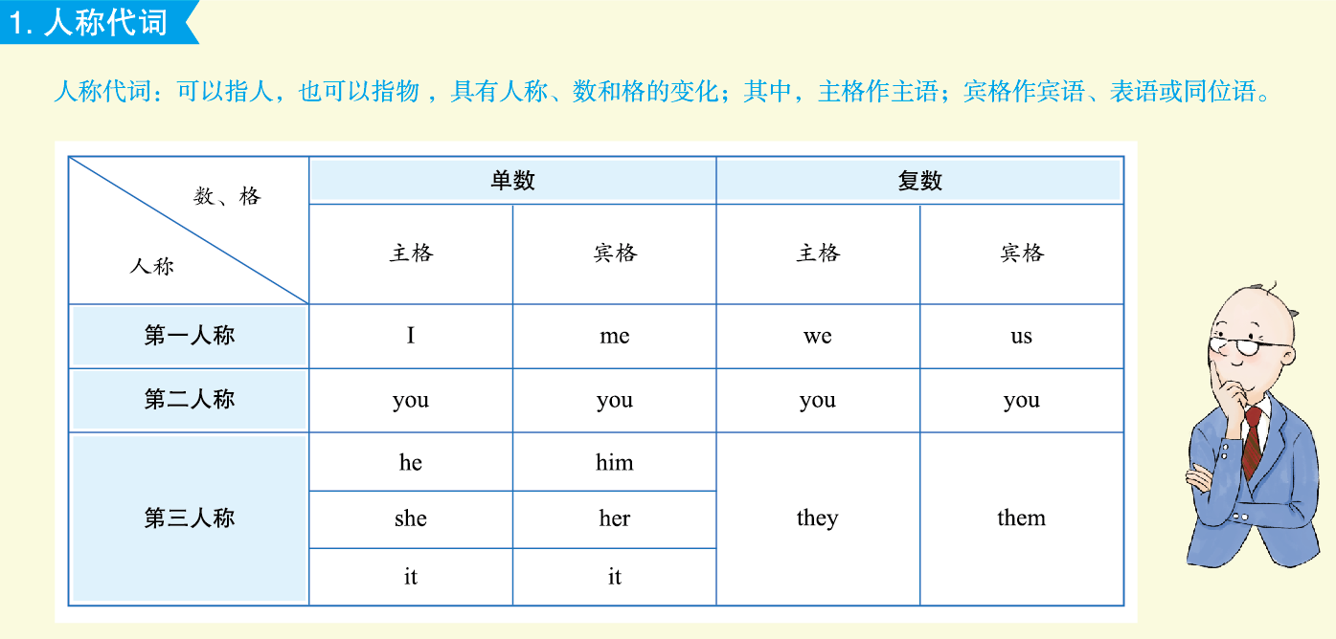

突破语法3
代词
P290

Slide 3
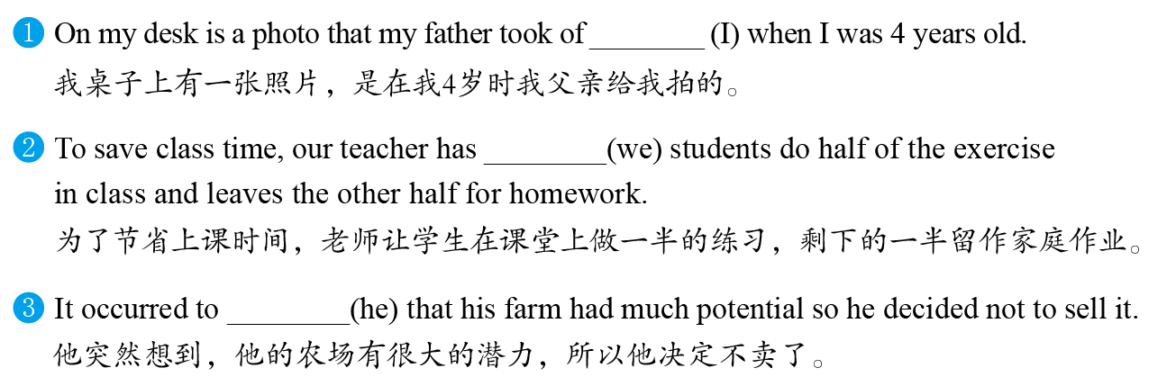
me
us
突破语法3
代词
P290
him

Slide 4
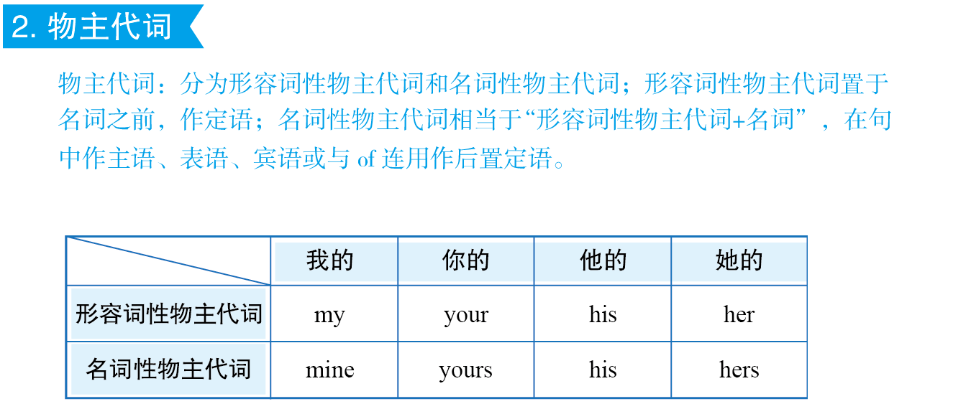
突破语法3
代词
P290

Slide 5
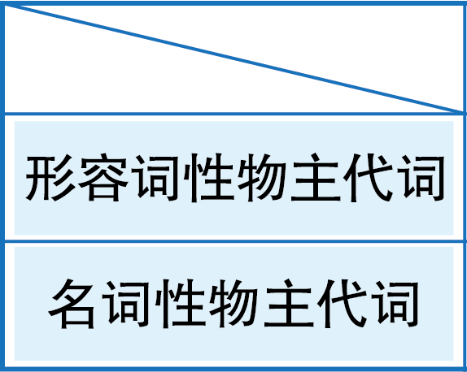
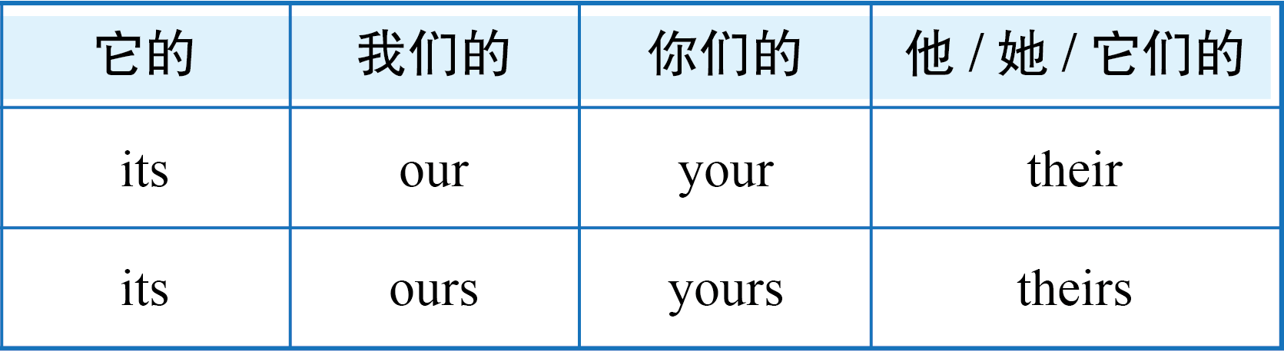
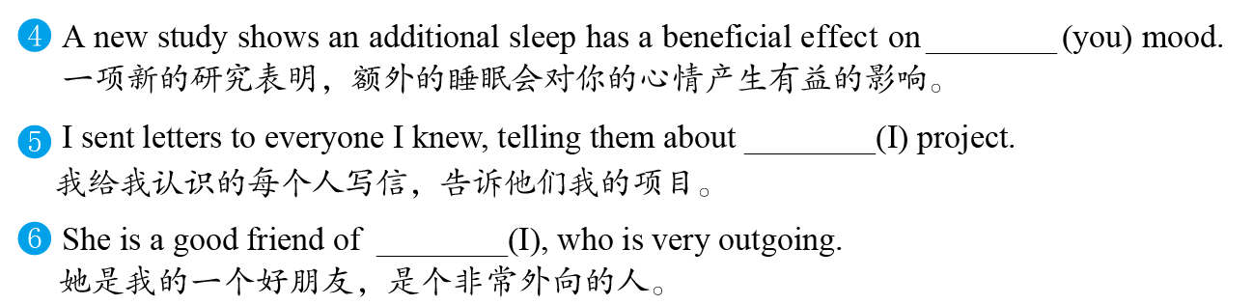
your
突破语法3
代词
P290
my
mine

Slide 6
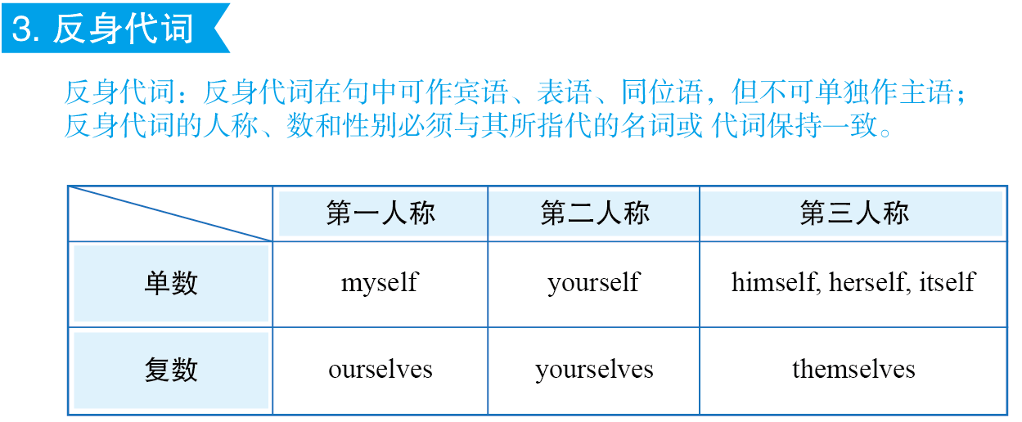
突破语法3
代词
P290

Slide 7
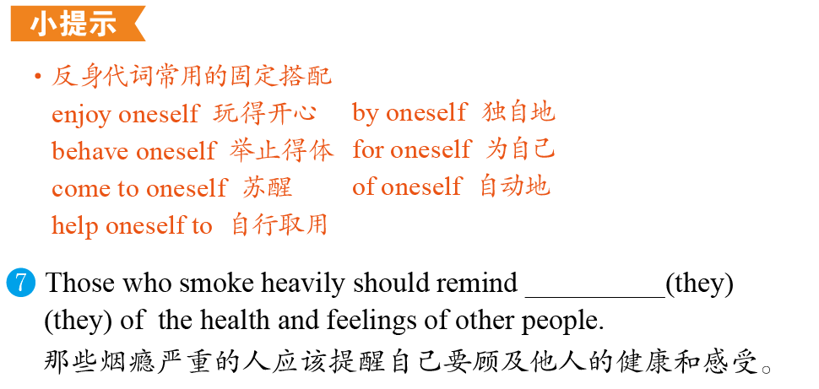
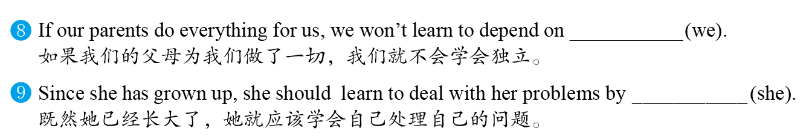
themselves
突破语法3
代词
P290
ourselves
herself

Slide 8
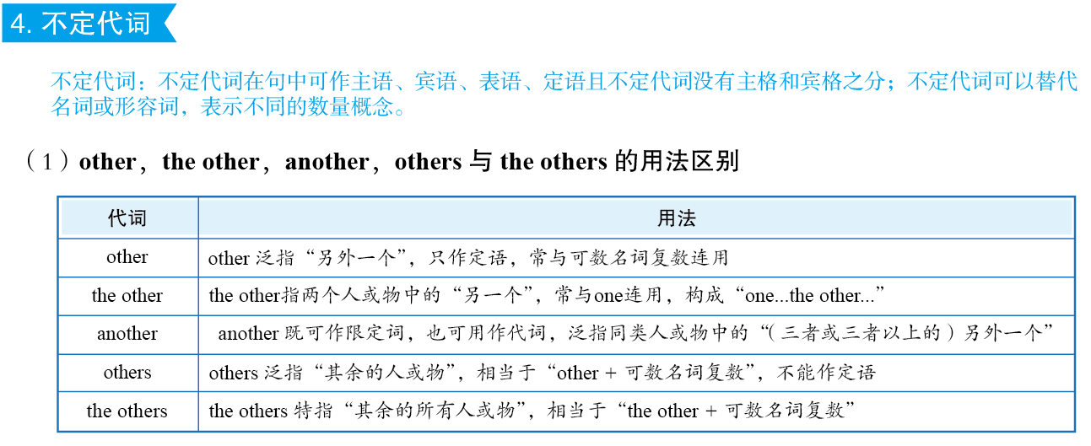
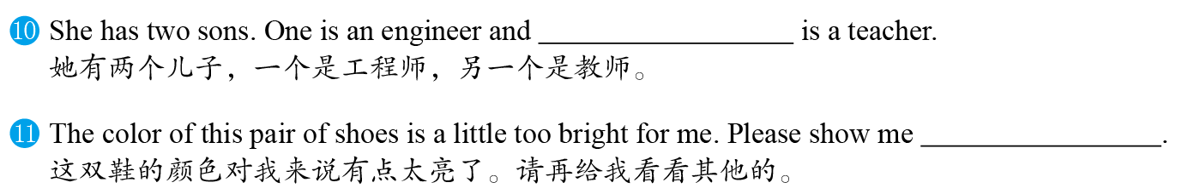
突破语法3
代词
P291
the other
another(pair)/others

Slide 9
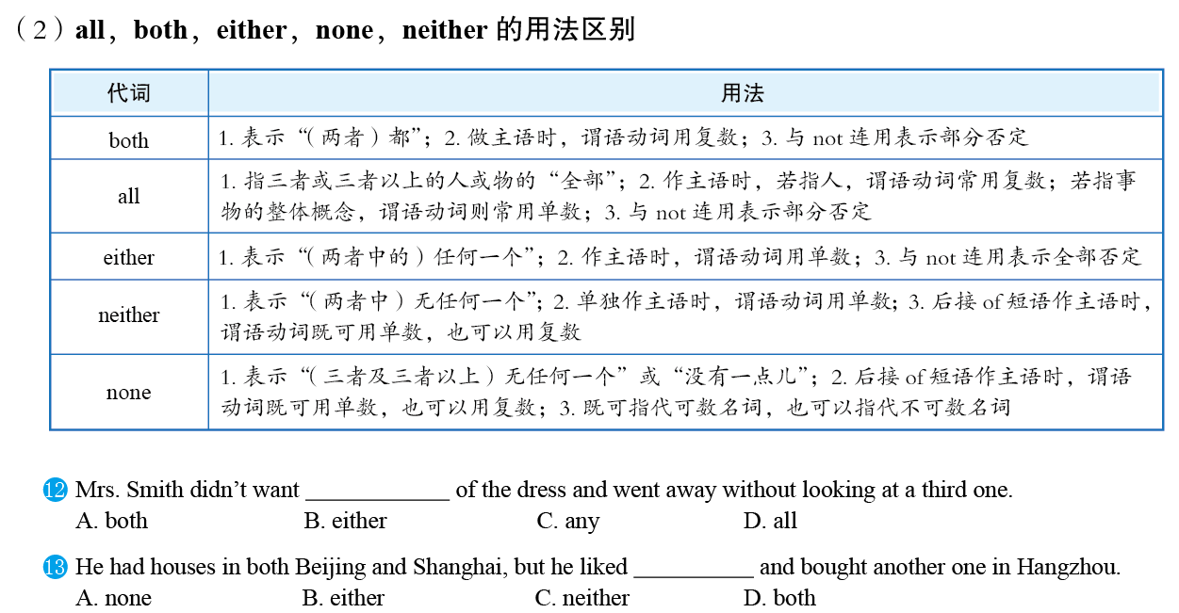
突破语法3
代词
P291
B
C

Slide 10
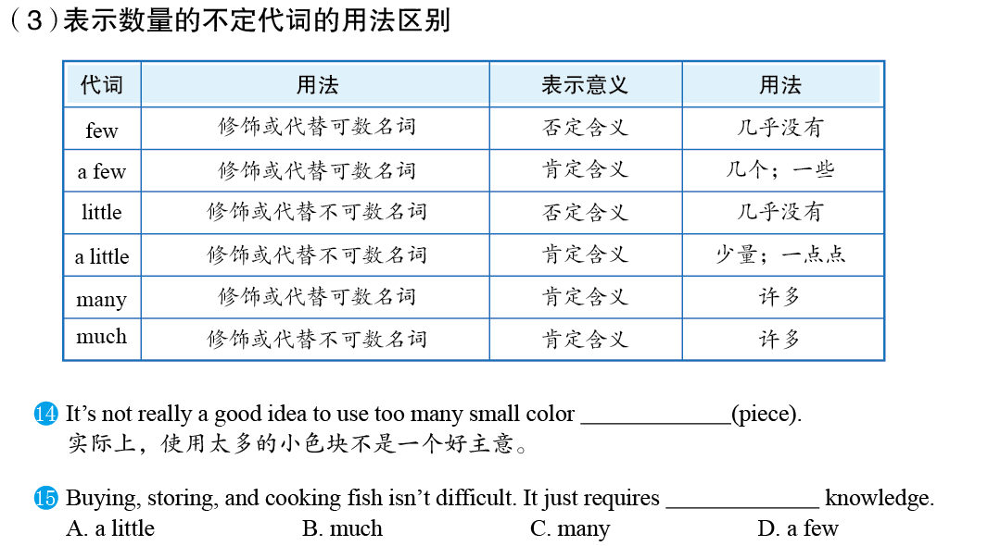
突破语法3
代词
P291
pieces
A

Slide 11
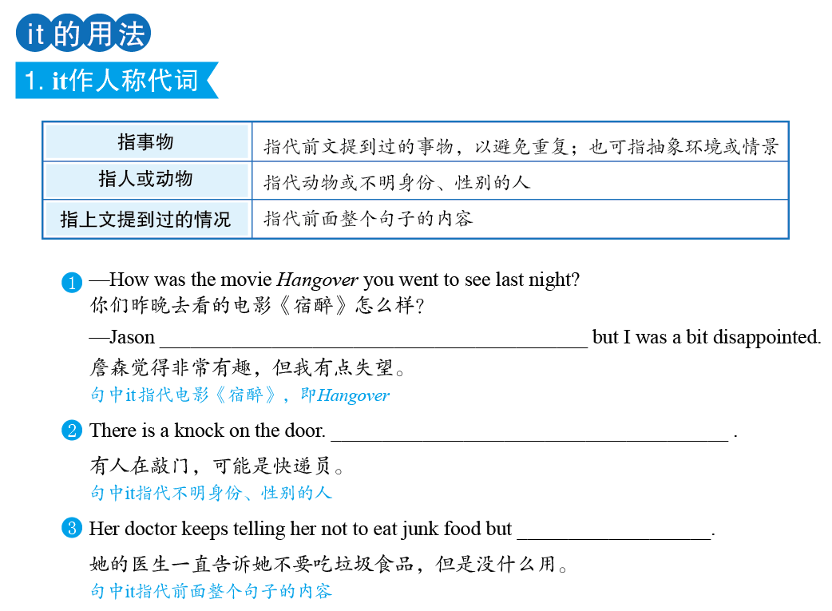
突破语法3
代词
P292
thought it was extremely amusing
It might be the expressman
it doesn’t work

Slide 12
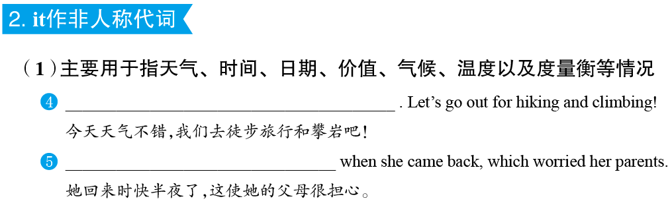
It is a lovely day today
It was nearly midnight
突破语法3
代词
P292

Slide 13
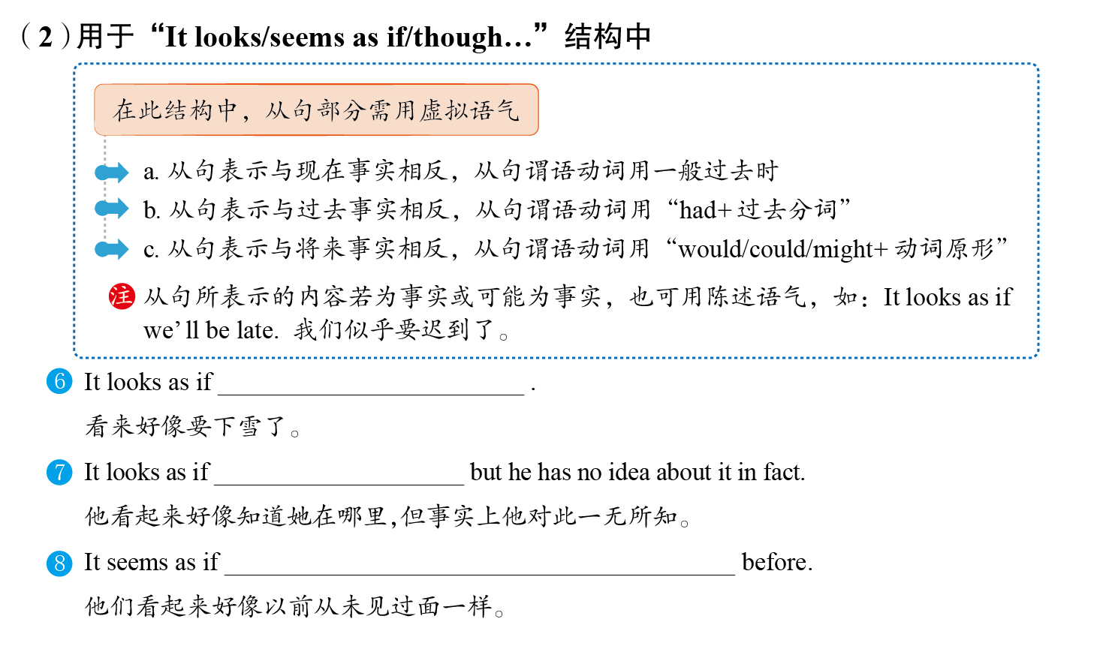
突破语法3
代词
P292
it will/is going to snow
he knew where she was
they had never seen each other

Slide 14
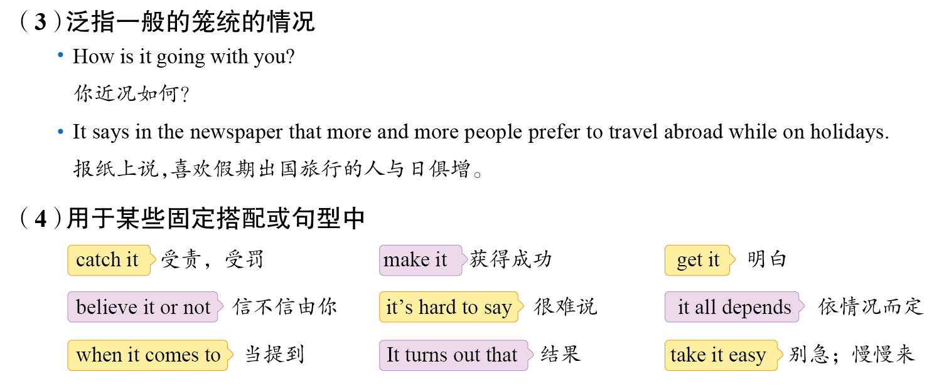
突破语法3
代词
P292

Slide 15
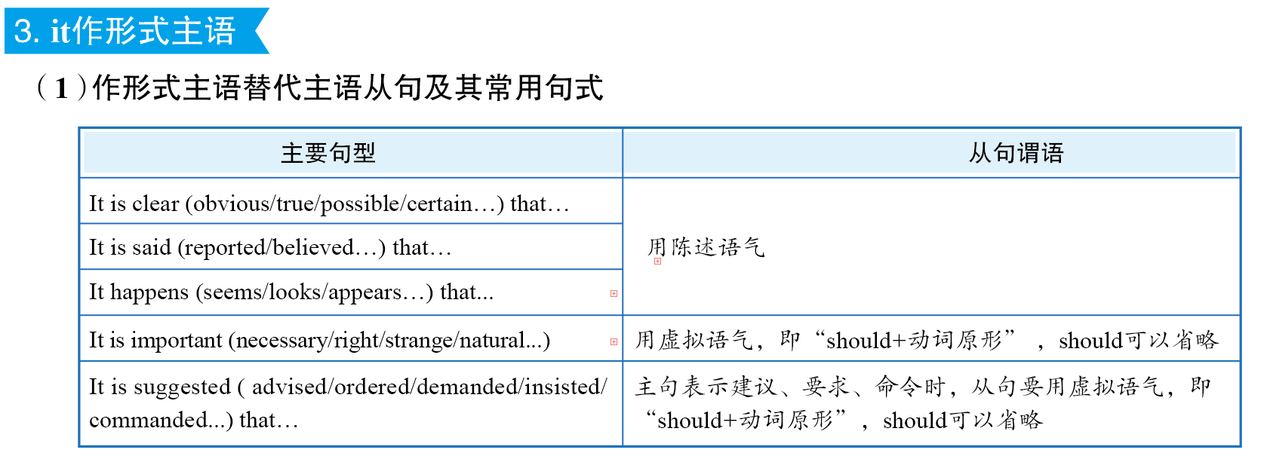
突破语法3
代词
P292

Slide 16
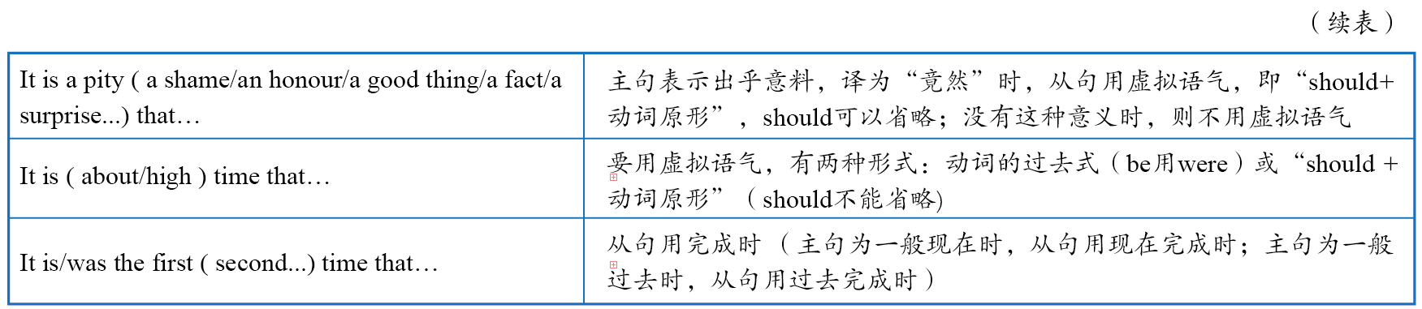
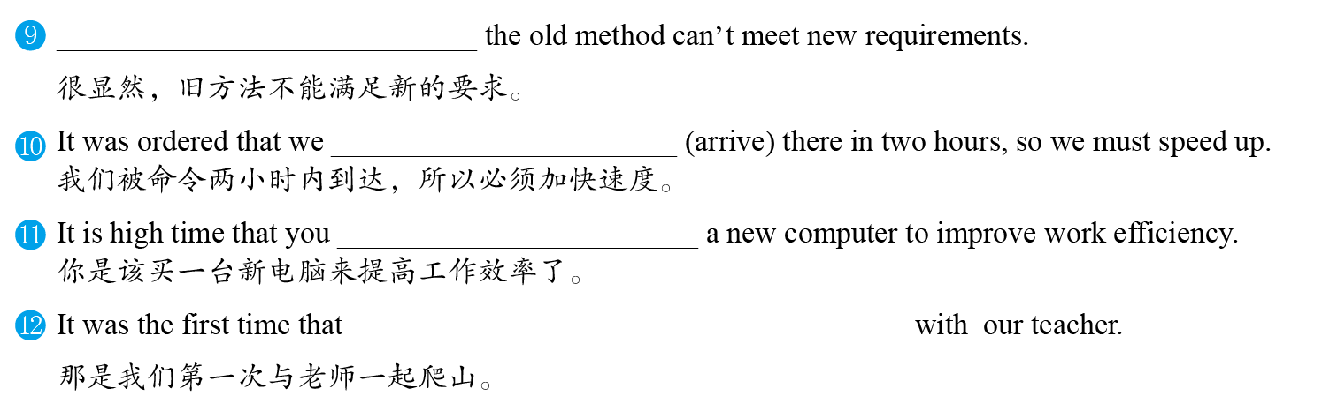
It is obvious that
突破语法3
代词
P293
(should) arrive
bought/should buy
we had climbed the mountain

Slide 17
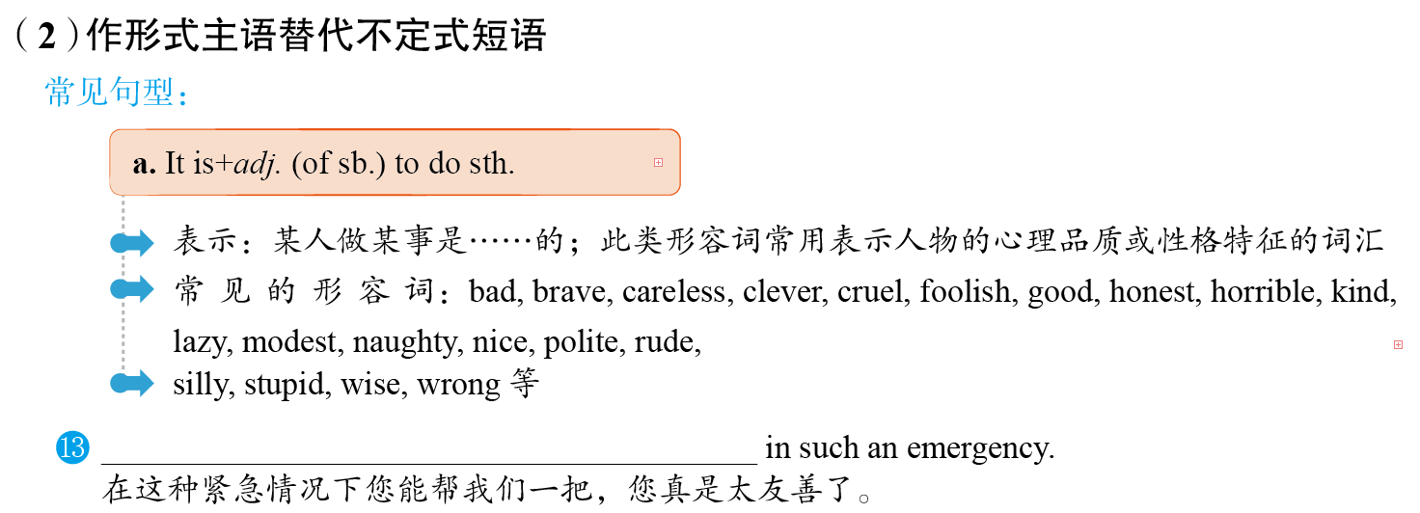

突破语法3
代词
P293
It is very kind of you to lend us a hand

Slide 18
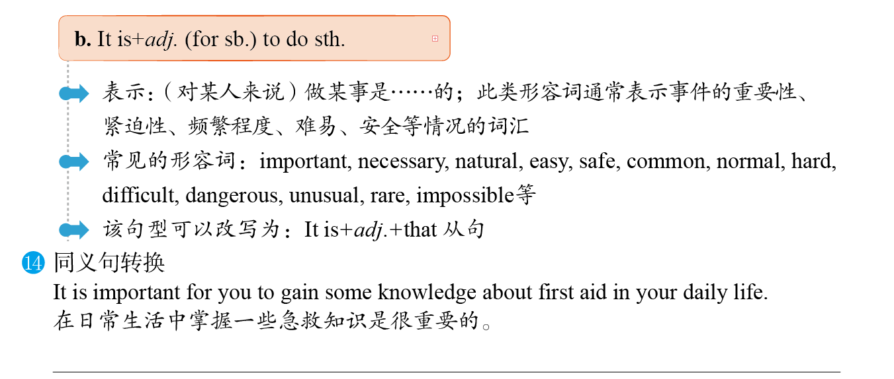
突破语法3
代词
P293
It is important that you (should) gain some knowledge about first aid in your daily life.

Slide 19
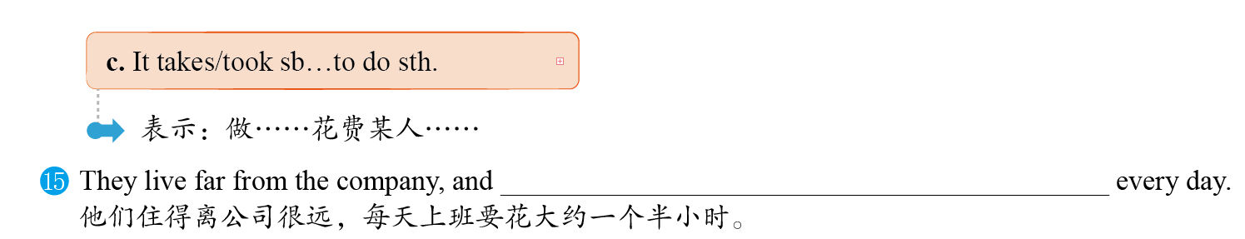
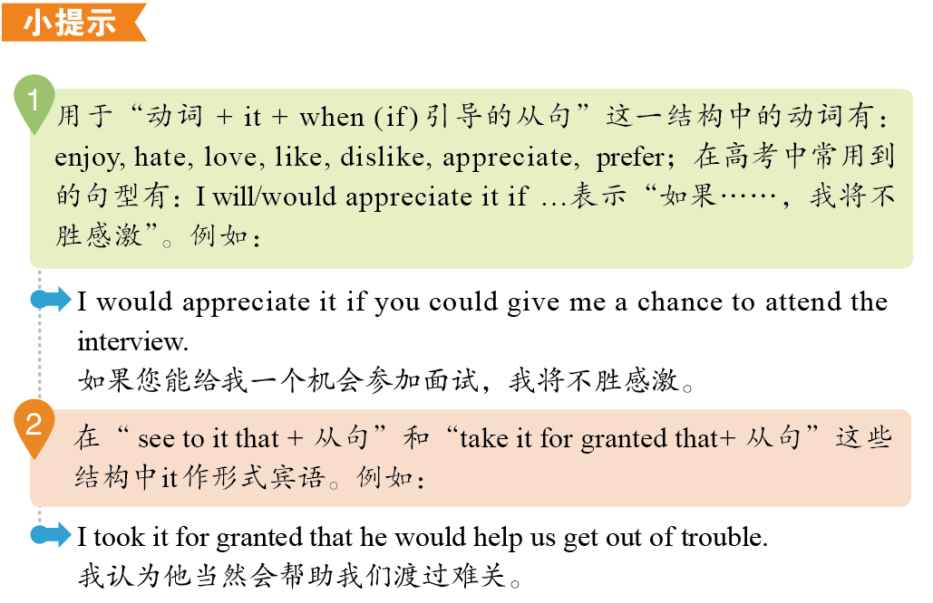
it takes them about an hour and a half to go to work
突破语法3
代词
P293

Slide 20
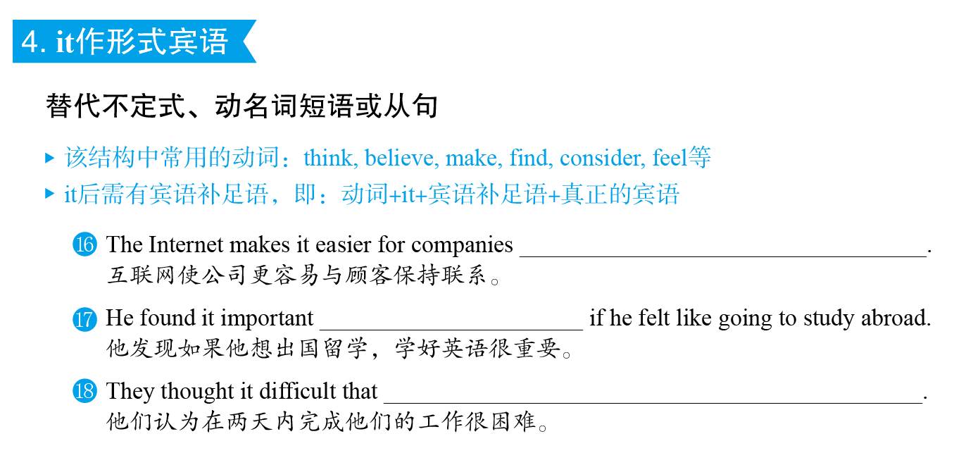
to keep in touch with customers
突破语法3
代词
P293
to learn English well
they would finish their work in two days

Slide 21
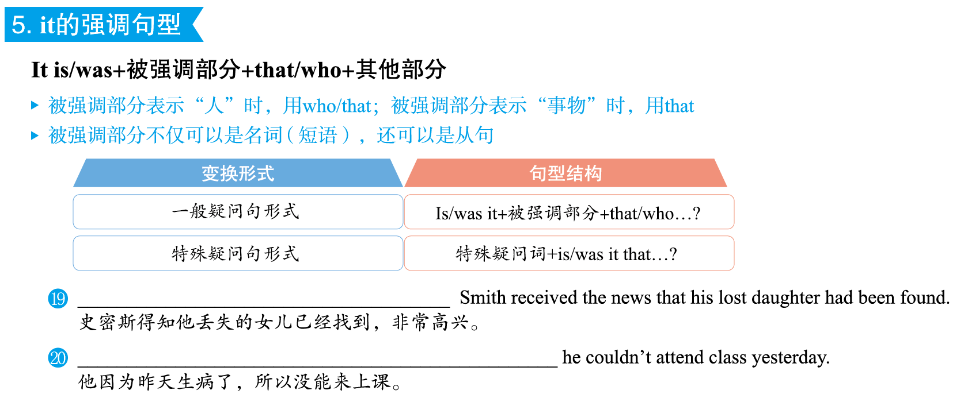
突破语法3
代词
P294
It was with great joy that
It was because he was ill that

Slide 22
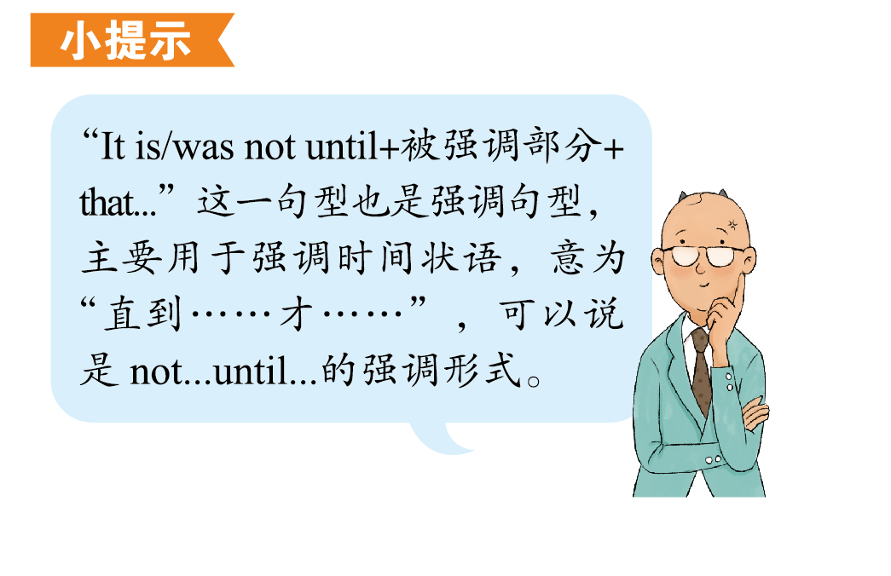
突破语法3
代词
P294

Slide 23
Ⅰ单句语法填空
突
破
积
累
练
阅读下面句子，填入合适的词或用所给词的适当形式填空。
It is polite you to give the seat to the old man and help him get off the bus.
(2019•新编)
1.
of
突破语法3
突破积累练
P288
突破语法3
突破积累练
P294
解析：
“It is + adj. (of sb.) to do sth.”句型中，形容词体现人的品质；“It is + adj. (for sb.) to do sth.”句型中，形容词体现不定式动作的性质。句意：你给这位老人让座并在他下车时帮助他，真是太有礼貌了。polite体现的是you的性格品质，故介词应选用of。

Slide 24
Ⅰ单句语法填空
2.
Many westerners who come to China cook much less than in their own countries once they realize how cheap can be to eat out.
(2018•浙江卷)
it
解析：
此处代词指代本句中不定式“to eat out”，作形式主语，故填it。
突破语法3
突破积累练
P294

Slide 25
Ⅰ单句语法填空
to
3.
For us students, no matter how busy we are, it is necessary
(spare) some time to do exercise.
(2019•新编)
spare
解析：
It is+adj.（for sb.）to do sth.为固定句型，意为“（对某人来说，）做某事是很……的”，故填to spare。句意：对于我们学生来说，不管我们有多忙，我们都应该抽出时间做运动。
突破语法3
突破积累练
P294

Slide 26
Ⅰ单句语法填空
4.
We can buy a new car this year or we can travel abroad but we can’t do .
(2019•新编)
both
解析：
分析语意可知，“我们”不能两件事都做，both表示“（两者）都”，与否定词连用时，表示部分否定，故填both。句意：我们今年要么买一辆新车，要么出国旅行，但不能两者都做。
突破语法3
突破积累练
P294

Slide 27
Ⅰ单句语法填空
Three years ago, I lost a dear friend of (I) in a car accident.
(2019•新编)
5.
mine
解析：
分析语意，空格处应表示“我的（朋友）”，又因为其后没有名词，故应填提示词的名词性物主代词mine。句意：三年前，在一次车祸中我失去了一位挚友。
突破语法3
突破积累练
P294

Slide 28
Ⅰ单句语法填空
6.
However, anger can easily turn violent, and it is best to know the reasons for anger to appear in order to prevent (it) presence.
(2018•北京卷改编)
its
突破语法3
突破积累练
P294
解析：
根据空格后的名词presence可知，空格处应填提示词的形容词性物主代词its，修饰后面的名词。句意：然而，愤怒很容易变成暴力，因此最好知道愤怒出现的原因，以防止它的出现。

Slide 29
Ⅰ单句语法填空
7.
But as the 200th anniversary of Dickens’s birth approaches, it is important for our own culture to understand how he made
(he) a lasting one.
(2018•浙江卷改编)
himself
突破语法3
突破积累练
P294
解析：
分析语意，空格处应表示“他自己”，故填提示词的反身代词himself。句意：但是，随着狄更斯诞辰200周年的临近，了解他是如何使自己成为一个不朽的人对（振兴）我们自己的文化是很重要的。

Slide 30
Ⅰ单句语法填空
8.
As is known to all, the education system of America is totally different from (we).
(2019•新编)
ours
突破语法3
突破积累练
P294
解析：
分析语意，空格处应表示“我们的教育体系”，又因为其后没有名词，故填提示词的名词性物主代词ours，相当于our education system。句意：众所周知，美国的教育体系与我们的完全不同。

Slide 31
Ⅰ单句语法填空
Here are a few (tip) to help you win over everyone in the neighbourhood quickly.
(2018•浙江卷改编)
9.
tips
突破语法3
突破积累练
P294
解析：
a few修饰可数名词复数，故空格处应填提示词的名词复数形式tips。句意：这里有一些技巧可以帮助你迅速赢得每位邻居的好感。

Slide 32
Ⅰ单句语法填空
either
10.
It had also given me a choice， to leave that page blank or to keep writing the story with hope. I chose hope.
(2018•江苏卷改编)
突破语法3
突破积累练
P294
解析：
分析句意可知，此处应表示选择关系，应用either，与后面的or构成“either…or…”，意为“要么……要么……”。句意：它也给了我一个选择，要么让这一页空白，要么继续满怀希望地继续写故事。我选择了希望。

Slide 33
Ⅱ 单句改错
下列各句中均有一处错误，请改正。
1.
My mother was ill in hospital all weekend. I had to look after her, which took her much time.
(2019•新编)
me
突破语法3
突破积累练
P294
解析：
分析语意，此处应表示“这花了我很多时间”。句意：我母亲整个周末都在医院里。我不得不照顾她，这花了我很多时间。

Slide 34
Ⅱ 单句改错
2.
In a word, pressure is an inevitable part of your life. You are supposed to make the most of it to promote ourselves.
(2019•新编)
yourself或yourselves
突破语法3
突破积累练
P294
解析：
根据句子主语you可知，此处应表示“提高你（们）自己”。句意：总之，压力是你（们）生活中不可避免的一部分。你（们）应该充分利用它来提高自己。

Slide 35
Ⅱ 单句改错
3.
I plan to take you directly to visit her. I’m sure she’ll be able to help yourself.
(2019•新编)
you
突破语法3
突破积累练
P294
解析：
分析语意，此处应表示“帮助你”。句意：我打算直接带你去看她，我相信她能够帮到你。

Slide 36
Ⅱ 单句改错
4.
Firstly I collected all the books, newspapers and another things scattered in the rooms and put them in place.
(2019•新编)
other
突破语法3
突破积累练
P294
解析：
分析语意，another表示“（三者或三者以上的）另外一个”，根据句意可知这里没有强调范围，故不能用another；other可以作形容词，other things表示“其他的东西”。句意：首先，我收集了散落在房间里的所有书籍、报纸和其他东西，并把它们放好。

Slide 37
Ⅱ 单句改错
5.
My grandpa said last summer them earned quite a lot by selling
the fish. I felt happy that their life had improved.
(2018•全国Ⅰ卷改编)
they
突破语法3
突破积累练
P294
解析：
分析句子结构可知，此时“他们”应该作宾语从句的主语，应用人称代词主语they。句意：我爷爷说去年夏天他们卖鱼赚了不少钱。我很高兴看到他们的生活有所改善。

Slide 38
Ⅲ 单句写作
根据所给提示完成句子。
1.
我不喜欢在我学习时她给我打电话，因为这会让我不能专心学习。(hate it)
(2019•新编)
, because it will make me not concentrate on my study.
I hate it when she calls me at study
突破语法3
突破积累练
P294
2.
这完全取决于你这一生希望实现什么目标。(depend on; accomplish)
(2019•新编)
in your life.
It all depends on what you want to accomplish

Slide 39
Ⅲ 单句写作
3.
有人建议我们应该更加关注环境保护和节能方面的问题。(it is suggested)
(2019•新编)
It is suggested that we should pay more attention to the problems of environment protection
突破语法3
突破积累练
P294
and energy conservation.
4.
你自己完成不了这项任务，因此你要和别人合作。(by oneself；others)
(2019•新编)
You can’t finish the task by yourself so you have to work with others.

Slide 40
Ⅲ 单句写作
5.
听说你要去参加她的聚会，希望你玩得开心。(enjoy oneself)
(2019•新编)
I hear that you are going to her party and I hope you can enjoy yourself.
突破语法3
突破积累练
P294

