Slide 1


AMC 8
2014
Hely

Slide 2

AMC 8
Algebra
Problem 1 13
Number theory
Problem 4 8 21 22
Word problems
Problem 2 3 5 7 10 11 17 24
Counting
Problem 16
Probability
Problem 12 18 19
Geometry
Problem 6 9 14 15 20 25
Logic
Problem 23
延迟符

Slide 3
Algebra
延迟符

Slide 4
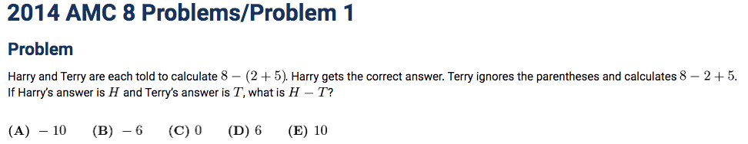


Slide 5
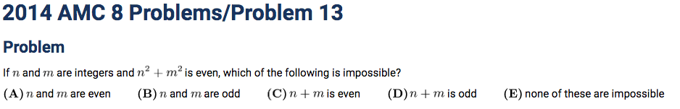

Slide 6
Number theory
延迟符

Slide 7
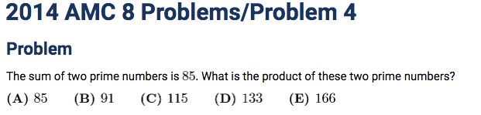



The smallest prime number:2 (the only even prime number)
延迟符

Slide 8
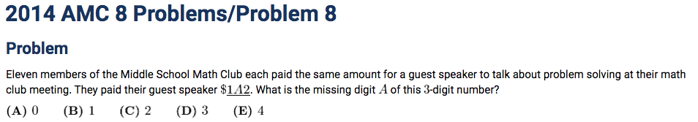

A number is divisible by if the difference between the sum of the digits in the odd-numbered slots (e.g. the ones slot, the hundreds slot, etc.) and the sum in the even-numbered slots (e.g. the tens slot, the thousands slot) is a multiple of
Divisibility rule for 11:
The positive difference between the sum of the digits in the odd-numbered slots and the sum in the even-numbered slots is 0 or a multiple of 11.
延迟符

Slide 9



延迟符

Slide 10
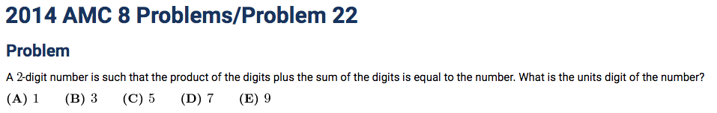

延迟符

Slide 11
Word problems
延迟符

Slide 12
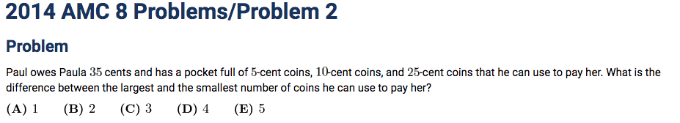

延迟符

Slide 13
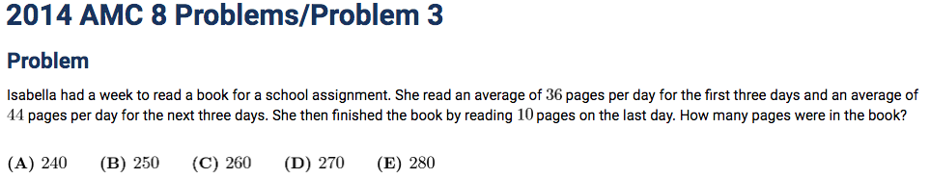
延迟符

Slide 14
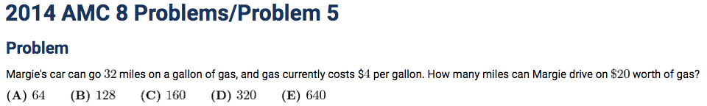
延迟符

Slide 15
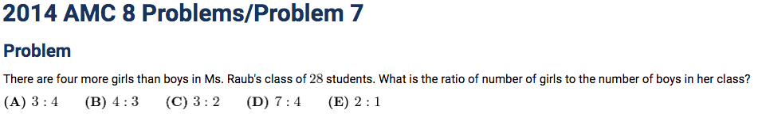

延迟符

Slide 16
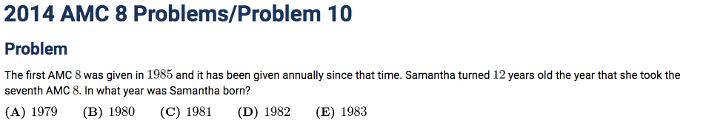

延迟符

Slide 17
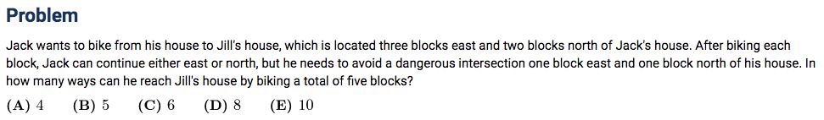

延迟符

Slide 18
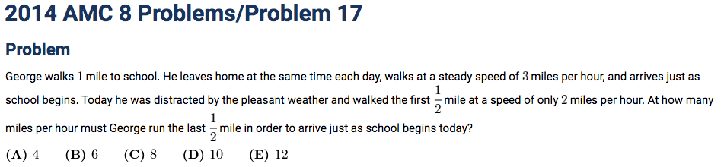
延迟符

Slide 19
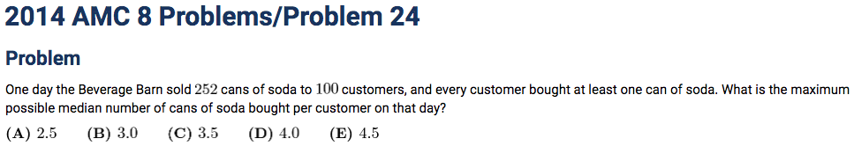
Median: A mid-point in an ordered set values or the arithmetic mean of the two middle values if there is no middle number.
延迟符

Slide 20
Counting problems
延迟符

Slide 21
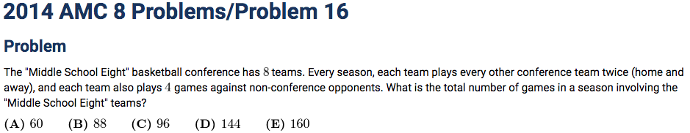

延迟符

Slide 22
Probability
延迟符

Slide 23
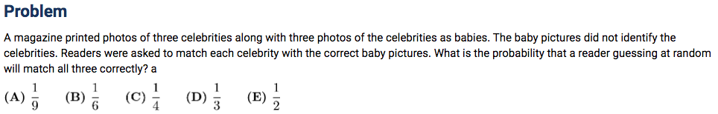

延迟符

Slide 24
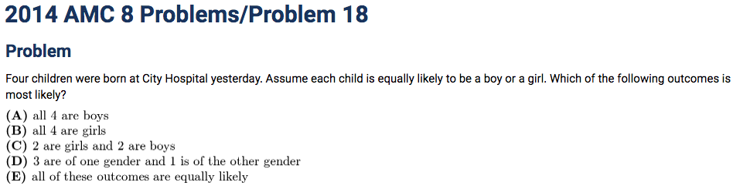

延迟符

Slide 25
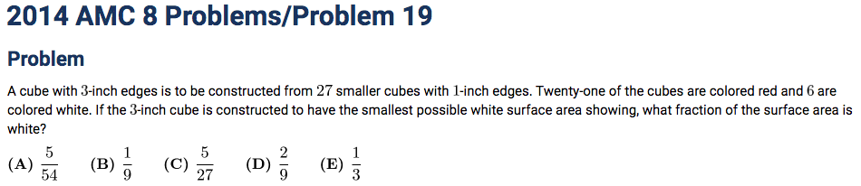

延迟符

Slide 26
Geometry
延迟符

Slide 27

延迟符

Slide 28
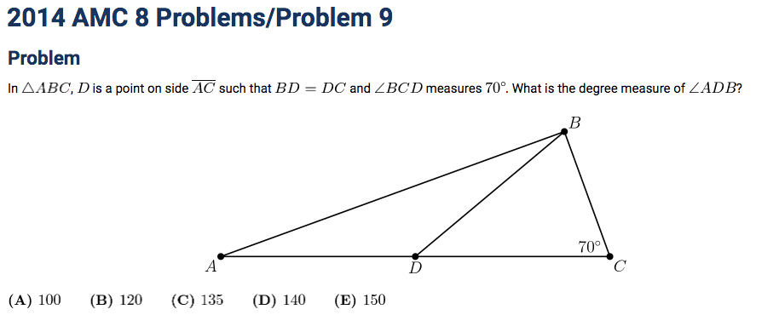

延迟符

Slide 29
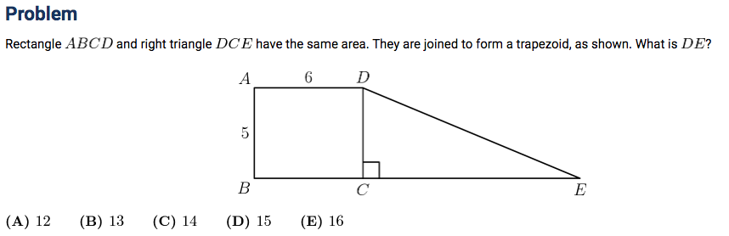

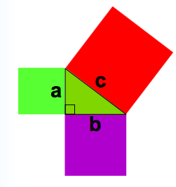
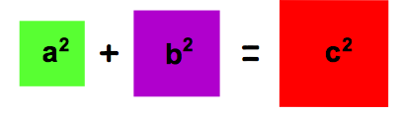

Pythagoras' Theorem
In a right-angled triangle , the square of the hypotenuse is equal to the sum of the squares of the other two sides.
延迟符

Slide 30
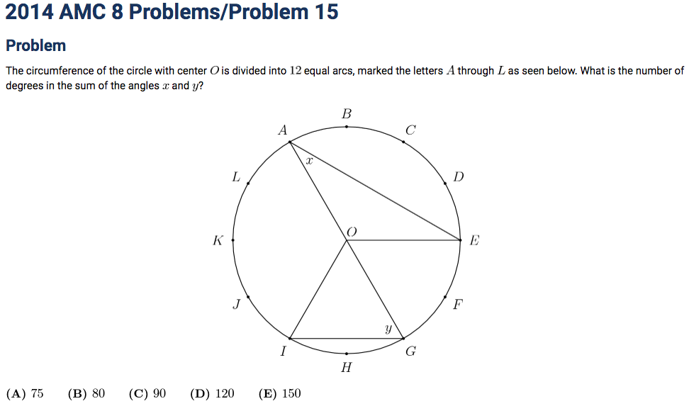

延迟符

Slide 31
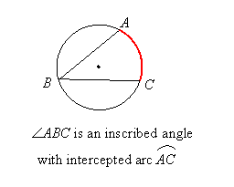
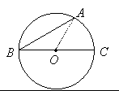

Inscribed Angles
An inscribed angle is an angle with its vertex on the circle and whose sides are chords of the circle:
The measure of an inscribed angle is half the measure of its corresponding central angle
External angle of a triangle is the sum to the two remote interior angles
延迟符

Slide 32
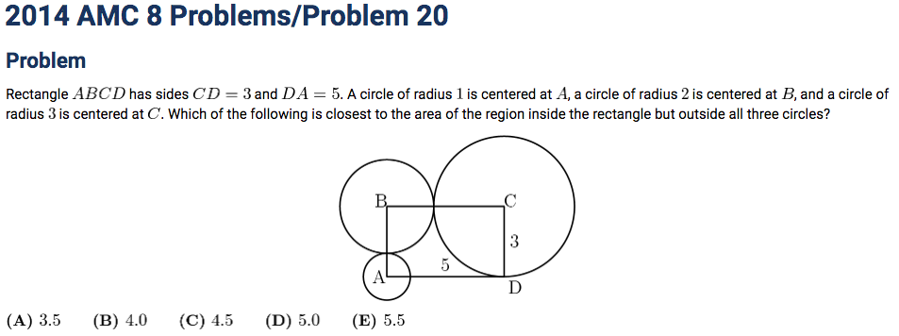

延迟符

Slide 33
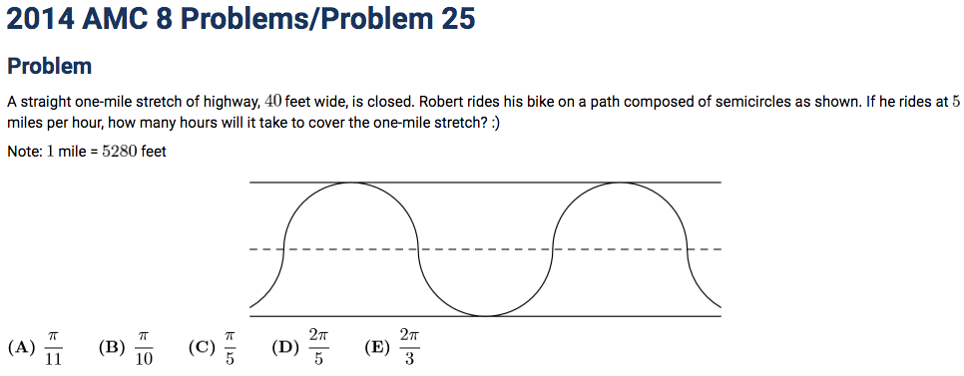

延迟符

Slide 34
Logic and Imagination
延迟符

Slide 35
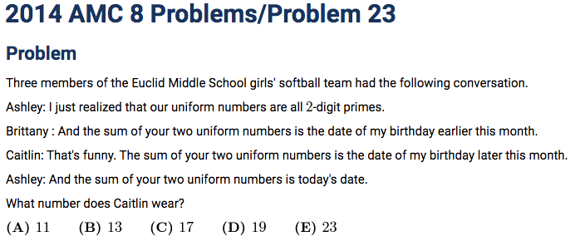

延迟符

Slide 36
Median: A mid-point in an ordered set values or the arithmetic mean of the two middle values if there is no middle number.
延迟符

Slide 37
Thank
You

