Slide 1


AMC 8
2017
Hely

Slide 2

AMC 8
Algebra
Problem 1 3 4 5 9 14 21 24
Number theory
Problem 7 8 12 17 19 23
Statistics
Problem 2
Counting Probability
Problem 10 13 15 20
Geometry
Problem 6 11 16 18 22 25
延迟符

Slide 3
Algebra
延迟符

Slide 4
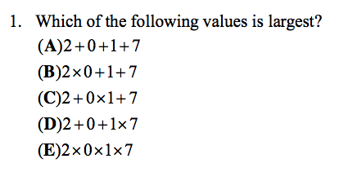

Slide 5
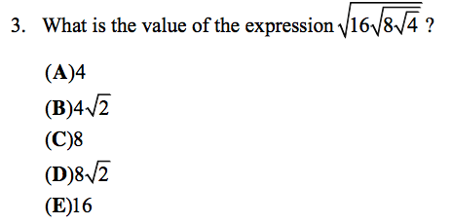

Square Root $√$
A factor of a number that when squared gives the number
Eg.The square root of 9 is 3
Square and square root are inverse operations
延迟符

Slide 6
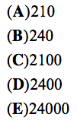

Slide 7
(A)1020 (B)1120 (C)1220 (D)2240 (E)3360
延迟符

Slide 8

9.All of Marcy's marbles are blue, red, green, or yellow. One third of her marbles are blue, one fourth of them are red, and six of them are green. What is the smallest number of yellow marbles that Marcy could have?
延迟符

Slide 9

14.Chloe and Zoe are both students in Ms. Demeanor‘s math class. Last night they each solved half of the problems in their homework assignment alone and then solved the other half together. Chloe had correct answers to only 80% of the problems she solved alone, but overall 88% of her answers were correct. Zoe had correct answers to 90% of the problems she solved alone. What was Zoe’s overall percentage of correct answers？
延迟符

Slide 10
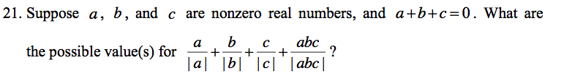
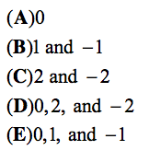

Absolute value
The magnitude of a real number without regard to its sign
≥0
延迟符

Slide 11

延迟符

Slide 12
Number theory
延迟符

Slide 13

7.Let Z be a 6-digit positive integer, such as 247247, whose first three digits are the same as its last three digits taken in the same order. Which of the following numbers must also be a factor of Z？
延迟符

Slide 14



延迟符

Slide 15
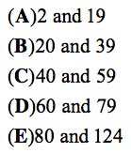
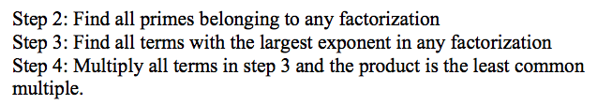
LCM

Slide 16

17.Starting with some gold coins and some empty treasure chests, I tried to put 9 gold coins in each treasure chest, but that left 2 treasure chests empty. So instead I put 6 gold coins in each treasure chest, but then I had 3 gold coins left over. How many gold coins did I have?

Slide 17

19.For any positive integer M, the notation M ! Denotes the product of the integers 1 through M . What is the largest integer n for which 5^{n} is a factor of the sum 98!+99!+100!?
延迟符

Slide 18

23.Each day for four days, Linda traveled for one hour at a speed that resulted in her traveling one mile in an integer number of minutes. Each day after the first, her speed decreased so that the number of minutes to travel one mile increased by 5 minutes over the preceding day. Each of the four days, her distance traveled was also an integer number of miles. What was the total number of miles for the four trips?
延迟符

Slide 19
Statistics
延迟符

Slide 20

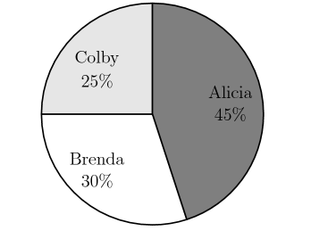
2.Alicia, Brenda, and Colby were the candidates in a recent election for student president. The pie chart below shows how the votes were distributed among the three candidates. If Brenda received 36 votes, then how many votes were cast all together?
延迟符

Slide 21
Counting problems
Probability
延迟符

Slide 22

10.A box contains five cards, numbered 1, 2, 3, 4, and 5. Three cards are selected randomly without replacement from the box. What is the probability that 4 is the largest value selected?
延迟符

Slide 23

13.Peter, Emma, and Kyler played chess with each other. Peter won 4 games and lost 2 games. Emma won 3 games and lost 3 games. If Kyler lost 3 games, how many games did he win?
延迟符

Slide 24

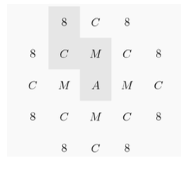
15.In the arrangement of letters and numerals below, by how many different paths can one spell AMC8? Beginning at the A in the middle, a path allows only moves from one letter to an adjacent (above, below, left, or right, but not diagonal) letter. One example of such a path is traced in the picture.
延迟符

Slide 25

20. An integer between 1000 and 9999, inclusive, is chosen at random. What is the probability that it is an odd integer whose digits are all distinct?
延迟符

Slide 26
Geometry
延迟符

Slide 27

6.If the degree measures of the angles of a triangle are in the ratio 3:3:4, what is the degree measure of the largest angle of the triangle?
延迟符

Slide 28

延迟符

Slide 29


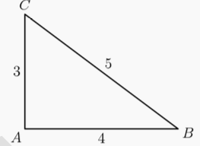
延迟符

Slide 30

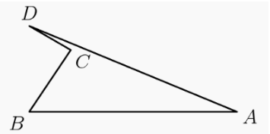
延迟符

Slide 31
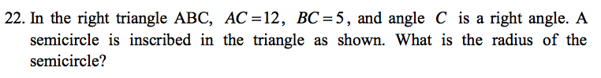

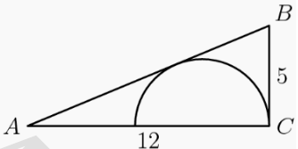
延迟符

Slide 32
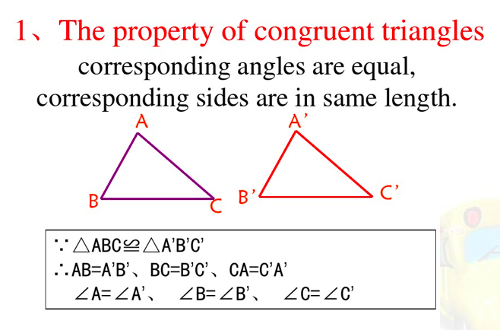
延迟符

Slide 33
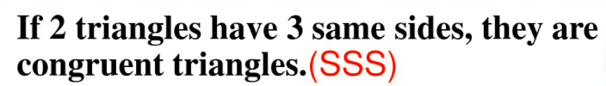
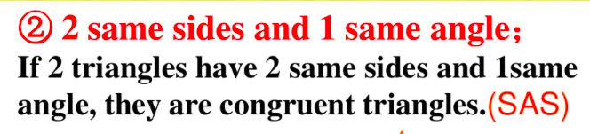
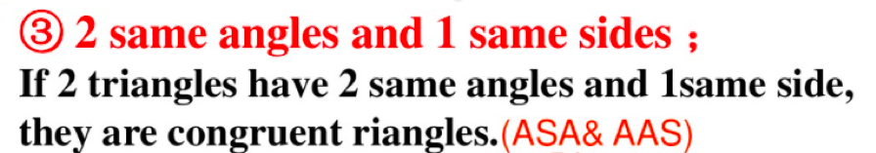
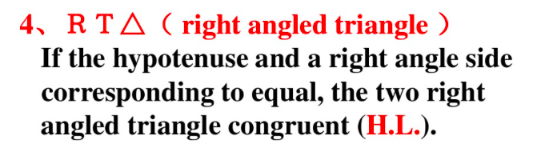
延迟符

Slide 34
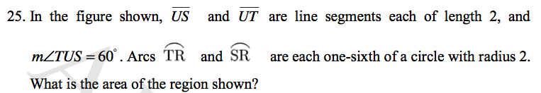
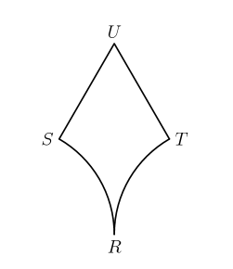
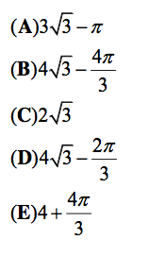
延迟符

Slide 35
Thank
You

