Slide 1

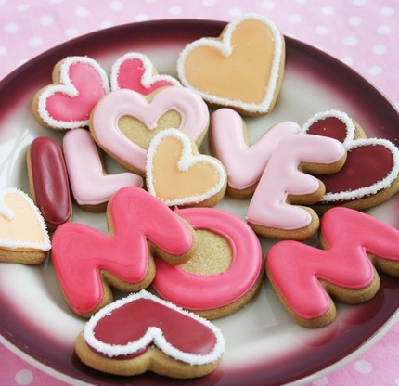
Oxford English
Module 1 People and places
Unit
1
People around us
More
Practice

Slide 2
You raise me up,
你激励了我
so I can stand on mountains;
故我能立足于群山之巅
You raise me up,
你鼓舞了我
to walk on stormy seas;
故我能行进于暴风雨的洋面
I am strong when I am on your shoulders;
在你坚实的臂膀上，我变得坚韧强壮
You raise me up: 你鼓励了我
To more than I can be. 使我超越了自我
Who raise you up?

Slide 3

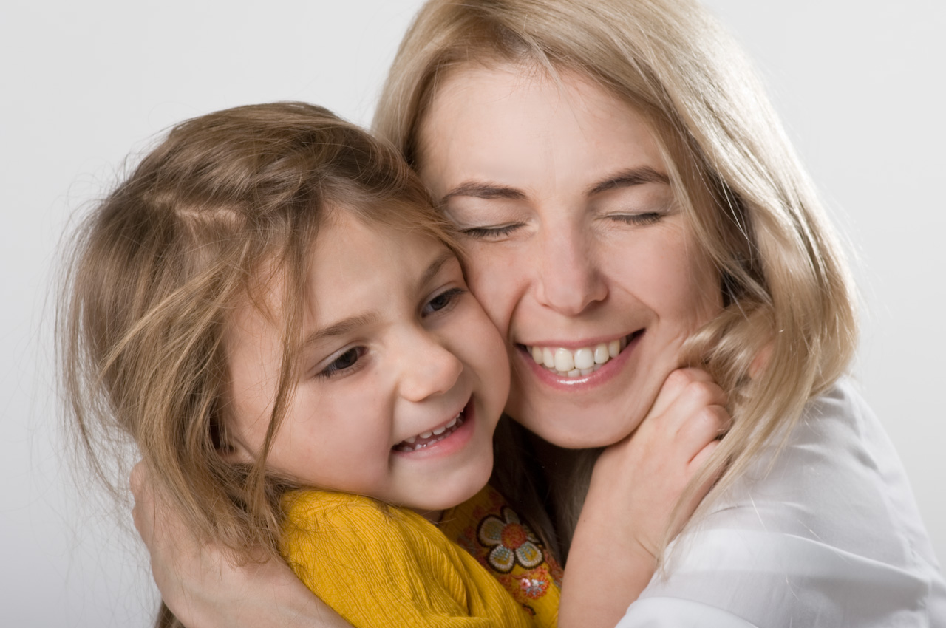
Warming-up
Discussion
It’s MUM!
Who is the greatest person in your family?
Who do you like best in your family? Why?
Who cooks and cleans for you in your family?
Who makes you feel better when you are sad in your family?

Slide 4
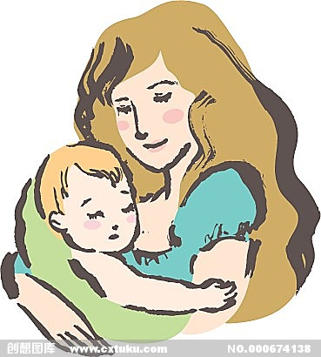
What is your mother like?
Hobby
Appearance
(外貌)
Character
(性格，品质)
Age/Job…

Slide 5

Mother’s Day
When is Mother’s Day?
In most countries, Mother’s Day is on the second Sunday in May every year.

Slide 6
Speak up:
How will you celebrate this Mother’s Day to show your love?

Slide 7

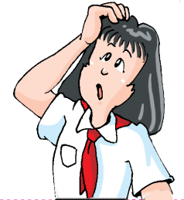
Ways to celebrate Mother’s Day
buy flowers
make special Mother’s Day cards
help them do the housework
take them to the park or the cinema
give them a simple hug or say “I love you, Mum”
…

Slide 8
Fill in the table below.
Mother's Day
Date
Things mums usually do for us | 1. cook for us
 | 2. clean for us
 | 3. encourage us
 | 4. give us support
ways to celebrate Mother's Day | 1. buy flowers
 | 2. make special Mother's Day cards
 | 3. help them do the housework
 | 4. take them to the park or the cinema
 | 5. give them a simple hug or say "I love you, Mum."
on the second Sunday in May

Slide 9
Read an online article about Mother’s Day and answer the questions below.
  When is Mother’s Day in most countries?
It is on the second Sunday in May every year.
  What do people like to do on this day?
People like to buy flowers and make special Mother’s Day cards for their mums.
  What does the author advise people to do on this day?
The author advises people to help their mums do the housework, take them to the park or the cinema, give them a simple hug or say “I love you, Mum”.

Slide 10
翻译下列词组
大量辛苦工作(L1)
鼓励我们(L2)
给我们支持(L2)
在大部分国家(L4)
在五月份第二个星期天(L4)
在这一天(L5)
不仅关于礼物(L7)
做家务(L7)
9. 带某人去某地(L8)
10. 一个简单的拥抱(L9)
11. 最好的礼物(L9)
12. 为什么不…… (L12)
a lot of hard work
encourage us
give us support
in most countries
on the second Sunday in May
on this day
not only about gifts
do the housework
take sb. to spl.
a simple hug
the perfect gift
Why not…?

Slide 11
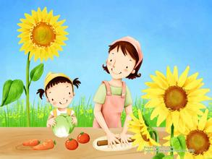
Notes（P12）
In most countries, people celebrate Mother’s Day on the second Sunday in May every year.
在大多数国家，人们在每年五月份的第二个星期日庆祝母亲节。
①celebrate v. 庆祝；庆贺
如:Jack and his friends will go out for a meal to celebrate his birthday.
杰克和他的朋友们要出去吃饭以庆祝他的生日。
②on和in是介词，在本句中表示时间。
on意为“在（某一天）”；
表示“在……月份”时用in。
表示时间的介词还有at。

Slide 12
on，in与at在表示时间时的不同用法
on | 在星期几 | on Monday在星期一
 | 在某月某日 | on 1 May 在五月一日
 | 在节日当天 | on New Year’s Day 在新年那天
 | 在具体某天的上午、下午或晚上 | on Sunday morning 在星期天上午
 | 在有限定词修饰的上午、下午或晚上 | on a cold winter evening 在一个寒冷冬天的晚上
in | 泛指在上午、下午或晚上 | in the afternoon 在下午
 | 在某年、某月或某个季节 | in 2013 在2013年
at | 在具体时刻前 | at six 在6点
 | 习惯搭配 | at noon 在中午at night在晚上

Slide 13
2. On this day ,people like to buy flowers and make special Mother’s Day cards for their mums.
①buy sth. for sb. = buy sb. sth. 给某人买礼物
如:My father often buys gifts for us.
= My father often buys us gifts.
我爸爸经常给我们买礼物。
②make sth. for sb.= make sb. sth.
给某人制作某物
如: She often makes cakes for her children.
= She often makes her children cakes.
她经常给她的孩子们做蛋糕。

Slide 14
3. why not plan a special Mother’s Day for her?
为什么不为她计划一个特别的母亲节呢？
Why not do sth.=Why don’t you/we do sth.?
为什么不做某事呢？ 用于提出建议。
如:Why not go out for a walk?
=Why don’t you/we go out for a walk?
为什么不出去走走呢？

Slide 15
英语作业
1 周五：学评 14-15页
周六： 学评 16-17页 周日：学评18页（书面表达要做）
（做完用红笔自己订正）
阅读21世纪英文报（TEENS Junior 初二）
每周看一份，在笔记本上做好摘抄。
3 请各位同学在钉钉班级师生群“家校本”拍照
上传周末的学评作业。
4 背诵这个单元的Reading。
英语早读时间是周一、三、五早晨：7:30---7:50
下周一听写unit1 单词、短语。

Slide 16
Thank you!

