Slide 1
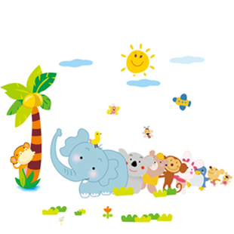
1. Have you ever been to the zoo?
2. What animals do you like best?

Slide 2

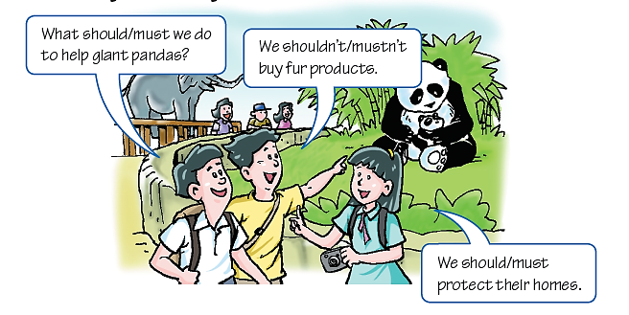
Read the conversation and answer the question.
What words do the students use when they are talking
about obligations?
Modal verbs like “should” and “must”.

Slide 3
Talking about obligations
should/ ought to和must表达义务或责任。
should/ ought to：应该
否定式：should not/ ought not to 不应该
must：必须
否定式：must not：禁止
在表示义务或责任时，should比must略轻一些。

Slide 4
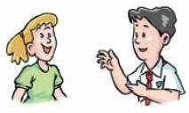
A1 Read the conversation below and practise it in pairs. Pay attention to the words in blue.
Kevin: What should we do to protect the fish in the river?
Amy: We mustn’t throw rubbish into the river. The fish will die if the river is polluted.
Kevin: What else should we do?
Amy: We should write to factories and ask them to stop polluting the river.
Kevin: Good idea.

