Slide 1
Unit 5 Save the endangered animals
Writing

Slide 2

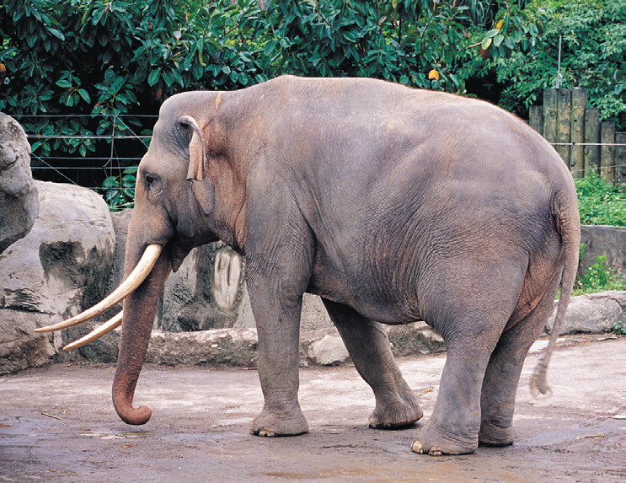
Guess
Can you guess the animal?
It is huge and grey.
It eats grass, leaves and fruit.

Slide 3
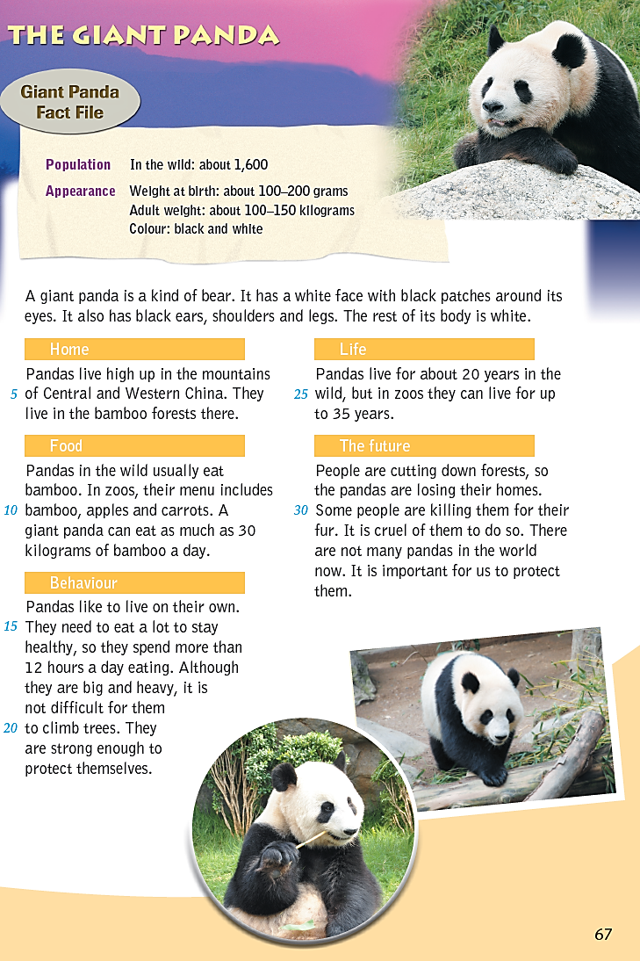
Think and make
Make a spidergram of topics about pandas.
Home
?
Food
The future
Behaviour
Life

Slide 4
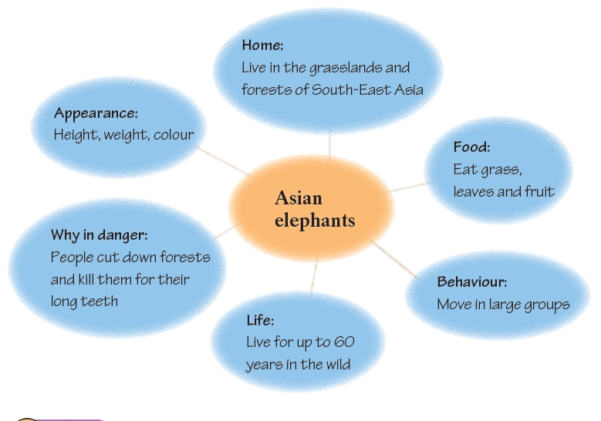

Slide 5
What can we write in a fact file?
Part I What do they look like?
Part II Where do they live?
Part III What do they eat?
Part IV How do they live and how long can they live?
Part V Why are they endangered?

Slide 6
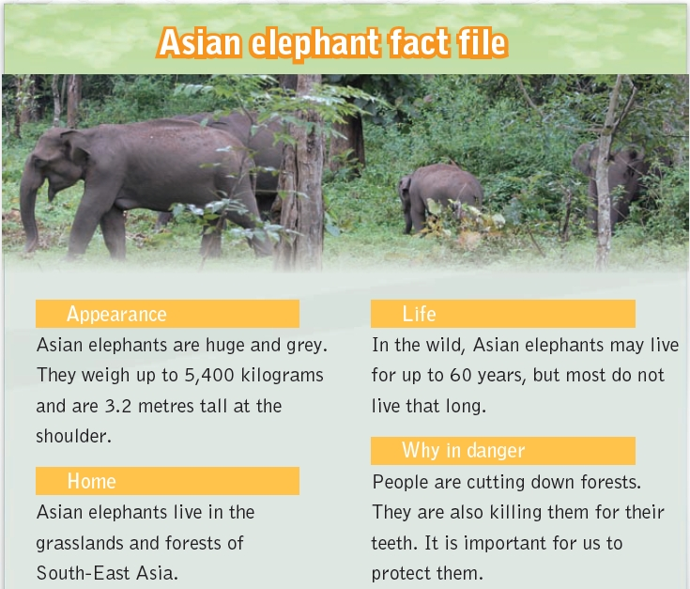

Slide 7
Rewrite your fact file into an article. Use the example below to help you.
Please help us!
Hello. I am a panda. My home is in Central and Western China. I live high up in the mountains. I have a white face with black patches around my eyes. I also have black ears, shoulders and legs. I love eating bamboo and I spend more than 12 hours a day eating.
There are about 1,600 of us in the wild. However, some people are still killing us for our fur.

