Slide 1

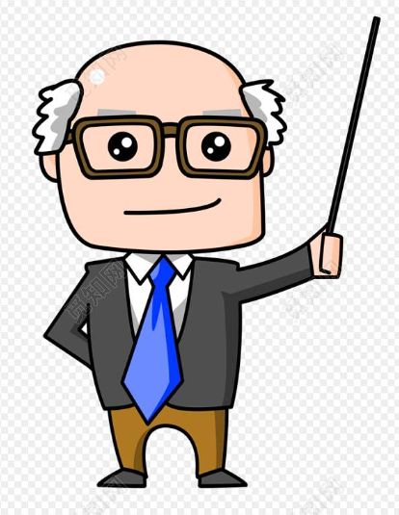
I can share my knowledge with you.
I can help you solve problems on study.
I must correct homework every day.
Who am I?
teacher

Slide 2

I can taste different kinds of food every day.
I can cook delicious dishes.
I must wash my hands before I work.
Who am I?
cook

Slide 3
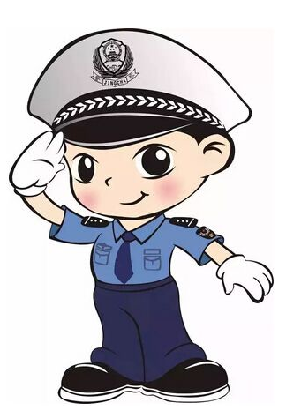
I can catch the thief.
I can fight with the bad person.
I must protect you and make sure you are safe.
who am I?
policeman

Slide 4
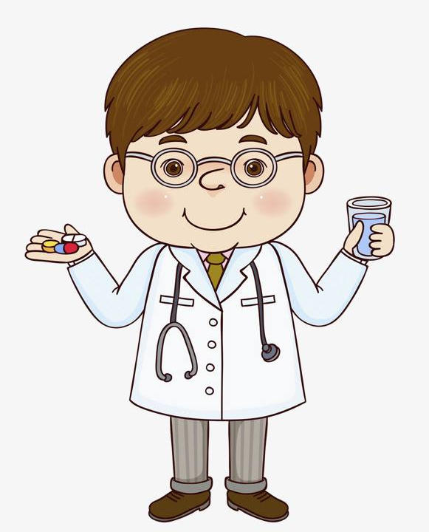
I can save people’s lives.
I can take care of people.
I must do my jobs very carefully.
who am I?
doctor

Slide 5

can &
cannot
01

Slide 6
can and cannot
We can use electricity to do many things.
We cannot/ can’t see electricity.
Can we use electricity to do many things?
Yes, we can.
No, we cannot/ can’t.
When?
We use ____ to say we are able to do something.
We use _____ to say we are unable to do something.
can
cannot

Slide 7
must & must not
02

Slide 8
must and must not
You must turn off the electricity first.
You mustn’t/ must not say that, Benny!
Must I turn off the electricity first?
Yes, you must.
No, you needn’t/ don’t have to.
When?
must
We use _____ to tell people what to do.
We use _______ to tell people what not to do.
must not

Slide 9
may & may not
03

Slide 10
may and may not
You may turn on the TV.
You may not touch the wires.
May I touch the wires?
Yes, you may.
No, you may not.
When?
We use ____and ________to ask for and give permission.
may
may not

Slide 11
Work out the rule
We can use electricity to do many things.
We cannot/ can’t see electricity.
You may turn on the TV.
You may not touch the wires.
You must turn off the electricity first.
You mustn’t/ must not say that, Benny!
After modal verbs such as can, may and must, we use (the base form/ the –ing form/ the –ed form)of a verb.

Slide 12
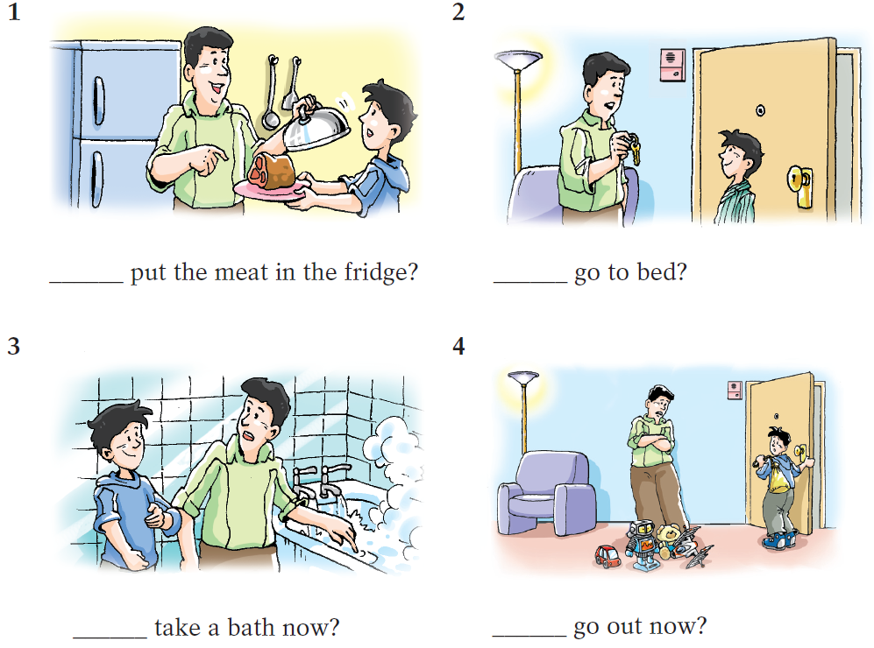
When Johnny does the housework, his father is talking with him about safety at home. P81
cover the meat
lock the door
test the water
tidy up
J: May I …?
D: No, you may not.
You must …first.
Then you may…

Slide 13
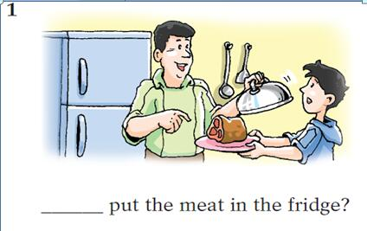
When he do the housework, his father is talking with him about safety at home.
J: May I … ?
D: No, you may not.
You must … first.
Then you may…
put the meat in the fridge
cover the meat
put the meat in the fridge.

Slide 14
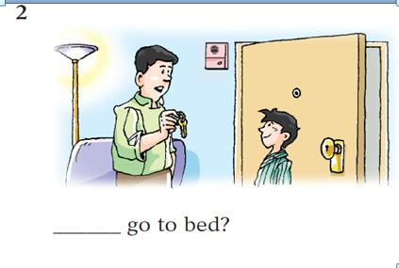
When he do the housework, his father is talking with him about safety at home.
go to bed
J: May I … ?
D: No, you may not.
You must … first.
Then you may… .
lock the door
go to bed

Slide 15
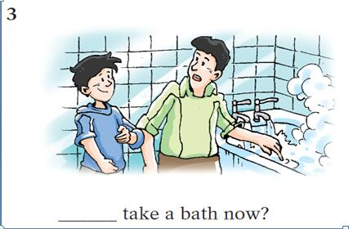
When he do the housework, his father is talking with him about safety at home.
J: May I … ?
D: No, you may not.
You must … first.
Then you may … .
take a bath now
test the water
take a bath

Slide 16
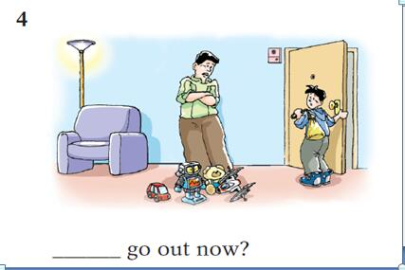
When he do the housework, his father is talking with him about safety at home.
J: May I … ?
D: No, you may not.
You must … first.
Then you may … .
go out now
tidy up
go out

Slide 17

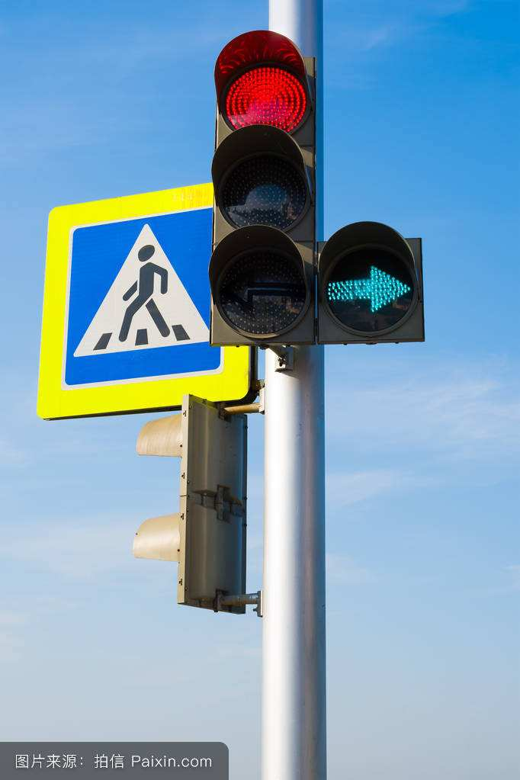
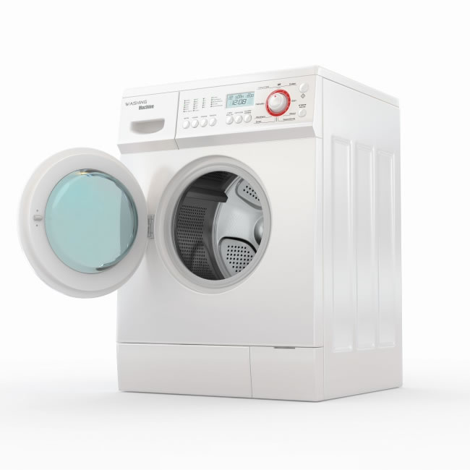
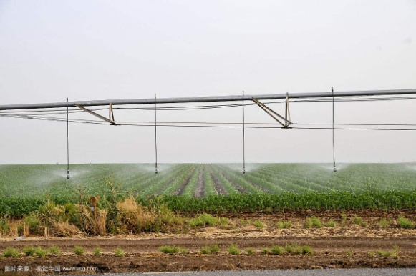
What can we use electricity to do?

Slide 18
What can we use electricity to do in streets?
make the traffic lights work
light the roads
We ________________
_______________
can use electricity to make the traffic lights work.
can use electricity to light the roads.
We _________________
____________________
____________________

Slide 19
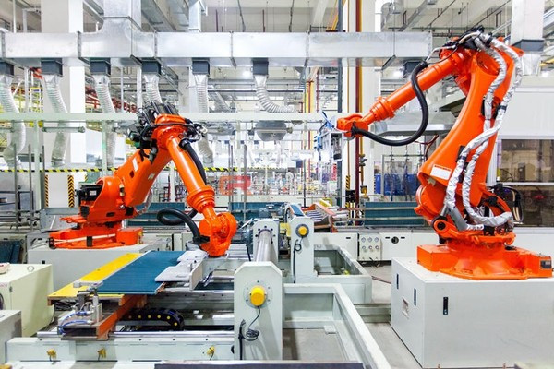
What can electricity do in factories and villages?
work the machines
water the land
Electricity __________
___________________
can help water the land in villages.
can work the machines in factories.
Electricity _____________
___________________

Slide 20
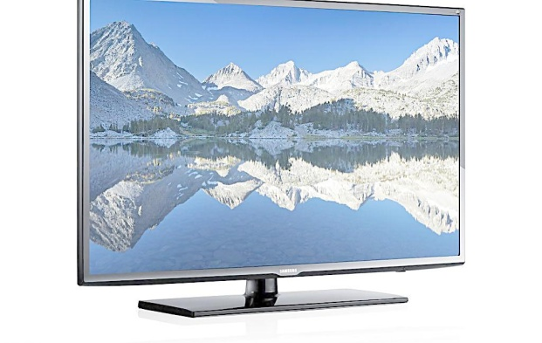
What can electricity do in families?
wash clothes
bring us information
can help wash clothes in families.
Electricity ___________
___________________
can use electricity to bring us information.
Television ___________
____________________
____________________

Slide 21
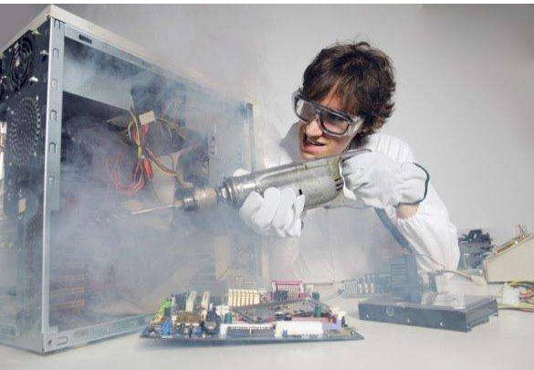
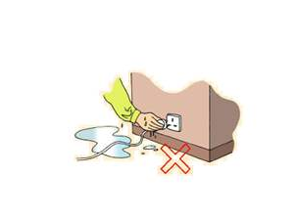
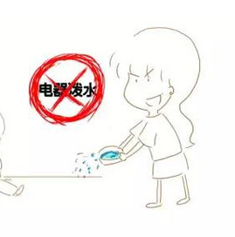
How should we use electricity safely at home?
(according to the following pictures)
At home, we must (not)…
repair machines
touch the plug
put out the fire with water

Slide 22
How should we use electricity safely at home?
(according to the pictures)
At home, we mustn’t
_________________________.
repair machines by ourselves.
repair machines

Slide 23
How should we use electricity safely at home?
(according to the pictures)
At home, we mustn’t
_________________________.
touch the plug with wet hands
We must ______________________ first.
dry up our hands
touch the plug
(dry up)

Slide 24
How should we use electricity safely at home?
(according to the pictures)
At home, we mustn’t
_________________________
when machines are on fire.
put out the fire with water at once
We must _____________________ first.
turn off the electricity
put out the fire with water

Slide 25
Writing
下周，你将要在班级里进行一次关于“电的重要性”和“用电安全”的演讲，请根据以下内容写一份80词左右的演讲稿，内容如下：
我们在生活中使用电的范围越来越广泛，电在多个方面帮助着我们。如：
可以照亮教室； 2. 各种各样的电器使我们的生活更加便捷；3. …
●但电也是危险的，我们必须安全用电。如：
用完电器后要关掉； 2. 不要接触电线； 3. …
Dear class,
Today, electricity is widely used in our daily lives.
——————————————————————————————————————————————————

Slide 26
Summary
can (not)
modal verbs ____________,
____________,_____________
may (not)
must (not)
2. What can we use electricity to do
____________,____________,
____________, ____________?
in streets
in factories
in villages
in families
3. How should we use electricity safely
____________,____________,
_________________________?
at home
at school
when we are outside

