Slide 1
Unit7 Period 3
Notes:
本资料来自于资源最齐全的２１世纪教育网www.21cnjy.com

Slide 2
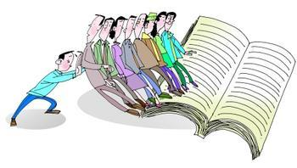
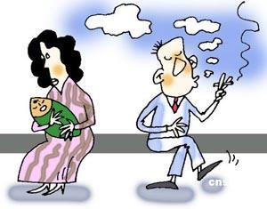
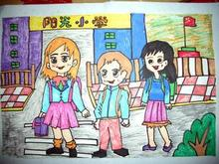
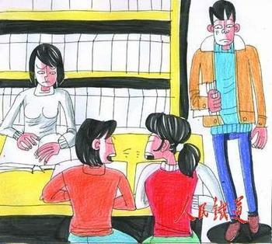
Presentation
Imperatives
Read more!
give orders or advice
postive and negative
Don't smoke!
Let's go home!
Be quiet, girls!
Notes:
本资料来自于资源最齐全的２１世纪教育网www.21cnjy.com

Slide 3
Presentation
Please read more.
Turn on the light,please.
Be careful,boys.
Don't be late again.
Things to remember
It is more polite for us to use please .
Add be before adjectives.
Notes:
本资料来自于资源最齐全的２１世纪教育网www.21cnjy.com

Slide 4
Presentation
Work out the rule
We use the base form of a verb in (positive/negative) imperative.
In a (positive/negative) imperative, we use don't before the base form of the verb.
Notes:
本资料来自于资源最齐全的２１世纪教育网www.21cnjy.com

Slide 5
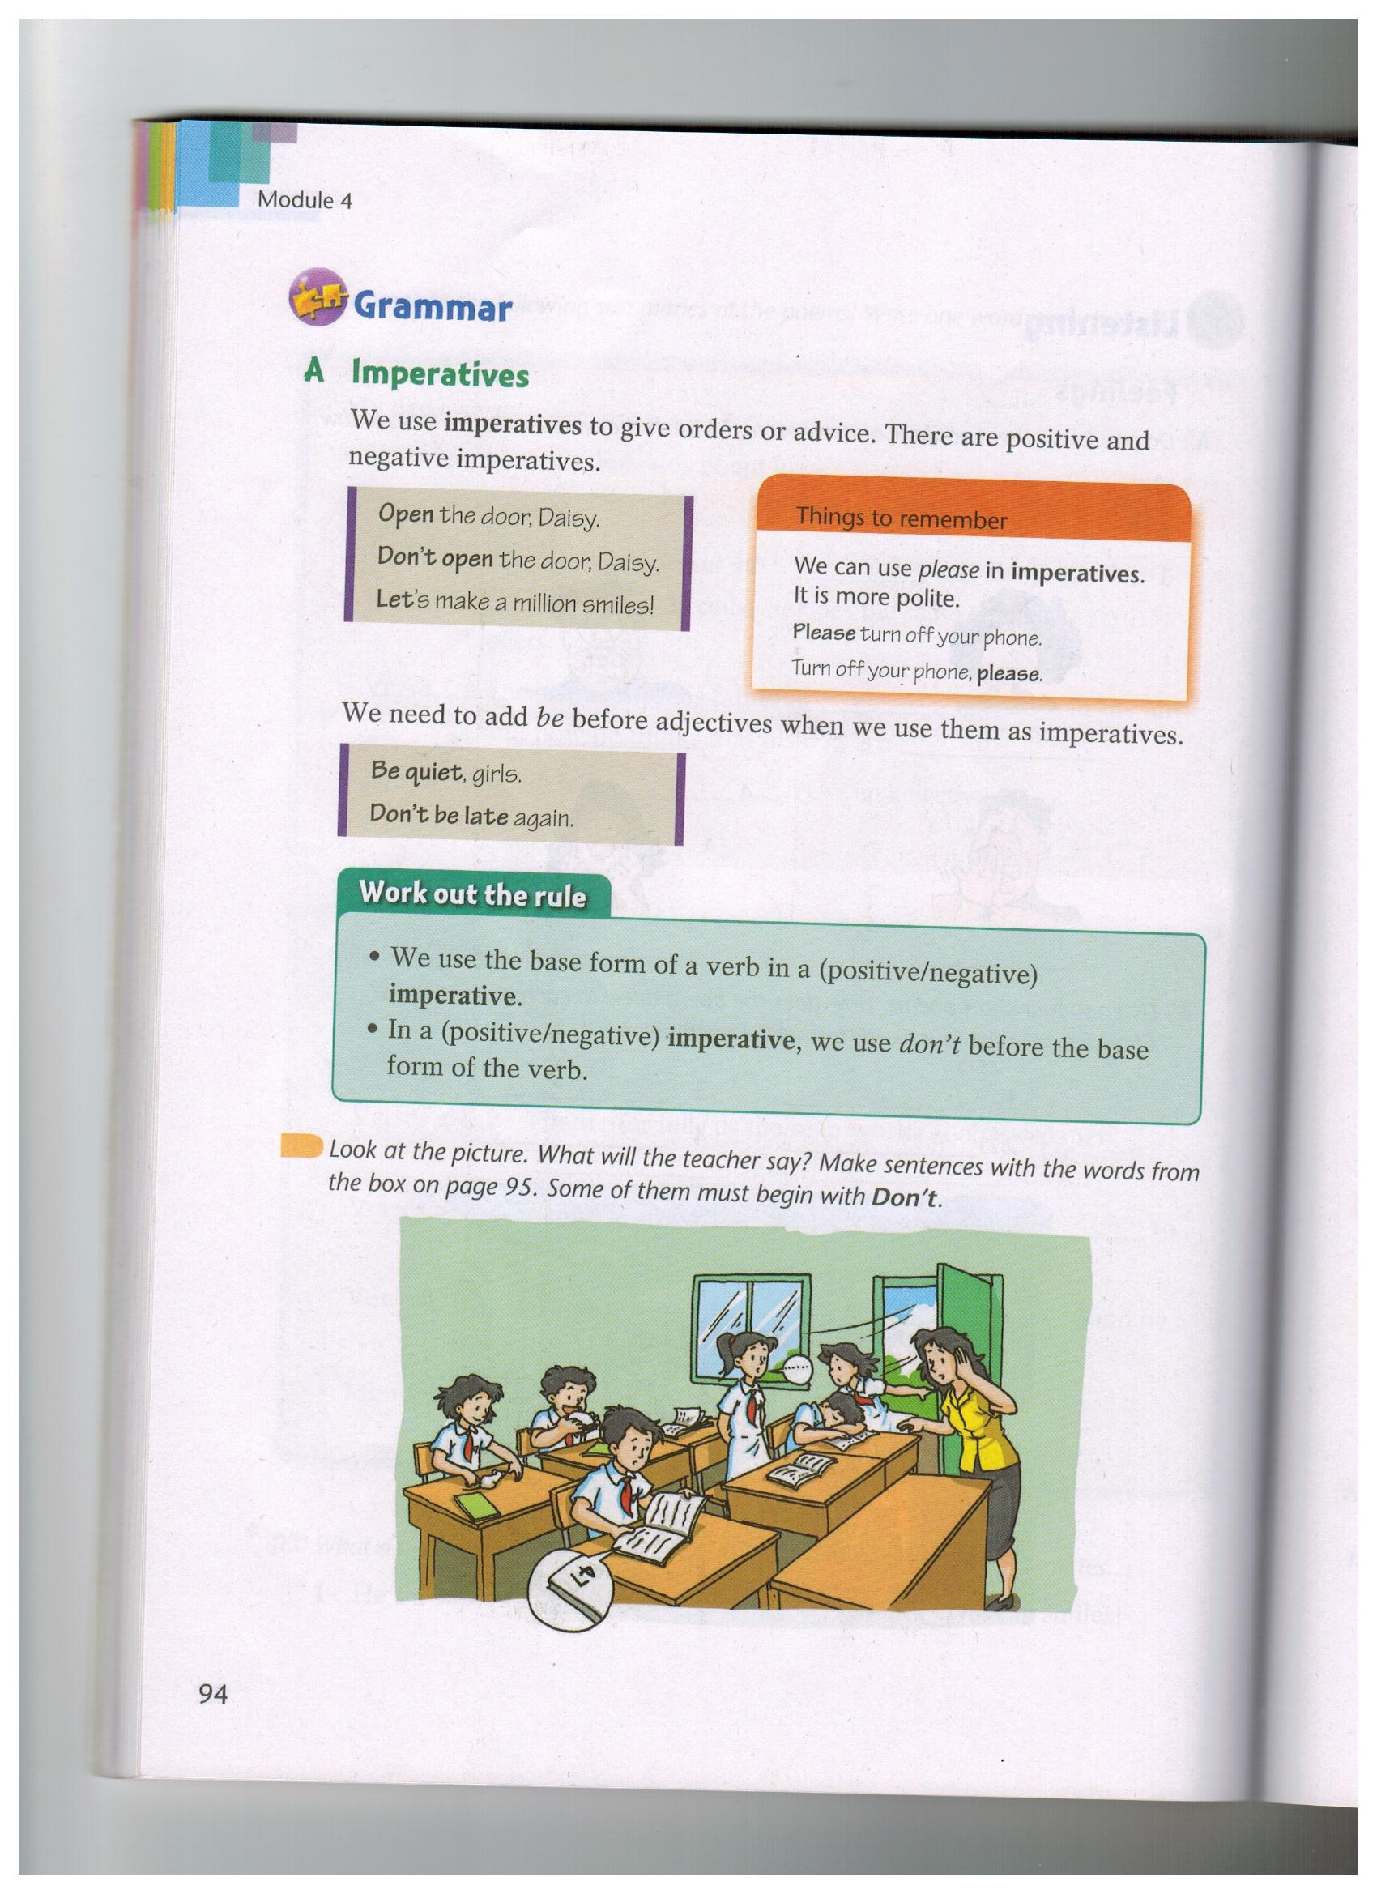
Presentation
What will the teacher say?
Notes:
本资料来自于资源最齐全的２１世纪教育网www.21cnjy.com

Slide 6

Presentation
bring close eat sleep
speak louder turn to
Don't eat in class, Bill.
1. Bill is eating in class
Close the door, Rose.
2. Rose left the door open on a
windy day.
Notes:
本资料来自于资源最齐全的２１世纪教育网www.21cnjy.com

Slide 7
Presentation
bring close eat sleep
speak louder turn to
Please say loudly, Jane.
3.Jane is answering a question in a low voice.
Don't sleep in class, James.
4.James is sleeping at his desk.
Notes:
本资料来自于资源最齐全的２１世纪教育网www.21cnjy.com

Slide 8
Presentation
bring close eat sleep
speak louder turn to
Please look at page74, Steven.
5.Steven is looking at page47.He should look at page 74.
Don't bring your pet to school,Mary.
6.Mary brought her pet mouse to school.
Notes:
本资料来自于资源最齐全的２１世纪教育网www.21cnjy.com

Slide 9
Presentation
Exclamations
What +(a/an)+adj.+n.+subject+verb+!
How +adj./adv.+subject+verb+!
What beautiful flowers they are!
How beautiful the flowers are!
Notes:
本资料来自于资源最齐全的２１世纪教育网www.21cnjy.com

Slide 10
Presentation
What +(a/an)+adj.+n.+subject+verb+!
多么有趣的一首诗啊！
What an interesting poem （it is） !
多么漂亮的花啊！
What beautiful flowers（ they are）!
多么糟糕的天气呀！
What bad weather （it is）!
Notes:
本资料来自于资源最齐全的２１世纪教育网www.21cnjy.com

Slide 11
Presentation
How +adj./adv.+subject+verb+!
我们多么幸运啊！
How lucky （we are）!
时间过得真快呀！
How quickly （the time passed）!
星星多么明亮啊！
How bright （the stars are）!
Notes:
本资料来自于资源最齐全的２１世纪教育网www.21cnjy.com

Slide 12
practice
Work out the rule
We often begin an exclamation with the word________ or ________.
We often use" __________ " at the end of
an exclamation.
What
How
!
Notes:
本资料来自于资源最齐全的２１世纪教育网www.21cnjy.com

Slide 13
Presentation
B1 Rewrite the sentences with what or how
1.You are wearing an old shirt.
What an old shirt you are wearing!
2.The boys are very excited.
How excited the boys are!
3.They are friendly people.
What friendly people they are!
4.She studies very hard.
How hard she studies!
Notes:
本资料来自于资源最齐全的２１世纪教育网www.21cnjy.com

Slide 14
B2 Complete their conversation.
Presentation
Oh no! How wonderful! What a lovely baby!
Lisa: Tom won the first prize in the speech
competition.
Bob:_______________He must be very happy.
Lisa:Yes. But Jeff hurt his leg when he
played basketball.
Bob:__________How is he feeling now?
Lisa: He's feeling better. By the way, our Maths teacher had a baby last month.Look,
here's a picture.
Bob: Wow! ____________________
How wonderful!
Oh no!
What a lovely baby!
Notes:
本资料来自于资源最齐全的２１世纪教育网www.21cnjy.com

