Slide 1

Unit 8 From hobby to career
Period 4: Grammar

Slide 2
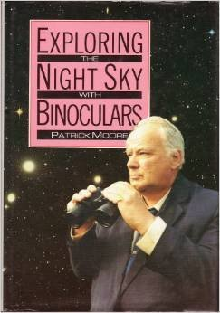
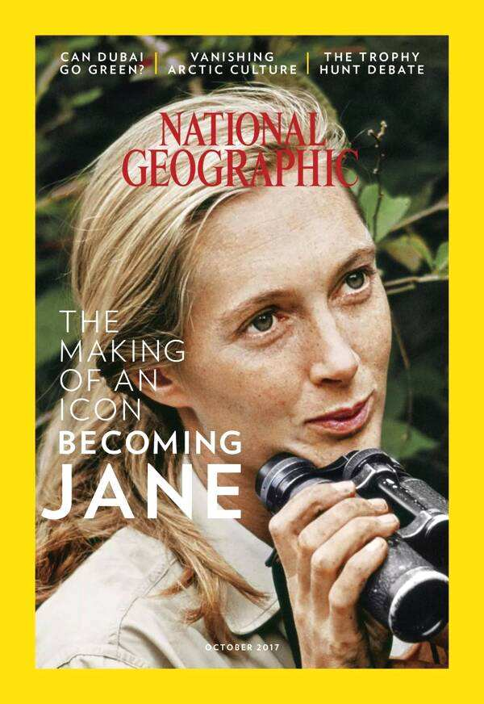
Revision
Hobby
What happened?
Career

Slide 3
Something happened in some specific time.
    When I was eight, I got a book about stars.
    I was not very interested in animals when I was a child.
    When I was a 16-year-old schoolgirl, I dreamt of a career studying wild animals in Africa.
    When I was 26, I travelled from Britain to the mountains of East Africa.

Slide 4
Observe the sentences and think about the questions.
What's the relationship between the two actions in each sentence? Do they happen at the same time or differnt times?
    When I was eight, I got a book about stars.
    I was not very interested in animals when I was a child.
    When I was a 16-year-old schoolgirl, I dreamt of a career studying wild animals in Africa.
    When I was 26, I travelled from Britain to the mountains of East Africa.

Slide 5
Grammar A
Adverbial clauses of time (when)
用连词when引导的时间状语从句
We can use the conjunction when to form an adverbial clauses of time. It links two clauses into one sentence.(P109)
adverbial clauses of time
时间状语从句
When we arrived, the sky went dark.
main clause
主句

Slide 6
Look at the following sentences and answer the questions.
When he was eight, he got a book about the stars.
He got a book about the stars when he was eight.
Do the sentences have different meanings?
What is the difference between the two sentences?
What about the punctuations (标点符号)?

Slide 7
Keep them in mind.
1. when引导的时间状语从句，可位于句首，也可位于句末。
2. 当由when引导的时间状语从句位于主句之前时，句中要加逗号。
3. 在时间状语从句中，通常不用将来时态，而是用现在时表示将来的动作或状态。
（主将从现）
e.g. 当他回来的时候，我会把一切都告诉他。
I will tell him everything when he comes back.
When he comes back, I will tell him everything.

Slide 8
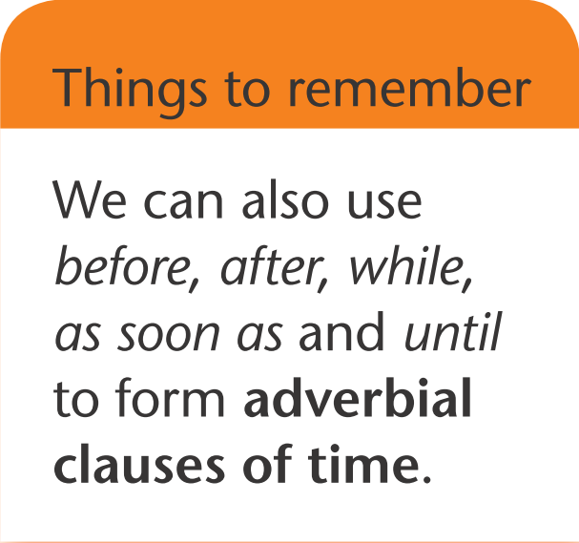
Things to remember
时间状语从句的连词还有：
before
after
while（当……发生时)
as soon as (一……就……)
until (直到……才……)

Slide 9
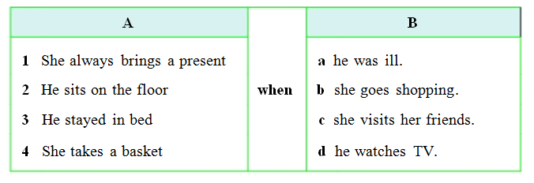
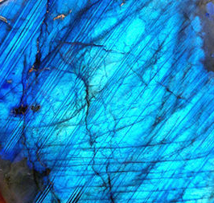
Exercise time.
Match the clauses in column A with those in column B to make complete sentences with when.

Slide 10
Now, rewrite each sentence with the adverbial clause at the beginning.
Can we express the same ideas in another way?
When she visits her friends, she always brings a present.
She always brings a present when she visits her friends.
When he watches TV, he sits on the floor.
He sits on the floor when he watches TV.
When he was ill, he stayed in bed.
He stayed in bed when he was ill.
When she goes shopping, she takes a basket.
She takes a basket when she goes shopping.

Slide 11

Use the correct forms to fill in the blanks.
works
1. She always ______( work) hard when she is at school.
2. He likes to listen to the music when he _____ (do) his homework.
3. When I ____ (be) at the age of five, I ______ (like) playing toy cars.
4. Chen Na ______ (be) a computer engineer when she grows up.
5. When I was young, I usually ______ (go) outside with my mum on clear night.
does
was
liked
will be
主将从现
went

Slide 12
When I was young, I usually went outside with my mum on clear nights.
However, I hardly have the chance to do that anymore.
When I was young, I used to go outside with my mum on clear nights.

Slide 13
used to / did not use to
I used to go outside with my mum on clear nights and look at the sky.
When did her dad use to take them for trips on his boat?
I didn't use to have much money.
Different forms:
肯定式：used to ...
否定式：didn't / did not use to ...
疑问式：(wh-words) did...use to ...?

Slide 14
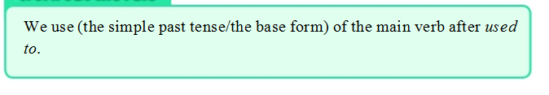
Work out the rule

Slide 15
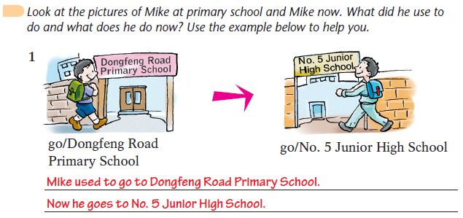
Grammar exercise

Slide 16
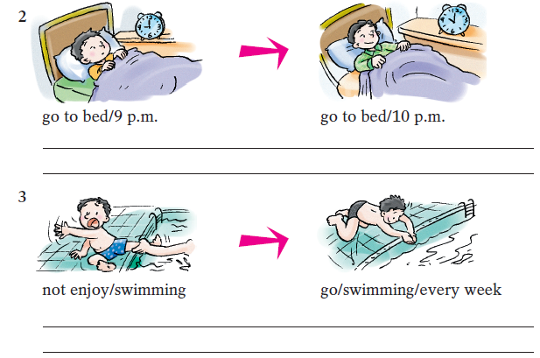
Mike used to go to bed at 9 p.m.
Now he goes to bed at 10 p.m.
Mike didn’t use to enjoy swimming.
Now he goes swimming every week.

Slide 17
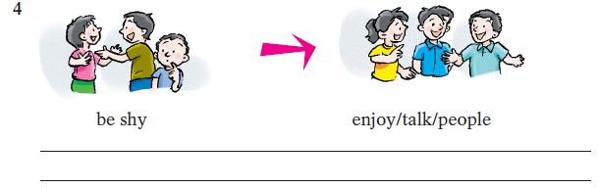
Mike used to be shy.
Now he enjoys talking to people.

Slide 18
Things to remember
He used to look at the stars every night, but now he does not.
He used his knowledge to tell people about the stars in a lively way.
He gets / is used to living in Guangzhou now.
The mobilephone is used to call his mum.
sb. used to do sth.： 某人过去常做某事
sb. use sth to do sth.： 某人用某物来做某事
sb. get / be used to doling sth.: 某人习惯于做某事
sth./sb. be used to do sth.: 某物/某人被用来做某事

Slide 19
Exercise Ⅰ
1. I bought some red wine. I was in Italy at that time.
（改为同义句）
_____ I was in Italy, I _______ some red wine.
2. She often went to school on foot in the past, but she doesn’t do it now.（改为同义句）
She ____ ____ go to school on foot in the past.
When
bought
used to

Slide 20
3. I used to visit my grandparents every weekend. （改为否定句）
I ____ ____ ____ visit my grandparents every weekend.
4. Tom used to play basketball with his classmates.（改为一般疑问句）
____ Tom ____ ____ ____ basketball with his classmates?
didn’t use to
Did use to play

Slide 21
Exercise Ⅱ
1. 他过去不常看书，但现在看。
He ____ ____ ____ ____ books, but he does now.
2. 我爸爸过去常常吸烟，但他现在不吸了。
My father ____ ____ ____, but now he doesn’t.
didn’t use to read
used to smoke

Slide 22
Exercise Ⅲ
( )1. Daisy ____ me with my English homework, but she doesn’t now.
A. used to helping B. is used to help
C. used to help D. uses to help
( )2. We will go to the park ____ the weather is fine.
A. after B. when
C. before D. what
( )3. What do you want to be when you ____ up?
A. will grow B. growing
C. grew D. grow
C
B
D

Slide 23
( )4. When we ____ on holidays, we ____ a lot of beautiful photos.
A. are; took B. were; took
C. were; take D. will be; take
( )5. — ____ Lucy ____ to eat a lot of food?
— Yes, she did. But now she eats little to keep fit.
A. Did; use B. Does; use
C. Did; used D. Is; use
B
A

Slide 24
Thank you!

