Slide 1
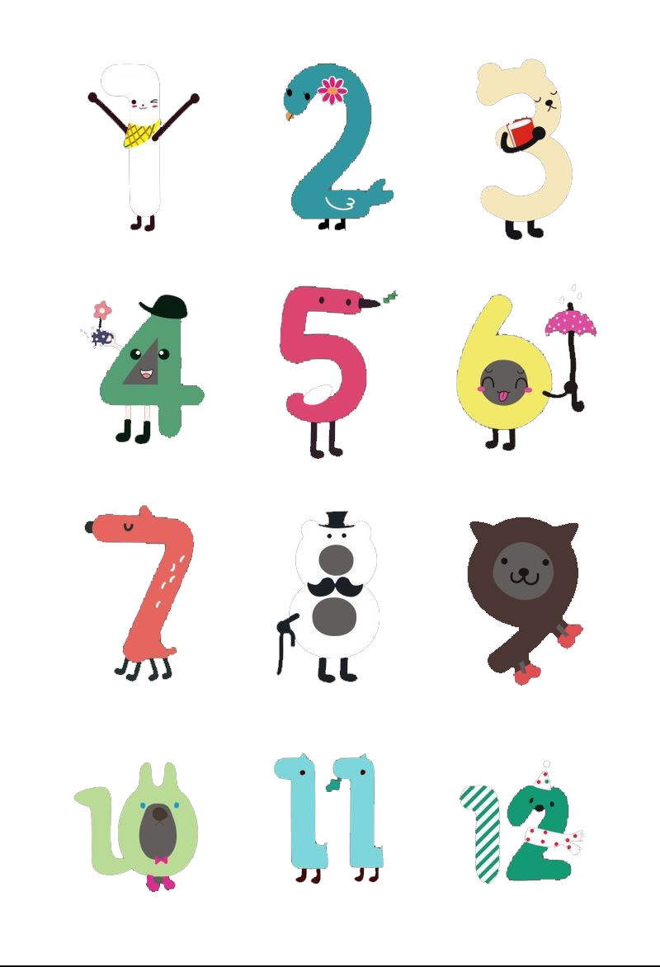
Numbers
专题七 数词
Grammar

Slide 2
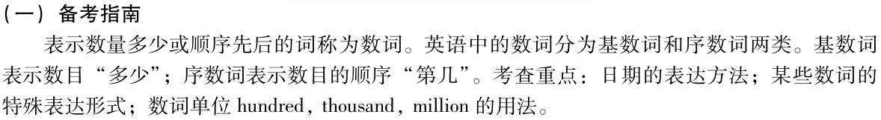

Slide 3
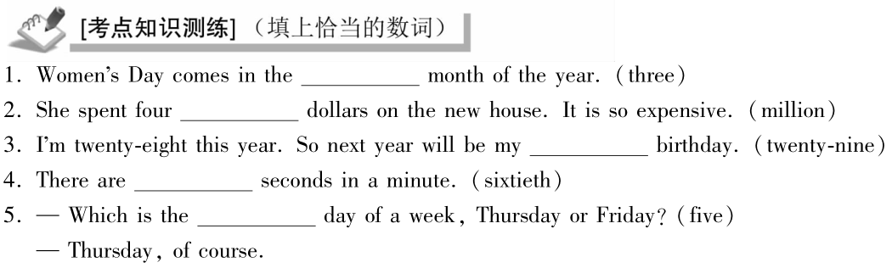

Slide 4
Numbers consist of cardinal numbers and ordinal numbers.
表示数目多少的数词叫_____；表示顺序的数词叫_____。
基数词
序数词

Slide 5
基数词 | 序数词 | 基数词 | 序数词 | 基数词 | 序数词
one |  | 12 |  | 20
two |  | 13 |  | 21
three |  | 14 |  | 22
four |  | 15 |  | 30
five |  | 16 |  | 40
six |  | 17 |  | 90
eight |  | 18 |  | 100
nine |  | 19 |  | 129
first
twelve
twelfth
twenty
twentieth
second
thirteen
thirteenth
twenty-one
twenty-first
third
fourteen
fourteenth
twenty-two
twenty-second
fourth
fifteen
fifteenth
thirty
thirtieth
fifth
sixteen
sixteenth
forty
fortieth
sixth
ninety
ninetieth
seventeen
seventeenth
one hundredth
eighth
one hundred
eighteen
eighteenth
one hundred and twenty-ninth
nineteenth
one hundred and twenty-nine
ninth
nineteen

Slide 6

基数词的构成
1）1－12, 独立成词。
one two three four five six
seven eight nine ten eleven twelve
2）13--19, 由3－9 + teen构成。读时，重音落在最后一个音节。
14–fourteen 16--sixteen 17--seventeen 19—nineteen
特殊拼写: 13– 15-- 18—
thirteen
fifteen
eighteen

Slide 7
3）20－90, 以-ty结尾。
正常拼写： 60---sixty 70---seventy 90—ninety
特殊拼写：20— 30---
40— 50— 80---
4）21－99， 两位数，十位与个位之间必须有 “-”。
21 twenty-one 55 fifty-five 99 ninety-nine
twenty
thirty
forty
fifty
eighty

Slide 8
5）101—999，三位数，百位与十位之间加and，若十位上数字为0，则百位与个位之间加上and。

Slide 9


Practice
432
four hundred and thirty-two
170
one hundred and seventy
865
eight hundred and sixty-five
109
one hundred and nine

Slide 10

6) 若位数在四位及以上，每三位数加一个逗号，从右往左数，第一个逗号前的数为_________，第二个逗号前的数为_________（百万）, 第三个逗号前的数为__________（十亿），第四个逗号前的数为____________（万亿）。
thousand
million
billion
trillion
trillion [ˈtrɪljən] 万亿
billion [ˈbɪljən] 十亿
million [ˈmɪljən] 百万
thousand ['θaʊznd] 千
hundred [ˈhʌndrəd] 百

Slide 11
Practice
and
and
,
,
6
500
431
,
7
29
hundred
thousand,
million,
billion,

Slide 12
基数词的用法
1、表示具体数目,hundred, thousand, million等不用复数
表示不确定数目, 则用hundreds of,
thousands of, millions of+ 名词复数。
我们国家有14亿人口。
1) Our country has a population of 1,400 million people.
战争过后，成千上万的人无家可归。
2) After the war, thousands of people became
homeless.

Slide 13
序数词的构成
1) 1－3, first, second, third
2) 4－19, 相应基数词+th,
特殊拼写：
第五：
第八：
第九：
第十二：
fifth
eighth
ninth
twelfth

Slide 14
3) 20－90, y变成ie +th。
twenty-twentieth,
sixty-sixtieth,
ninety-ninetieth
4) 21－99, 十位数用基数词，个位数用序数词，中间必须有连字符“-”。
twenty-first, sixty-eighth, ninety-ninth
5) 百、千、万等序数词由hundred， thousand等加-th，
前面加有关的基数词构成。
one hundredth two thousandth
6) 序数词缩写：数字＋最后两字母
如1st, 2nd, 3rd ,4th…

Slide 15
序数词的用法
(1)序数词作定语，前面要加the；若序数词前有别的修饰词，the省略。
The first truck is carrying a food basket．
John lives on the fifteenth floor．
She is my first English teacher.
(2)有时序数词前加a/an，表示“再一”，“又一” 。
When I sat down, a fourth man rose to speak．
They had a second child in 1988.

Slide 16
年代、年月等的表示法
1998年
20世纪80年代
2000年
2008年
在16世纪初期/中期/晚期
农历十月十日上午
10月10号
2020年5月11号
nineteen ninety-eight/ nineteen hundred and ninety-eight
nineteen eighties （可写成1980’s 或1980s）
(year) two thousand
two thousand and eight
in the early/mid/late sixteenth century
on the morning of the 10th day of the 10th lunar month
on October 10th/ October (the) tenth
May 11, 2020
11 May, 2020

Slide 17
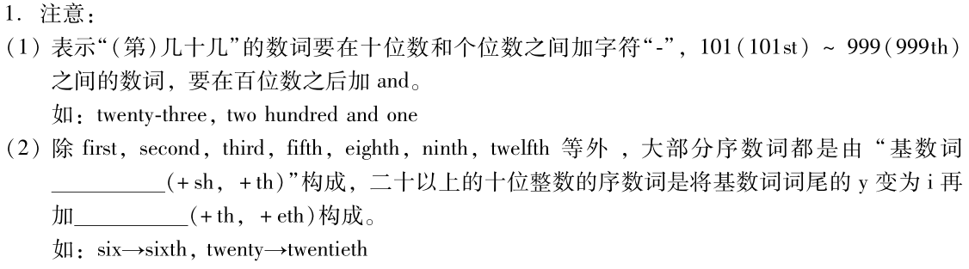

Slide 18
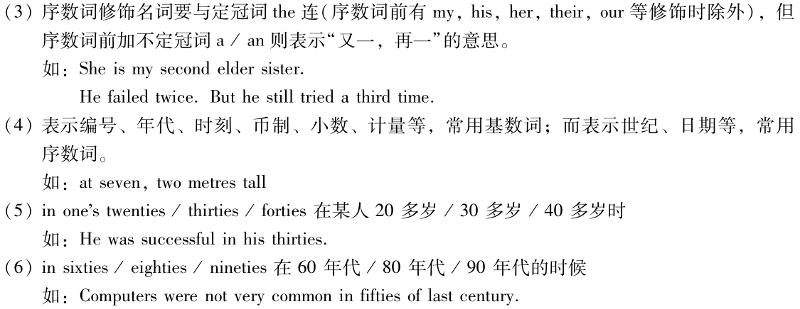

Slide 19
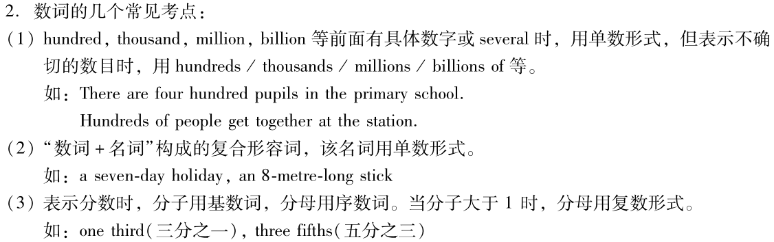

Slide 20
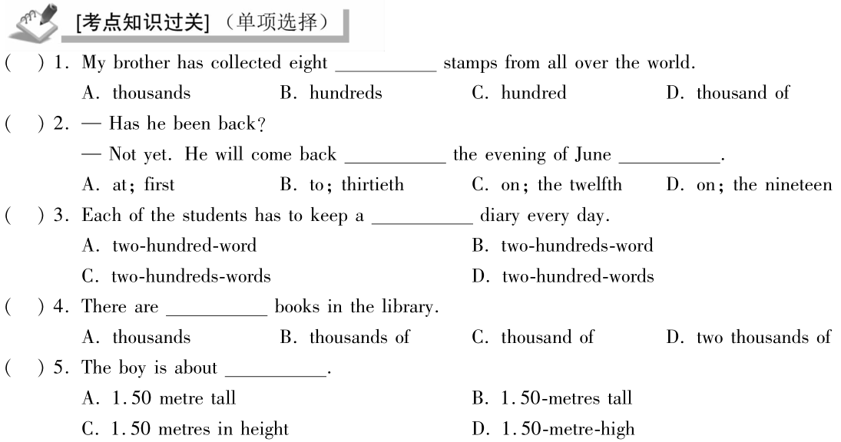

Slide 21
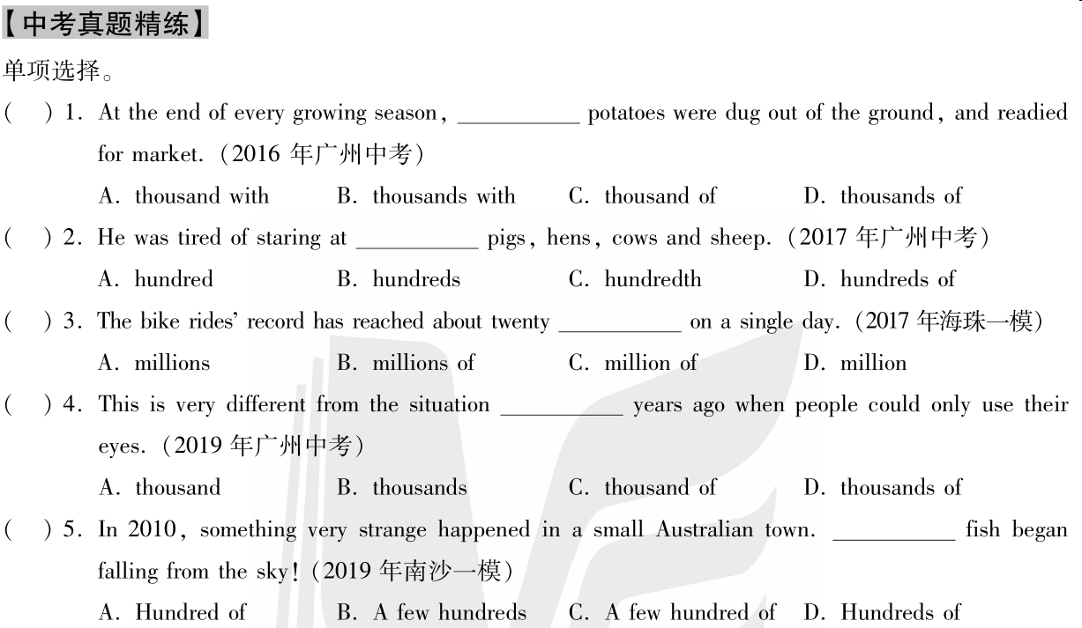

Slide 22
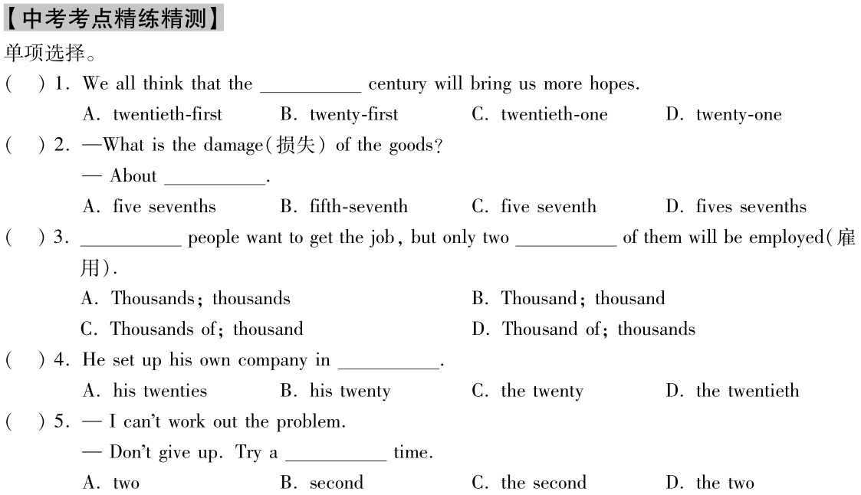

Slide 23
Exercises
一、根据句意，填入适当的数词
Thursday is the ______ day of a week in the
West.
2. Autumn is the ______ season of a year.
3. Christmas is on December the _______
each year.
4. August is the ______ month in a year.
5. June the ______ is Children’s Day.
fifth
third
twenty-fifth
eighth
first

Slide 24
二、用括号内所给单词的正确形式填空。
1. This is his __________(thirty) novel.
2. This happened at the beginning of the
__________(twenty-one) century.
3. Mother’s Day is on the __________ (two)
Sunday in May.
4. Although he got the _______ (four) place in
the competition, that was good enough for him.
5. Tomorrow is my grandmother’s
__________ (eighty-nine) birthday.
We will have a big party for her.
thirtieth
twenty-first
second
fourth
eighty-ninth

Slide 25
三、选择最佳答案填空。
( )1. July is ____ month of a year.
A. six B. the sixth
C. seven D. the seventh
( )2. Five ____ dollars is a lot of money.
A. million B. millions
C. the million D. the millions
( )3. The beautiful hotel is about ____ years old.
A. hundred of B. a hundred
C. a hundred of D. hundreds
D
A
B

Slide 26
B Instructions about numbers
1. 没有给出结果的加减乘除英文表达法
3+9
Add 3 and 9.
祈使句，以v.原开头。
add： v.原
A+B
Add A and B.
Add 8 and 3.
8+3.
Add 12 and 14.
12+14.

Slide 27
9-3
Subtract 3 from 9.
祈使句，以v.原开头。
Subtract…from：[səbˈtrækt] v.从…中减去
A-B
Subtract B from A
8-3
Subtract 3 from 8
Subtract 4 from 18
18-4

Slide 28
3 x 9
Multiply 3 by 9.
祈使句，以v.原开头。
multiply ：[ˈmʌltɪplaɪ] v.乘
A x B
Multiply A by B
Multiply 4 by 5
4 x 5
Multiply 6 by 9
6 x 9

Slide 29
9 ÷ 3
Divide 9 by 3.
祈使句，以v.原开头。
divide ：[dɪˈvaɪd] v.除
A ÷ B
Divide A by B
14 ÷ 2
Divide 14 by 2.
15 ÷ 5
Divide 15 by 5.

Slide 30
小结
1. 没有给出结果的加减乘除英文表达法
（1）要用祈使句，以v.原开头。
Add A and B.
A+B
Subtract B from A.
A-B
A x B
Multiply A by B.
Divide A by B.
A ÷ B

Slide 31
B Instructions about numbers
2. 给出结果的加减乘除英文表达法
3+9=12
用陈述句。
equals/is
3 plus 9 equals/is 12.
（Think：Is it correct to say “Add 3 and 9 equals/is 12”？）
谓语动词是哪个？
equal
plus
介词，“加”
v.等于
A+B=C
A plus B equals/is C.
4+5=9
4 plus 5 equals/is C.
12+1=13
12 plus 1 equals/is 13.

Slide 32
B Instructions about numbers
9-3=6
用陈述句。
9 minus 3 equals/is 6.
谓语动词是哪个？
equals/is
minus
介词，“减”
A-B=C
A minus B equals/is C.
5-1=4
5 minus 1 equals/is 4.
12 minus 1 equals/is 11.
12-1=11

Slide 33
B Instructions about numbers
3 x 9 =27
用陈述句。
3 multiplied by 9 equals/is 27.
谓语动词是哪个？
equals/is
Multiplied by
过去分词，“乘以”
A x B=C
A multiplied by B equals/is C.
4x1=4
4 multiplied by 1 equals/is 4.
12 multiplied by 2 equals/is 22.
12x2=22

Slide 34
B Instructions about numbers
9 ÷ 3 =3
用陈述句。
9 divided by 3 equals/is 3.
谓语动词是哪个？
equals/is
divided by
过去分词，“除以”
A divided by B equals/is C.
A ÷ B=C
4 ÷ 1=1
4 divided by 1 equals/is 1.
12 ÷2=6
12 divided by 2 equals/is 6.

Slide 35
小结
2. 给出结果的加减乘除英文表达法
要用陈述句，谓语动词是equals/is。
A+B=C
A plus B equals/is C.
A-B=C
A minus B equals/is C.
A x B=C
A multiplied by B equals/is C.
A divided by B equals/is C.
A ÷ B=C

Slide 36
Read the instructions aloud.
2+10
Add 2 and 10.
10-2
Subtract 2 from 10.
2 × 10
Multiply 2 by 10.
10÷2
Divide 10 by 2.

Slide 37
Read the statements aloud.
2+10 = 12
2 plus 10 equals/is 12.
10-2 = 8
10 minus 2 equals/is 8.
2 × 10 = 20
2 multiplied by 10 equals
/is 20.
10÷2 = 5
10 divided by 2 equals
/is 5.

Slide 38
In pairs, complete the sentences like those in Table I and Table II.
dd
and
1 S1: A 11 _____ 1.
S2: p equals/is .
( )
2 S1: S__________ 5 __________ 13.
S2: _____ m_____ ______ equals/is ___.
( )
3 S1: M__________ 7 _____8.
S2: _____m_________by_____ equals/is____.
( )
11
lus
1
12
11+1=12
ubtract
from
13
inus
5
8
13-5=8
ultiply
by
7
ultiplied
8
56
7x8=56

Slide 39
4 S1: D_________ 16 ____ 4.
S2: ____d _______ by ____ equals / is ____.
( )
5 S1: A ____ 9 ______6.
S2: ____ p ____ _____ equals / is ____.
( )
6 S1: A______14 and 4 and d_____ the answer
by 2.
S2:_______ p____ ____ and the
answer d______by ______ equals / is ______.( )
ivide
by
16
ivided
4
4
16÷4= 4
dd
and
9
lus
6
15
9+6= 15
dd
ivide
14
lus
4
ivided
2
9
(14+4) ÷2= 9

Slide 40
Part III Review

