Slide 1

语法复习
Grammar
形容词和副词

Slide 2
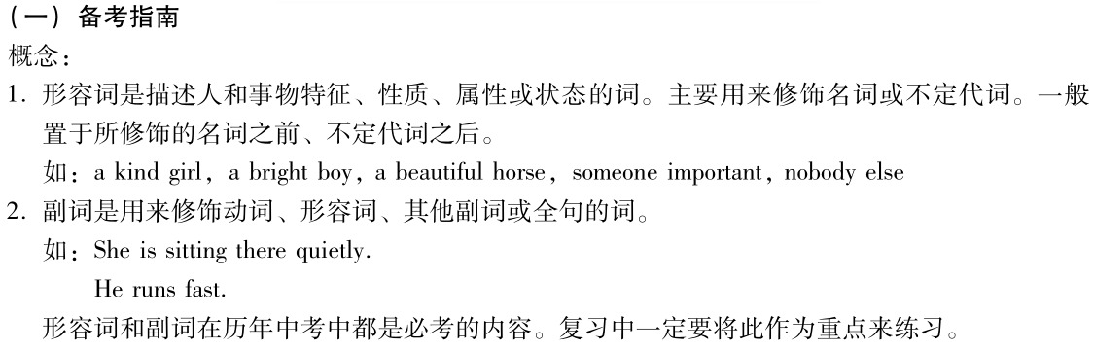
专题八 形容词和副词

Slide 3
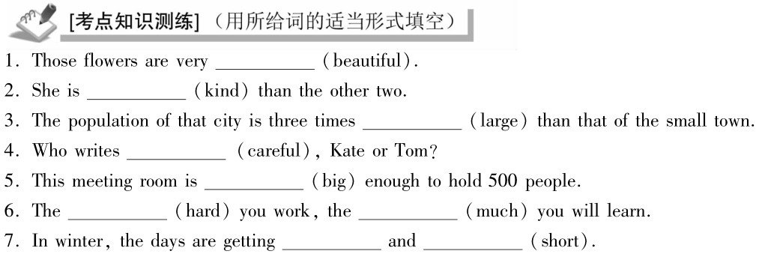
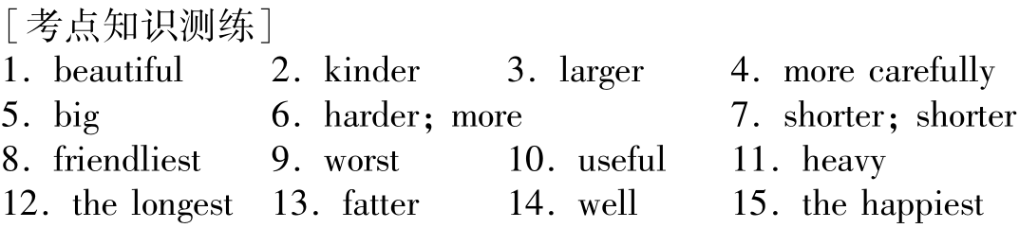

Slide 4
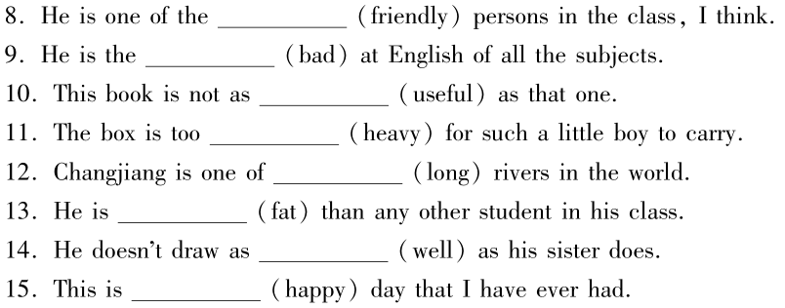

Slide 5
How to form the comparative of adjectives:
1)在形容词(单音节或少数双音节)后直接加-er。
short – shorter small -- smaller
clever – cleverer narrow -- narrower
2)以不发音的e结尾，直接加 r.
nice -- nicer safe – safer
large – larger wide -- wider
特例：free -- freer

Slide 6
3) 在重读闭音节词（辅元辅）末, 双写末尾的辅音字母, 再加-er。
big – bigger thin – thinner
hot – hotter fat -- fatter
4) 以“辅音字母+ y”结尾的双音节词，改y为i加-er。
easy – easier happy – happier
heavy – heavier busy -- busier

Slide 7
5) 多音节词和部分双音节词在词前加more。
proper ---- more proper
eager ---- more eager
delicious ---- more delicious
interesting ---- more interesting

Slide 8
How to form the superlative of adjectives:
a. 直接加-est。
short--shortest small—smallest
b. 以-e 结尾的形容词，最高级加st。
large—largest nice—nicest
c. 以辅音字母+y结尾的形容词，变y为i + est。
busy—busiest heavy—heaviest

Slide 9
d. 以重读闭音节结尾，双写最后一个辅音字母，再+est。
big—biggest thin—thinnest
fat—fattest hot—hottest
e. 多音节和部分双音节形容词，+ most 构成最高级。
proper ---- most proper
important — most important
difficult — most difficult

Slide 10
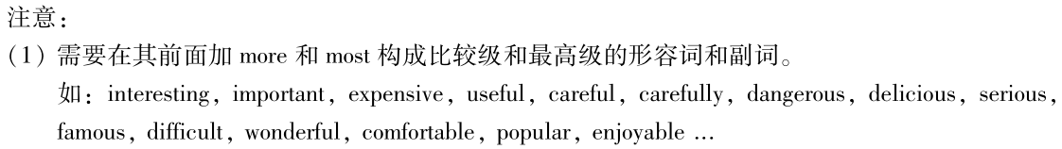
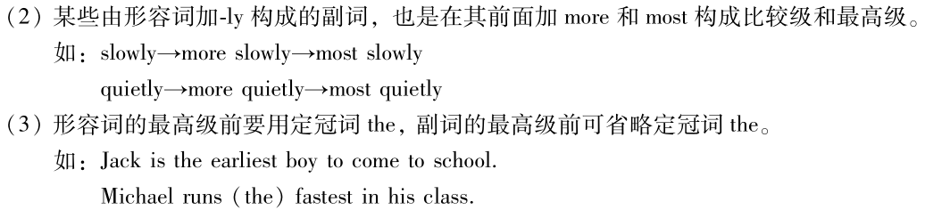
friendlier
friendliest
friendly-_________-__________

Slide 11
不规则变化：
原级 | 比较级 | 最高级
good /well | better | best
bad /ill | worse | worst
little | less | least
many /much | more | most
far | farther /further | farthest /furthest
old | older /elder | oldest /eldest

Slide 12
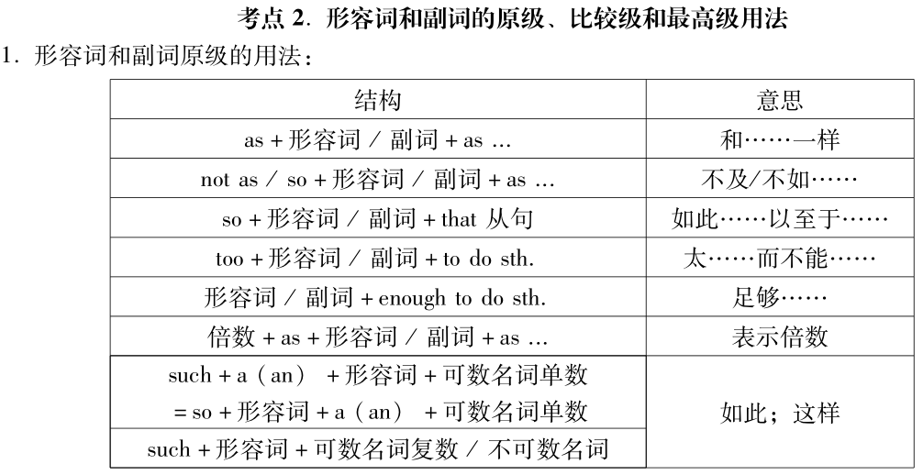

Slide 13
1. as+ adj./adv原级 +as 和 not so / as + adj./adv.原级+as。
前者意为“和…一样”，后者意为“不及…”
这条河同那条河一样长。
The river is as long as that one. (adj.)
你可以像其他人一样在这儿住那么久。
You can live here as long as others did. (adv.)
只要我们尽最大努力，就能成功。
We can succeed as long as we try our best.
(引导条件状语从句，意为“只要”)
你的咖啡质量不如我的好。
Your coffee is not so/as good as mine.

Slide 14
2. too+形容词或副词+to do 具有否定意义，表示“太…不能，太…不会”。这种结构相当于=
so … that …not ;
not + adj. /adv.(反义形容词) + enough to do
太晚了，我们赶不上火车了。
It’s too late for us to catch the train.
= We are so late that we can not catch the train.
= We are not early enough to catch the train.
她太粗心了，不可能注意到这一点。
She is too careless to have noticed it.
= She is so careless that she can not have noticed it.
= She is not careful enough to have noticed it.

Slide 15
3. X times as + adj./adv.原级 + as。
①A是B的X倍； ②A比B增加了（X-1）倍
杰克跑的速度是吉姆的三倍。
Jack runs three times as fast as Jim.
也可以说成杰克跑的比吉姆快两倍。
4. X times + adj. /adv. 比较级 （greater, longer, faster）+ than
① A 比B大、多、长、快…X倍；
② A的大小、数量、长度、速度…是B的X+1倍。
棉花产量比2000年增产三倍。
The cotton output was three times greater than that of 2000.
（是2000年的4倍）

Slide 16
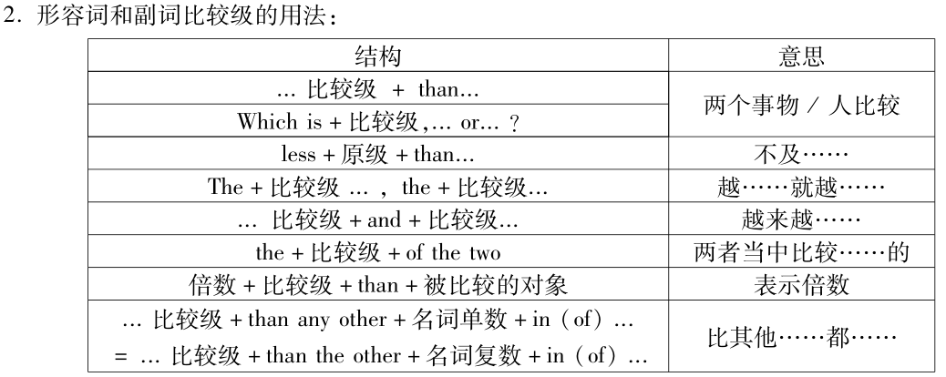

Slide 17
形容词和副词比较级的用法
1. 表示两者之间的选择,
Which/Who + 谓语 + 比较级，…or…?
Who runs faster, he or she?
Which is better, the red hat or the yellow hat?
2. 表示两者之间的比较，通常用连词 than引导，表示“更······一些”．
后接代词一般用主格形式
He runs faster than she.
The red hat is better than the yellow hat.

Slide 18
3. 表示“越来越……” ①比较级+and+比较级
② more and more +形容词原级
他越来越健康。
He becomes healthier and healthier.
上海变得越来越现代化。
Shanghai is becoming more and more modern.

Slide 19
4. “the + 比较级 , the + 比较级”表示“ 越…, 越 …”
多多益善。
The more, the better.
你越锻炼，就越健康。
The more you exercise, the healthier you will be.
你越抄别人的作业，别人就越不尊重你。
The more you copy others’ homework, the less others will show respect for you.

Slide 20
5. the + 比较级 + of the two“两者中比较…的”
He is the taller of the two.
The computer is the more expensive of the two.

Slide 21
6. 用比较级形式表示最高级。
比其他…都…
1. 比较级+ than any other + 名词单数 + in / of
2. 比较级+ than the other + 名词复数 + in/of …
3. 比较级+ anyone else+ in/ of …
注意：以上三个句型均是在相同的范围内比较。
他比他班里任何一个别的男生都要高。（他和其他男生属于同一个班）
He is taller than any other boy in his class.
=He is taller than the other boys in his class.
=He is taller than anyone else in his class.

Slide 22
1. 一Beijing is bigger than in Japan, isn't it?
一Yes. Beijing is also one of the biggest cities in the world.
A．any city B．any other city C．the other city D．the other cities
2. 一Tokyo is bigger than in Japan, isn't it?
一Yes. Tokyo is also one of the biggest cities in the world.
A．any city B．any other city C．the other city D．the other cities
【答案】1. A any city表示任何一个城市，北京与日本的所有城市相比，比任何一个都大.
2. B/D any other city/the other cities表示同一范围内的任何其他城市.

Slide 23
7. 能修饰比较级的程度副词（以tall为例）：
高一点：
高得多：
（甚至）更高：
不比…高：
注：在否定句和疑问句中，用any来修饰比较级。
He can’t jump any higher.
Can he jump any higher?
a little taller/ a bit taller
much taller/ far taller/ a lot taller
even taller/ still taller
no taller

Slide 24
8. 进行比较时，比较对象要相互呼应，相比内容必须相同，为了避免重复，可用one，that，those等代替前面出现过的名词。
肉的价格比大米的价格高。
The price of the meat is higher than rice.(肉价不可和大米比较)
改：The price of the meat is higher than that of rice.
人的大脑比猴子的大脑要大些。
Human brains are bigger than monkeys. (人脑不可和猴子比较)
改：Human brains are bigger than those of monkeys.

Slide 25
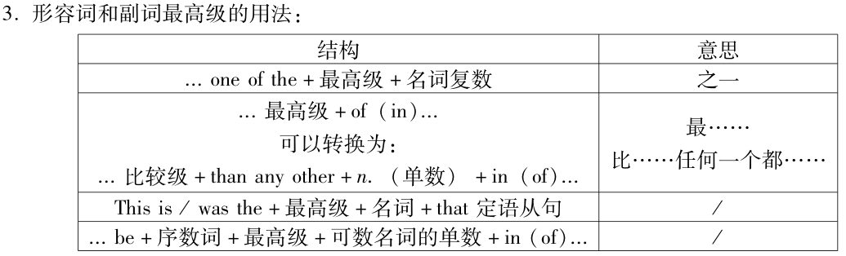

Slide 26
形容词和副词的最高级的用法
1. 表示三者或三者以上比较,可用
“Which/Who +谓语+ the + 最高级, A, B or C？”表示.
Who is the tallest, Tom , Mike , or Jack?
2. 形容词最高级前一般加定冠词the，副词最高级前the可以省略，句末常跟一个in/of短语来表示范围。
Tom runs (the) fastest in our class.
Tom runs faster than any other student/ the other students of Class 1.

Slide 27
形容词和副词的最高级的用法
3. 形容词最高级前可以加序数词，表示“第几最…”
Mike is the second tallest student in our class.
4. one of + 形容词最高级 + pl. 表示“最… 之一”
Jack is one of the tallest students in our class.

Slide 28
形容词和副词的最高级的用法
5. 形容词最高级前可以有物主代词、指示代词、名词所有格等修饰，但此时不能再用定冠词the。
Yesterday was his busiest day.
This is Mary’s longest dress.
That fastest girl is little cutie.

Slide 29
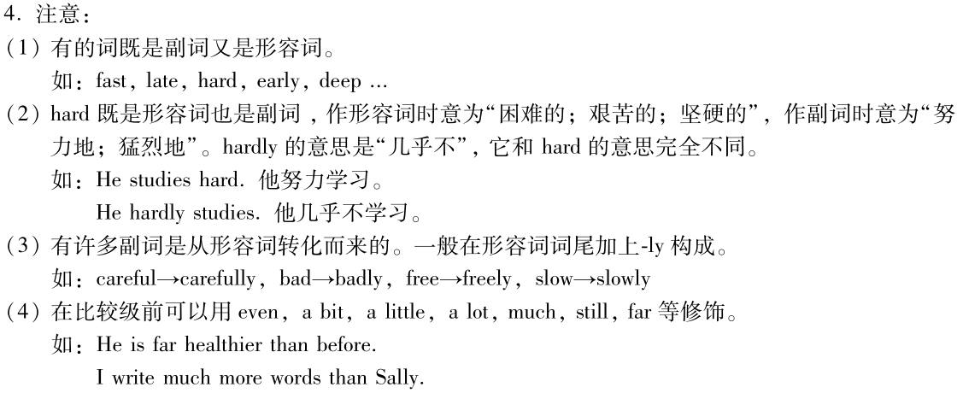
high adj./adv. 高的/在高处
highly adv. 很；非常 highly successful/ intelligent
adv. 钦佩地，赞赏地 She speaks highly of you.
adv. 高标准地 ，大量地 a highly paid job

Slide 30
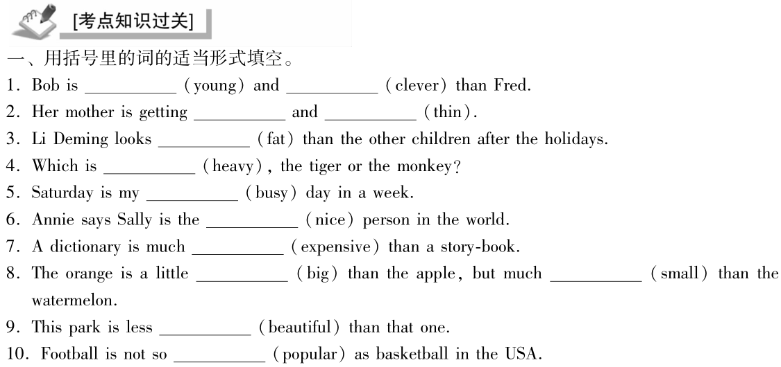
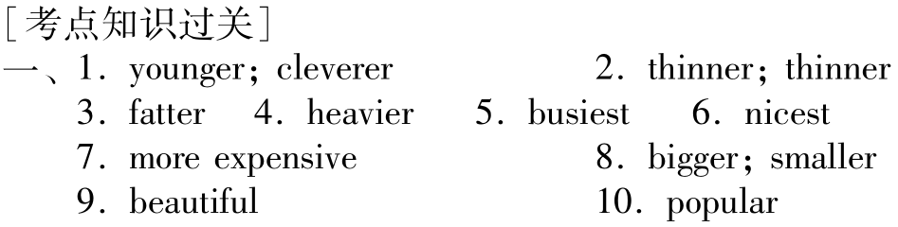

Slide 31
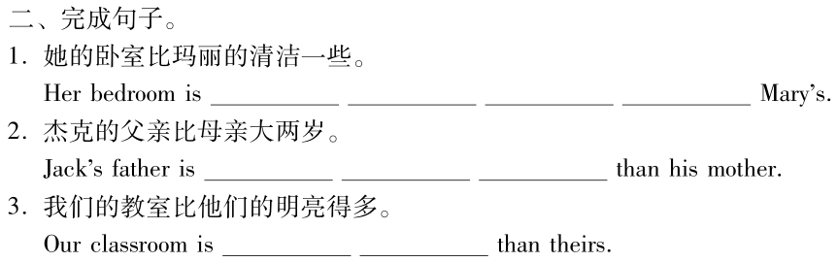
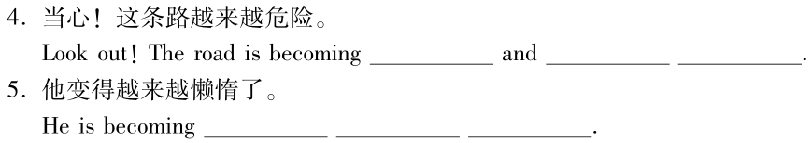
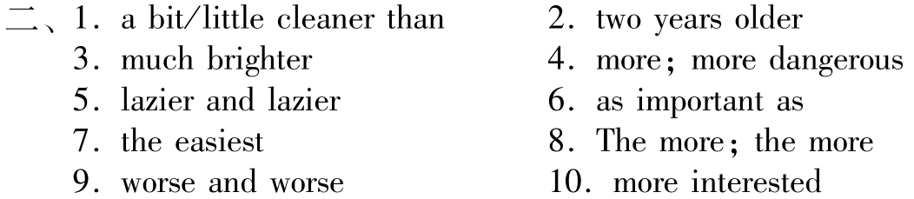

Slide 32
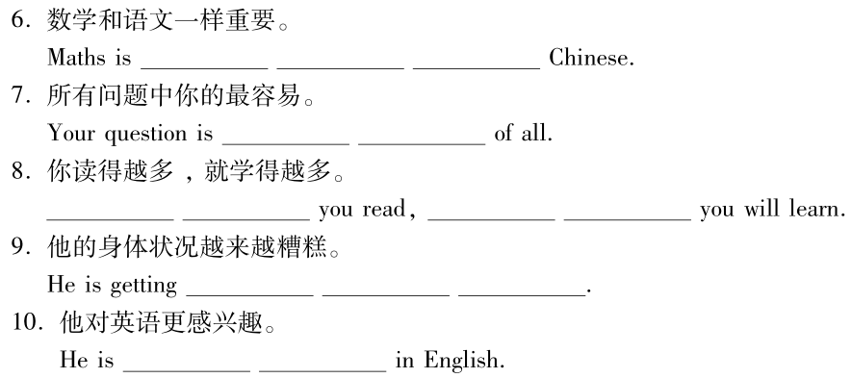

Slide 33
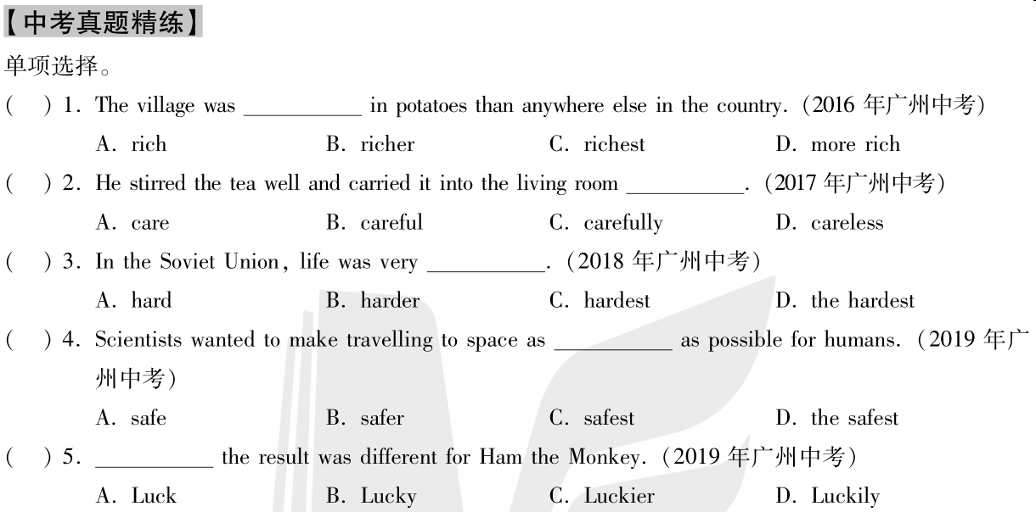

Slide 34
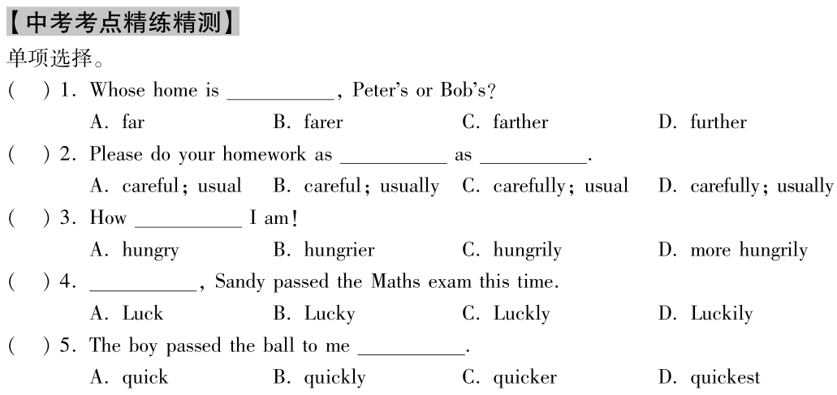

Slide 35


