Slide 1
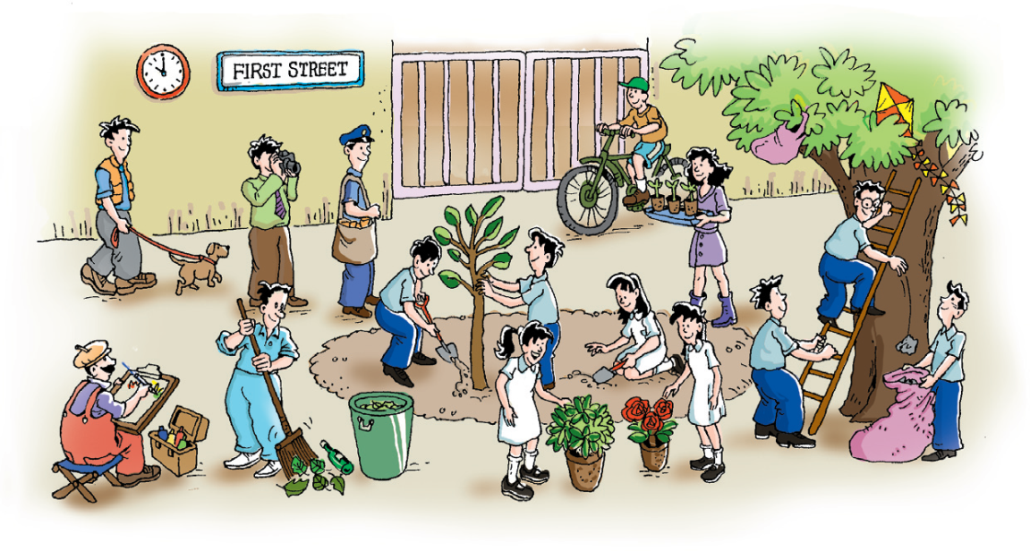
Unit 3 The environment
Grammar

Slide 2
目录
Lead-in
1
While-Learning
2
Post-Learning
3
Review
4

Slide 3
Part I Lead-in

Slide 4
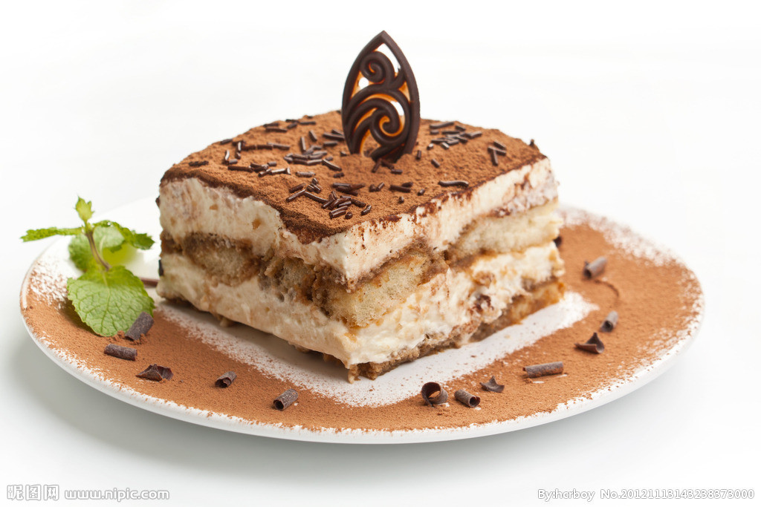
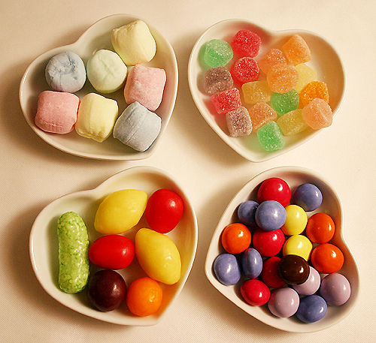
Are they the same or different?
They’re the same / different.
be the same
be different from

Slide 5
Part II While-Learning

Slide 6

Grammar A
the same and different

Slide 7
If things are exactly like one another, we say they are the same.
If they are not like one another, we say they are different.
These light bulbs look the same, but their effects on the environment are different.

Slide 8
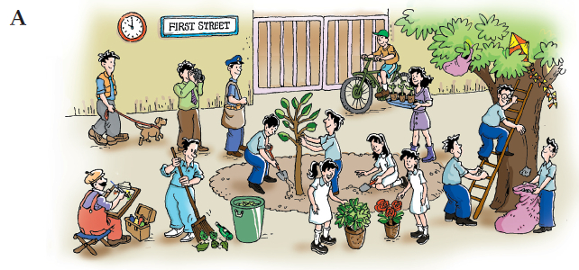
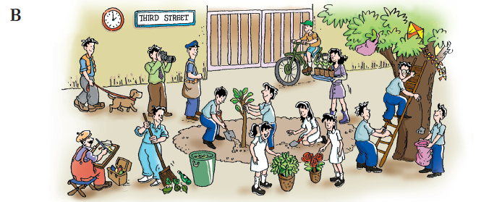
Look and find the similarities and differences between these two pictures.

Slide 9
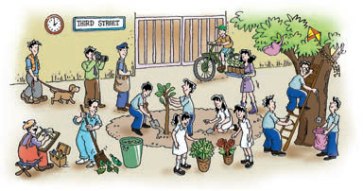
Some students are helping improve the environment of their school. Work in pairs. S1 should ask about something in the two pictures. S2 should say if they are the same or different. Take turns to ask questions. Follow the example.
S1: Look at the two dustbins. Are they the same or
different?
S2: They’re the same.
S1: Look at the two dogs. Are they the same?
S2: No. They’re different. The dog in Picture A is
smaller than the one in Picture B.

Slide 10
different 反义词：same
be different from “和……不同”
be the same as “和……相同”
Paul’s very different from his brother.
保罗与他的哥哥大不一样。
Our job today is the same as before.
今天的活儿跟往常一样。

Slide 11
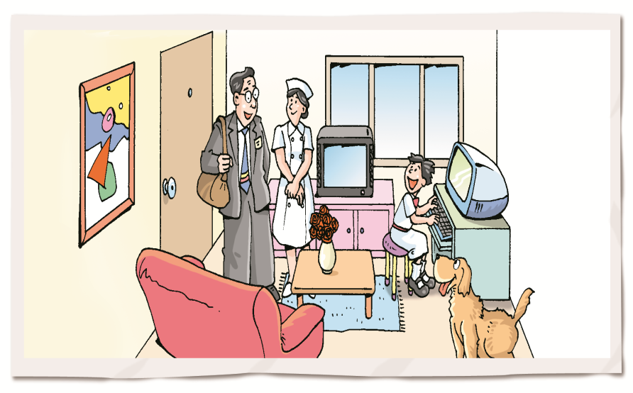
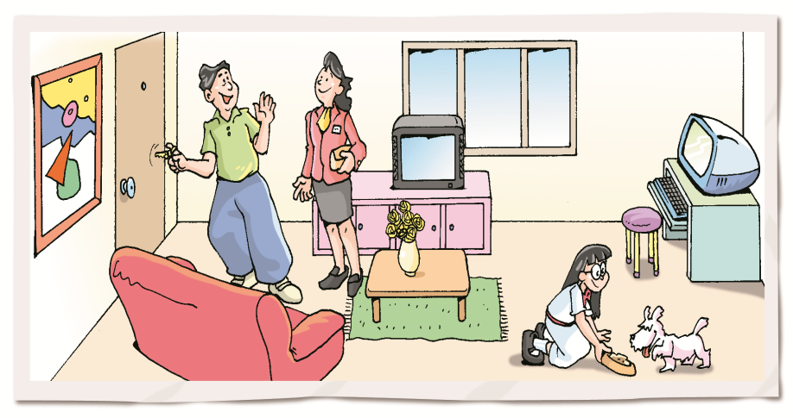
Look at the following two pictures. Work in pairs to discuss the similarities and differences between these two pictures. Follow the example.
A
B
S1: Look at the two computers in the pictures. Are they the same?
S2: Yes, they’re the same.
S1: Look at the two dogs. Are they the same?
S2: No, they’re different. The dog in Picture A is bigger than the dog in Picture B.

Slide 12

Grammar B
like, the same as and different from

Slide 13
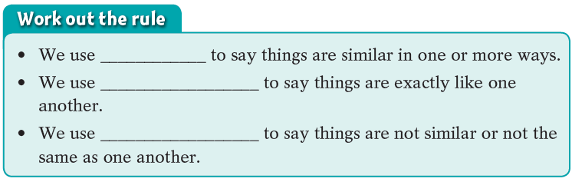
B like, the same as and different from
The atmosphere is like the glass of a greenhouse.
Without the atmosphere, the Earth would be the same as the Moon—cold and lifeless.
We should be different from many consumers and
become “green consumers”.
like
the same as
different from

Slide 14
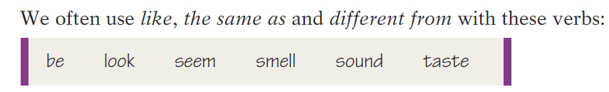
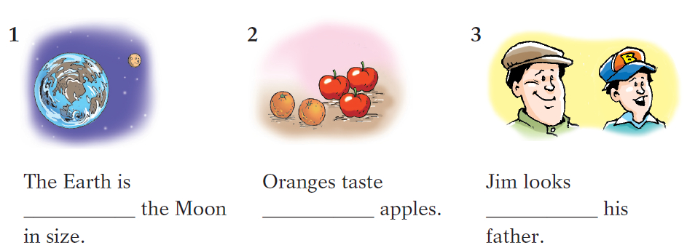
Complete these sentences with like, the same as or different from.
different from
different from
like

Slide 15
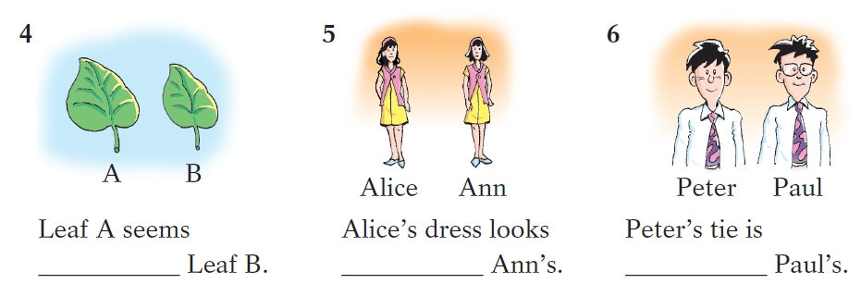
Complete these sentences with like, the same as or different from.
like
the same as
the same as

Slide 16
Complete the following passage with like, the same as or different from.
Jean and Jane are twins. In some ways, they look exactly (1) ________. In other ways, they look slightly (2)____________ each other. They look (3)_________ each other because they are nearly the same height and they are both thin. But Jean is (4)_____________ Jane in hairstyle.
At school, Jean likes English best, but Jane’s favourite subject is (5)____________ Jean’s. She likes Maths best. As they both enjoy swimming and playing tennis, Jean’s favourite sports are (6)_____________ Jane’s.
the same
different from
like
different from
different from
the same as

Slide 17
Grammar C
Using the same … as with nouns and phrases

Slide 18
C Using the same ... as with nouns and phrases
Sometimes we put a noun or a phrase after the same.
We can reuse things for the same purpose
as before.
Jerry uses the same amount of electricity
as his neighbour does.

Slide 19
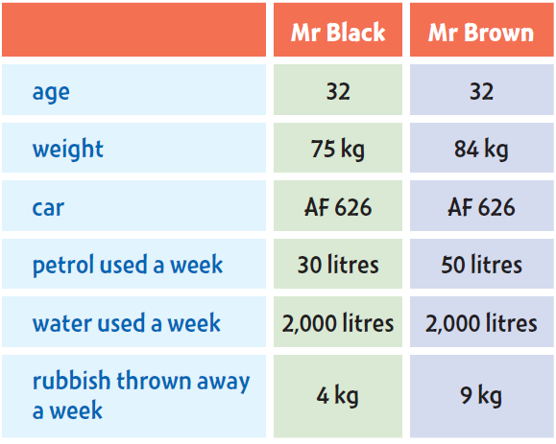
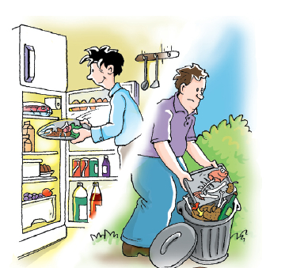
C1 Work in pairs. S1 should ask S2 about Mr Black and Mr Brown. S2 should respond using information from the table below. Follow the example.
S1: Is Mr Black the same age as Mr Brown?
S2: Yes, he is.
S1: Does he use the same amount of petrol each week as Mr Brown?
S2: No, he doesn’t.

Slide 20
C2 Use different, the same, the same ... as and the information in C1 to complete the following paragraph.
Mr Black is 1)__________________ Mr Brown, but their weights are 2)____________. Their cars are 3)_____________, but the amounts of petrol they use each week are 4)__________. Mr Black uses 5)_____________________________________ Mr Brown, but he throws away less rubbish each week than Mr Brown. Mr Black is greener than Mr Brown.
the same age as
different
the same
different
the same amount of water each week as

Slide 21
Part III Post-Learning

Slide 22
Work in pairs and find out the similarities between you and your partner. Use the same … as to express.
I am the same age as Peter (is).
I study in the same class as Peter (does).
I am dressed in the same colour as Peter (is)
I have the same bicycle as Peter (has).

Slide 23
Conduct a survey in your class. In pairs, make a conversation according to the result of the survey. Follow the example.
Find someone in the class … | Name
who lives in the same neighbourhood as you. | ______________
who has a different number of cousins from you. | ______________
who graduates from the same primary school as you. | ______________
who has the same number of pencils in their pencil case as you. | ______________
who goes to school in a different way from you. | ______________
whose birthday is the same as yours. | ______________
S1: Who lives in the same neighbourhood as you?
S2: Ann.
S2: Who has a different number of cousins from you?
S1: May has a different number of cousins from me. I have two
cousins, and May has three cousins.

Slide 24
Part IV Review

Slide 25
一、选择最佳答案填空。
( )1. The cameras in the pictures are ____. The
camera in Picture A is smaller than the one
in Picture B.
A. similar B. different
C. the same D. like
( )2. I have the same bicycle ____ my good friend.
A. as B. to C. of D. like
B
A

Slide 26
( )3. The food ____ Guangzhou is quite different
____ that there.
A. in; from B. from; to
C. in; like D. of; as
( )4. Every culture use ____ gestures, but they use
them in ____ ways.
A. same; different
B. the same; different
C. different; different
D. different; the same
A
B

Slide 27
D
( )5. My house ____ yours. Mine is brighter and
bigger.
A. looks like B. is the same as
C. is the same D. is different from
( )6. — Your mother’s job is ____ your father’s,
isn’t it?
— No. My father is an engineer and
my mother is a doctor.
A. different from B. same as
C. different in D. the same as
D

Slide 28
( )7. My watch is not the same ____ yours.
Mine is much more expensive.
A. to B. like C. as D. from
( )8. — How is the weather in Guangzhou now?
— Well, it’s ____ that in your city.
A. as colder as
B. so cold as
C. the same cold as
D. as cold as
C
D

Slide 29
二、将下列句子改为同义句。
1. The weather of this year is not the same as that of the past years.
The weather of this year ____ _______ ____ that of
the past years.
2. Shirley is the same weight as Mary.
Shirley is ____ ____ ____ Mary.
3. They are in different classes.
They aren’t in ____ ____ class.
is different from
as heavy as
the same

Slide 30
4. My family doesn’t throw away as much
rubbish as the Blacks.
My family doesn’t throw away ____ ____ amount
of rubbish ____ the Blacks.
5. Tom’s bike seems different from Paul’s.
Tom’s bike doesn’t ____ ____ Paul’s
the same
as
look like

Slide 31
Thank you!

