Slide 1
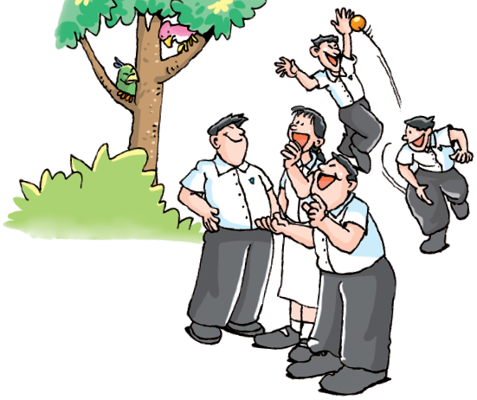
Unit 6 Caring for your health
Vocabulary

Slide 2
目录
Words and expressions
1
2
Notes

Slide 3
Reading
conduct v. 实施；执行 p. 81
*lifestyle n. 生活方式 p. 81
quarrel n. 争吵 p. 82
focus v. 集中（注意力、精力等）于 p. 83
*peer n. 同龄人；同辈 p. 83
pressure n. 压力 p. 83
whether conj. 是否 p. 83
risk n. 风险 p. 83
guard v. 守卫；保卫 p. 83
*positive adj. 积极乐观的；自信的 p. 83

Slide 4
Reading
cancel v. 取消；撤销；终止 p. 83
bright adj. 有希望的 p. 83
force v. 强迫；迫使（某人做某事） p. 83
concert n. 音乐会；演奏会 p. 83
private adj. 私人的 p. 83
silent adj. 不说话的；沉默的 p. 83
musical instrument n. 乐器 p. 83
enemy n. 危害物；大敌 p. 83
regular adj. 有规律的；定时的 p. 83
cheer v. 鼓励；鼓舞 p. 83
low adj. 沮丧的；消沉的；无精打采的 p. 83

Slide 5
Reading
deal with 解决；处理；应付 p. 83
guard against 防止；提防 p. 83
cancel out 抵消；对消 p. 83
look on the bright side（ 对不好的状态）持乐观的 态度 p. 83
take up （尤指为消遣）学着做；开始做 p. 83
(be) busy with 忙于做…… p. 83
leave ... behind 把……抛在后面 p. 83
cheer ... up （使）变得更高兴；
（使）振奋起来 p. 83

Slide 6
Listening
eyesight n. 视力 p. 86
Speaking
dentist n. 牙科医生 p. 91
Writing
recovery n. 恢复；痊愈 p. 92

Slide 7
Part II Notes

Slide 8

Reading
conduct v. 实施；执行
会议以很积极的方式进行。
The meeting have been conducted in a
positive manner.

Slide 9
lifestyle n. 生活方式
healthy lifestyle 健康的生活方式
way of life , mode of life , styles of living
生活方式
她的梦想是主持一档电视时尚生活节目。
Her dream is to present a lifestyle show
on television.

Slide 10

quarrel n. 争吵
quarrel with抱怨；不同意；拒绝接受；跟…吵架
quarrel about 争论；为…争吵
争吵导致了男孩离家出走。
The quarrel resulted the boy leaving the house.

Slide 11

focus v. 集中（注意力、精力等）于
focus in 焦点；专注于…
out of focus 焦点没对准的；模糊不清的
每个练习各有不同的语法重点。
Each exercise focuses on a different grammar
point.

Slide 12
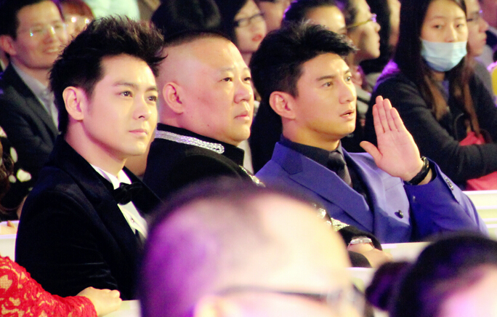
peer n. 同龄人；同辈
peer pressure 来自同辈的压力
peer group 同辈群体；同龄群体
孩子很容易受同辈影响。
Children are easily influenced by their peer.

Slide 13
pressure n. 压力
under pressure 面临压力，在压力之下；
受到压力
high pressure 高压，高气压；高度紧张
blood pressure n. 血压
怎么会有人喜欢都市生活的压力呢？
How can anyone enjoy the pressures of city life?

Slide 14
whether conj. 是否
我们明天是否外出取决于天气。
Whether we will go out tomorrow depends on the
weather.
risk n. 风险
high risk 高风险
没有足够的人愿意冒这个险。
There's not enough people willing to take the risk.

Slide 15

guard v. 守卫；保卫
security guard 保安人员
狗守护着主人的行李。
The dog was guarding its owner’s luggage.

Slide 16
positive adj. 积极乐观的；自信的
positive effect 积极的效果；明显效果
positive attitude 积极态度
我尽力往积极的方面想。
I'm trying to think positive thoughts.
cancel v. 取消；撤销；终止
如果你没有时间，你可以取消会议。
You may cancel the meeting if you are busy.

Slide 17
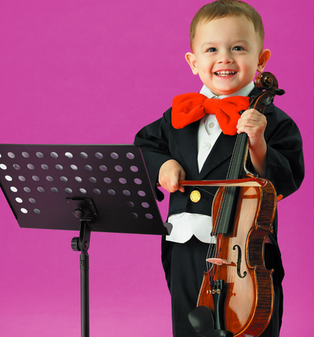
bright adj. 有希望的
bright future 光明的未来 ; 锦绣前程 ; 前程似锦
bright eyes 明亮的眼睛 ; 眼睛明亮
这位年轻的音乐家前途无量。
This young musician has a bright future.

Slide 18
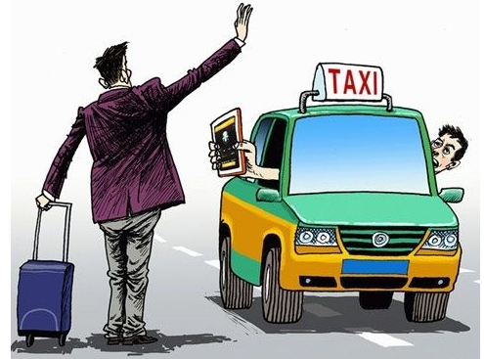
force v. 强迫；迫使（某人做某事）
最后一班公共汽车已经开走，所以我只好叫了一
辆出租车。
I was forced to take a taxi because the last
bus had left.

Slide 19
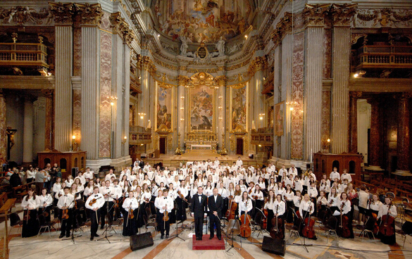
concert n. 音乐会；演奏会
go to the concert 去听音乐会，去参加音乐会
concert hall 音乐厅
你愿意和我一起去听音乐会吗？
Would you like to go to the concert with me?

Slide 20
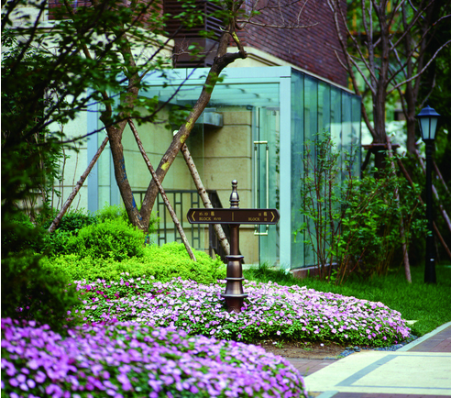
private adj. 私人的
in private 私下地；秘密地
private property 私有财产；私有制
城里的公园是对公众开放的, 但有些花园是私人的。
The park in town is public, but some gardens
are private.

Slide 21

silent adj. 不说话的；沉默的
keep silent 保持沉默；缄默
silent film 默片，无声片
电影开始时，观众安静了下来。
As the film began, the audience fell silent.

Slide 22

musical instrument n. 乐器
他几乎会弹奏每一种乐器。
He can play nearly every musical instrument.

Slide 23

enemy n. 危害物；大敌
natural enemy 天敌
public enemy 公敌；要犯
他在敌人面前从不屈膝。
He never bent his knees before the enemy.

Slide 24
regular adj. 有规律的；定时的
regular meeting 例会
regular exercise 常规性的锻炼；经常操练，
按时训练
他把他身体健康归功于运动和有规律的生活。
He owes his good health to plenty of exercise
and a regular life.

Slide 25
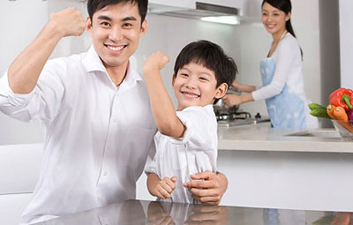
cheer v. 鼓励；鼓舞
cheer team 拉拉队 ; 啦啦队
cheer up 使高兴；高兴起来；使振奋
cheer for 为…欢呼，喝彩；给…加油
我写那首歌是给我自己打气的。
I wrote that song just to cheer myself up.

Slide 26
low adj. 沮丧的；消沉的；无精打采的
low cost 低成本，廉价的
low temperature 低温
low price 低价；廉价
当你觉得十分低沉的时候会做什么?
What do you do when you feel really low and
depressed?

Slide 27
deal with 解决；处理；应付
这是艰难的工作，他必须应付许多困难。
This is hard work. He must deal with many
difficulties.
guard against 防止；提防
我们必须谨防事故。
We must guard against accidents.

Slide 28
cancel out 抵消；对消
真抱歉, 不过我不得不取消午餐的约会。
I'm sorry. I have to cancel out the lunch
appointment.
look on the bright side 持乐观的态度
如果看事情的光明面, 你就可以活得很快乐。
Look on the bright side of things, and you will
live happily.

Slide 29
take up （尤指为消遣）学着做；开始做
他们学起打高尔夫球来了。
They have taken up golf.
(be) busy with 忙于做……
这些日子你忙什么呢 ?
What have you been busy with these days?

Slide 30
leave ... behind 把……抛在后面
我不想留下任何东西。
I don't want to leave anything behind.
cheer ... up （使）变得更高兴；
（使）振奋起来
振作起来吧! 消息还不算太坏。
Cheer up! The news isn't too bad.

Slide 31
eyesight n. 视力
eyesight check 视力检查
lose eyesight 失明
poor eyesight 视力很差；视力差
她的视力变得很糟,几乎什么也看不见了。
Her eyesight grew so bad that she could hardly
see.

Slide 32
Speaking
dentist n. 牙科医生
dentist 指专门从事治牙的医生。
surgeon 指专修外科或专修人体某个部分的外科
专科医生，一般需对患者进行手术治疗。
physician 指医院的内科医生。
doctor 普通用词，泛指各科医生，即一切有行
医资格的人。
我牙疼, 必须去看牙医。
I have got toothache, so I must go to a dentist.

Slide 33
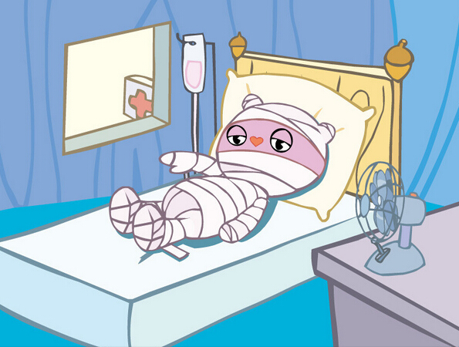
Writing
recovery n. 恢复；痊愈
她病得很重没有痊愈的希望。
She is badly ill and with no hope of recovery.

Slide 34
Thank you!

