Slide 1
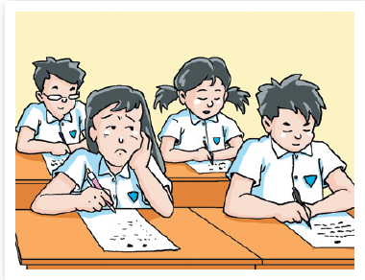
Unit 6 Caring for your health
Grammar

Slide 2
目录
Lead-in
1
While-Learning
2
Post-Learning
3
Review
4

Slide 3
Part I Lead-in

Slide 4
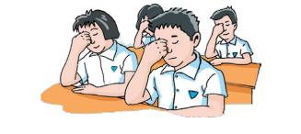

Check-up
Tell us your suggestions on how to protect our eyes.

Slide 5
Part II While-Learning

Slide 6

Grammar A
Using adjectives + that-clause

Slide 7
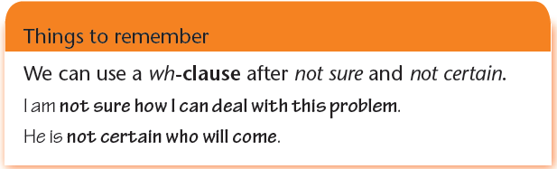
Some adjectives can be followed by a that-clause. Note
that we can sometimes leave out that.
You should be aware (that) stress is a risk to your health.
Here are some adjectives we can use in this way:
afraid glad pleased sorry surprised upset
certain happy sad sure unaware worried

Slide 8



You went to see a doctor last week. Write about the visit using the adjectives from the box and the sentences below. Use a different adjective each time.
glad pleased sure surprised worried
1. I arrived at the hospital on time.
I was glad that I arrived at the hospital on time.
2. There were a lot of people.
I was surprised that there were a lot of people.
3. The doctor might be too busy to see me.
I was worried that the doctor might be too busy to see me.
4. The doctor was very patient.
I was pleased that the doctor was very patient.
5. I would get well soon.
I was sure that I would get well soon.

Slide 9
根据括号中的形容词，运用“形容词+名词性从句”的结构，以第一人称改写句子。
1. She does not know the answer. (afraid)
I am afraid that she doesn’t know the answer.
2. I was late for class. (sorry)
I am sorry that I was late for class.
3. Lily might fail the exam. (worried)
I am worried that Lily might fail the exam.
4. You feel better. (happy)
I am happy that you fell better.

Slide 10
5. The little boy can run so fast. (surprised)
I am surprised that the little boy can run so fast.
6. Our school team will win the football match. (certain)
I am certain that our school team will win the football match.
7. The car was moving towards me. (unaware)
I was unaware that the car was moving towards me.
8. I failed to catch the last bus. (upset)
I was upset that I failed to catch the last bus.

Slide 11
Grammar B
Review of object clauses

Slide 12
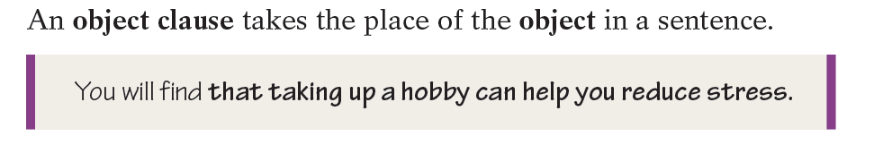


Read and review.

Slide 13
Join the two sentences.
Kitty told me something last night.
Kitty will go to London to further her studies.
Kitty told me last night that she would go to London to further her studies.

Slide 14
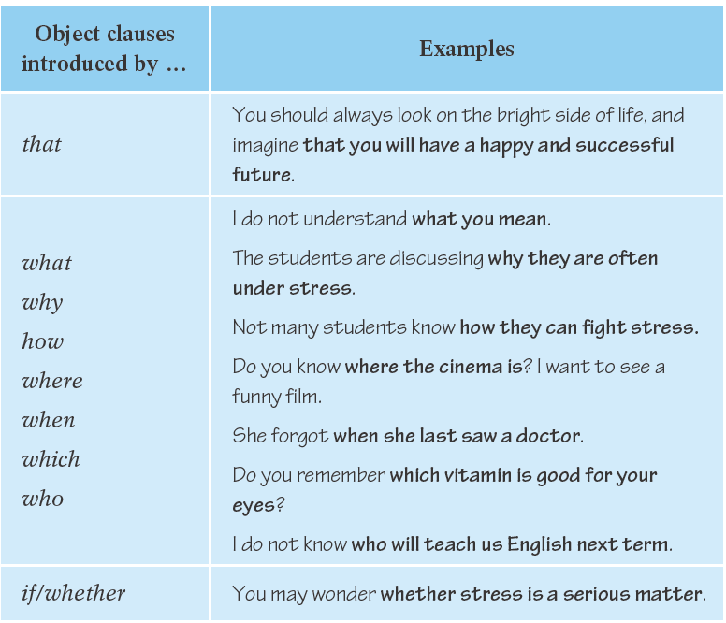

Read and review object clauses.

Slide 15
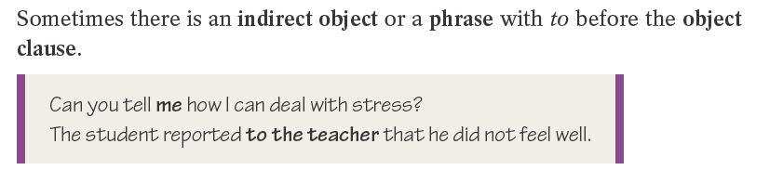
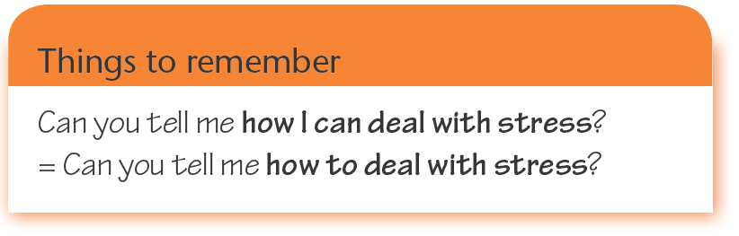
Read and learn.
subject（主语）+ verb（谓语） + indirect object （间接宾语）+that /wh-（引导词）+ clause（从句）

Slide 16
宾语从句
一、用作宾语的句子，叫宾语从句，位于及物动词或介词后面。
二、宾语从句的类型：宾语从句的类型取决于连接词，不同的连接词表示不同的意义。

Slide 17
宾语从句类别 | 连接词 | 例句
1. 表示陈述意义 | that(在口语和非正式文体中可省略) | We hope (that) you will enjoy your holiday.

Slide 18
宾语从句类别 | 连接词 |  | 例句
2. 表示对某个具体内容的疑问意义，如谁，谁的，什么，哪个，什么时候，什么地方，怎么样，为什么等 | 连接代词 | Who whom whose what which | Do you know who he is? He asked me whom I talked with just now. Can you tell me whose book it is? Ask him what he wants. Tell me which class you are in.
 | 连接副词 | when where how why | Mike asked when the meeting started. I wonder where I can post my letter. Mother showed us how she made pizza. He told Mr Wang why he was late for school.

Slide 19
宾语从句类别 | 连接词 | 例句
3. 表示对“能否，是否，对否，有否”等的疑问意义 | if, whether（如果句子有or (not)只能用whether） | I wonder if/whether he can drive a car. We don’t know whether he will come or not.

Slide 20
宾语从句类别 | 连接词 | 例句
4. 在glad, happy, afraid, sure等某 些形容词 后面 | 上述各连接词，如果是that可省略 | We are very glad (that) you have come to help us. I’m afraid (that) it’s going to snow. Are you sure when we will start?

Slide 21
使用宾语从句时要注意：
1. 宾语从句表示疑问时，仍然要用陈述句语序。
2. 宾语从句的时态取决于主句的时态
主句时态 | 宾语从句时态
现在时（一般现在时，现在完成时） | 可用所需的任何时态
过去时 | 用过去的某一时态
提示：如果宾语从句叙述的是客观事实或真理，不
管主句用什么时态，从句都用一般现在时。

Slide 22
Four patterns of object clause
1. 主语＋谓语动词＋that 宾语从句
I hope (that) you will like the book.
2. 主语＋be＋形容词＋that 宾语从句
I am sorry that you missed the last bus.
3. 主语＋谓语动词＋if/whether＋宾语从句
I wonder if/whether you can afford the car.
4. 主语＋谓语动词＋疑问词＋宾语从句
What don’t know what time it is.

Slide 23
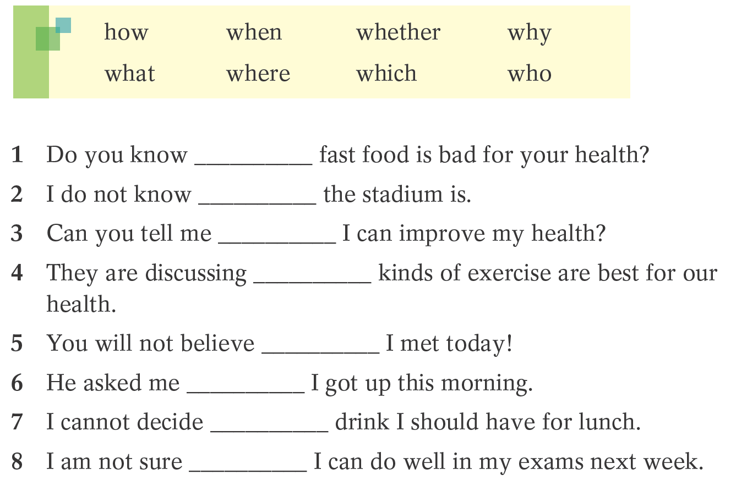





B1 Complete the object clauses with the words from the box.
why
where
how
what
who
when
which
whether

Slide 24
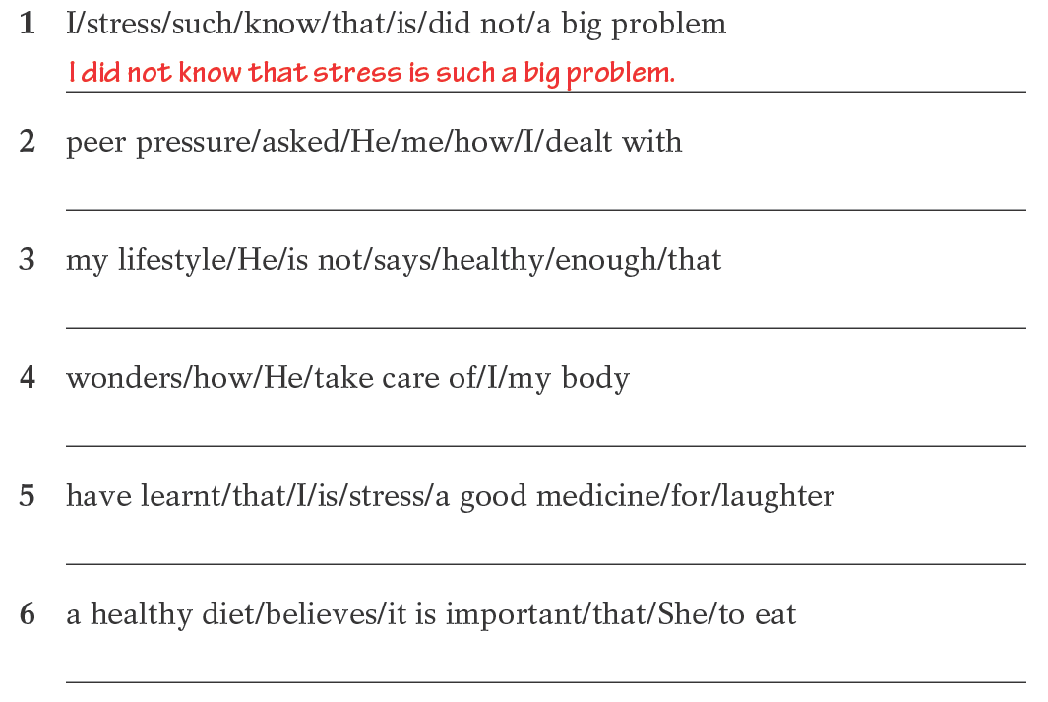




B2 Put the words in the correct order to make meaningful sentences.
He asked me how I dealt with peer pressure.
He says that my lifestyle is not healthy enough.
He wonders how I take care of my body.
I have learnt that laughter is a good medicine for stress.
She believes that it is important to eat a healthy diet.

Slide 25
Part III Post-Learning

Slide 26
一、用连接词if，whether，what，who，whose，
which，where，when，why，how填空。
1. — Do you know ______ he didn’t come to the party?
— I don’t know. Maybe he was ill.
2. Could you tell me ______ the girl is under the tree?
3. I’m looking for Mr White. Do you know ______ he is?
4. — He wanted to know __________ you wanted to go fishing with him.
— I promised to go.
why
who
where
if / whether

Slide 27
5. These rules tell us ______ a sentence is broken down into phrases.
6. I can’t say ______ he will come to help us or not.
7. I will never forget ______ you’ve done for the poor children.
8. — Could you tell me ______ we will have the party?
— On Saturday evening.
9. — I’m wondering ______ digital camera it is.
— It may be Lucy’s.
how
whether
what
when
whose

Slide 28
二、选择最佳答案填空。
( )1. — Hi, Jimmy. Here is a letter for you.
— Thanks. I wonder ____.
A. who was the letter from
B. who was from the letter
C. who the letter was from
D. who from the letter was
( )2. Does anybody know if ____ to Guangzhou next Sunday morning?
A. is there a flight B. there is a flight
C. there was a flight D. was there a flight
C
B

Slide 29
( )3. Our teacher said that the Moon ____ around the Earth.
A. go B. went
C. has gone D. goes
( )4. The Physics problem is so difficult. Could you tell me ____?
A. how to do it B. how to do
C. what to do it D. why to do it
D
A

Slide 30
C
( )5. — Excuse me, do you know ____?
— About 10 minutes’ walk.
A. where is the bookshop
B. how to get to the bookshop
C. how far the bookshop is
D. where the bookshop is
( )6. — Tell me ____.
— Well, she failed the exam.
A. what is her
B. what does she like
C. what the matter is with her
D. what is wrong with her
D

Slide 31
A
( )7. John, do you know ____ tomorrow?
A. how we will go there
B. what will we do
C. where we went
D. when will we start
( )8. — I’m not sure ____. Can you tell me?
— At 2:00 p.m.
A. where the meeting will be held
B. when the meeting will begin
C. where will the meeting be held
D. when will the meeting begin
B

Slide 32
Thank you!

