Slide 1
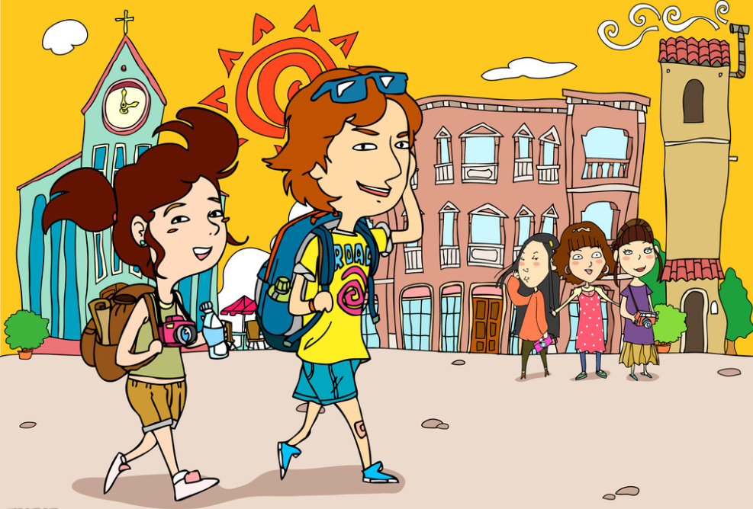
Unit 1 Great explorations
Writing

Slide 2

New words and expression
Writing
compare...with... 把……与……对比

Slide 3
Language points
compare...with... 把……与……作对比
Let's compare this article with that one.
让我们把这篇文章和那一篇作一下比较。
compare……to…… “将……比作……”
心脏常被比作水泵。
The heart is often compared to a pump.

Slide 4
A famous travel writer
A James Turner is a famous travel writer. Here is part of an interview with him. Work in pairs to match the answers with the questions. Write the letters in the boxes.
When and where were you born?
What did your parents do?
What did you do when you left school?
How did you start writing your first book?
What do you like to write about?
What’s your next book about?

Slide 5
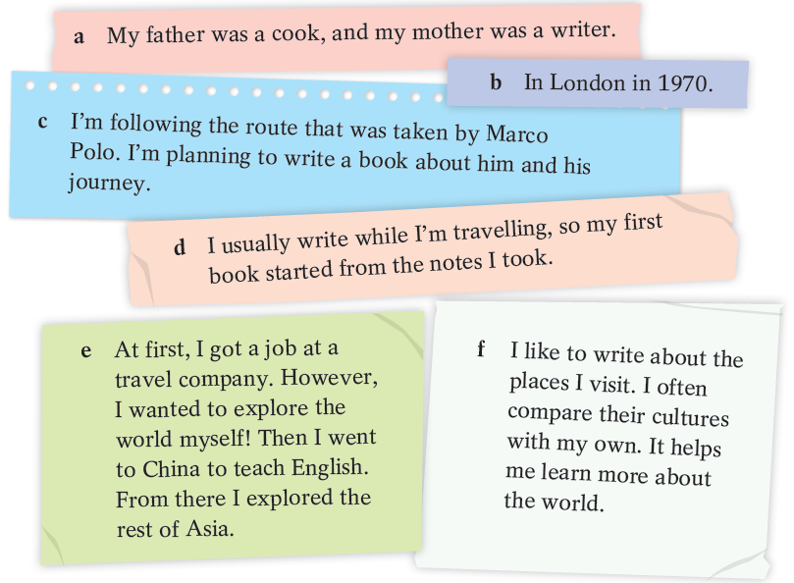

Slide 6
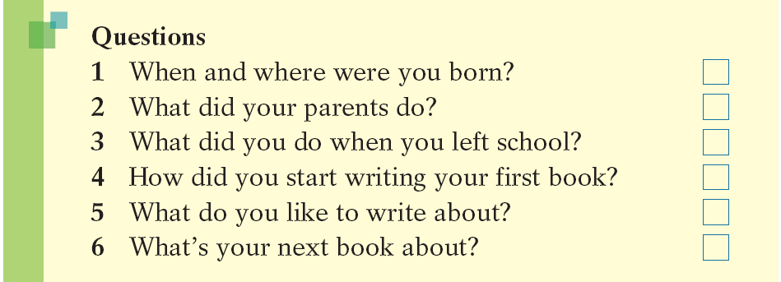
Writing
A famous travel writer
a
a My father was a cook, and my mother was a writer.

Slide 7
b
a
b In London in 1970.

Slide 8
b
a
c
c I’m following the route that was taken by Marco Polo. I’m planning to write a book about him and his journey.

Slide 9
b
a
d
c
d I usually write while I’m travelling, so my first book started from the notes I took.

Slide 10
b
a
e
d
c
e At first, I got a job at a travel company. However, I wanted to explore the world myself! Then I went to China to teach English. From there I explored the rest of Asia.

Slide 11
b
a
e
d
f
c
f I like to write about the places I visit. I often compare their cultures with my own. It helps me learn more about the world.

Slide 12
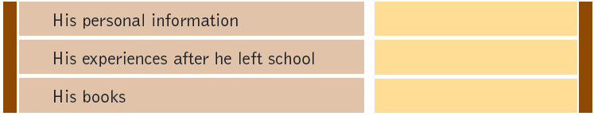
B Which of the questions in A are about James Turner’s personal information, his experiences after he left school and his books？ Write the numbers 1-6 in the boxes.
When and where were you born?
What did your parents do?
What did you do when you left school?
How did you start writing your first book?
What do you like to write about?
What’s your next book about?
1
2
3
4
5
6

Slide 13
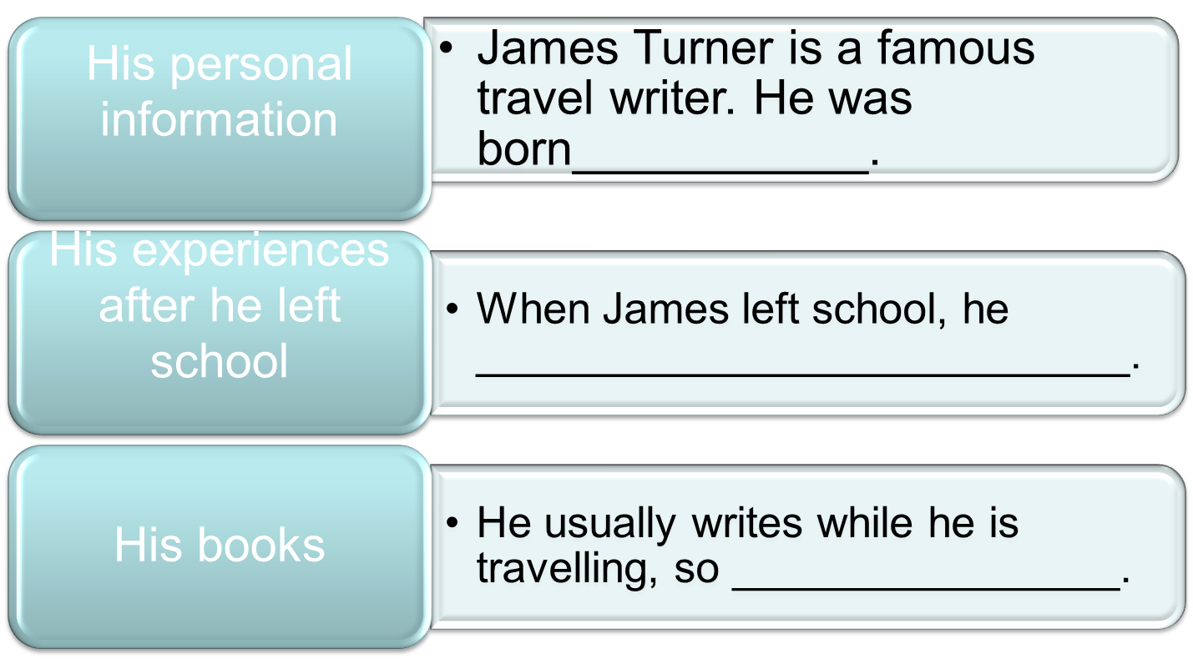
Work on your own. Write an article about James Turner in three paragraphs.
Use James’s answers and the outline below to help you.
James Turner — a famous travel writer

Slide 14
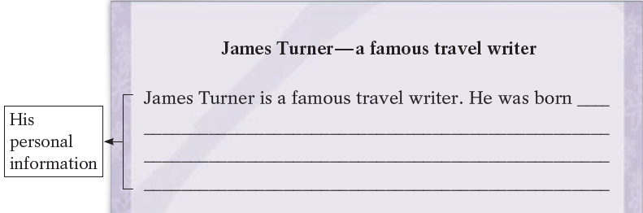
C Work on your own. Write an article about James Turner in three paragraphs. Use James’s answers and the outline below to help you.
in London in 1970. His father was a cook, and his mother was a writer.

Slide 15
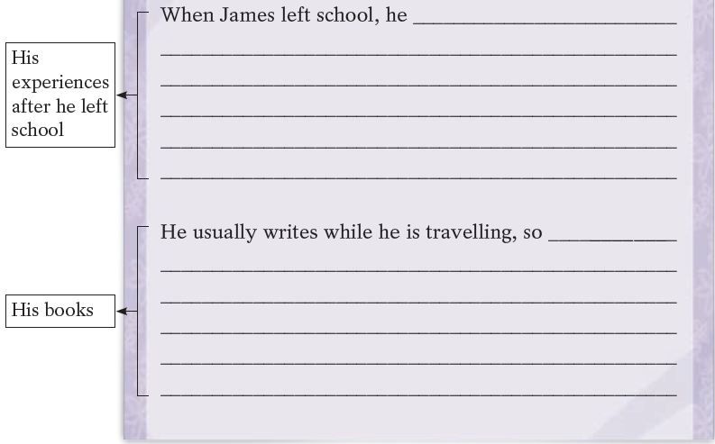
got a job at a travel company. However, he wanted to explore the world himself. Then he went to China to teach English. From there he explored the rest of Asia.
his first book started from the notes he took. He likes to write about the places he visits. He often compares their cultures with his own. It helps him learn more about the world. He’s planning to write a book about Marco Polo and his journey.

Slide 16
Thank you!

