Slide 1
初高中衔接之
句子成分+基本句型+
句子结构

Slide 2
句子成分+基本句型

Slide 3
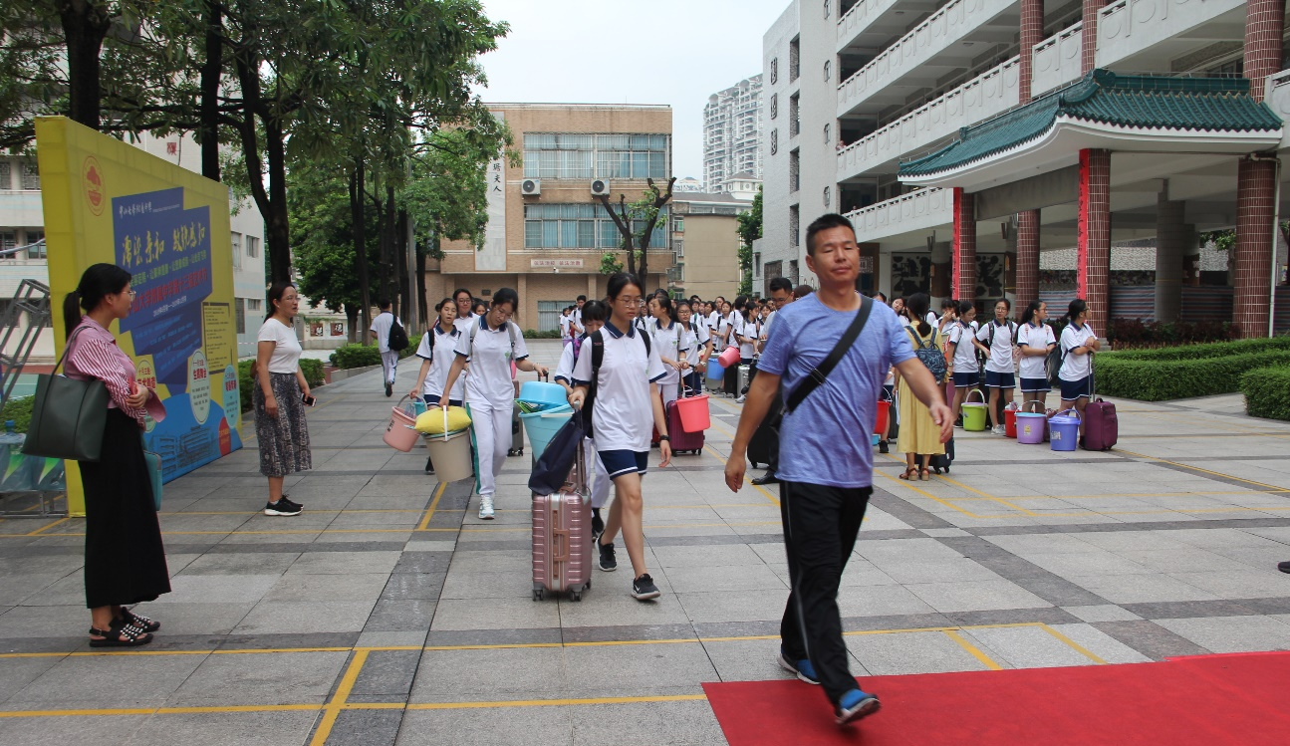
句型1
Mr. Liu came.
主Subject
谓
Verb(vi)
动作发起者
动作

Slide 4
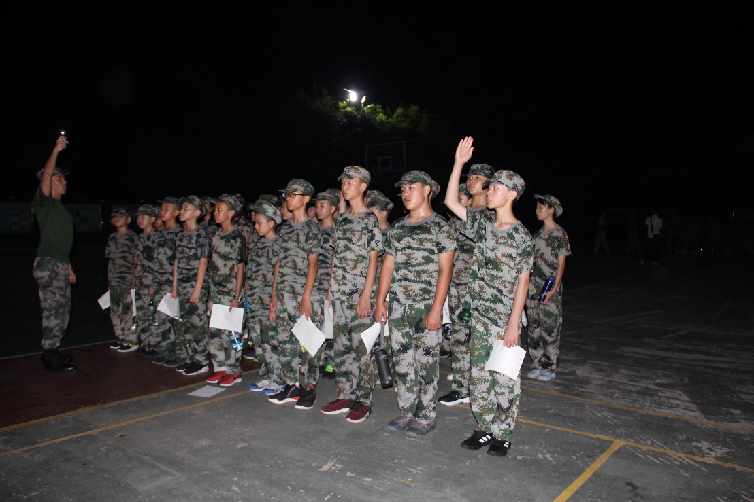
句型2
He puts up his hands.
主Subject
谓
Verb(vt)
宾
Object
动作发起者
动作
动作承受者

Slide 5
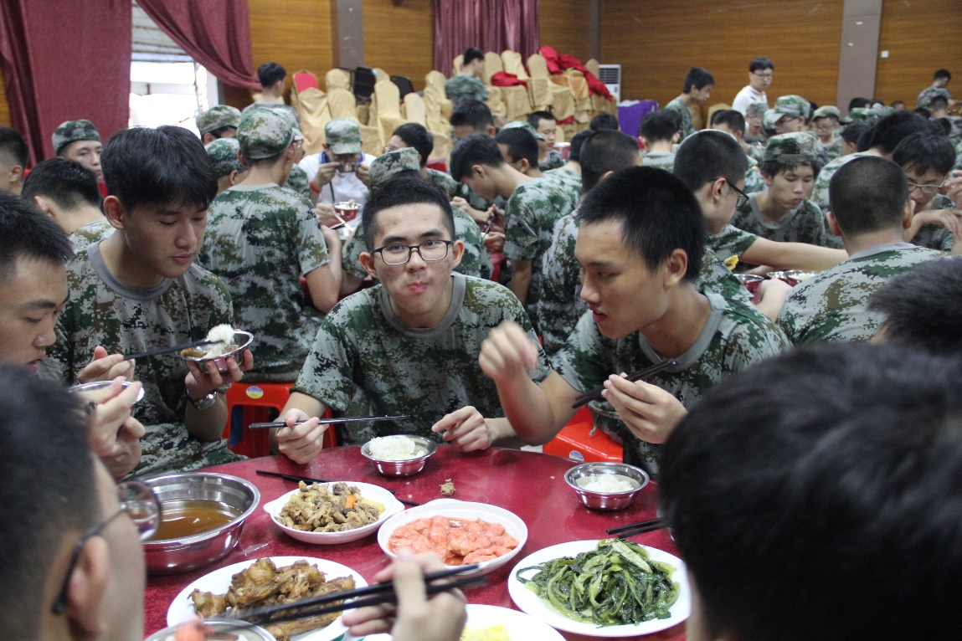
句型3
The food tastes so delicious.
主
Subject
系
(Link) Verb
表
Predicate
动作发起者
系动词
身份、特征、状态
系动词有哪些？

Slide 6
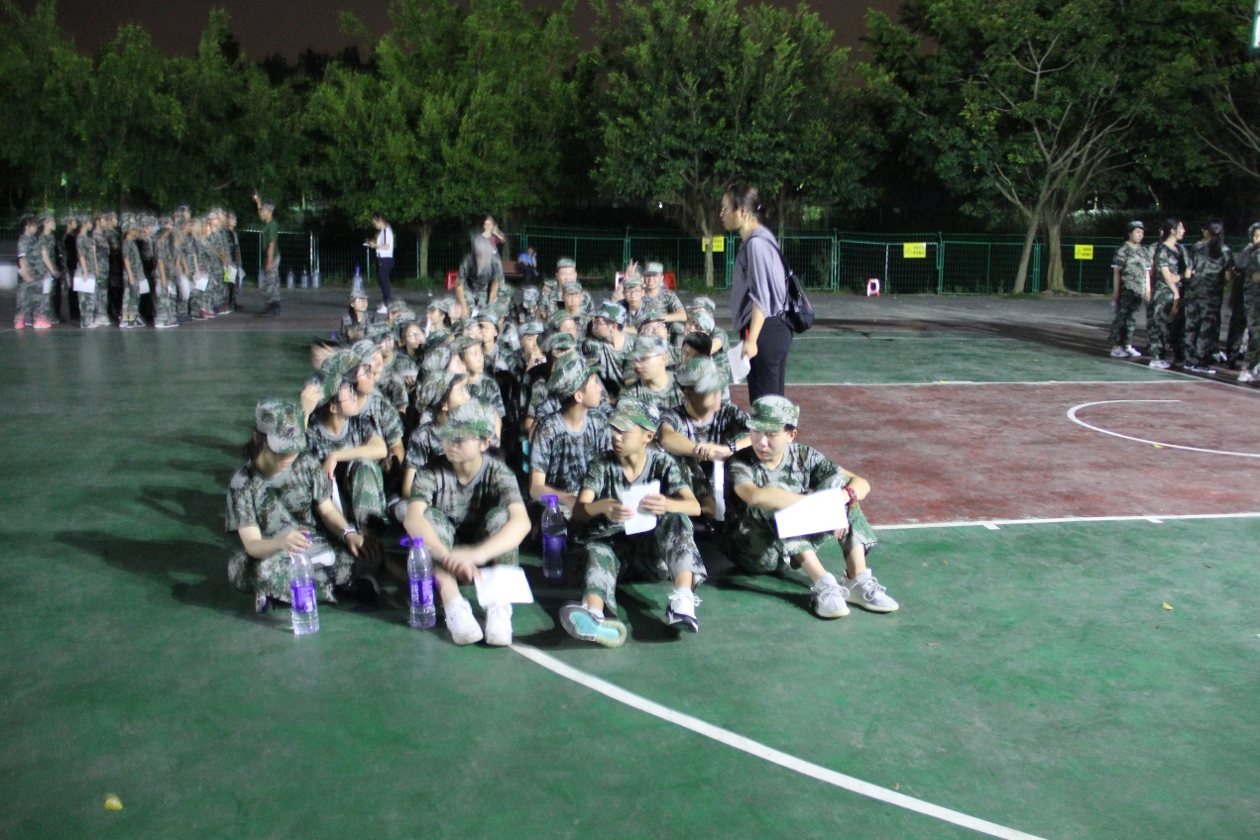
句型4
Our teacher gives us a lecture.
主
Subject
谓
Verb
间接宾语
Indirect Object
直接宾语
Direct Object
动作发起者
动作
动作承受者（人）
动作承受者（物）

Slide 7
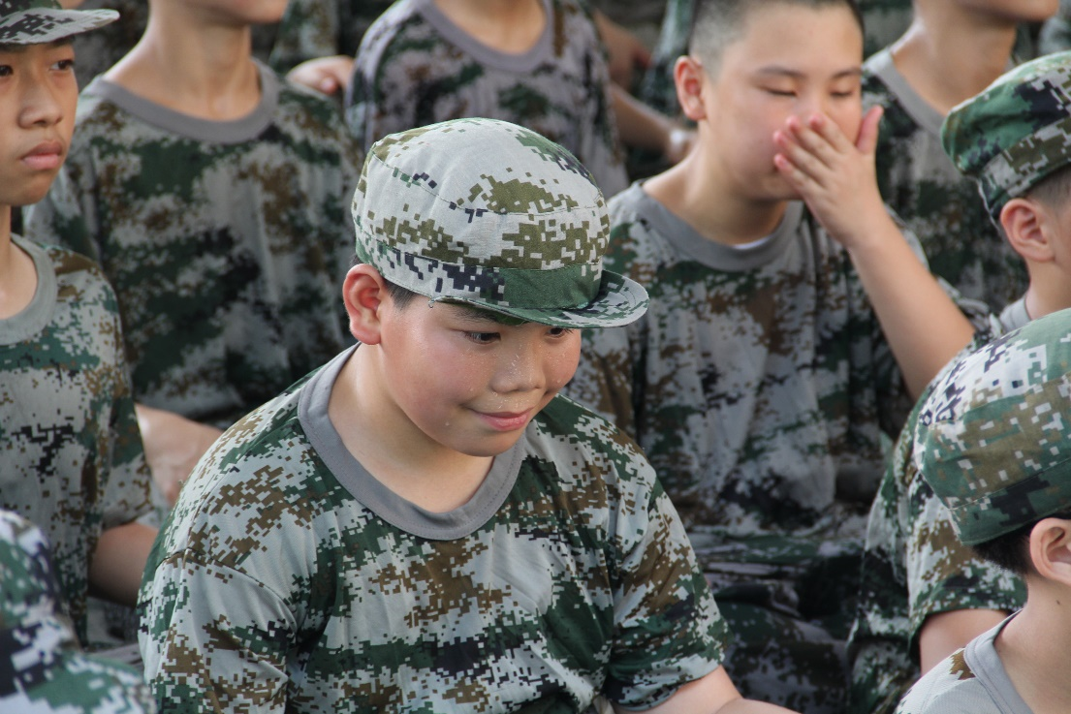
句型5
He finds it so hot.
谓
Verb
宾
Object
宾补
Complement
主
Subject
动作发起者
动作
动作承受者
补充说明宾语
接宾补的有哪些动词？

Slide 8
Handsome
Mr. Liu came
this way.
定Attributive
主Subject
谓
Verb(vi)
状Adverbial
修饰
动作发起者
动作
修饰

Slide 9
判断下列句子类型
1.Time flies.
2.The dinner smells good.
3.He is playing.
4.The book is interesting.
5.He understands English.
6.He bought nothing for you.
7.I gave him a hand.
8.We keep the table clean.
主谓
主系表
主谓
主系表
主谓宾
主谓直宾间宾
主谓间宾直宾
主谓宾宾补

Slide 10
Conclusions
Time He Ｓ(主） | flies. is playing. Ｖ（谓）
The dinner The book Ｓ | smells is LinkＶ | good. interesting. Ｐ（表）
He Ｓ | understands Ｖ | English. Ｏ（宾）
He I Ｓ | bought gave Ｖ | you him InO | nothing. a hand. DＯ
We Ｓ | keep Ｖ | the table Ｏ | clean. OＣ
主语：名词/代词(=名词)
谓语：动词
表语：形容词(=形容词)
宾语：名词（=名词）

Slide 11
Group discussion
Check the answers.

Slide 12
句子结构

Slide 13
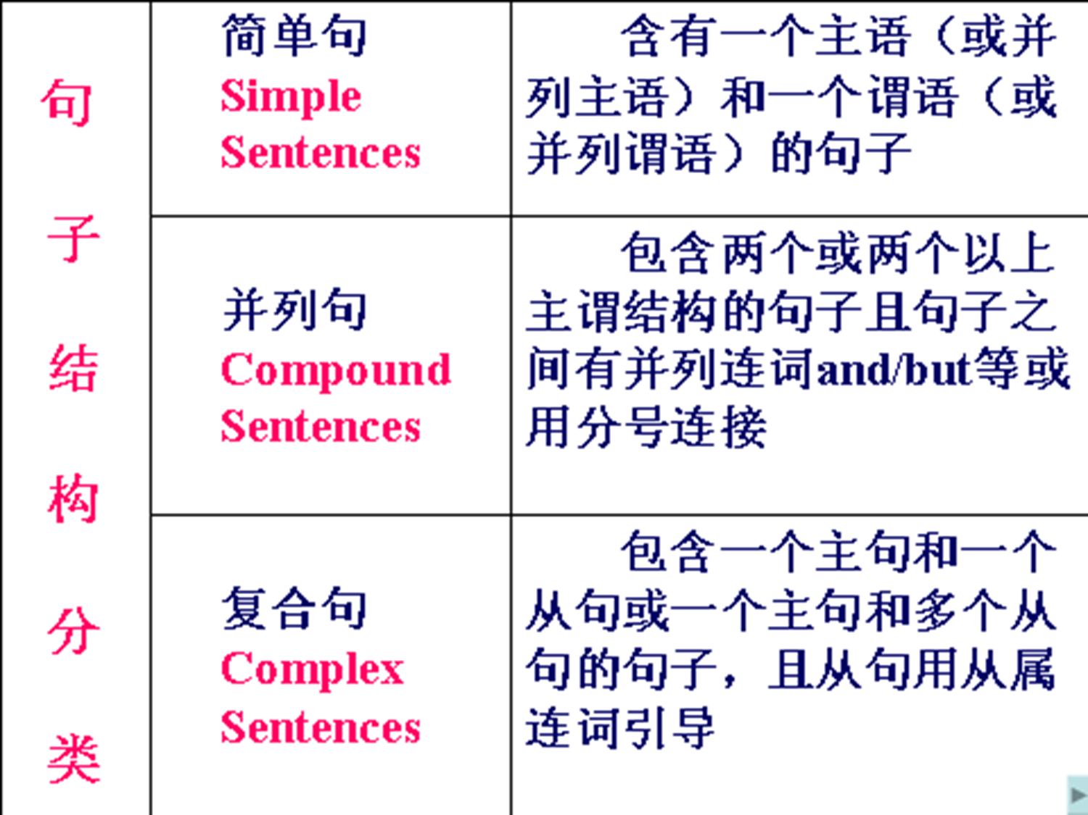

Slide 14
按结构英语句子主要可以分成三种：
简单句， 并列句，复合句
e.g. 1) The teacher’s name is Smith.
2) The teacher’s name is Smith and the
student’s name is John.
3) He is Smith who likes going hiking.
4) He is Smith and he likes going hiking.
5) Hurry up, or you’ll be late.
6) I saw him when I walked past the street.
7) He often gets up early because he wants
to catch the early bus.
简单句
并列句
复合句
并列句
并列句
复合句
复合句

Slide 15

Analyze the sentences:
(
At first the English spoken in England
between about AD 450 and 1150 was very
different from the English spoken today.
__________________
S
)
_______________________________
V
At.(定语)
(
)
______________
P
At.(定语)
简单句

Slide 16
Analyze the sentences:
I don’t want to set down a series of facts
in a diary as most people do, but I want
this diary to be my friend, and I shall call
my friend Kitty.
__________
__________________________
S
V
O
(
)
_________
___________
Ad.
V
S
V
S
________
______________
_________
S
V
O
OC
______
O
OC
并列复合句

Slide 17
Analyze the sentences:
I can well remember that there was a
time when a deep blue sky, the song of the
birds, moonlight and flowers could never
have kept me spellbound.
{
__________________
S
V
Oc
S
V
（
_____________________________
P
Ac
____________________________
___________
S
}
）
_________
V
O
OC
复合句

Slide 18
Mr. Liu came.
, our PE teacher,
主Subject
同位语
appositive
谓
Verb(vi)
动作发起者
解释说明
动作

Slide 19

They both went to the cinema.
主
Subject
同位语
appositive
谓语
Verb
动作发起者
解释说明
动作

Slide 20
Group discussion
Check the answers.

