Slide 1
U1 friendship
Warming-up and reading

Slide 2


I Lead in
What’s the movie about?
Friendship.

Slide 3
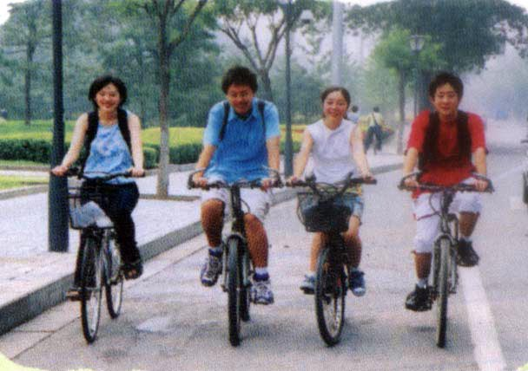
I Lead in
What do you think a good friend should be like? List the good qualities a good friend should have.

Slide 4
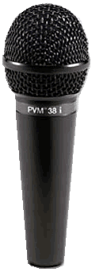
I Lead in
Interview
Four students in a group,
each one has to interview
the other group mates.
What do you think a good friend should be like?
Name | Age | Gender (性别) | Three qualities
Student 1
Student 2
Student 3

Slide 5
I think a friend should be …
A good friend is someone who …
brave
kind
honest
patient
responsible
friends
generous
helpful
humorous
hard-working
clever

Slide 6
Think about what is friendship?
F
R
I
E
N
faithful / friendly/ fair …
reliable / respectful / responsible
interesting…
everlasting / eternal /equal /
encouraging…
nice…

Slide 7
D
S
H
I
P
different / devoted…
sharing / sincere…
helpful / honest…
incredible / independent…
polite / patient / punctual…

Slide 8
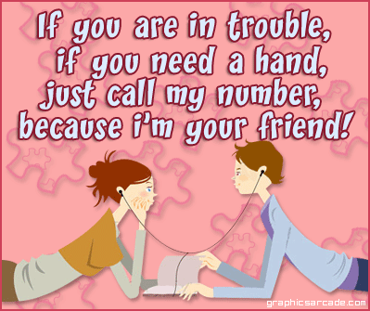
Do the survey on P1 by yourself. Then add up your score and see how many points you get.

Slide 9
II Warming Up
Do the survey on P1 by yourself. Then add up your score and see how many points you get.
A=1, B=3, C=2
A=1, B=2, C=3
A=1, B=2, C=3
A=3, B=2, C=1
A=0, B=3, C=0

Slide 10
4-7 points:
You are not a good friend. You either
ignore your friend’s needs or just do
what he/she wants you to do. You
should think about what a good
friend needs to do. Think more
about this.

Slide 11
8-12 points:
You are a good friend but you sometimes let your friendship
become too important, or you
fail to show enough concern for
your friend’s needs and feelings. Try to strike a balance between your friend’s needs and your own responsibilities.

Slide 12
13+ points:
You are an excellent friend who recognizes that to be a good friend you need to balance your needs and those of your friends. Well done!

Slide 13
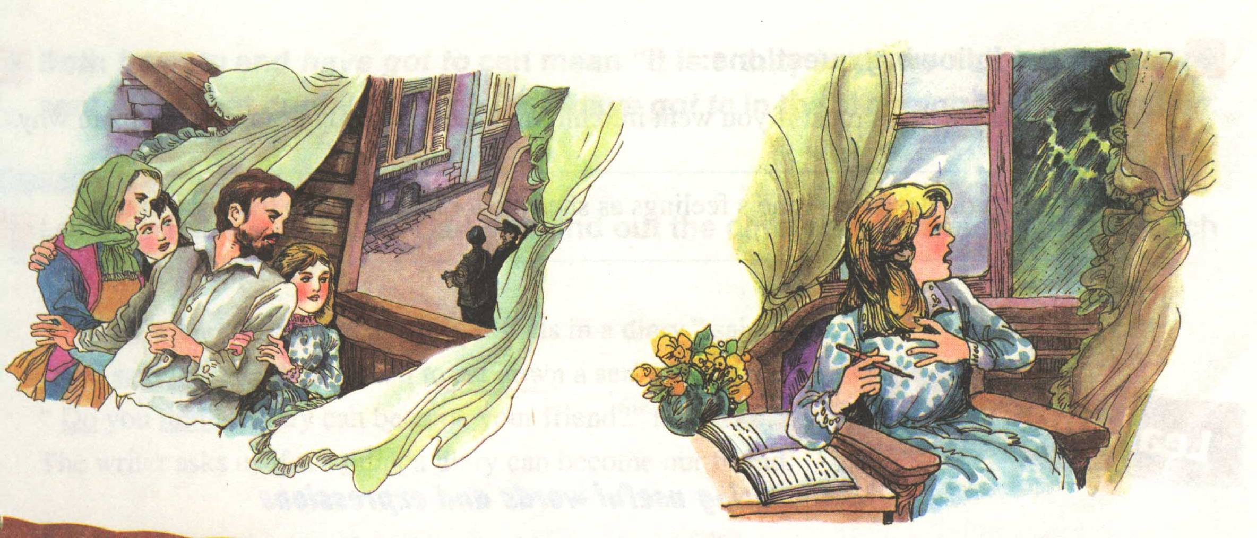
Reading: Anne’s best friend
1. Look at the pictures and the title of the reading passage. Guess what it might be about.
They stayed on the top floor, with
curtains drawn so as not to attract
unwanted attention.

Slide 14

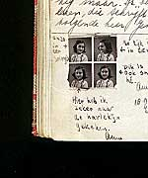
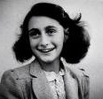
Reading: Anne’s best friend
What do you know about Anne? Say one
or two things you know about Anne.
German-Jewish

Slide 15
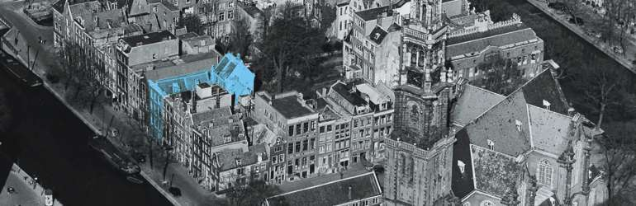
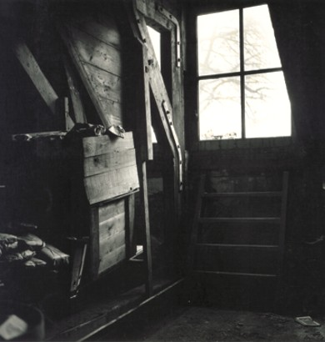
hiding place
attic

Slide 16
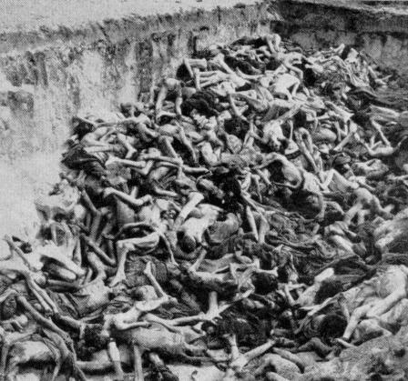
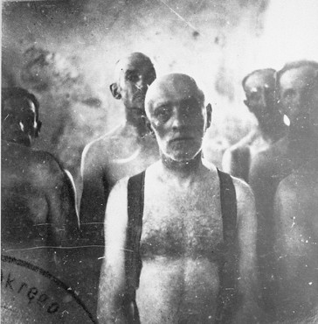
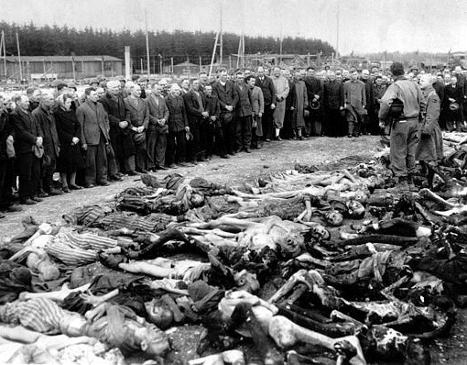
The Holocaust
（大屠杀）
Background: World War II
A mass grave
Victims of the gas chambers
（毒气室）

Slide 17
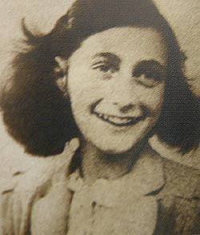
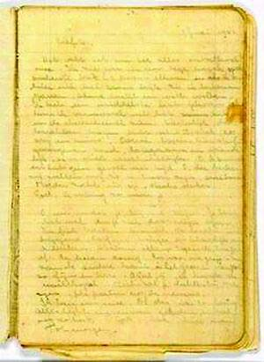
Pre-reading
1. Look at the structure and find out:
how many parts it contains
what the different parts are about
One part is the _________________
about Anne and her diary, the other one is one page of_____________.
background knowledge
Anne’s diary

Slide 18
While-reading
2. Listen to part 1, and fill in the form below:
The place of the story(where)
The time of the story(when)
The heroine’s（女主人公）full name (who)
Her best friend (who)
The length of time her family hid away (when)
The time they started to hide (when)
Netherlands
During World War II.
Anne Frank
her diary--Kitty
over two years
July 1942

Slide 19
While-reading
3. Join the correct parts of the sentences.
Anne kept a diary because
She felt very lonely because
They have to hide because
Anne named her diary
Kitty because
she couldn’t meet her friends.
Jews were caught by Nazis and put away.
she could tell everything to it.
she wanted it to be her best friend.

Slide 20
While-reading
4. Listen to Part 2 to get the main idea
of the diary.
Anne expressed ____________________
after hiding for a long time.
_______________________ kept Anne
spellbound.
her feelings about nature
Everything about nature
Spellbound means to concentrate
with delight for some time.

Slide 21
While-reading
5. How did Anne feel about nature before and after she and her family hid away?.
Time | Nature | Feeling
Before hiding
After hiding
blue sky, songs of birds, moonlight, flowers
never felt spellbound
darkness, rain, wind, thundering clouds
felt crazy

Slide 22
While-reading
6. Why do you think her feelings changed towards nature?
Before: never felt spellbound,
Now: felt crazy
She was no longer be able to go out. She lost her freedom.

Slide 23
After-reading
How would you describe Anne’s feelings as she was looking out at the night sky?
sad
anxious
excited
eager
earnest
lonely
crazy
calm

Slide 24
Retelling
I lived in ___________in the ______________ during _____________. My family were ______, so we had to ___________ for a year and a half in order ________________ by the German Nazis. During that time I wasn’t able to go ________ for so long that I had ______________ about everything to _______ nature. Once, I decided to look at the moon ___________ by myself.
Amsterdam
Netherlands
World War II
Jewish
hide away
not to be caught
grown so crazy
outdoors
do with
at midnight

Slide 25
Retelling
But I didn’t _______ open the window to see the night ___________ because I was afraid of being discovered by the Nazis.
I felt very _______ without seeing my old friends. So I had to make a new friend --_____________, whom I could tell _________ to. Sadly, at last my family was discovered and caught by _______________ sometime later.
dare to
face to face
lonely
my diary Kitty
everything
the German Nazis

Slide 26
Exercises
1. Find the word or expression for each of the following meanings from the text.
1)________
2)_____
3)_________________
4)______
5)__________
outdoors
not inside a building
feeling disturbed
to be worried about
free, not tied up
to experience something
upset
be concerned about
loose
go through

Slide 27
Exercises
6) _______
7) _________
8) _________
9) _______
10) _______
ignore
to take no notice of
staying close to and looking at somebody
to become quiet after nervous activity
piece of material hung to cover a window
number of things that happen one after another
face to face
calm down
curtain
series

Slide 28
Exercises
2. Complete this passage with some of the words and phrases above.
upset
Anne’s sister, Margot was very ________ that the family had to move. However, she knew that she had got to __________ all the difficulties with her family. She found it difficult go settle and __________in the hiding place, because she was _________________ whether they would be discovered. She suffered from loneliness, but she had to learn to like it there.
go through
calm down
concerned about

Slide 29
Exercises
What she really missed was going __________ and walking the dog for her neighbour. It was such fun to watch it run ______ in the park. She wished she could tell her neighbour ____________ that she was sorry not to be able to do it any longer, but she knew that was too dangerous!
outdoors
loose
face to face

Slide 30
Exercises
3. Complete the following sentences using words and expressions from the text.
1)When the man saw the car accident on the highway, he stopped ____________ offer help.
2)“How can Linda recover from her illness in this room when it’s so dirty and ______? It will only make her worse,” said the doctor.
3)After Peter died, George __________ the story of their friendship in a book.
in order to
dusty
set down

Slide 31
Exercises
at dusk
4)When the street lights go on ________, they make a beautiful picture, so different from the daytime.
5)Good friends do not _____________what they do for each other; instead they offer help when it is needed.
6)Although Tim and Mike come from __________different backgrounds, they became close friends.
7) Please draw the _______; the sunlight is too bright.
8) “Sorry, I didn’t break the plate ___________.”
“It’s OK. Don’t worry about it.”
add up
entirely
curtain
on purpose

