Slide 1
Grammar
Direct speech & indirect speech

Slide 2
一个概念
Direct speech:直接引述别人的原话
Indirect speech:用自己的话转述别人的话
两个形式
Direct speech：引语前后加引号
Indirect speech:不加引号
四个变化
代词, 状语，时态，语序

Slide 3
一、代词
人称代词
一随主，二随宾，三不变
She said, “I am hungry.”
She said she was hungry.
指示代词
this-that, these-those

Slide 4
二、状语
时间状语
现在now-then; this morning-that morning;
将来tomorrow-the next/following day
next week-the next week;
过去ago-before
yesterday-the day before;
last night-the night before;

Slide 5

三、时态
一般现在时
一般将来时
现在进行时
一般过去时
现在完成时
过去完成时
一般过去时
过去将来时
过去进行时
过去完成时
过去完成时
过去完成时

Slide 6
四、语序
A 直接引语为陈述句时
间接引语：用that引导，语序不变
Anne: “My family and I are hiding in Amsterdam”.
Anne said _____ she and her family were hiding in Amsterdam.
that

Slide 7
B. 直接引语为一般疑问句
间接引语：用if/whether引导，语序变陈述句语序
He said, “Are you interested in English？”
→He asked (me) _________ I was interested in English.
if/whether

Slide 8
C 直接引语为特殊疑问句时
间接引语：疑问词保留不变，语序变为陈述句
He asked, “When do you harvest the wheat?”
They asked when we harvested the wheat.

Slide 9
Exceptions
There are some cases in which we don’t need to change the tense in indirect speech.
Summary:
When direct speech is about:
a) a truth 真理
b) a timetable 时间表
c) a saying/proverb/quotation 格言/引用语
d) An adverbial indicating the past 过去的时间状语
e) 主句的动词为现在时

Slide 10
祈使句

Slide 11
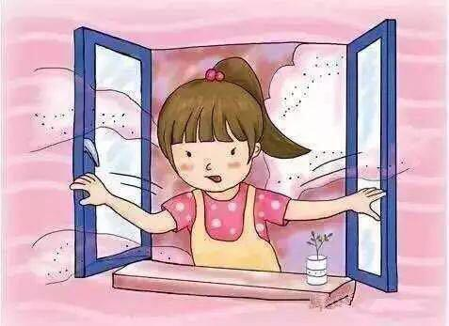
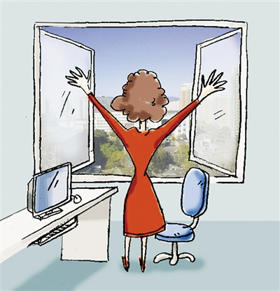
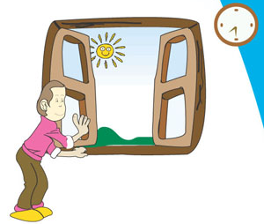
Not polite
S1: Open the window.
Command
S2: Please open the window.
S3: Would you please open the window？
Request
Very polite

Slide 12

观察句子中直接引语与间接引语的转化规律，加以总结。
He said to me, “Please open the window.”
→ He asked me to open the window.
“Be careful with the dog,” she said to me.
→ She told me to be careful with the dog.
DS变ID转述祈使句时，通常采用“动词+宾语+________ ”结构。
不定式

Slide 13
“Tom, stop playing computer games!” said mother.
→ Mother ordered Tom to stop playing computer games.
1. ____ 型祈使句，变ID，用_____________________.
命令
ask/tell/order sb. to do sth.

Slide 14
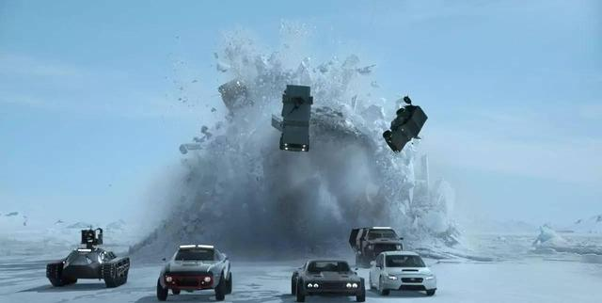
Tom’s father said to him, “Don’t drive too fast.”
→ Tom’s father told him not to drive too fast.
2. 命令型祈使句的否定，变ID，用___________________________。
tell/warn/remind sb. not to do sth.

Slide 15
He said, “Let’s go to the theater.”
→ He suggested going to the theater.
→ He suggested that we (should) go the theater.
3. _____型祈使句，变ID，用_____________________________.
建议
suggest doing sth./advise sb. to do sth.

Slide 16
My daughter said to me, “Please don’t leave me alone at home.”
→ My daughter begged me not to leave her alone at home.
4. _____________, 变ID，用
__________________________
请求类祈使句
ask/beg/request sb. to do. sth.

Slide 17
Tom said to me, “Don’t forget to buy that book.”
→ Tom reminded me not to forget to buy that book.
5. __________________, 变ID，用
__________________________
警告/提醒类祈使句
warn/remind sb. not to do sth.

Slide 18
“What a lovely house it is!” Peter said.
→ Peter said what a lovely house it was.
“How well you look!” Jane said.
→ Jane said how well I looked.
6. 感叹句，变ID，用______或_____为引导词引导分句。
what
how

Slide 19

★ 如果直接引语中的谓语动词是一般现在时、现在完成时或将来时，变成间接引语时，时态无需变化。（这一点同样适用于陈述句和疑问句。）

Slide 20

The children asked their teacher to sing a song for them. (request)
The mother told her child to turn off the radio. (command)
The dentist asked his/her patient to open his/her mouth so that he/she could see the bad tooth clearly. (request)
The secretary asked the woman on the phone to hold on for a minute or two. (request)
John asked his classmate if he could borrow his pen. (request)
The teacher told his/her student to come up to his/her office. (command)

Slide 21

Language points
1. Can you find the following command and request from Reading?
command n. 命令；掌握
have a ... command of sth. 掌握……
e.g. Since he was the head of the family,
his wish was a command.
Mary has a good command of Chinese.

Slide 22
The officer commanded his men to fire.
He commanded that the students (should) cross the river.
command v. 吩咐，命令
常用于以下结构：______________________；
command + that sb. (should) do sth.
command sb. to do sth.

Slide 23
根据括号内的提示补全下列句子。
1. He’s studied in the US and _____________________________ (精通英语).
2. You must obey ____________________ (老师的命令).
3. I command ____________________
__________________________ (你立即动身).
has a good command of English
the teacher’s commands
you to start at once /
that you (should) start at once

Slide 24
2. request n. 要求，请求
Mike was there at the request of his manager / at his manager’s request.
Water is served only on / upon request in this restaurant.
at sb.’s request / at the request of sb.
依照某人的要求
on / upon request 一经要求
make a request for 要求/请求……

Slide 25
e.g. Many people have requested this song.
May I request you to stop talking?
Passengers are requested to take their seats immediately.
She requested that we (should) go home right now.
request v. 要求，请求
request sth.
request sb. to do sth.
request + that sb. should do sth.

Slide 26
翻译下列句子。
1. 参观者请勿触摸油画。
2. 我要求她独自去那里。
3. 他们已经发出请求要求国际救援。
Visitors are requested not to touch the paintings.
I request her to go there alone.
They have made a request for international aid.

