Slide 1

Unit 7 The unknown world
Grammar

Slide 2

Adverbial clauses of reason
原因状语从句
Read the following sentences and underline the conjunction in each sentence.
I am going to North Country Park because I want to go cycling.
I am going to North Country Park as I want to go cycling.
I am going to North Country Park since I want to go cycling.

Slide 3
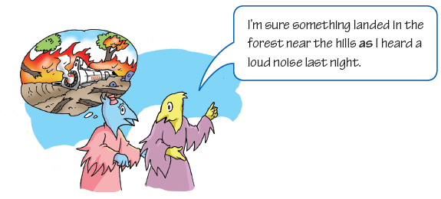
Adverbial clauses of reason tell us why things happen. We usually use because, as and since to start adverbial clauses of reason.

Slide 4
Adverbial clause of reason 从句 |  | Main clause 主句
Because | no one else saw these aliens, | I refuse to believe you.
As
Since
We can also put the adverbial clause of reason after the main clause.
We can also put the adverbial clause of reason after the main clause.
Main clause Adverbial clause of reason 主句 从句
I refuse to believe you | because | no one else saw these aliens.
 | as
 | since

Slide 5
Because no one else saw these aliens, I refuse to believe you.
As I like cycling, I am going to North Country Park.
原因状语从句放在句首时，与主句要用逗号隔开。
Things to remember
When we put the adverbial clause of reason at the beginning of the sentence, we often separate it from the main clause with a comma (,).

Slide 6
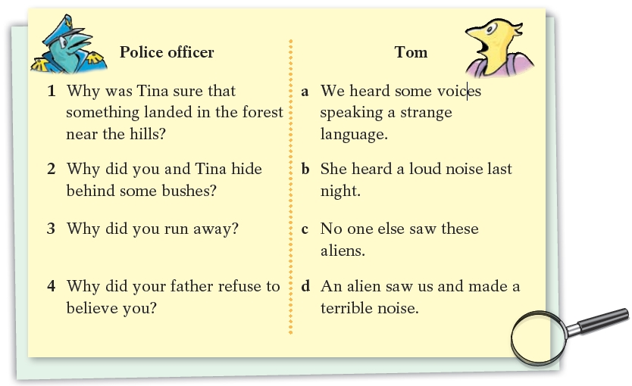
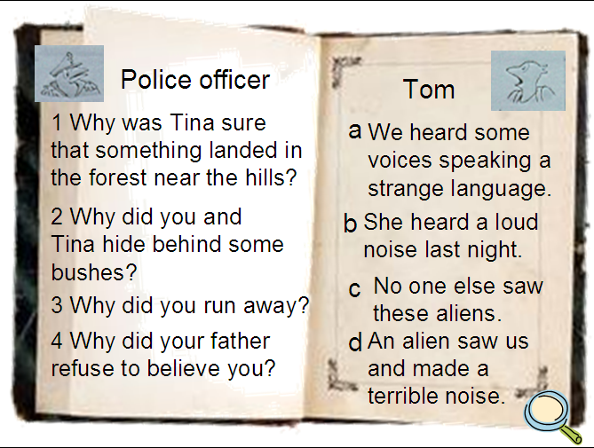

The police officer asked Tom some more questions about the aliens. Match the questions with the answers. Then use them to complete the police officer’s notes with as, since or because.

Slide 7
1 （because）Tina was sure that something landed in the forest near the hills because she heard a loud noise last night.
（as）
3（Because）
4 （Since）
Tina and I hid behind some bushes as we heard some voices speaking a strange language.
Because an alien saw us and made a terrible noise, we ran away.
Since no one else saw these aliens, our father refused to believe us.

Slide 8
because, as 与since三者的区别
【观察】
1. — Why is she so late?
— Because the bus didn’t come on time.
2. Since everyone is here, let’s start the meeting.
/ Let’s start the meeting since everyone is here.
3. As Xiao Wang was not ready, we went without
him. / We went without XiaoWang as he was not ready.

Slide 9

(1) because，since，as 都是表示“原因”的连
词，引导原因状语从句。从句既可以位于主句的前面，也可以位于主句的后面；从句位于主句前面时，要用逗号与后面的主句分开。这三个词所表达的语气由强至弱依次为：
because → since → as。

Slide 10
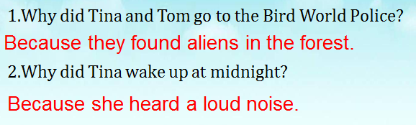
(2) because 表示直接原因，着重点在从句，它所指的原因通常是听话人所不知道的，语气最强。常用来回答why 的提问。如：
不用as和since

Slide 11
(3) since 侧重主句，从句表示明显的或已为人所知的理由，常译为“因为；既然”，语气比because 稍弱，可以放在主句后面，但通常放在句首。如：
Since the weather is so bad, we have to delay
our journey.
Since the rain has stopped, let’s go for a walk.
Since we are young, we shouldn’t be too afraid
of making mistakes.

Slide 12
(4) as 引导的原因状语从句语气最弱，它所表示的原因只是对结果的附加说明，可位于句首或句末。常译为“由于；鉴于”。如：
I left a message as Jim wasn’t here.
I’m sure something landed in the forest near the
hills as I heard a loud noise last night.

