Slide 1

Unit 8 Life in the future
Grammar

Slide 2
观察这些句子
1. We were having supper when the phone rang.
2. I was watching TV at home last night.
3. This time yesterday Jack was not watching TV. He was repairing his bike.
4. --Were you playing basketball at four
yesterday afternoon?
--Yes, I was./ No, I wasn’t
5.Jenny was reading while Danny was writing.
过去进行时

Slide 3
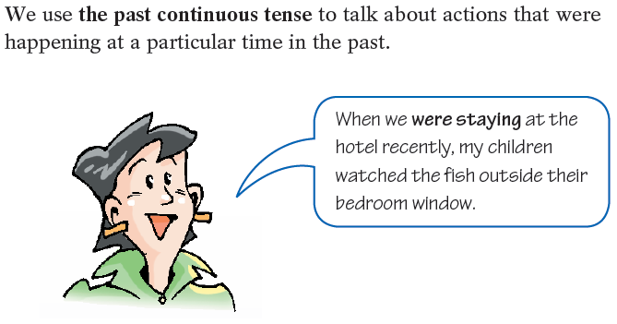
The past continuous tense
我们用过去进行时来表示在过去特定的时间正在发生的动作。

Slide 4
I/He/She/It | was(not) | watching | TV at eight o'clock last night.
You/We/They | were(not)
Was | I/he/she/it | having | dinner at eight o'clock last night?
Were | you/we/they
Yes, | I/he/she/it | was.
 | you/we/they | were.
No, | I/he/she/it | Was not/wasn’t.
 | you/we/they | Were not/weren’t.

Slide 5
Work out the rule
Work out the rule
We form the past continuous tense with __________ or __________+ the -ing form of the main verb.
was
were

Slide 6
一、过去进行时的句子结构
1. 肯定句：
主语+ was / were +动词现在分词+其他 如：
My mother was cooking dinner at 6 p.m. yesterday.
2. 否定句：
主语+ was / were + not+动词现在分词+其他 如：
I was not sleeping at home from 7:00 to 9:00
yesterday evening.

Slide 7
At 7:30, Linda
2 At 8:30, she
At 9:30, she and some friends
At 12:30, they
5 At 16:30, she
6 At 17:30, she
was getting ready to go out.
was travelling on the underground.
were buying food in the market.
were having lunch.
was meeting a friend at a tea shop.
was going home on the underground.

Slide 8
Things to remember
We can also use the past continuous tense to talk about two actions happening at the same time in the past.
While I was driving my old car, I was polluting the city.
通常我们用while谈论过去两个持续进行的动作。
Usually we use while to talk about two continuing actions in the past.

Slide 9
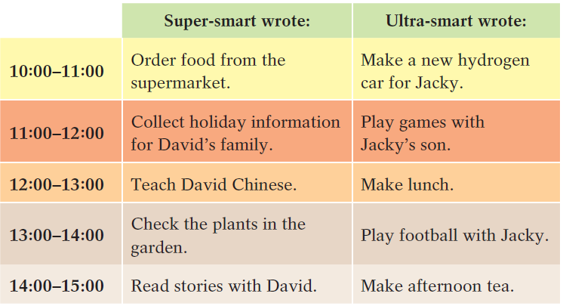
B Super-smart is a smart computer and Ultra-smart is a smart robot. Look at their notes about what they did on Wednesday and complete the paragraph below.

Slide 10
While Super-smart (1)_______________ from the supermarket, Ultra-smart (2)___________________________ for Jacky. While Super-smart (3)_____________________________for David's family, Ultra-smart(4)________________ with Jacky's son. While Super-smart(5)_________________ Chinese, Ultra-smart(6)________________. While Super-smart (7)______________________in the garden, Ultra-smart and Jacky(8)________________.
While(9)___________________________ with David, (10)____________________ afternoon tea.
was ordering food
was making a new hydrogen car
was collecting holiday information
was playing games
was teaching David
was making lunch
was checking the plants
were playing football
Super-smart was reading stories
Ultra-smart was making

Slide 11
一、选择最佳答案填空。
( )1. We ____ the classroom at half past two yesterday
afternoon.
A. clean B. cleaned
C. have cleaned D. were cleaning
( )2. When I saw him, he ____ a letter in his room.
A. writes B. wrote
C. was writing D. has written
( )3. While I was cleaning the windows, Sally ____ water.
A. was carrying B. carries
C. carried D. was carried
( )4. I was washing my clothes when the telephone ____.
A. rang B. has rung
C. was rang D. was ringing
D
C
A
A

Slide 12
二、用括号内所给动词的适当形式填空。
1. The children were not __________(dance) in the garden then.
2. What was your brother __________ (do) when you were watching TV?
3. When I saw them, they __________ (have) dinner.
4. Lily was reading a book while Lucy __________ (listen) to music.
5. When it _____ (begin) to rain, I __________ (walk) in the street.
dancing
doing
were having
was listening
began was walking

