Slide 1
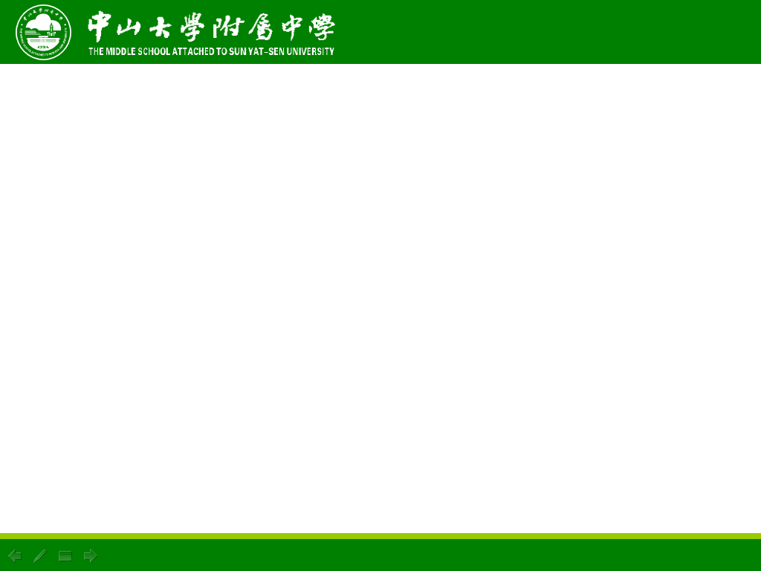
1.语言
2.交流，交际
3.接受（建议/邀请）
4.意义，意思
5.手势
6.衣着入时的，穿着讲究的
7.叹气，叹息
8.表情，神色
9.外貌，外表
10.向，朝
11.使保持（在某位置） 过去式
12.以后，后来
13.颈，脖子
14.肢体语言
15.发生
16.坐起来，坐直
17.给…留下好印象
18.提醒某人某事
19.带着微笑
20.在很小的时候

Slide 2
1.language
2.communication
3.accept
4.meaning
5.gesture
6.well-dressed
7.sigh
8.expression
9.appearance
10.towards
11.hold-held
12.later
13.neck
14.body language
15.take place
16.sit up
17.make/give/leave a good
impression on
18.remind sb.about sth.
19.with a smile
20.at an early age

Slide 3
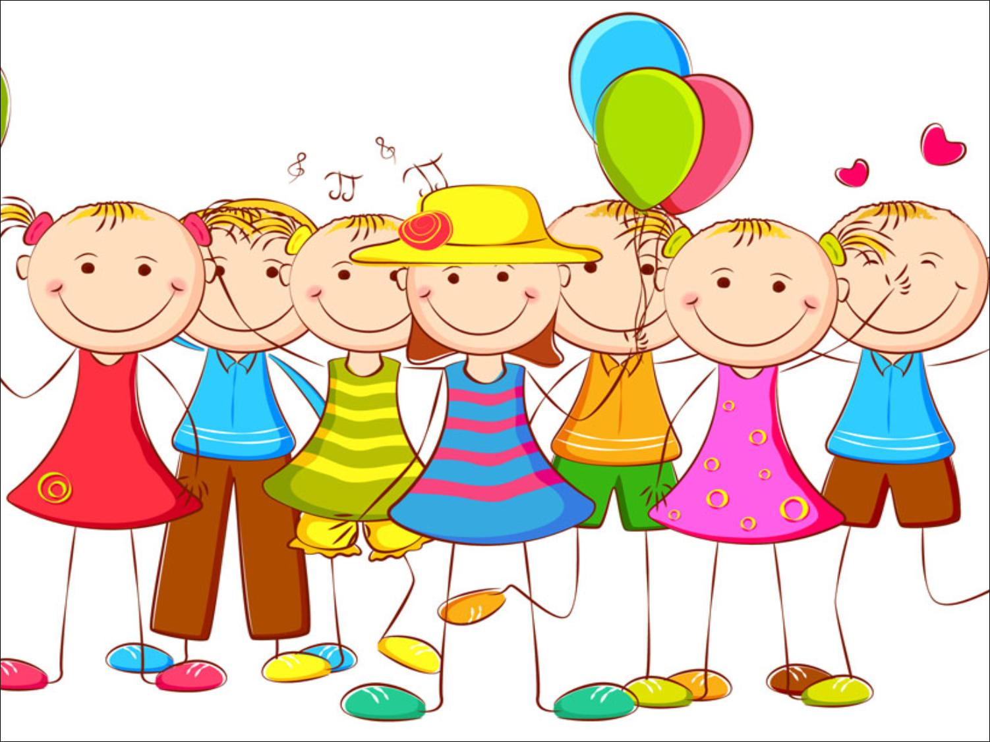
Unit 2 Body Language
Grammar

Slide 4
目录
Lead-in
1
Pre-Learning
2
3
While-Learning
Post-Learning
4
5
Review

Slide 5
Part I Lead-in

Slide 6


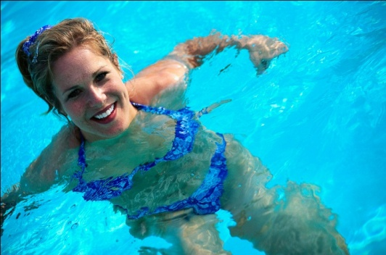
Look at the pictures and complete the sentences with -ing.
1. I like
_______.
Smoking
2. ______ damages
your health.
drawing
3. ______ builds
your imagination.
Reading
4. ________ is fun.
Swimming

Slide 7
Part II Pre-Learning

Slide 8
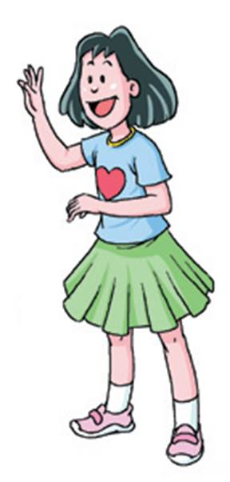
动名词是以-ing结尾的名词。这些名词描述动作和活动
Gerunds 动名词
Gerunds are nouns ending in -ing. These nouns refer to actions and activities.
Communicating is more than just speaking.
He tried smiling at people.
We use gerunds as subjects, objects,
predicatives, etc.
动名词可作主语、宾语以及表语等句子成分

Slide 9
Gerunds are nouns ending in –ing. These nouns refer to actions and activities.
双写最后一个字母加-ing
We form gerunds from verbs.
begin | beginning
communicate | communicating
dance | dancing
hold | holding
sigh | sighing
lie | lying
去e加-ing
直接加-ing
把ie变为y加-ing

Slide 10
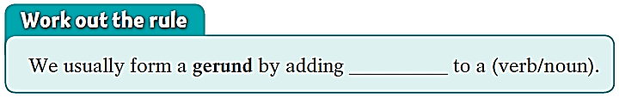
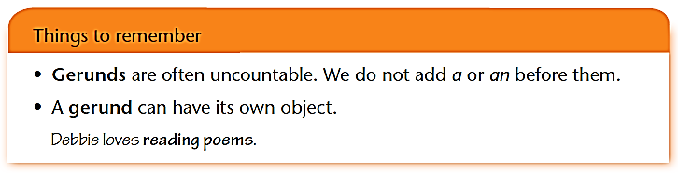
-ing
我们通常通过在动词后加-ing来构成动名词。
动名词通常都是不可数的，不能在前面加a或an.
动名词可以有自己的宾语。

Slide 11
动名词的用法总结一
1. 动名词是以-ing结尾的名词。这些名词描述动作和活动。
2. 动名词可作主语、宾语以及表语等句子成分。
3. 我们通常通过在动词后加-ing来构成动名词。
4. 动名词通常都是不可数的，不能在前面加a或an。
5. 动名词可以有自己的宾语。

Slide 12
动名词的构成
1. V-ing: work-working
2. 以e结尾的去e+-ing: make-making
3. 以重读闭音节结尾的双写最后一个辅音字
母,再+-ing: put-putting
4. 特例: lie-lying die-dying

Slide 13
Part III While-Learning

Slide 14
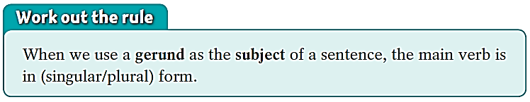
Gerunds as subjects
动名词做句子主语
We can use a gerund as the subject of a sentence.
Smiling shows that you are happy.
Ballet training usually starts at an early age.
Dancing is her favourite hobby.
subject
动名词做句子主语时，谓语动词使用单数形式。

Slide 15
动名词的用法总结二
▲ 动名词作主语时，谓语用单数：如：
Communicating is not just speaking.
交流不仅仅是说话。
▲ 两个或两个以上不同的动名词作主语，谓语用 复数。如：
Playing computer games and playing basketball are
my hobbies.
打游戏和打篮球是我的兴趣爱好。

Slide 16
In pairs, ask and answer questions about the pictures. Follow the example.
S1: What can shaking your closed hand show?
S2: Shaking your closed hand can show that you are angry.
shake your closed hand/angry

Slide 17

rest your head on your hand/bored
S1: What can resting your head on your hand
show?
S2: Resting your head on your hand can show that
you’re bored.

Slide 18
S1: What can sighing show?
S2: Sighing can show that you’re
sad.
sigh/sad

Slide 19
S1: What can closing your eyes show?
S2: Closing your eyes can show that you’re thinking.
close your eyes/thinking

Slide 20

Gerunds as objects
动名词做句子宾语
We can also use a gerund as the object of a sentence.
Debbie enjoys smiling and always looks friendly.
Simon tried smiling at people.
object
We often use gerunds after these verbs.
consider finish mind suggest
enjoy imagine practise

Slide 21
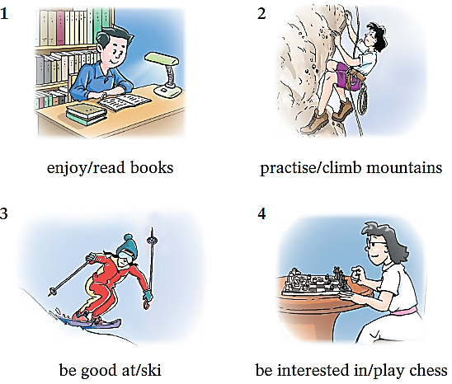
In pairs, ask and answer questions about the pictures. Follow the example.
S1: What does the boy enjoy?
S2: He enjoys reading books.
S1: What is the girl practising?
S2: She is practising climbing mountains.

Slide 22
S1: What is the girl good at?
S2: She is good at skiing.
S1: What is the girl interested in?
S2: She is interested in playing chess.

Slide 23

Things to remember
介词后要使用动名词
We often use gerunds after prepositions.
Debbie is good at communicating with people.
I am looking forward to going to Beijing.
这些短语后要使用动名词
We often use gerunds after these phrases.
be fond of | be interested in | be used to | keep on | think of
be good at | be tired of | give up | look forward to

Slide 24
动名词的用法总结三
1.英语中有一些动词（短语）后面常接动名词作宾语。如： enjoy（like, love) , suggest ，mind, finish, practise, deny，avoid，admit, keep, miss
例如：
He denied stealing my bike.
他否认偷了我的自行车。

Slide 25
动名词的用法总结三
2.介词后要使用动名词。
例如：
He is good at drawing pictures.
他善于画画。

Slide 26
3. 常见的“动词＋介词+动名词”的短语有：prefer... to, be used to, look forward to , feel like, give up, keep on, insist on, succeed in等。例如：
You must give up smoking at once.
你必须马上戒烟。
He doesn’t feel like doing his homework.
他不想做家庭作业。

Slide 27
4. 用于某些惯用法中。例如：
be busy doing sth “忙于做某事”
妈妈在厨房忙着做饭。
Mother is busy cooking dinner in the kitchen.
(2) be worth doing sth “值得做某事”
这本书值得一读。
The book is worth reading.
(3) It’s no use / good doing sth
“做……无用 / 无好处”
向他寻求帮助没有用。
It’s no use going to him for help.

Slide 28
Complete the sentences using the verbs in the box in the -ing form.
breathe do hear organize smoke take use walk
breathing
1 She is tired of ________ the dirty air in the city centre.
2 She keeps on ________ to school instead of ______ a bus.
3 He finally gave up ________.
4 She is used to ________ a handkerchief instead of a tissue.
5 She was interested in ________ the puzzle.
6 She looks forward to ________ from her new e-friend.
7 She is good at __________ party activities.
walking
taking
smoking
using
doing
hearing
organizing

Slide 29
Part IV Post-Learning

Slide 30
动名词的用法总结
动名词是以-ing结尾的名词。这些名词描述动作和活动。动名词可作主语、宾语以及表语等句子成分。我们通常通过在动词后加-ing来构成动名词。
一、动名词的构成
1. V-ing: work-working
2. 以e结尾的去e+-ing: make-making
3. 以重读闭音节结尾的双写最后一个辅音字
母,再+-ing: put-putting
4. 特例: lie-lying die-dying

Slide 31
动名词的用法总结
二、动名词的数。
动名词通常都是不可数的，不能在前面加a或an。
动名词可以有自己的宾语。
1. 动名词作主语时，谓语用单数：
2. 两个或两个以上不同的动名词作主语，谓语用 复数。

Slide 32
动名词的用法总结
三、动名词作宾语
1.英语中有一些动词（短语）后面常接动名词作宾语。如： enjoy（like, love) , suggest ，mind, finish, practise, deny，avoid，admit, keep, miss
2.介词后要使用动名词

Slide 33
动名词的用法总结
3. 常见的“动词＋介词+动名词”的短语有：prefer... to, be used to, look forward to , feel like, give up, keep on, insist on, succeed in等。

Slide 34
动名词的用法总结
4. 用于某些惯用法中。例如：
be busy doing sth “忙于做某事”
妈妈在厨房忙着做饭。
Mother is busy cooking dinner in the kitchen.
(2) be worth doing sth “值得做某事”
这本书值得一读。
The book is worth reading.
(3) It’s no use / good doing sth
“做……无用 / 无好处”
向他寻求帮助没有用。
It’s no use going to him for help.

Slide 35
注意：
1. begin，hate，like，love 等动词后面既可以
接动名词，也可以接动词不定式，两种结
构表达的意思区别不大。

Slide 36
2. forget，remember，stop，try 等动词后面既
可以接动名词，也可以接动词不定式，但
两种结构表达的意思有区别。
例如：forget to do sth 表示“忘记去做某事”；
forget doing sth 表示“忘记做过某事”。
remember to do sth 表示“ 记得去做某事”；
remember doing sth 表示“记得做过某事”。
stop to do sth 表示“停下来去做另一件事”；
stop doing sth 表示“停止正在做的事情”

Slide 37
Part V Review

Slide 38
一、用以下方框内的动名词作宾语的用法造句。
be fond of be good at be interested in
be tired of be used to consider
dislike enjoy finish

Slide 39
We are all fond of collecting stamps.
Are you good at flying kites?
Are you interested in going to the museum with me at the weekend?
I’m tired of sitting here for so long.
Simon is used to living in Beijing.
We are considering leaving Hong Kong tomorrow.
I dislike riding horses.
She enjoys swimming.
They finished doing their homework an hour ago.

Slide 40
二、用所给动词的适当形式填空。
1. I’ll keep on ________(try).
2. He practises ________ (play) the piano every day.
3. ________(run) is a very popular sport.
4. I’m looking forward to ________ (meet) Lin Shuhao.
5. It took me two months to finish ________ (write) the book.
trying
playing
Running
meeting
writing

Slide 41
三、选择最佳答案填空。
( )1. Mum suggested ____ for a walk.
A. to go B. going C. go D. to going
( )2. My brother gave up ____ after the car accident.
A. drinking B. drink C. to drink D. to drinking
( )3. I don’t mind __ by bus, but I am afraid of ___ in
the crowded people.
A. to travel; standing B. to travel; to stand
C. travelling; to stand D. travelling; standing
( )4. Remember __ the newspaper when you finish__ it.
A. putting away; to read B. to put away; to read
C. to put away; reading D. putting away; reading
B
A
D
C

Slide 42
Thank you!

