Slide 1


Unit 3 Traditional skills
Writing

Slide 2
目录
Lead-in
1
Pre-Learning
2
3
While-Learning
Post-Learning
4
5
Review

Slide 3
Part I Lead-in

Slide 4
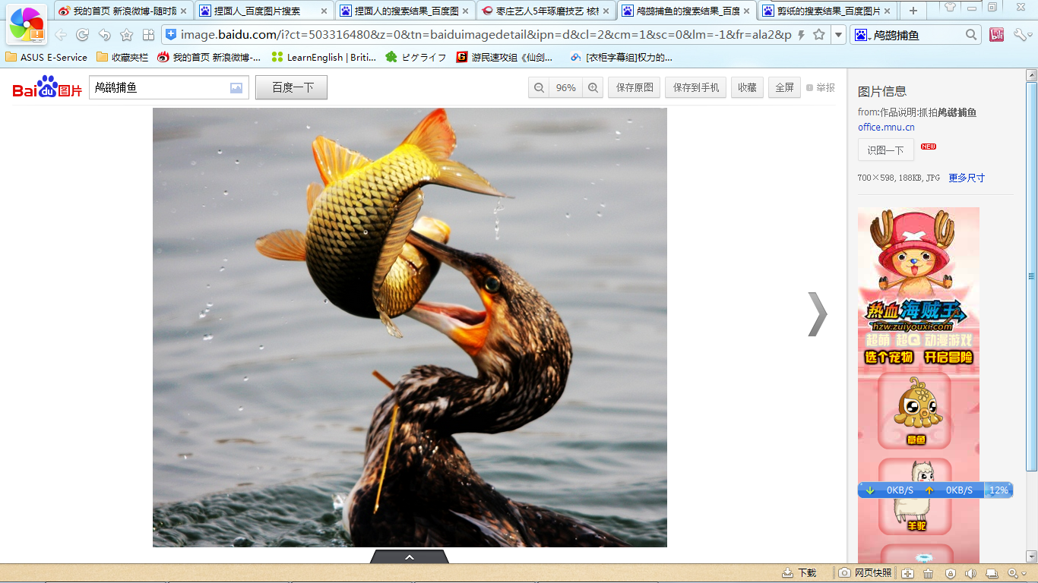
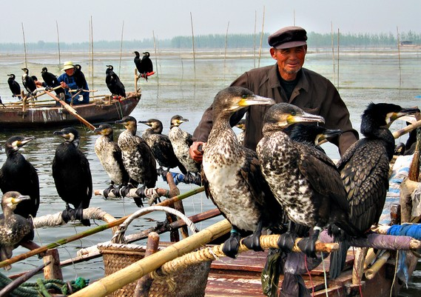
Retell
Retell the process of cormorant fishing in the passive voice.

Slide 5

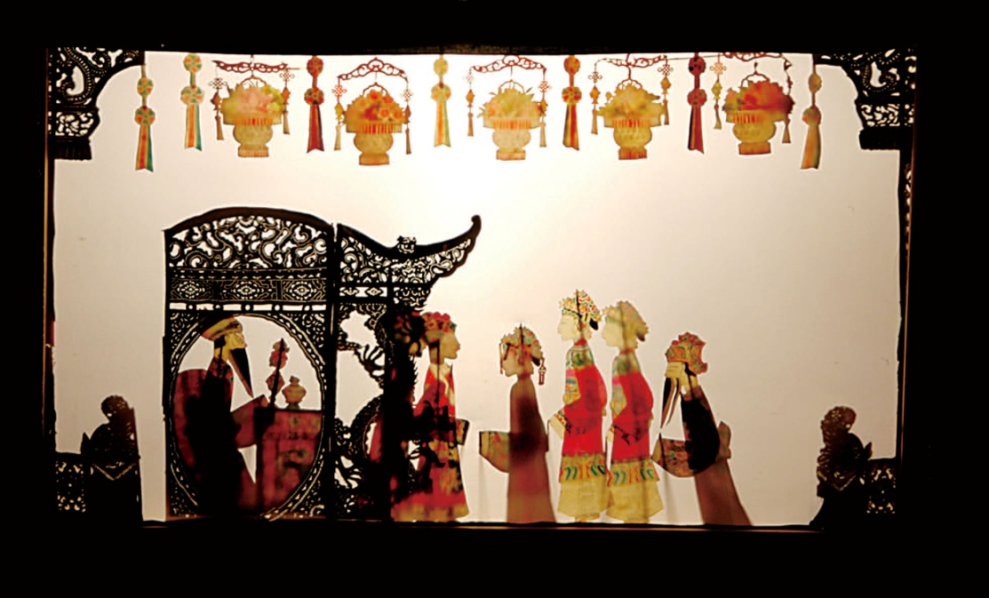
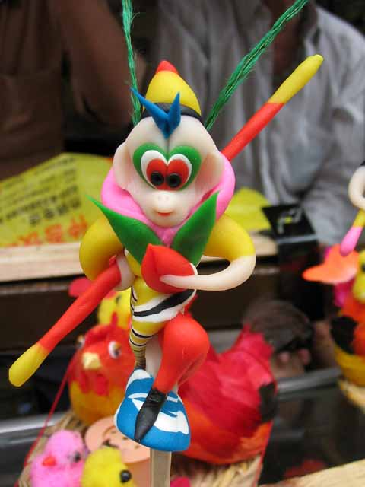
Do you still remember them? What are they?
Can you tell something about them?

Slide 6
Part II Pre-Learning

Slide 7
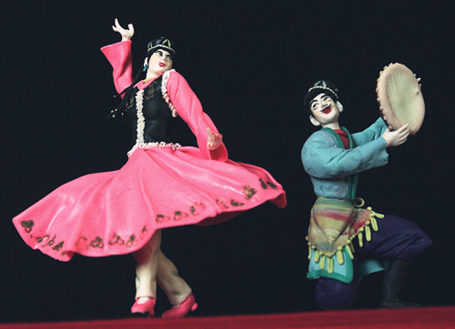
1.Have you ever heard of dough toys?
2.Do you know anyone who knows how to make dough toys?

Slide 8

Let’s learn the new words and expressions.

Slide 9
New words and expressionsP44
*dough n. 生面团
*rough adj. 粗糙的
size n. 大小
simple adj. 简单的
lovely adj. 有吸引力的；迷人的
all the time
（ 在某段时间内）一直 ；始终

Slide 10
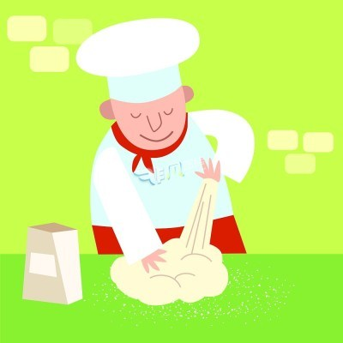
Notes P44
*dough n. 生面团
如：
Roll out the dough into one large circle.
将面团擀成大的圆形面皮。

Slide 11
2. *rough adj. 粗糙的
如：
His hands were rough.
他的双手粗糙不平。

Slide 12
3. size n. 大小
size作“大小、尺寸、体积”讲时是不可数名词。作“衣服、鞋等的尺码、号”讲时是可数名词。
这本书同那本书的大小一样。
This book is the same size as that.
我想看看不同号码的鞋。
I want to look at the shoes of different sizes.
这双鞋是38号的，你可以穿上它们试一试。
This pair of shoes in size 38. You can try them on.

Slide 13
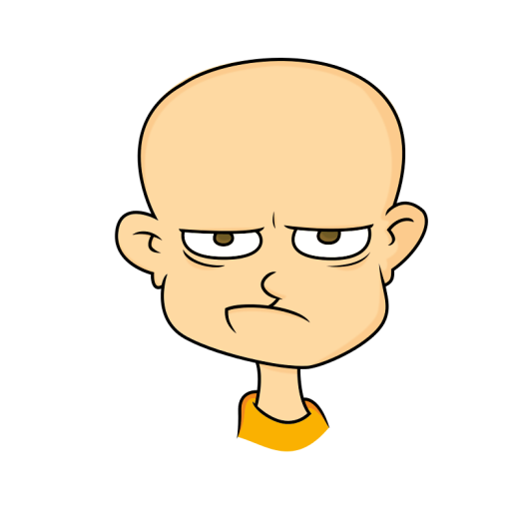
4. all the time
（ 在某段时间内）一直 ；始终
如：
Why does he keep such a long face all the time?
为什么他总是拉长着脸？

Slide 14
5. simple adj. 简单的
simply adv. 仅仅，只，简单地
这台机器使用起来很简单。
The machine is quite simple to use.
这些数学练习题太简单，任何人都会做。
The math exercises are simple enough for anyone to work out.
让我简单地介绍一下他。
Let me introduce him simply.

Slide 15
6. lovely adj. 有吸引力的；迷人的
adj. 令人愉快的，可爱的
The house has many large rooms and there is a lovely garden.
这幢房子有很多大房间，并有一个让人喜爱的花园。
The blossom on the trees looks lovely in springtime.
春天树上的花看起来很可爱。

Slide 16
7. Mr Chen uses his hands to turn the dough into different characters.
陈先生用手把这些面团变成不同的人物造型。
turn ... into ... 把……变成……
（强调渐变的过程）
turn into ...也表示“变成……” 例如：
他们把这栋旧楼改成了图书馆。
They turned the old building into a library.
这场战斗有可能变成一场战争。
The fighting may turn into a war.

Slide 17
【拓展】
change ... into ...也表示“变成”，但更强调形
式上的改变，注重变化的结果；turn ... into ...
除了表示形式上的改变，还可以表示状态上
的改变，注重变化的过程。试比较：
她把美钞换成了人民币。
She changed the US dollars into RMB.
她的经历让她变得更坚强了。
Her experience has turned her into a stronger
person.

Slide 18
Practice
根据中文意思完成句子。
1. 让我们把这片地改成花园吧。
Let’s ______ this area ______ a garden.
2. 她正成为一位伟大的音乐家。
She ______ ______ ______ a great musician.
3. 仙女把那个小孩变成了一只兔子。
The fairy _______________ the child ______ a rabbit
turn into
is turning into
turned / changed into

Slide 19
Part III While-Learning

Slide 20
A person with a traditional skill
A. Mark wrote an article about Mr Chen. Read the article and answer the questions below.
Mr Chen makes toys from dough. He is over 50 years old now. His hands are rough because he works with dough all
the time.

Slide 21
Mr Chen makes dough toys of different sizes. Only a small piece of dough and some simple tools are required to make a dough toy. Mr Chen uses his hands to turn the dough into different characters, for example the Monkey King. Dough of different colours is used to make the toys more interesting.
I like Mr Chen’s toys because they are very lovely. I hope that one day I can learn to make dough toys.

Slide 22
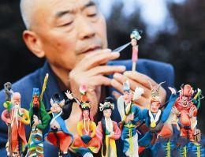
How does Mark describe Mr Chen?
He is over 50 years old now. His hands are rough because he works with dough all the time.

Slide 23
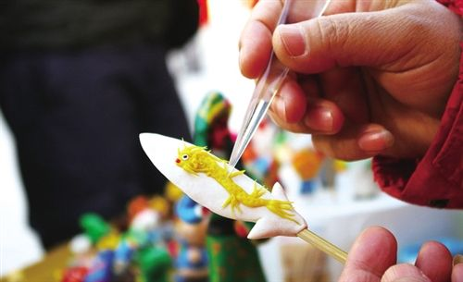
2. How does Mark describe Mr Chen’s work?
Mr Chen makes dough toys of different sizes. Only a small piece of dough and some simple tools are required. He uses his hands to turn the dough into different characters.

Slide 24
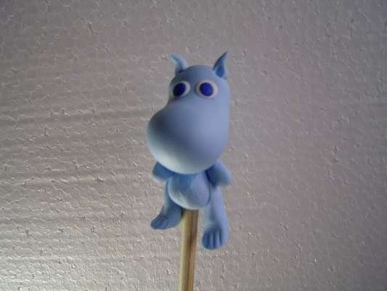
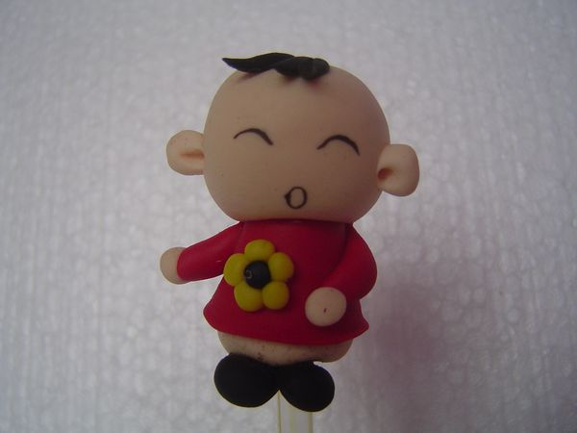
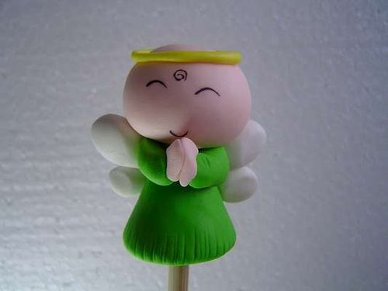
3. What does Mark think of Mr Chen’s
dough toys?
He thinks that they are very lovely.

Slide 25

Read the article again and answer the questions.
How old is Mr Chen?
Over 50 years old.
What are Mr Chen’s hands like?
They are rough.
What does Mr Chen make?
Dough toys of different sizes.

Slide 26
What does Mr Chen require when he
makes a dough toy?
Dough toys of different sizes.
What kind of dough toys does he make?
He makes different characters.
What is used to make the toys more interesting?
Dough of different colours.

Slide 27
Read the article again and match each paragraph with its general idea.
Describes the person’s work and the tools needed for his/her work.
Paragraph 1
Paragraph 2
Paragraph 3
Gives an opinion about the person and his/her skill.
Describes the person.

Slide 28
B. Write a short article about a person with a traditional skill. Use the example in A and the outline below to help you.
Paragraph 1.
Describe the person.
(Who is he/she? What does he/she look like?)
Paragraph 2.
Describe the person’s work and the tools needed for
his/her work. You may also describe the important
steps in his/her work.
Paragraph 3.
Give your opinion about the person and his/her skill.
(What do you think of his/her skill? Would you like
to learn his/her skill?)

Slide 29
Part IV Post-Learning

Slide 30

假设你是学校剪纸社的成员，你的爷爷
是你们家乡的民间剪纸老艺人。请根据下面的内容提示，用英语向社员们介绍你爷爷。词数80左右，开头
已给出，不计入总词数。

Slide 31
【内容提示】
1. 爷爷70多岁，但很健康，喜欢剪纸；
2. 能剪出各种形状。多次举办展览，作品很受欢迎，人们认为很美，能带来好运；
3. 你的评价。

Slide 32
My grandpa is a paper cutting artist.
________________________________________________________________________________________________________________________________________________

Slide 33
My grandpa is a paper cutting artist. Although he is over 70, he is very healthy and still enjoys paper cutting. My grandpa learnt paper cutting at an early age. He can cut out different shapes from paper, such as animals, flowers and Chinese characters that stand for good luck. He has held many paper cutting shows. His paper cuttings are very popular and attract many visitors. They think
his paper cuttings are very beautiful and can bring good luck. I like my grandpa’s paper cuttings very much. I want to learn paper cutting and be good at paper cutting like my grandpa one day.

Slide 34
Part V Review

Slide 35
一、翻译下列短语。
1. 一直
all the time
2. 擅长做……
be good at doing
3. 一种
a kind of
4. 有一天
one day

Slide 36
二、用英语翻译下列句子。
1. 他喜欢烹饪。
He enjoys cooking.
2. 烹饪美味的食物需要精湛的技艺以及一些
工具。
Good skills and some tools are required to
cook delicious food.
3. 我希望有一天也像他一样成为一名厨师。
I hope that I can be a cook like him one day.

Slide 37
Thank you!

