Slide 1

Unit 4 Cartoons and comic strips
Grammar

Slide 2
目录
Review
1
Pre-Learning
2
3
While-Learning
Post-Learning
4
5
Review

Slide 3
Part I Review

Slide 4

英语的谓语动词有两种语态
We speak English.
主动语态
主语
谓语
宾语
English is spoken by us.
主语
谓语
宾语
宾变主,主变宾,前加by

Slide 5

1. Tom broke the window.
The window was broken by Tom.
2. He broke the windows.
The windows were broken by him.
be要随着主语变
逻辑主语by来引
被动语态的大体构成：
Be + PP（过去分词）

Slide 6
一般现在时的被动语态:
am／is／are done
一般过去时的被动语态:
was／were done
一般将来时的被动语态:
will／shall be＋done
Basketball is played by people all over the world.
A party was held (by them) last Sunday.
You will be fined if you go wrong

Slide 7
主动变被动解题步骤:
1. 找宾语 ----即动作的承受者
2. 判断宾语的单复数 ----即be动词的单复数
3. 判断动词的时态 ----即be动词的时态
4. 修改谓语的时态 ----即原句动词改为过去分词
5. 修改原句的主语 ----即by+ 主语 / 宾语
They make shoes in that factory.
are
were
Shoes
made
by them in that factory.

Slide 8

主动语态变被动之歌：
被动语态强调宾，be后加上过去分。
be要随着主语变，人称时态要弄准。
行为对象作主语， 逻辑主语by来引。

Slide 9
Part II Pre-Learning

Slide 10
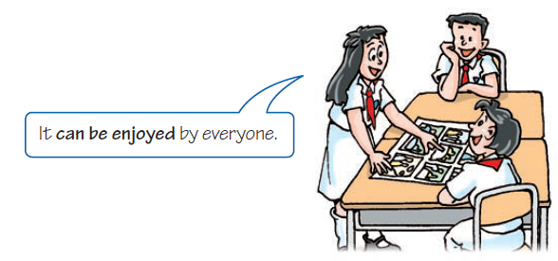
A The passive voice with model verbs
情态动词的被动语态

Slide 11
Aby can take good care of Tina．
Tina can be taken good care of by Aby.
情态动词变被动：
情态动词 + be+过去分词

Slide 12
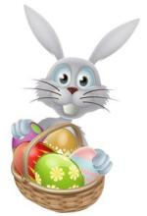
Exercise
1. He may carry the basket easily.
The basket may be easily carried by him.

Slide 13
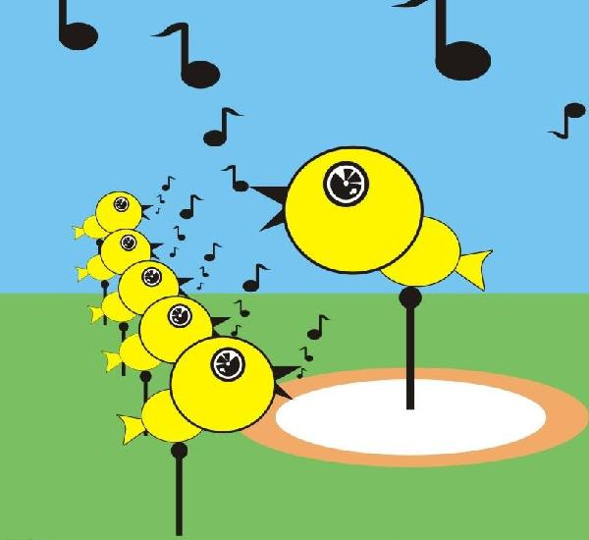
2. They can sing some beautiful songs.
Some beautiful songs can be sung by them.

Slide 14
Part III While-Learning

Slide 15
A1 Read the following sentences.
Each picture | should be should not be | made a little different from the one before it. made the same as the one before it.
Sound effects | must be must not be | added. forgetten.

Slide 16
A1 Read the following sentences.
Should | each picture | be | made a little different from the one before it?
Must | sound effects | be | added?
Yes, | it should. | No , | it should not / shouldn’t.
Yes, | they must. | No, | they must not / mustn’t.

Slide 17
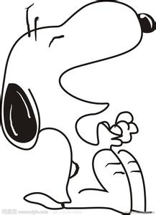
Work out the rule
be
To make the passive voice with modal verbs, __ is used
between the modal verb and the past participle of the
main verb.
含情态动词的被动语态——情态动词+be +PP
can/could
must
should
may/might
had better
have to
+
be done

Slide 18
肯定句：
情态动词+ be + 过去分词 如：
每天应该浇花。
The flowers should be watered every day.
否定句：
情态动词+ not + be +过去分词 如：
这里禁止停车。
Cars mustn't be parked here.
疑问句：
情态动词+ sb./sth. + be +过去分词 如：
什么东西会被从卫星上扔下？
What could be dropped from a satellite?

Slide 19
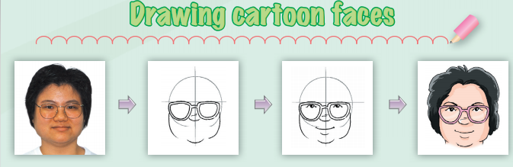
Complete the article below with the correct forms of the words in brackets.

Slide 20
Drawing cartoon faces
When we draw a cartoon face, some parts of the
face ________________(should / make) bigger to
make the face look funny. So let’s start to draw a
cartoon face for the woman!
A rough circle _________________ (should/draw)
first. Then a nose and big glasses ______________
(should/add).
should be made
should be drawn
should be added

Slide 21
Next ,a pair of small eyes and a smiling mouth
______________ (must/draw). The mouth
______________ (can/make) larger to make the
woman look friendlier.
Finally, some hair _______________ (should/add)
to the cartoon. The face _____________ (can/colour)
with bright colours.
must be drawn
can be made
should be added
can be coloured

Slide 22
B The passive voice in the present perfect tense
现在完成时的被动语态
We use the passive voice in the present perfect tense like this:
After everything has been checked, it is ready to
be played for everyone to enjoy.
The cartoon characters have been drawn
carefully by the artists.

Slide 23
Work out the rule
We form the passive voice in the present perfect tense by using have/has+ _____ before the past participle of the main verb.
been
现在完成时的被动语态——have/has+been +PP

Slide 24
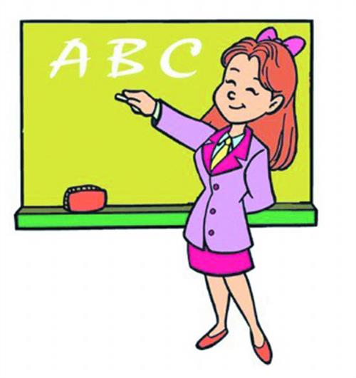
We have made twenty keys．
Twenty keys have been made by us.
现在完成时被动结构：
have/has + been+过去分词

Slide 25
肯定句：
have/has + been + 过去分词 如：
他们的家乡建立了一座发电站。
A power station has been set up in their hometown.
否定句：
have/has + not + been +过去分词 如：
汤姆的小说还没有被出版。
Tom’s novel has not been published.
疑问句：
have/has + sb./sth. + been +过去分词 如：
谁受到了邀请？
Who has been invited?

Slide 26
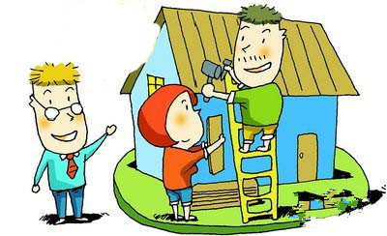
Exercise
Workers have built the house since two years ago.
The house has been built since two years ago.

Slide 27
B1 In pairs, read the article in A on page 56 again. Ask and answer questions about drawing cartoon faces. Follow the example.
S1: Now I’ve drawn a rough circle. What should I do next?
S2: After a rough circle has been drawn, you should add a nose and big glasses.
S1: I’ve added the nose and big glasses. What must I do now?
…

Slide 28
S2: After the nose and big glasses have been added, you must draw a pair of small eyes and a smiling mouth.
S1: I’ve drawn a pair of small eyes and a smiling mouth. What should I do next?
S2: After a pair of small eyes and a smiling
mouth have been drawn, you should add some hair to the cartoon.
S1: I’ve added some hair to the cartoon. What can I do next?
S2: After some hair has been added to the cartoon, you can colour the face with bright colours.

Slide 29
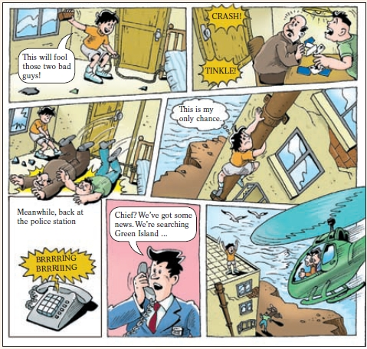
How to make a comic strip
B2 Complete the article below with the correct forms of the words in brackets.

Slide 30
How to make a comic strip
To make a comic strip, first, a story ____________ (must/think) of. The story _________________ (should/make) interesting with an exciting ending. After the story __________________ (create), pictures ____________________ (must/draw).
Look at the comic strip below. Speech and thought bubbles have been added so that the pictures __________________ (can/understand) easily. A line of words called a “caption” ____________(put) at the top of the fifth picture to explain a change of place or time.
must be thought
should be made
has been created
must be drawn
can be understood
has been put

Slide 31

Let’s learn the new words and expressions.

Slide 32
Notes P55-57
1. a pair of (P56-A) 一双/副/把……
后接可数名词复数。但当a pair of作主语时，
句子的谓语动词为单数；two/three/some…
pairs of + 可数名词复数作主语时，谓语动词
用复数。 如：
床上有一条裤子。
There _____ a pair of _______ on the bed.
桌上有两双筷子。
There _____ two pair of ________ on the table.
is trousers
are chopsticks

Slide 33
Part IV Post-Learning

Slide 34
Complete the table.
时态 | 主动语态 | 被动语态
一般 现在时 | They paint the wall. | Thewall _____________.
一般 过去时 | They painted the wall. | The wall _____________.
一般 将来时 | They will paint the wall. | The wall _____________.
现在 完成时 | They have painted the wall. | The wall _____________.
含情态 动词 | They can paint the wall. | The wall _____________.
is painted
was painted
will be painted
has been painted
can be painted

Slide 35

Summary
各种时态的被动情况：
一般现在时：
一般过去时：
现在进行时：
过去进行时：
现在完成时：
过去完成时：
一般将来时：
过去将来时：
情态动词变被动：
am / is / are done
was / were done
am / is / are being done
was / were being done
have / has been done
had been done
shall / will be done
be going to be done
would/should be done
情态动词 be done

Slide 36
Part V Review

Slide 37
一、选择最佳答案填空。
1. The work must ____ in two hours.
A. do B. does C. be done D. to be done
2. This coat ____ with water. You must dry
clean it.
A. can not wash
B. not can wash
C. can be not washed
D. can not be washed

Slide 38
3. In the past few years, lots of buildings ____ in
this city.
A. have been built B. are building
C. have built D. will build
4. So far, the Moon ____ by man several times.
A. is visited B. has been visited
C. will be visited D. has visited
5. The panda may ____ to the zoo tomorrow
morning.
A. send B. sent C. be sent D. sends

Slide 39
二、根据句意，用括号内所给词的正确形式
填空。
1.Your room should __________ (clean) at least
twice a week.
2. A new shopping mall may __________(build)
here next year.
3. This kind of works can only __________ (see)
in the museum.
4. This book ________________ (translate) into
many foreign languages by now.
be cleaned
be built
be seen
has been translated

Slide 40
5. So far, all the walls of the building ______
(paint) white.
6. More trees should __________ (plant) on the
mountains.
7. Nowadays, different kinds of information
can __________ (find) on the Internet.
8. The cake ___________ (keep) for two days.
You’d better not eat it.
have been painted
be planted
be found
has been kept

Slide 41
三、根据要求完成句子。
1. Teenagers should be allowed to play with their
friends at night. (改为否定句)
Teenagers ______ ______ ______ ______
to play with their friends at night.
2. These fruits must be kept in cool places.
(改为一般疑问句)
____ these fruits ____ ____ in cool places?
3. Should the sofa be placed here? (作肯定回答)
______, ______ ______.
should not be allowed
Must be kept
Yes it should

Slide 42
Thank you!

